Slide 1

Smart Home Automation & Security System
P NAGA VENKATA KUSHAL 23BDS0133
HARSHIT SAI KARANAM 23BCE0586
ASHWIN BOBBY VALLIYATHARAYIL 23BCE0610
ARNAV KUMAR 23BDS0044

Slide 2
Problem Statement
Traditional home systems lack intelligent automation and real-time monitoring. Users cannot remotely control appliances or receive instant alerts about security threats. This creates inconvenience, energy inefficiency, and vulnerability to intrusions.

Slide 3
Objective
The main objective of this project is to design and implement a smart home system that allows users to control appliances remotely and detect suspicious activities using sensor-based intelligence, while providing real-time alerts.

Slide 4
Idea / Solution
Our solution integrates an Arduino-based control system and a Python-based GUI interface. In addition to this, the system can be controlled via voice from the user’s mobile phone while in the vicinity of the system. The Arduino continuously monitors ambient sound levels, dynamically calibrates a baseline, and uses a spike-detection algorithm to identify suspicious patterns. When multiple abnormal sound spikes occur within a short time window, the system triggers an alarm by activating a buzzer and alert LEDs. Simultaneously, the Python application displays real-time system data, allows users to control lights in different rooms via relays, and sends instant Telegram notifications in case of intrusion.

Slide 5
System Overview
The system consists of a hardware layer (Arduino + sensors + relays) and a software layer (Python GUI + Telegram alerts). These components work together to provide seamless control, monitoring, and alerting.

Slide 6
Components Used
Arduino Uno R3
HC-05 Bluetooth module
KY-038 sound sensor
LEDs
kOhm resistors
Jumper wires
Breadboard
9W bulbs
2-channel relay module
Buzzer
Android phone
Windows laptop for Python GUI

Slide 7
Hardware Details
Relays act as switches to control appliances.
The sound sensor detects environmental noise levels.
The buzzer provides audible alerts
LEDs indicate system status such as armed/disarmed states and whether bulbs are on or off.

Slide 8
Software Used
The system is developed using Arduino IDE for embedded programming and Python for GUI development.
Additional libraries include Tkinter for interface design and Serial communication for data transfer.

Slide 9
Tech stack
The tech stack of this project combines embedded systems and software development to create a complete smart security solution. Embedded C is used to program the Arduino, where all core functionalities such as sound sensing, baseline calibration, spike detection logic, and control of relays, buzzer, and LEDs are implemented.
On the software side, Python is used to develop a desktop application with a Tkinter-based GUI, which provides real-time monitoring and user control of the system. Communication between the Arduino and the Python application is achieved through serial communication over USB, enabling continuous data exchange and command transmission.
Additionally, the system integrates the Telegram Bot API using HTTP requests in Python, allowing it to send instant intrusion alerts to the user’s mobile device. This combination of hardware-level programming, real-time communication, and cloud-based notification services makes the system both responsive and user-friendly.

Slide 10
Arduino Role
Arduino acts as the brain of the hardware system. It continuously reads sensor inputs, processes data, executes decision logic, and controls outputs such as relays, buzzer, and LEDs.

Slide 11
Python Role
The Python application provides a user-friendly interface to monitor system status, control devices, and receive alerts. It also logs events and communicates with Arduino via serial connection.

Slide 12
Communication
The communication in this system is designed to ensure reliable, real-time interaction between hardware and software components. The primary mode of communication is serial communication over USB between the Arduino and the Python application running on the computer. The Arduino continuously sends structured data (such as sound level, baseline value, alarm status, relay states, and system state) through the serial port, which the Python program reads, parses, and displays on the GUI in real time.
In addition to receiving data, the Python application also sends control commands back to the Arduino via the same serial connection. These commands allow the user to arm or disarm the security system, control lights in different rooms, and stop the alarm when needed. The communication is bidirectional, ensuring seamless synchronization between the hardware and the user interface.
Furthermore, a Bluetooth module connected to the Arduino provides an alternative wireless communication channel. This allows users to send voice or text-based commands from a mobile device, making the system more flexible and user-friendly.
Finally, for remote alerting, the Python application communicates with the Telegram Bot AI over the internet using HTTP requests. When an intrusion is detected, the system instantly sends a notification message to the user’s Telegram account, enabling real-time monitoring even when the user is away from the system.

Slide 13
Smart Detection Logic
The smart detection logic in this system is designed to accurately identify suspicious activity while minimizing false alarms. Instead of triggering an alert based on a single sudden noise, the system first establishes a baseline sound level during calibration, which represents the normal ambient environment. This baseline is continuously updated using a weighted averaging method to adapt to gradual changes in background noise.
When the system is armed, it continuously reads sound values from the sensor and compares them with the baseline. If the difference exceeds a predefined threshold (spike margin), it is considered a potential spike. However, to avoid false triggers caused by random noises such as small disturbances or background sounds, the system does not immediately activate the alarm.
Instead, it uses a time-based spike counting mechanism. If multiple spikes (for example, three or more) occur within a short time window (such as 2 seconds), the system interprets this pattern as suspicious activity. Only then is the alarm triggered. This approach ensures that the system responds to consistent abnormal patterns rather than isolated noise events.
Once the threshold condition is met, the system activates the buzzer and alert LED, updates the GUI to reflect the alarm state, and sends a real-time notification via Telegram. This intelligent logic significantly improves reliability and makes the system more practical for real-world environments.

Slide 14
Working - Initialization
When the system starts, it initializes all components and calibrates the baseline sound level to adapt to the surrounding environment.

Slide 15
Working - Arming System
The user can arm the system using the GUI or Bluetooth commands. Once armed, the system begins active monitoring.

Slide 16
Working - Monitoring
The sound sensor continuously captures data, which is processed and compared with the baseline to detect variations.

Slide 17
Working - Detection
If multiple abnormal sound spikes are detected within a short duration, the system identifies it as a potential intrusion.

Slide 18
Working - Alert Mechanism
Upon detection, the system activates the buzzer, turns on alert LEDs, updates the GUI, and sends a Telegram notification.

Slide 19
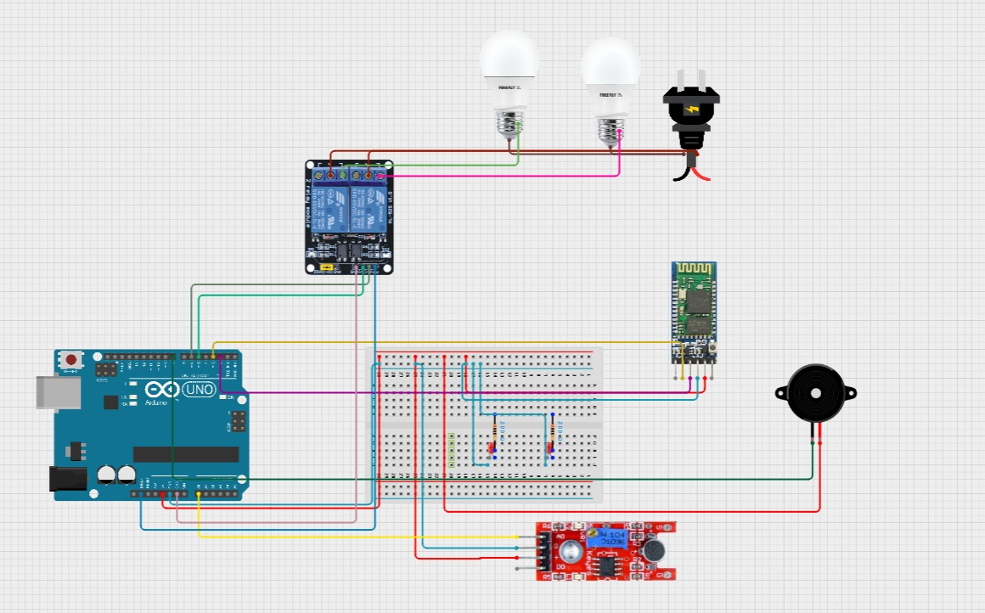
Circuit Diagram

Slide 20
Conclusion
This project demonstrates an effective and affordable smart home automation and security system. It enhances convenience, improves safety, and showcases the power of integrating hardware with software solutions.

