Slide 1

Flight Routes
Flight Recommendation Website
ALTF4-115
Ashwin C Kocheril
Reenu Rachel Thomas
Antu Jilson
Akshara Sanjeevan

Slide 2
Problem Statement: Develop an efficient airline route recommendation system that can provide precise results and data to customers within a maximum response time of 30 milliseconds, while minimizing factors such as layovers, ticket prices, and travel time. The system should offer well-informed and tailored suggestions for customers, ensuring high accuracy in filtering and selecting optimal flight routes.
Optional subtitle is Arial Regular 20pt, sentence case, two lines max

Slide 3








Tool and Technologies Used
Spring Boot
Angular
MySQL
Postman
VS Code
GitHub
Figma
Miro
Rest API

Slide 4
Time walk : Tracing Our Steps
Week - 1
Week - 2
Week - 3
Researched the problem statement
Attended sessions on How internet Works?, Web Scrapping, Git, Designing Innovation etc.
Brainstormed ideas.
Designed Database.
Used SpringBoot and REST API as framework.
Developed APIs for fetching airline , airport & routes
Developed an API to list the best recommendations, added filters for accepting multiple class and airline types.
Designed wireframe using Figma
Developed an API to list the airports based on the input search string and to get detailed itinerary information
Developed frontend using Angular.
Pushed and branched code into Git

Slide 5
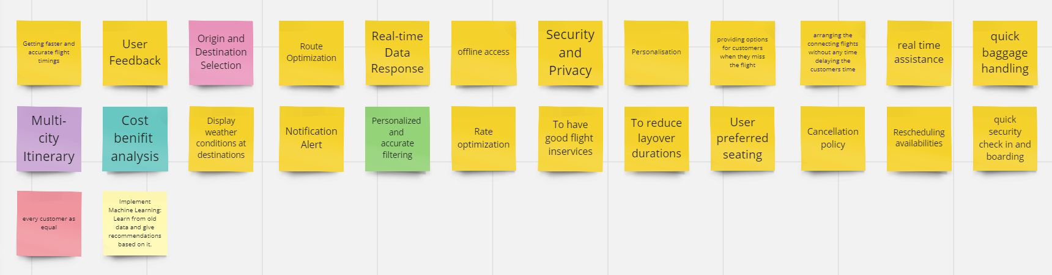
Brainstorm Ideas

Slide 6
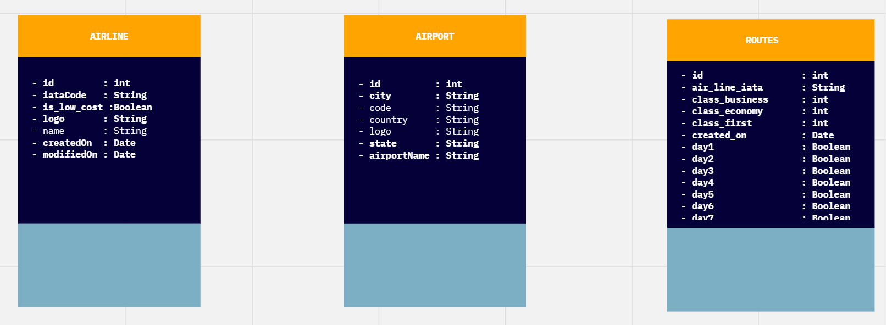
Miro: Database Design

Slide 7
API Endpoints
@GetMapping("/airline/getAll")
@GetMapping("/airline/getByCode/{code}")
@GetMapping("/airport/getByCode/{code}")
@GetMapping("/airlines")
@GetMapping("/routes")
@GetMapping("/airport“)
@GetMapping("/suggest/{starting}")

Slide 8
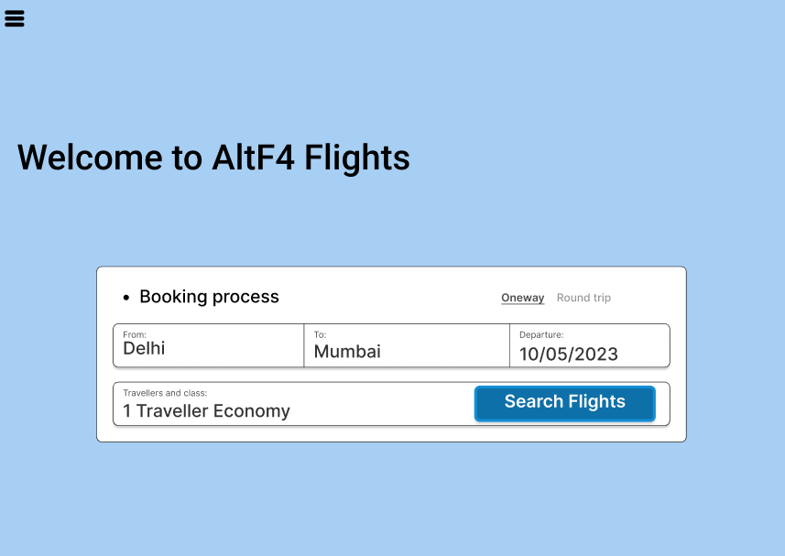
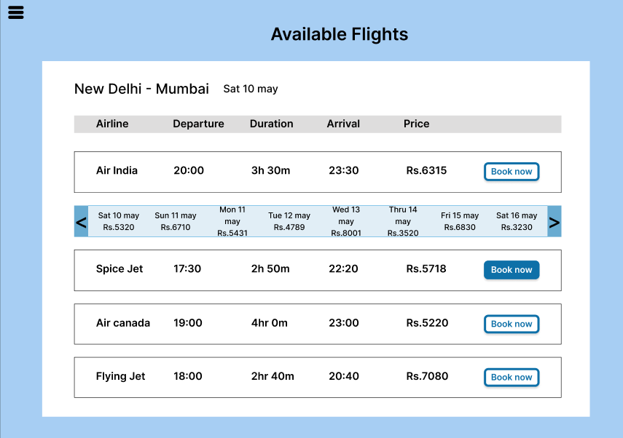
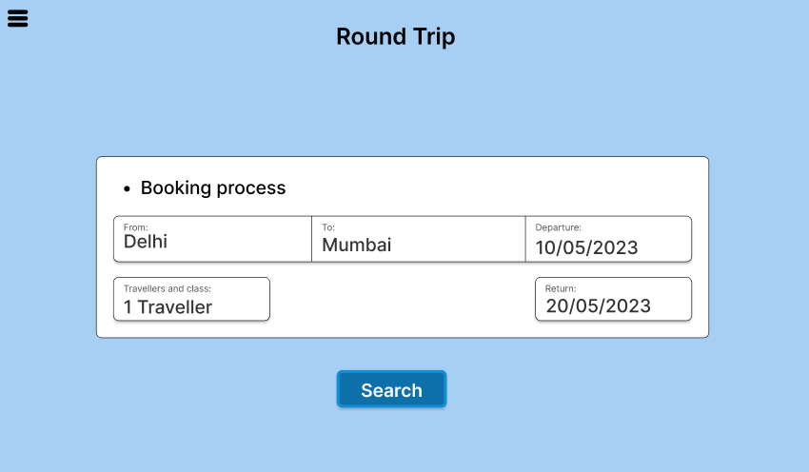
Wireframe

Slide 9
Conclusion: In conclusion, our project tackles the challenge of developing an airline route recommendation system . Our primary objective has been to provide customers with highly accurate results and data within an impressive maximum response time.
Optional subtitle is Arial Regular 20pt, sentence case, two lines max

Slide 10
References: 1. https://www.geeksforgeeks.org/how-to-call-or-consume-external-api-in-spring-boot/ 2. https://medium.com/@nutanbhogendrasharma/consume-rest-api-in-spring-boot-web-application-354c404850f0 3. https://www.springcloud.io/post/2022-03/spring-resttemplate/#gsc.tab=0
Optional subtitle is Arial Regular 20pt, sentence case, two lines max

