Slide 1

Analysis of covid-19 cases in kerala
Ashwin das

Slide 2
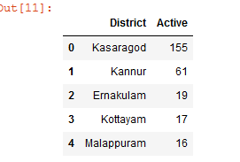
District-wise Split

Slide 3
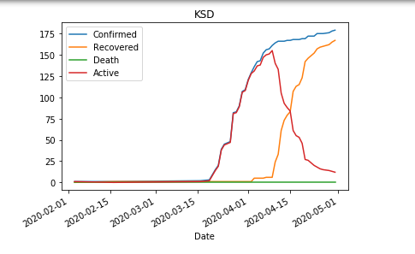
KASARAGOD

Slide 4
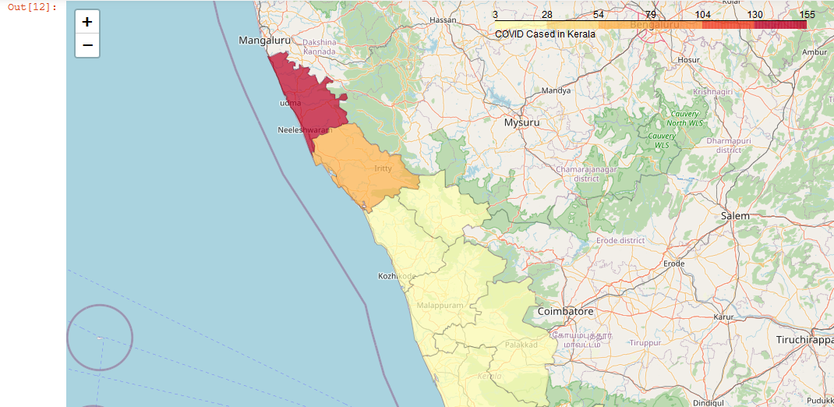
choropleth map

Slide 5
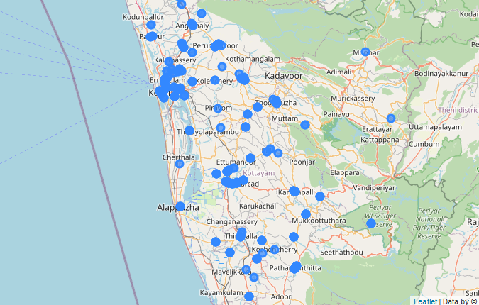
HOSPITALs in kerala

Slide 6
Thank you

