Slide 1

A Gentle Introduction to Reinforcement Learning
Ashwinee Pandey
IndabaX ‘22
University of pretoria

Slide 2
whoami
Senior Data Scientist at Vodacom (M-Pesa Africa)
Master’s student at Stellenbosch University (Machine Learning & Artificial Intelligence)
Get in touch: www.ashwineepandey.com
Github: https://github.com/ashwineepandey
LinkedIn: https://www.linkedin.com/in/ashwineepandey

Slide 3
What will be covered?
[Theory] Basic concepts of Reinforcement Learning ~ 30 mins
[Notebook] Rudimentary Gridworld ~ 20 mins
[Script] Train and Predict Gridworld Agent ~30 mins
By the end, you should be able to:
Have an understanding of how core concepts in RL
Be able to apply Python code to solve rudimentary problems in RL

Slide 4

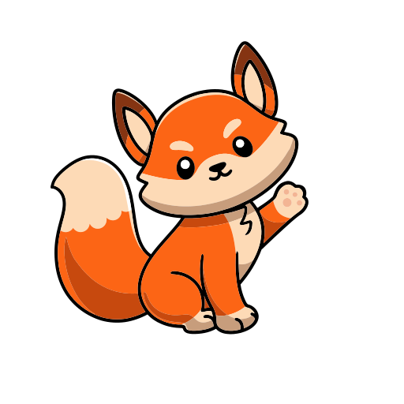
What is Reinforcement Learning?
Agent –
Action -
Environment -
Reward -
State –
Goal: The agent must take actions on the environment such that the sum of the rewards for those actions shall be maximized through repeated interactions.
Environment
State
Reward
Action
Agent

Slide 5
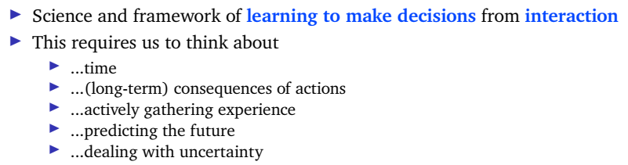
What is Reinforcement Learning?
Think about decision making from first principles
Learning to use interactions – active, sequential
Goal oriented
Does not require prior examples
Optimising for reward

Slide 6
What is an Agent?
Agent state
Policy
Value function
Model
Types of Agents
Value based
Policy based
Actor Critic
Model Free
Model based

Slide 7
Bellman Equation
Agent state
Policy

Slide 8
What is an Environment?
Environment state
Fully Observable Environments
Partially Observable Environments

Slide 9
What is an Environment?
Environment state
Fully Observable Environments
Partially Observable Environments

Slide 10
Exploration vs Exploitation

Slide 11
Experience vs Data

Slide 12
Q-Learning

Slide 13
How do I know how good my Agent is?
No labels – can’t use traditional KPIs like Confusion matrices or MSE, etc.

Slide 14
Differences to Deep Learning?
Supervised DL | RL
Need data to train model | Do not necessarily need data to train model (off-policy)
Aim is to minimize loss function | Aim is to maximise reward function
Gradient descent | Gradient Ascent

Slide 15
I want to learn more, how do I proceed?
Textbook: Reinforcement Learning An Introduction – By Richard Sutton and Andrew Barto (Free online copy available: http://incompleteideas.net/book/the-book-2nd.html)
Deepmind RL Course by David Silver: https://www.deepmind.com/learning-resources/introduction-to-reinforcement-learning-with-david-silver
Frameworks: Keras-RL/Keras-RL2, OpenAI Baselines/Stable Baselines, ACME

Slide 16

Q & A
Thank you!

