Slide 1

Excel Capstone Project
NAME:- Ashwin Avdhut Ghogale
Batch :- DS21DEC
Subject: Election 2019

Slide 2
Tittle:
Use Excel to analyze the Candidates for General Election 2019
Description:
The dataset in file ls2.0.xlsx contains Dataset of candidates who contested the 2019 Lok Sabha Elections. With over 600 Million voters voting for 8500+ candidates across 543 constituencies, the general elections in the
world's largest democracy are a potential goldmine of data. While there are existing separate datasets about the
votes each candidate received and the personal information of each candidate, there was no comprehensive
dataset that included both these information. Thus, this dataset will provide more usability than most existing datasets in this domain.
Source:
I have collected the data from www.kaggle.com maintained by the Association for Democratic Reforms and the website of Election Commission of India.
.

Slide 3
Source of Data
https://www.kaggle.com/prakrutchauhan/indian-candidates-for-general-election-2019

Slide 4
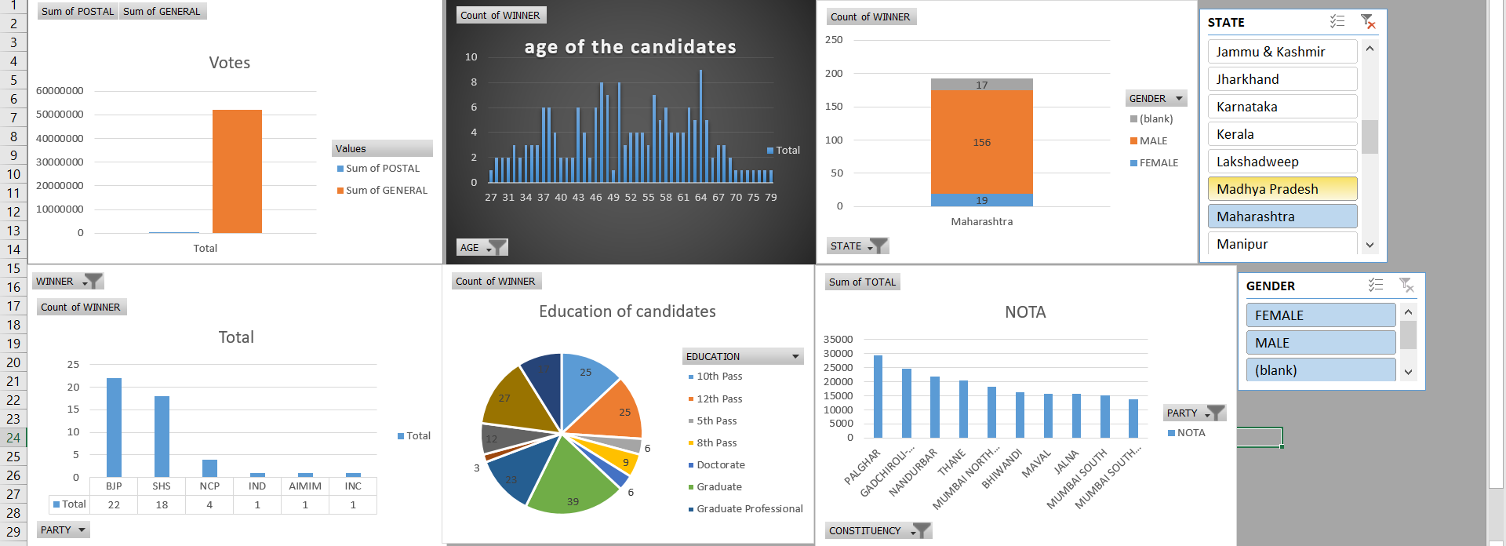
DASHBOARD

Slide 5
Problem statements
which party got max seats?
which candidate has max number of criminal case ?
which party has maximum criminal cases?
male and female candidate winner?
age-wise distribution of elected candidates
education of candidate
general + postal votes
which assembly has got highest nota votes
which constituency has max candidates
Which candidate got max percentage of votes in there constituency

Slide 6
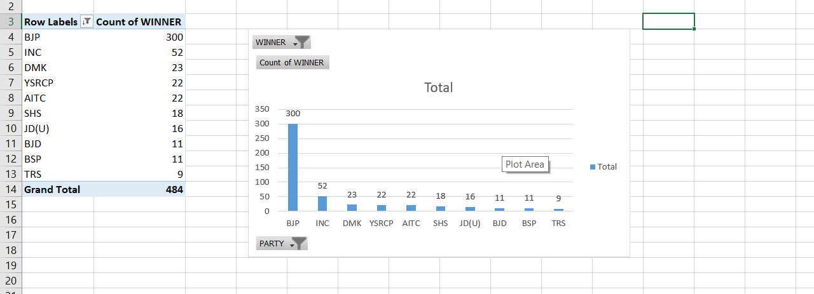
which party got max seats?

Slide 7
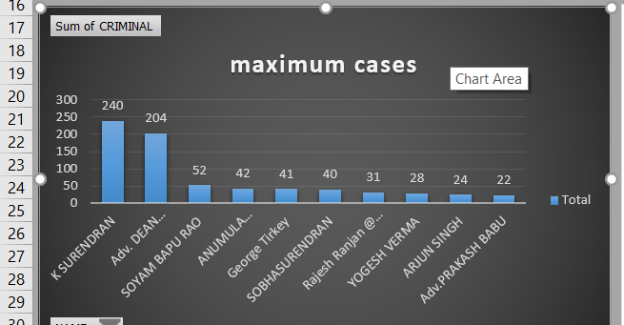
which candidate has max number of criminal case ?

Slide 8
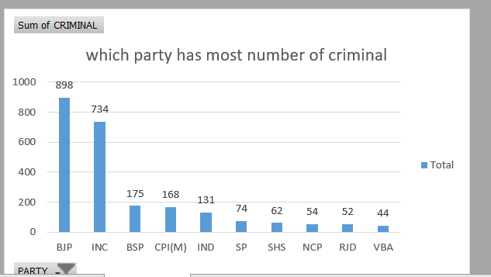
which party has maximum criminal candidates?

Slide 9
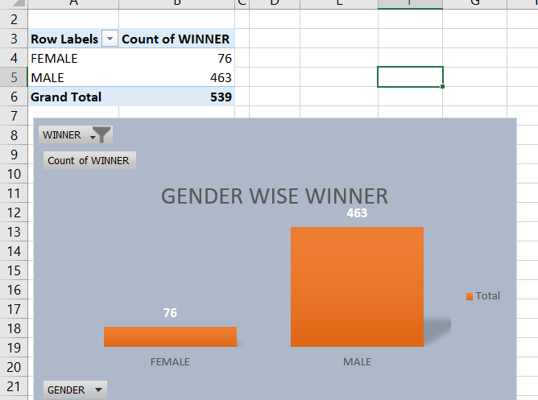
Gender-wise winners?

Slide 10
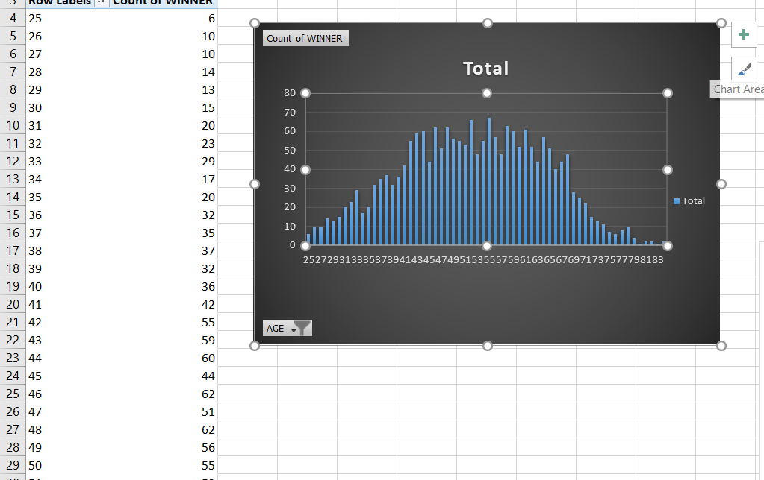
age-wise distribution of elected candidates?

Slide 11
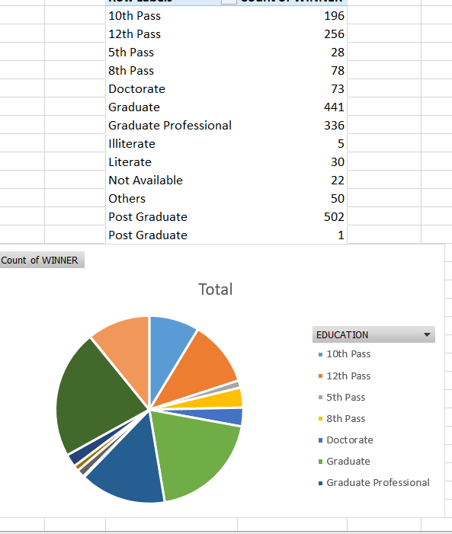
education of candidates

Slide 12
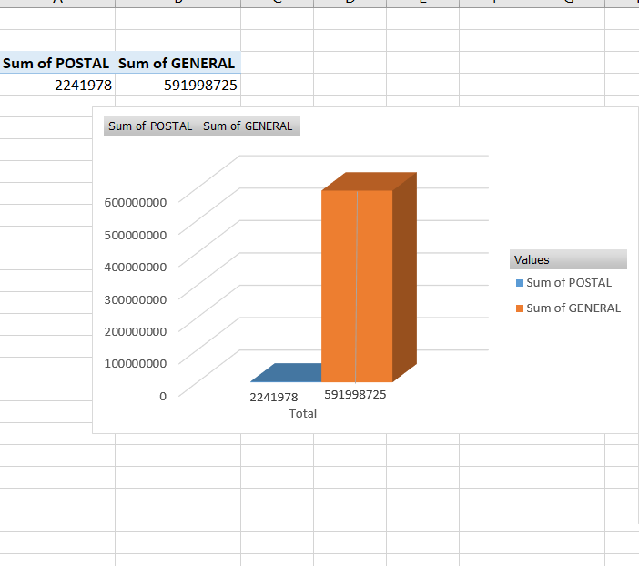
Votes Recieved

Slide 13
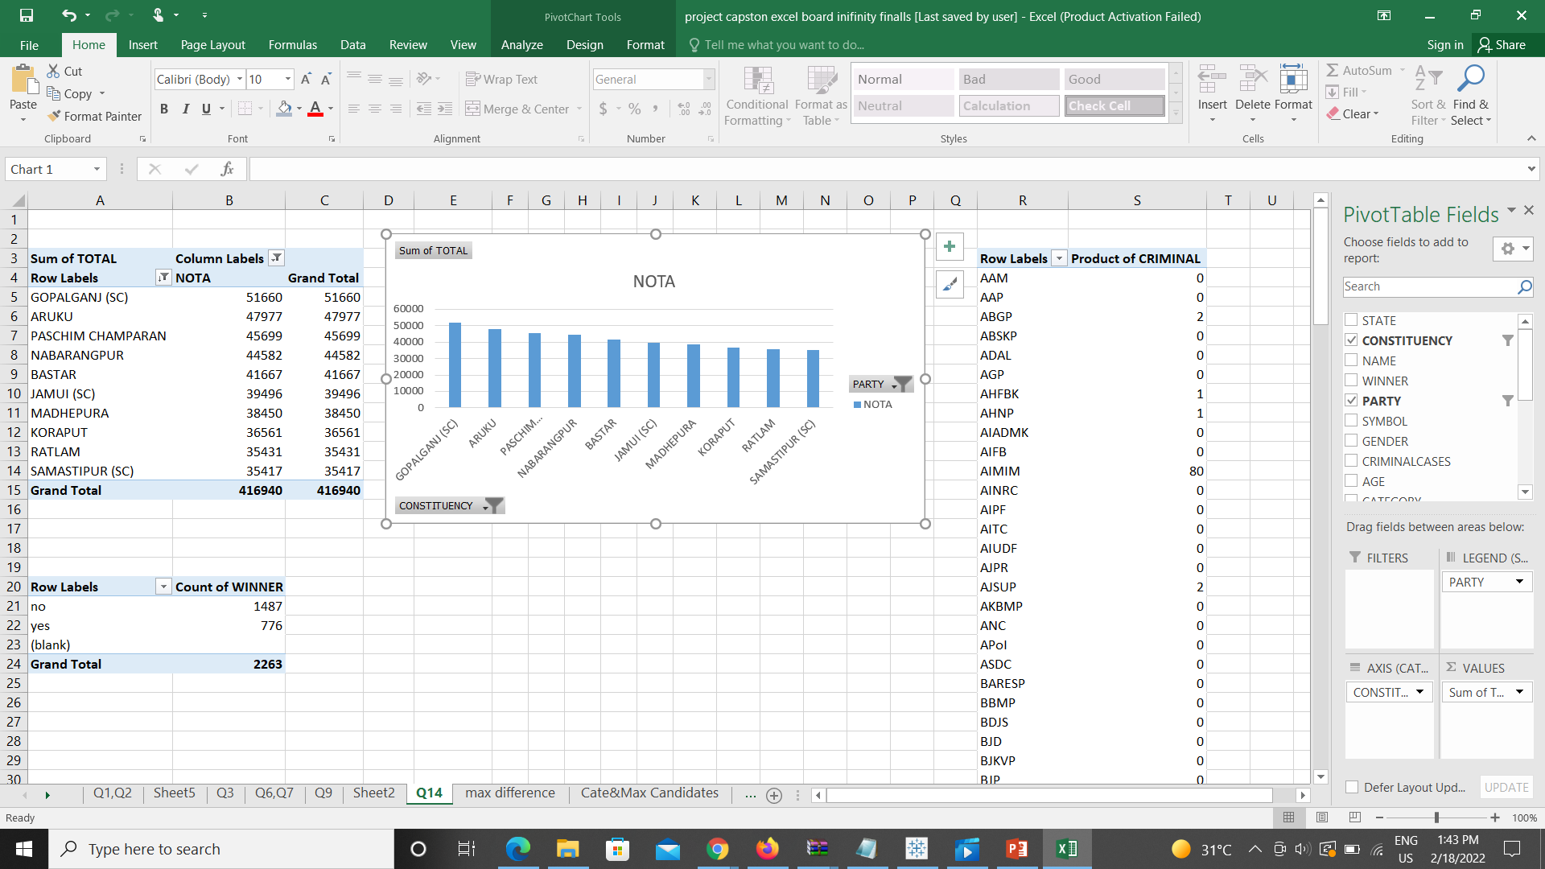
which assembly has got highest nota votes?

Slide 14
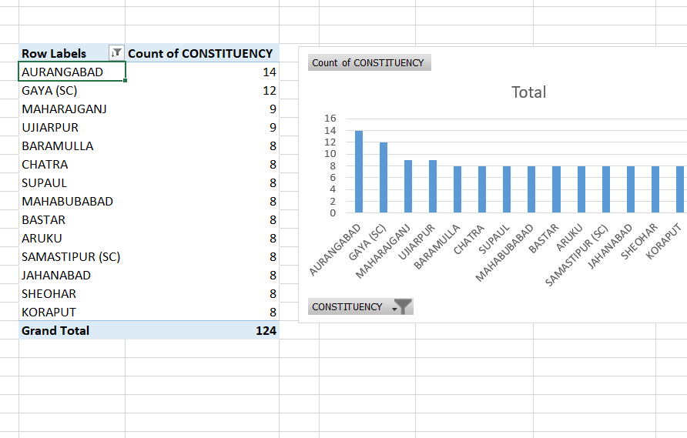
which constituency has max candidates

Slide 15
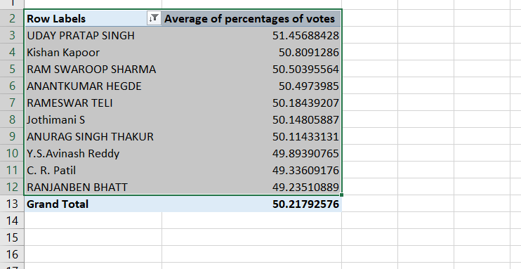
Which candidate got max percentage of votes in there constituency?

Slide 16

Dashboard 2

Slide 17
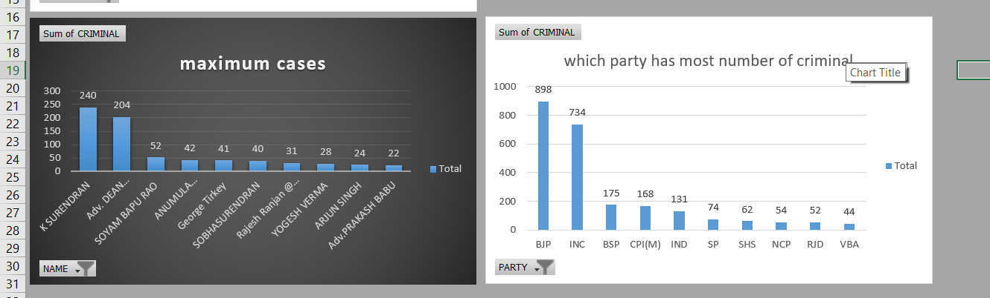
Conclusion
So, after analysing this data I reached that conclusion is the winning chances of criminal candidates is higher than others
or party which has higher criminal candidates has got maximum votes.
Sample output

Slide 18
Video link https://drive.google.com/file/d/1k_SOD-eiePPvw63z7NnwSEtdzA7-lt3Y/view?usp=sharing

Slide 19
Thank You

