Slide 1
Assignment
-Ashwin Gopal Muttagi
YML0320

Slide 2
Servers and its kinds.
It is a computer, a device or a program which provides the data/functionality to the other programs/devices.
Dedicated to manage the network resources.
Server computers usually have special OS.
A single server can serve multiple clients at same stime.

Slide 4
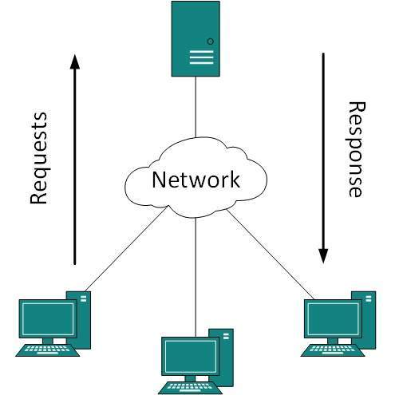
Client Server Model
Describes how server provides resources and services to one or more client.
It is centralized networking.
Works through request response methods.

Slide 5
http
Protocol which allows the fetching of resources.
It is a client-server protocol.
Stateless protocol.
HTTP request format.
    Opening line: method, path of resource, http version.
    Number of header lines
    Blank line
    A message body(optional)

Slide 6
HTTP response format.
    Status line.
      Echoes http version and gives response status code.
    Header lines.
      Contains header and value pair.
      header
      Request response

