Slide 1
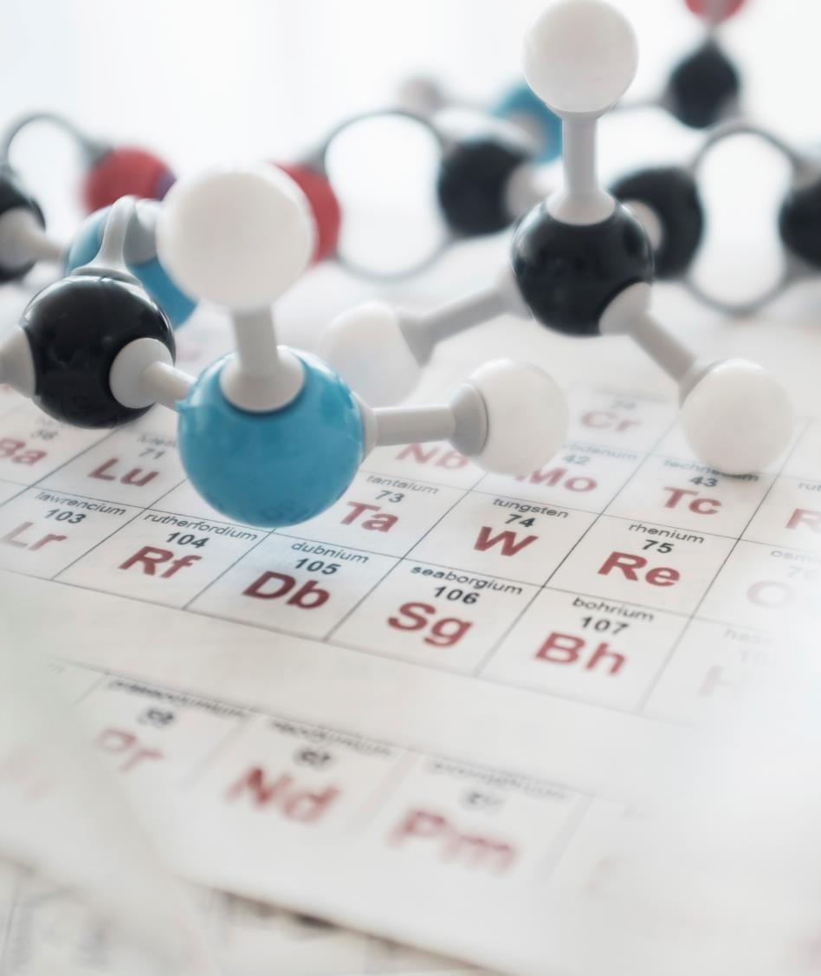
Micro-organisms
Created by Ashwin Subramaniam

Slide 2

Shri Manjunatheshwar Central School – Hubli -Karnataka,Asia
The symbol of our school

Slide 3
Different kinds of micro organisms
There are five types of micro-organisms :-
Viruses
Bacteria
Protozoa
Algae
Fungi

Slide 4
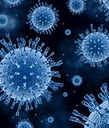
Viruses
(Virus in singular)
Viruses are said to be the connecting link between living and non-living things
Viruses infect all types of life forms , from animals and plants to micro-organisms , including Bacteria and Archaea
They grow, feed and reproduce inside the host cell.
They cause diseases like cold , cough , flu etc.

Slide 5
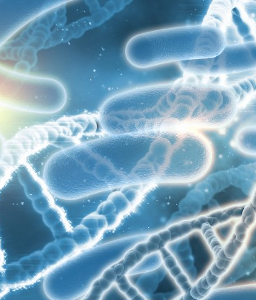
Bacteria
(bacterium in singular)
Bacteria have the simplest structure among all living organisms.
They constitute a large domain of prokaryotic micro-organisms.
Bacteria were among the first life forms to appear on Earth , and are present in most of its habitats.
They can be classified into four types:-
bacilli
cocci
spirillas
commas

Slide 6
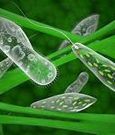
Protozoa
(Protozoan in singular)
Protozoa are single-celled organisms and the primitive class of animals in terms of development.
Protozoa feed on organic matter such as other micro-organisms, organic tissues and debris.
Malaria , leishmaniasis and toxoplasmosis are a few diseases caused by Protozoa

Slide 7
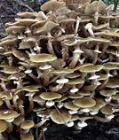
Fungi
(Fungus in singular)
Fungus is any member of the group of eukaryotic organisms that includes microorganisms such as yeast and molds, as well as the more familiar mushroom
They lack nutrition and obtain it from other organisms.
They are considered neither plants nor animals

Slide 8
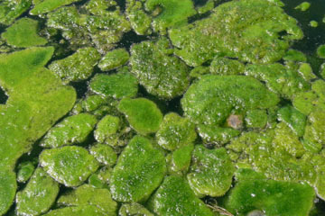
Algae
(Algae in singular)
Algae is an informal term for a large and diverse group of photosynthetic eukaryotic organisms.
The largest and most complex marine algae are called seaweeds, while the most complex freshwater forms are the Charophyta.
Some examples of Algae are spirogyra , stonewarts etc.

Slide 9

Thank You
Ashwin subramaniam

