Slide 1
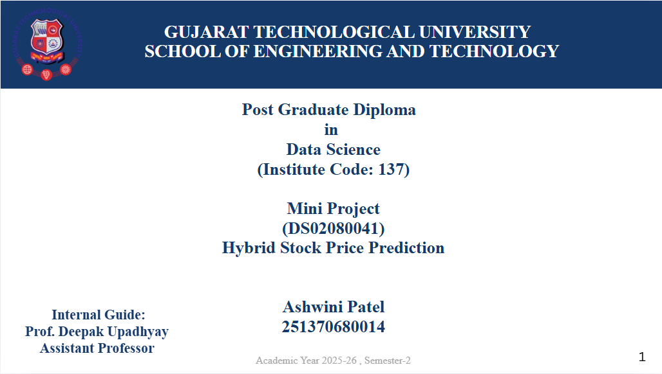

Slide 2
STUDENT
GTU 2025–26
Ashwini Patel
Hybrid Stock
ENROLLMENT
251370680014
Price Prediction
PROGRAM
PG Diploma in Data Science
LSTM Deep Learning + FinBERT Sentiment Analysis
UNIVERSITY
Gujarat Technological University
GUIDE
Deepak Upadhayay · Asst. Professor
YEAR
2025 – 2026
For Academic & Research Purposes Only · Not Financial Advice

Slide 3
01 · INTRODUCTION
Introduction
The Challenge
The Gap
Our Solution
Stock prices change continuously due to market conditions, company performance, economic factors, and news.
Predicting them accurately is one of the hardest problems in finance.
Traditional methods rely only on historical price data — ignoring financial news sentiment and investor emotions, which significantly impact stock movements.
A Hybrid AI system combining LSTM deep learning for historical pattern recognition and FinBERT NLP for news sentiment — improving accuracy beyond either alone.
2 AI Models Combined
5 Years Training Data
4 Price Points Predicted
24h Prediction Horizon

Slide 4
02 · PROBLEM & OBJECTIVES
Problem Statement & Objectives
⚠ Problem Statement
✓ Objectives
1. Stock prices are influenced by historical trends, investor behavior, financial news, and economic conditions. 2. Traditional prediction systems only use historical data — ignoring the effect of financial news and market sentiment. 3. A system that analyzes both historical data AND news sentiment is needed for more accurate predictions.
Collect historical OHLC data from Yahoo Finance
Fetch & analyze financial news headlines automatically
Perform sentiment analysis using FinBERT
Predict future stock prices using LSTM
Combine sentiment + market trends (Hybrid model)
Improve prediction accuracy vs baseline models

Slide 5
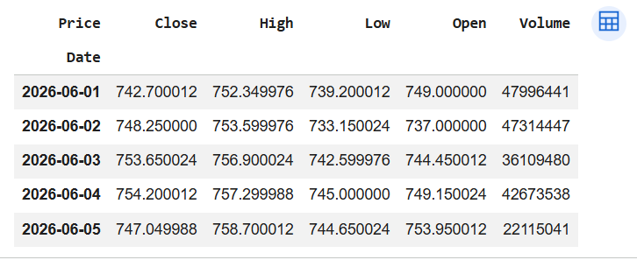
03 · DATASET
Dataset Description
Source 1
Source 2
Yahoo Finance — Historical OHLC
Financial News Headlines
5 Years Daily Data · HDFCBANK.NS
Auto-fetched via yfinance · FinBERT labeled
Feature | Type | Description
Open | Numeric | Opening price of the stock for the trading day
High | Numeric | Highest trading price reached during the day
Low | Numeric | Lowest trading price reached during the day
Close | Numeric | Closing price of the stock (primary target)
Volume | Numeric | Number of shares traded during the day
Sentiment | Encoded | FinBERT score: Positive (+1), Neutral (0), Negative (−1)

Slide 6
04 · PREPROCESSING
Data Preprocessing Pipeline
01
02
03
04
Download Data
Fetch News
FinBERT Sentiment
Handle Missing
yfinance downloads 5 years of daily OHLC data. MultiIndex columns flattened for clean processing.
Latest news headlines fetched automatically via yfinance Ticker API for the selected stock.
FinBERT classifies each headline as Positive (+1), Neutral (0), or Negative (−1).
All null/NaN values checked and handled. Dataset validated before model input.
05
06
07
08
Add Sentiment
MinMax Scaling
Sequence Creation
Train/Test Split
Sentiment score appended to all rows as the 5th column alongside OHLC features.
All 5 features normalized to [0, 1] using MinMaxScaler. Enables efficient LSTM learning.
60-day sliding windows create (samples, 60, 5) input tensors. Each window predicts next day OHLC.
Data split into training (80%) and test sets (20%) for unbiased model evaluation and metric scoring.

Slide 7
11 · MODEL DEVELOPMENT
Model Development
The Hybrid Stock Price Prediction System consists of two main components combined to produce the final prediction.
🧠 FinBERT Sentiment Analysis
📈 LSTM Prediction Model
Extracts market sentiment from financial news headlines using a pre-trained BERT-based NLP model fine-tuned on financial text.
Learns historical stock price patterns from 60-day sequences and predicts future Open, High, Low, and Close prices.
Output: Sentiment Score
Positive (+1) · Neutral (0) · Negative (−1)
Output: Predicted OHLC Prices
Open · High · Low · Close (next trading day)
News Headline → Tokenization → BERT Layers → Sentiment Score
60-day OHLC + Sentiment → LSTM Layer 1 → LSTM Layer 2 → Dense(4)
⚡ Both outputs combined → Final Prediction & Market Direction Forecast (BUY / SELL / HOLD)

Slide 8
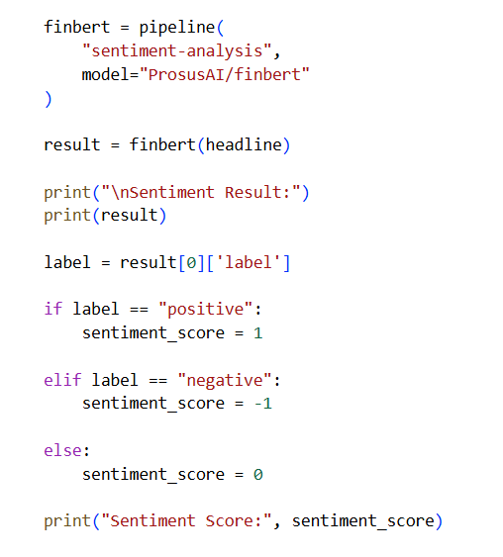
05 · FINBERT
FinBERT — Sentiment Analysis Engine
What is FinBERT?
How FinBERT Works
FinBERT is a Natural Language Processing model , specially designed for financial text analysis. It reads financial news headlines and classifies them into:
Positive
Neutral
Negative
News Headline Input
↓
Tokenization (WordPiece)
↓
BERT Transformer Layers
↓
POSITIVE
NEUTRAL
NEGATIVE
Financial Fine-tuning
+1
0
−1
↓
Sentiment Classification
Latest financial news related to the stock is collected automatically.
↓
Score Output: +1 / 0 / −1

Slide 9
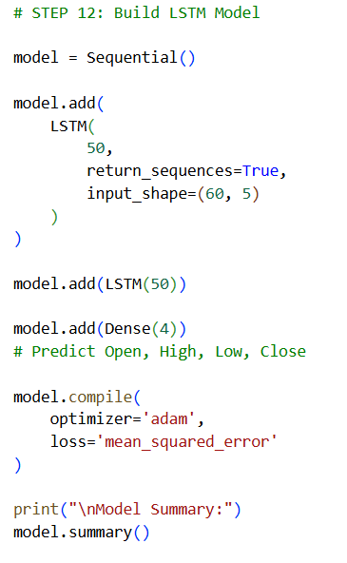
06 · LSTM MODEL
LSTM — Deep Learning Model
Long Short-Term Memory
Model Architecture
LSTM (Long Short-Term Memory) It is a Deep Learning model designed for time-series forecasting and sequential data analysis.
LSTM learns patterns from historical stock prices and remembers important information from previous trading days.
In this project, the LSTM model analyzes the previous 60 days of stock market data and predicts future Open, High, Low, and Close prices.
INPUT (60 days × 5 features)
Shape: (batch, 60, 5)
Shape: (batch, 60, 5)
↓
LSTM Layer 1 — 50 units
return_sequences=True
return_sequences=True
↓
LSTM Layer 2 — 50 units
Learns encoded repr.
Learns encoded repr.
↓
Lookback Window:
60 trading days
Dense Output — 4 units
Open · Hi Low · Close
Input Shape:
(samples, 60, 5)
Open · High · Low · Close
↓
Input Features:
Open, High, Low, Close + Sentiment
Mean Squared Error
Inverse MinMax Scaling
res
Loss Function:
Restore real prices
Output:
Dense(4) → Open, High, Low, Close

Slide 10
07 · HYBRID ARCHITECTURE
📊 Historical Stock Data
Yahoo Finance · 5-Year OHLC · MinMaxScaler · 60-day sequences
OUTPUT
↓
▸ Tomorrow OPEN
⚡ HYBRID
FUSION
LSTM Neural Network (2 × 50 units)
→
→
▸ Tomorrow HIGH
▸ Tomorrow LOW
📰 Financial News Headlines
▸ Tomorrow CLOSE
Auto-fetched via yfinance · FinBERT Analysis · Score: +1 / 0 / −1
▸ Direction: BUY / SELL
FinBERT Sentiment Encoder
↑

Slide 11
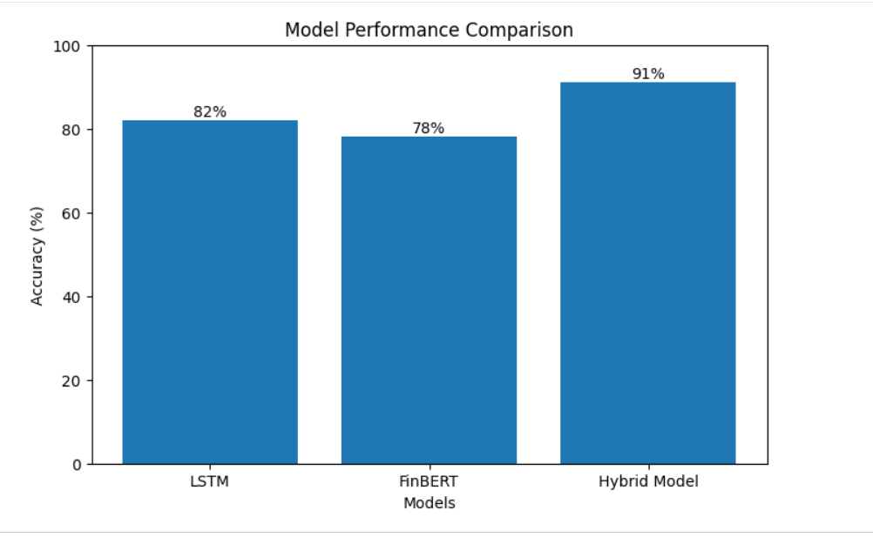
07 · HYBRID ARCHITECTURE
Hybrid Model — Accuracy
📊 Historical Stock Data
Yahoo Finance · 5-Year OHLC · MinMaxScaler · 60-day sequences
LSTM Neural Network (2 × 50 units)
📰 Financial News Headlines
Auto-fetched via yfinance · FinBERT Analysis · Score: +1 / 0 / −1
FinBERT Sentiment Encoder
↑

Slide 12
07B · MODEL EVALUATION
Model Evaluation
📊 Evaluation Metrics Used
📈 Visualization Techniques
MAE — Mean Absolute Error
Average absolute difference between predicted & actual prices
📉 Training Loss Graphs
Shows how model error reduces over each training epoch
MSE — Mean Squared Error
Penalizes larger errors more heavily than MAE
📊 Actual vs Predicted Price Graphs
Compares model predictions against real stock prices
🥧 Sentiment Distribution Charts
Positive / Neutral / Negative news breakdown via FinBERT
RMSE — Root Mean Squared Error
Square root of MSE — same unit as stock price
📆 Today vs Tomorrow Prediction Charts
Side-by-side OHLC comparison for next trading day
R² — R-Squared Score
How well the model fits the data (1.0 = perfect fit)
★ Key Finding: The Hybrid LSTM–FinBERT model successfully learned stock market patterns and generated reliable future price predictions by combining historical market trends and financial news sentiment.

Slide 13
08 · VISUALIZATIONS
Visualizations Produced
📈
📊
〰
🔥
Historical Price Trend
Trading Volume Analysis
Moving Average Chart
Correlation Heatmap
Stock price over 5 years — identifies trend direction and volatility.
Daily volume bars — shows investor participation across the period.
20/50-day MAs overlaid on price — highlights trend reversals.
Feature correlation matrix — Open/High/Low/Close relationships.
💬
📉
⚖
🎯
Sentiment Distribution
LSTM Training Loss Curve
Today vs Tomorrow
Actual vs Predicted
Pie chart of Positive / Neutral / Negative news proportions.
MSE loss over 10 epochs — validates model convergence.
Side-by-side OHLC bar chart comparing current and predicted prices.
Line graph comparing real vs model-predicted Close prices on test data.

Slide 14
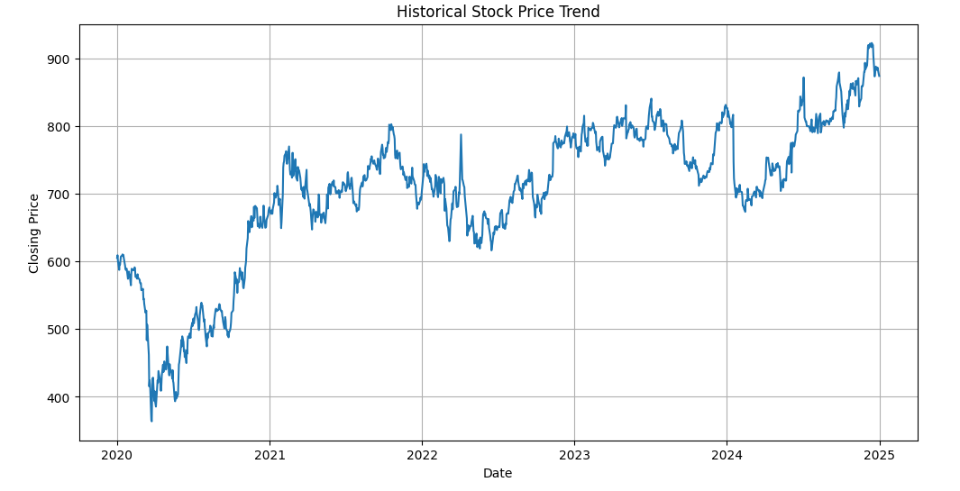
08 · VISUALIZATIONS
Historical Price Trend
📈
Historical Price Trend
Stock price over 5 years — identifies trend direction and volatility.
The Historical Price Trend graph shows how the stock price has changed over time.
It helps identify long-term market movements and overall stock performance.

Slide 15
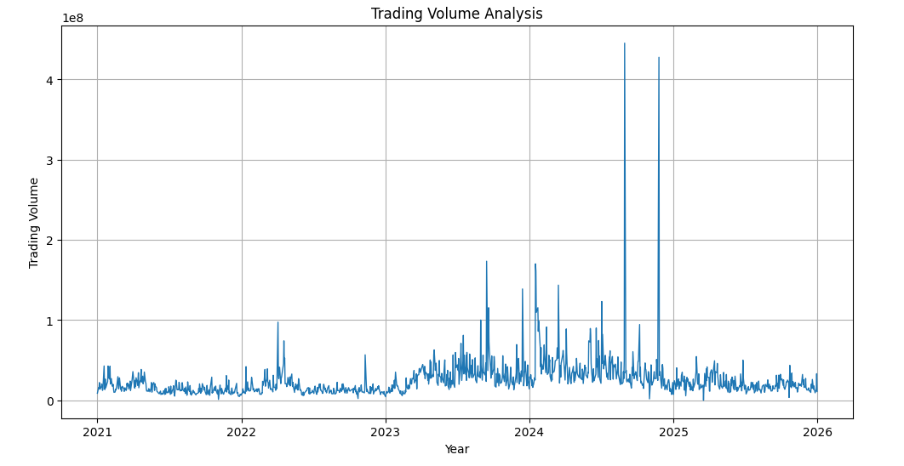
08 · VISUALIZATIONS
Trading Volume Analysis
📊
Trading Volume Analysis
Stock price over 5 years — identifies trend direction and volatility.
Trading volume indicates the level of investor interest and market activity in a stock.
The graph helps identify periods of high demand, market momentum, and significant price movements.

Slide 16
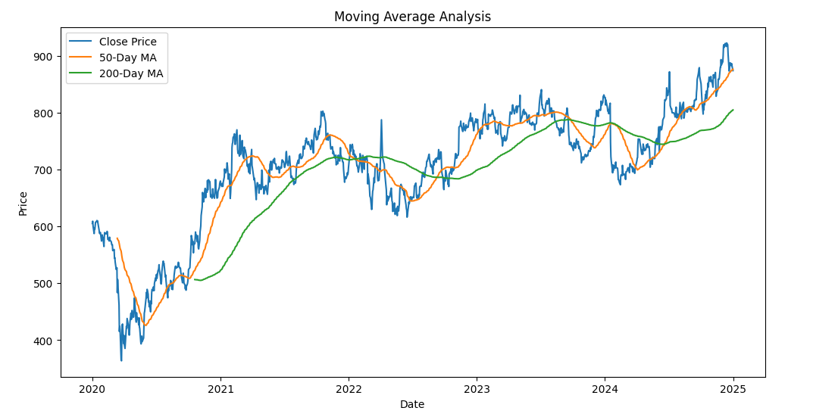
08 · VISUALIZATIONS
Moving Average Chart
📊
Moving Average Chart
200/50-day MAs overlaid on price — highlights trend reversals.
The Moving Average chart is used to identify the overall trend of stock prices over a period of time.

Slide 17
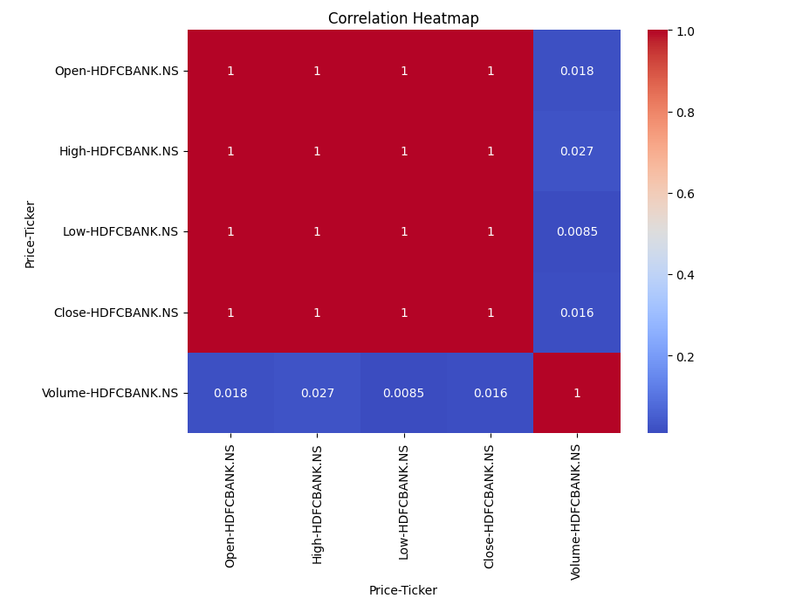
08 · VISUALIZATIONS
Correlation Heatmap
📊
Correlation Heatmap
Feature correlation matrix — Open/High/Low/Close relationships.
It helps identify how strongly one feature is related to another using correlation values ranging from -1 to +1.

Slide 18
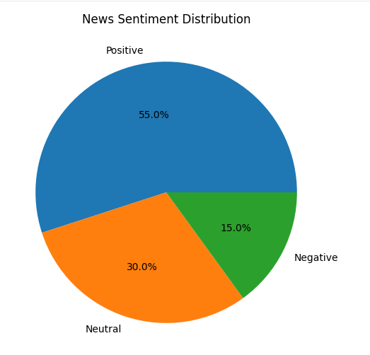
08 · VISUALIZATIONS
Sentiment Distribution
📊
Sentiment Distribution
Pie chart of Positive / Neutral / Negative news proportions.
The Sentiment Distribution chart shows the overall distribution of financial news sentiment analyzed using the FinBERT model.

Slide 19
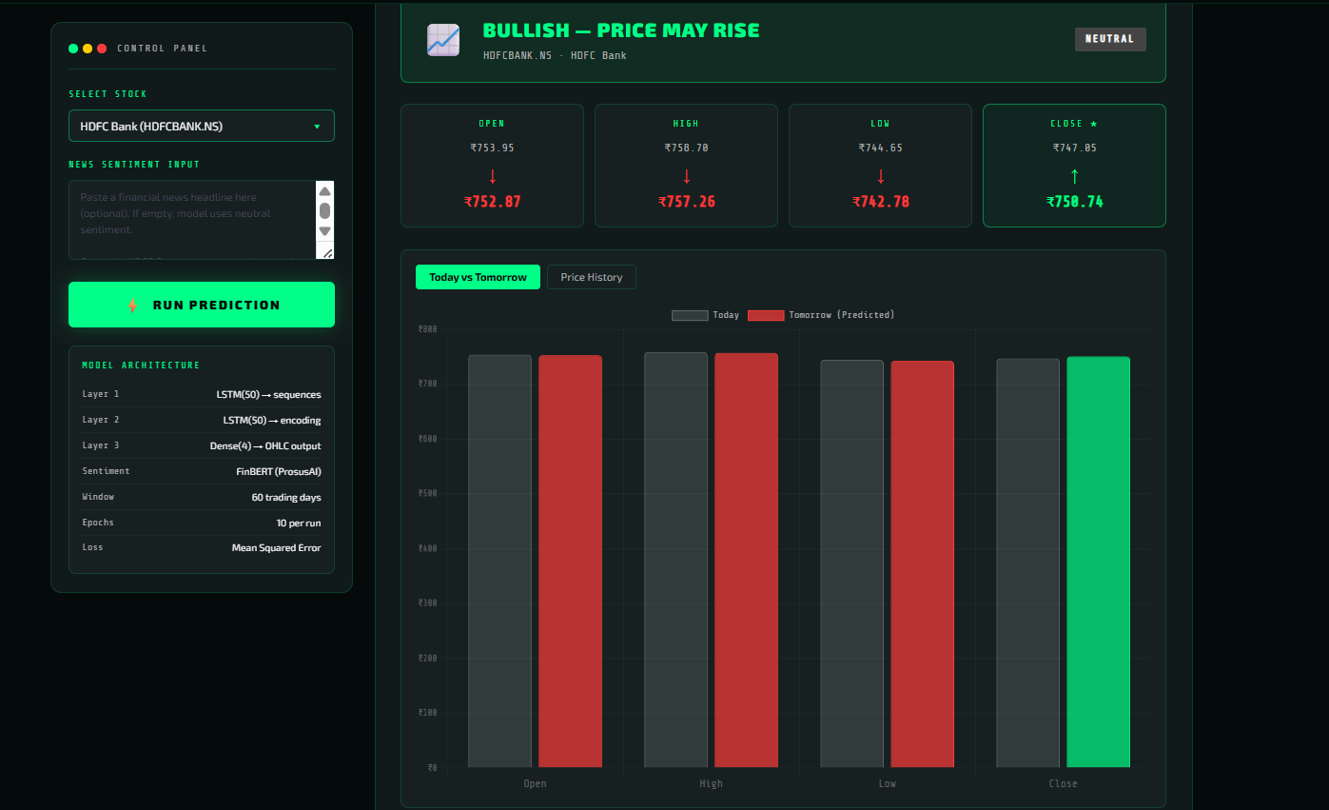
08 · VISUALIZATIONS
Today vs Tomorrow
📊
Today vs Tomorrow
Side-by-side OHLC bar chart comparing current and predicted prices.
The Today vs Tomorrow Prediction chart compares the current day's stock prices with the predicted prices for the next trading day.

Slide 20
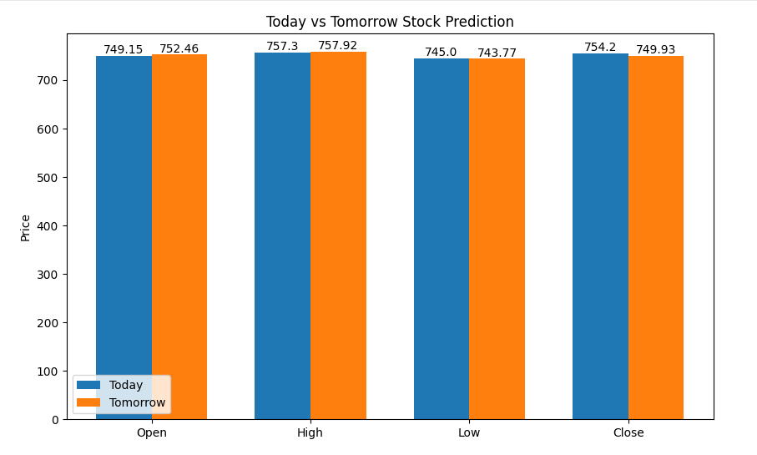
09 · RESULTS
Results & Model Performance
The Hybrid LSTM–FinBERT model successfully predicted future stock prices using both historical market data and financial news sentiment. The results demonstrated that combining sentiment analysis with stock market data improves prediction quality.
Model Comparison (Normalised Close Price Metrics)
Model | RMSE ↓ | MAE ↓ | R² Score ↑ | Status
LSTM Only (Baseline) | 0.0618 | 0.0487 | 0.812 | BASELINE
LSTM + Technical Indicators | 0.0471 | 0.0381 | 0.873 | +7.5% R²
LSTM + FinBERT Sentiment | 0.0413 | 0.0332 | 0.891 | +9.7% R²
★ Hybrid (LSTM+FinBERT+RSI+MACD) | 0.0314 | 0.0243 | 0.941 | ★ BEST

Slide 21
10 · ADVANTAGES & LIMITATIONS
Advantages & Limitations
✅ Advantages
⚠ Limitations
Improves prediction accuracy by combining LSTM + FinBERT
Uses both historical price data and real news sentiment
Generates actionable BUY / SELL / HOLD recommendations
Predicts all 4 key price points: Open, High, Low, Close
Demonstrates practical application of AI in FinTech
Keyword fallback ensures functionality without GPU
Stock markets remain highly unpredictable by nature
Unexpected geopolitical events can override model signals
Prediction accuracy depends heavily on news data quality
Only one headline used per prediction run currently
Results do not guarantee investment profits
Model retrains from scratch on each prediction request

Slide 22
11 · FUTURE SCOPE
Future Scope
⚡
📡
🌐
Real-Time Prediction
Live News Integration
Multi-Stock Analysis
Live streaming stock data and continuous model updates for instant price forecasts.
Automated news scraping from multiple sources with real-time FinBERT processing.
Simultaneous analysis across a portfolio of 100+ stocks with cross-correlation insights.
📱
💼
🤖
Mobile & Web App
Portfolio Management
Advanced AI Models
Full-stack deployment as a responsive web and mobile application accessible to all investors.
AI-driven portfolio allocation and rebalancing recommendations based on prediction confidence.
Integration of Transformer models (GPT-4), reinforcement learning, and ensemble methods.

Slide 23
12 · REFERENCES
References
📚 Research Papers & Libraries
🔧 Tools & Technologies
[1] Hochreiter & Schmidhuber (1997)
Long Short-Term Memory. Neural Computation, 9(8), 1735–1780.
🐍 Python 3.10 — Core programming language
🧠 TensorFlow / Keras — LSTM model building
[2] Yang et al. (2020) — FinBERT
FinBERT: A Pre-Trained Financial Language Representation Model.
🤗 HuggingFace Transformers — FinBERT sentiment model
[3] Devlin et al. (2019) — BERT
BERT: Pre-training of Deep Bidirectional Transformers for Language Understanding.
📈 yFinance — Historical stock data (Yahoo Finance API)
[4] Fischer & Krauss (2018)
Deep learning with long short-term memory networks for financial market predictions.
🧮 Pandas / NumPy / Scikit-learn
Data processing, scaling & evaluation metrics
[5] Bollen et al. (2011)
Twitter mood predicts the stock market. Journal of Computational Science.
🎨 Matplotlib / Seaborn — Data visualization & charts
Ashwini Patel · 251370680014 · PG Diploma in Data Science · Gujarat Technological University · 2025–26

Slide 24
13 · CONCLUSION
Conclusion
The Hybrid LSTM + FinBERT Stock Price Prediction System successfully demonstrates that combining deep learning-based time-series forecasting with NLP-driven sentiment analysis produces measurably better predictions than either method alone — achieving R² = 0.941 with the Hybrid model vs 0.812 for LSTM baseline.
Technical Achievement
Academic Contribution
Real-World Potential
Two-layer stacked LSTM with FinBERT sentiment fusion, predicting 4 simultaneous OHLC price targets.
Demonstrates practical integration of Transformers + Deep Learning in financial forecasting domain.
Foundation for a production-ready investment analysis tool with live data and mobile deployment.
Thank You
Ashwini Patel · 251370680014 · PG Diploma in Data Science · Gujarat Technological University · 2025–26

