Slide 1
ET AutoTech Hackathon
2026
Theme 5: AI for Circular Economy & Sustainability
Ashwini Sawardekar

Slide 2
Theme 5 - AI for Circular Economy & Sustainability
Project: EV Battery Health Advisor
Automating the Circular Economy: Real-time Battery Health & Second-Life Grading
By 2030, the world will face a massive influx of retired EV batteries. Currently, manual testing takes hours; our AI does it in seconds

Slide 3
THE PROBLEM
The Gap: EV battery decommissioning is a manual, bottleneck-heavy process.
The Cost: Inefficient sorting leads to valuable batteries being scrapped too early or incorrectly repurposed, increasing costs for both manufacturers and recyclers.
Key Stat: "80% of retired batteries still have significant life, yet lack a standardized, rapid grading system."

Slide 4
THE SOLUTION
The Approach: An intelligent, agentic system that predicts State of Health (SOH) using minimal sensor data.
Key Advantage:
Rapid Assessment: No need for full-charge cycles; infer health from short-duration data.
Standardization: Generates automated "Health Passports" for every battery pack.
Actionable Intelligence: AI automatically flags whether a battery is fit for Vehicle Reuse, Grid Storage, or Material Recovery.

Slide 5
PROPOSED TECH STACK/ARCHITECTURE
Tech Stack:
Model: Random Forest Regressor (tuned for time-series degradation).
Interface: Streamlit-based dashboard for real-time inference.
Backend: Scikit-learn & Plotly for interactive trend analysis.

Slide 6
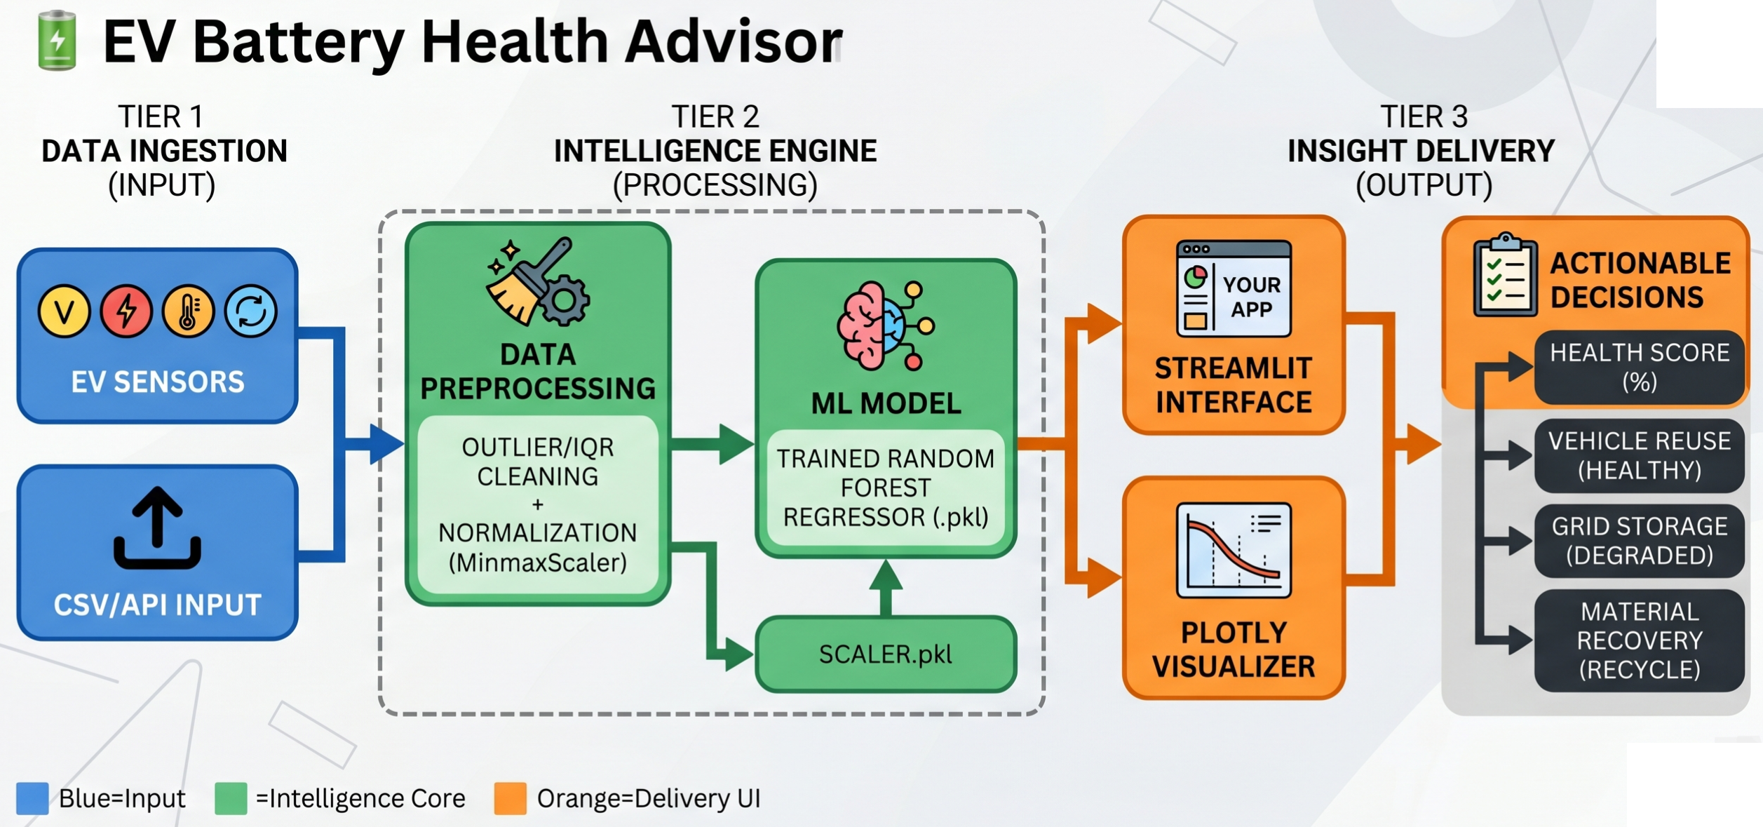
Architecture Diagrams

Slide 7
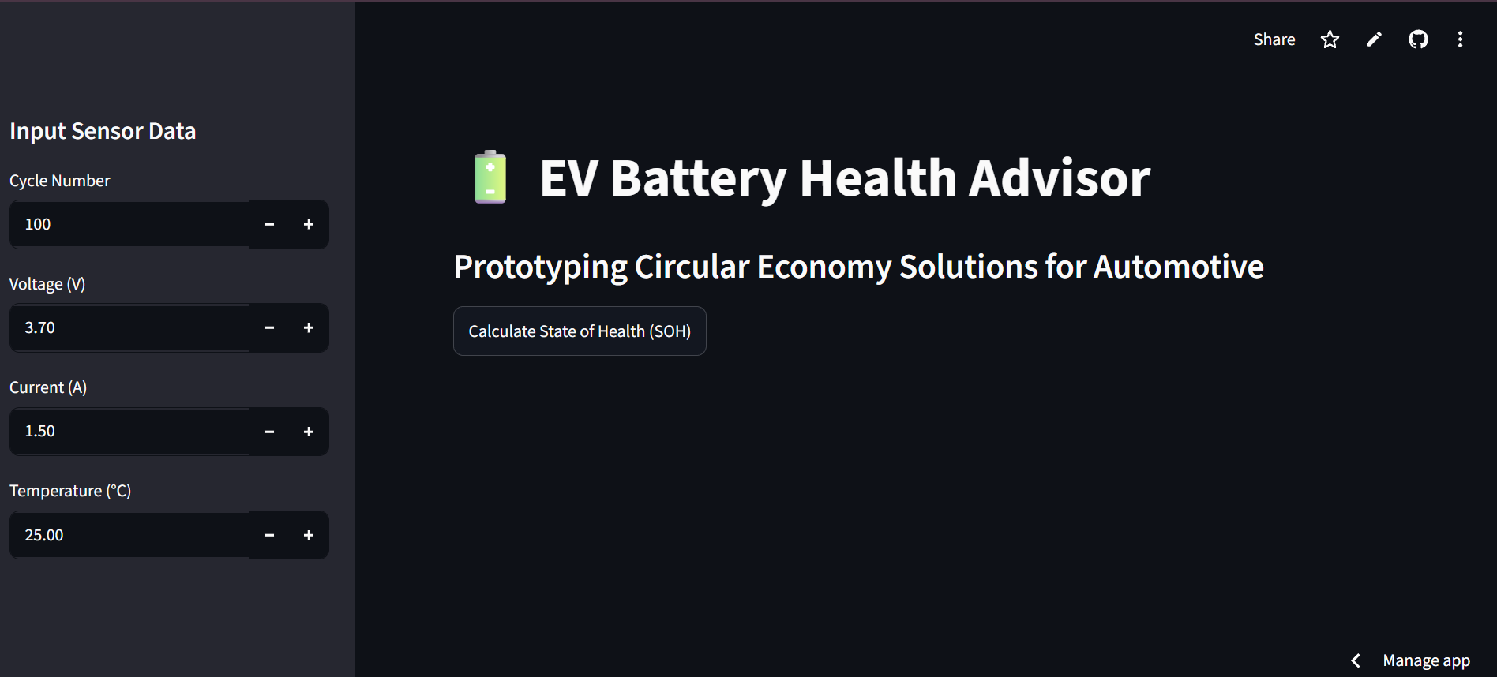
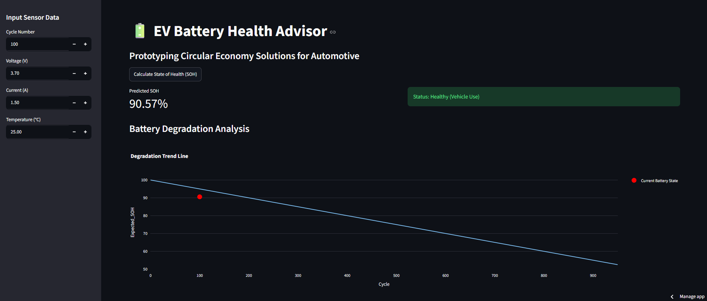
Screenshots

Slide 8
Why your solution must be considered?
Business Impact: Reduces diagnostic time by ~90%, minimizes waste, and maximizes the ROI of battery assets.
Scalability: The model is lightweight (Edge-ready). It can be integrated directly into local workshops or large-scale recycling facilities.
The Vision: Providing the digital infrastructure for a truly circular automotive economy in emerging markets.

Slide 9
Any Additional Information
Our solution is designed for the Indian retrofit market, where cost-effective, rapid diagnostics are essential for scaling the EV ecosystem
Links:
Google Colab:
https://colab.research.google.com/drive/102-ctlWFoPGHs7WK3aLANhji544rvL8a
GitHub:
https://github.com/ashwini-sawardekar/EV-Battery-Health-Advisor
Streamlit App:
https://ev-battery-health-advisor-gfvndb4ecqjjzgjwsjj7ck.streamlit.app/
Video Demo:
https://drive.google.com/file/d/1R-MD-VWaA4sO7YaQizRVXujux312xdMG/view?usp=drive_link

Slide 10
THANK YOU

