Slide 1
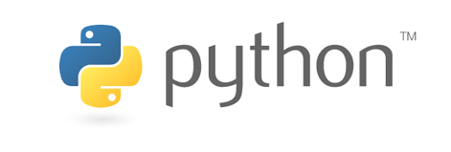

Slide 2
What do you think
about ‘Python’?

Slide 3
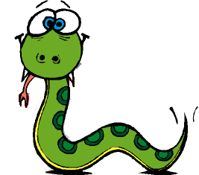
This?

Slide 4
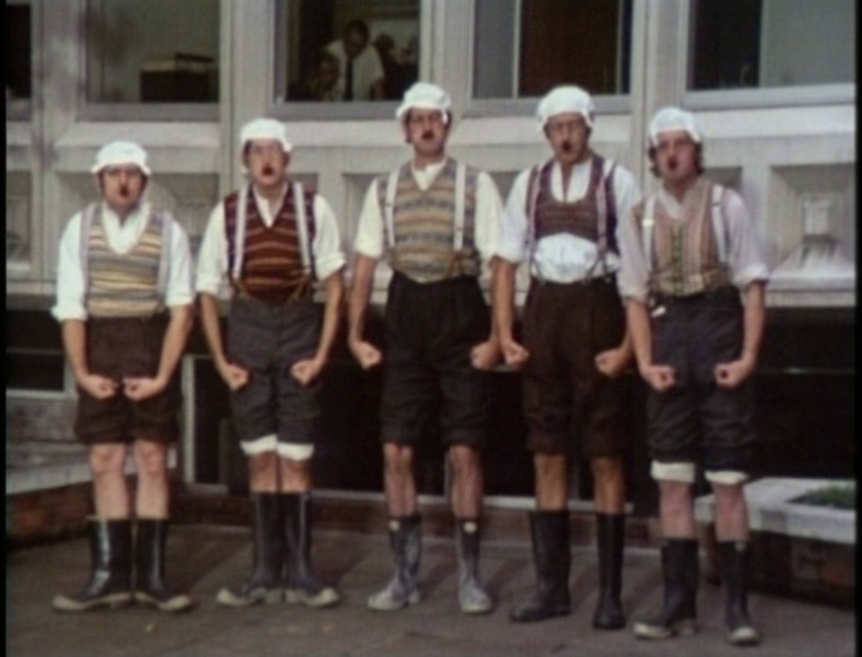
Or
this?

Slide 5
It doesn’t matter because we are
going to talk about
the second one

Slide 6
Python is a
programming
language.

Slide 7
An Open Source
language
which is very powerful
but easy to learn.

Slide 8
Python is
designed to be readable, and
hence maintainable.

Slide 9
Developed by
Guido van Rossum
In early 1990’s

Slide 10
Python code is
typically 1/3 to 1/5
the size of equivalent
C++ or JAVA code

Slide 11
Why should we care?

Slide 12
Let us see some code
snippet

Slide 13
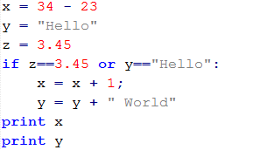

Slide 14
What is the output?
Any Guesses ?

Slide 15
Let me tell you…
The output would be:
12
Hello World

Slide 16
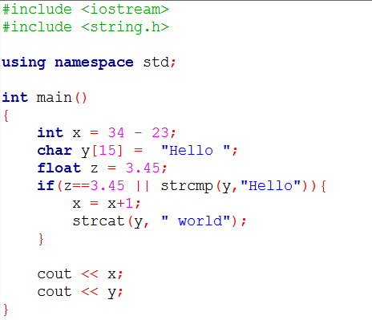
Same program in C++:

Slide 17
As that was a small program there was not much difference in size. But as you might have notice that Python

Slide 18
Didn’t have any curly braces
or parentheses for condition or block of code

Slide 19
Didn’t have any semicolons

Slide 20
No need to define data type Declare variables whenever you require. No need to mention type.

Slide 21
Isn’t that easy?

Slide 22
Okay...it is good. Fine.
It is easy. Fine.
But where can I use it?

Slide 23
It has a variety of applications

Slide 24
You can do
system programming

Slide 25
Game development

Slide 26
Web Development

Slide 27
GUI (Graphical user Interface)
applications

Slide 28
And Internet Scripting,
Database Programming,
Images,
Artificial Intelligence,
XML, etc.

Slide 29
Okay..Why haven’t I have heard
About it before then?

Slide 30
We don’t know.
We seriously don’t know.

Slide 31
Is it being used anywhere?

Slide 32
GLAD that finally you asked!

Slide 33
The answer could be very
Long but we’ll try to keep is
short

Slide 34
It is used in
Anki spaced repetition Bazaar BitTorrent Blender 3D (software) BuildBot Calibre Chandler Cinema 4D Deluge GNOME Dropbox emesene MSN/WLM Exaile Gajim XMPP GRAMPS genealogy software Gwibber microblogging Image Packaging System package management system Solaris operating system OpenSolaris Juice Mercurial Miro internet television Morpheus MusicBrainz Picard MusicBrainz Nicotine PyGTK Soulseek OpenLP OpenShot Video Editor OpenStack PiTiVi non-linear video editor Portage Quake Army Knife Quake engine Quod Libet Resolver One spreadsheet SABnzbd Sage SCons Sublime Text Tryton Ubuntu Software Center package manager Ubuntu Wammu Wicd Linux WikidPad YUM OpenERP ERP5 GNU Mailman MoinMoin Planet Plone content management system Roundup ViewVC CVS SVN Trac Turntable.fm CherryPy Django Flask Google App Engine Pylons Pyramid Quixote Topsite Templating System TurboGears SQLObject SQLAlchemy Kid Genshi CherryPy Pylons web2py Zope content management systems edit Pygame SDL Panda3D Python Imaging Library Python-Ogre Soya3D edit PyGTK GNOME PyQt KDE PySide wxPython wxWidgets edit Biopython graph-tool NetworkX complex networks SciPy SymPy Veusz VisTrails edit Matplotlib MATLAB NumPy Sage free software SymPy edit Cheetah IPython Jinja Django mod python Apache PYthon Remote Objects PyObjC Sphinx (documentation generator) reStructuredText HTML PDF EPub Man pages Twisted VPython edit ADvantage Framework Amarok ArcGIS Autodesk Maya 3D modeler MEL Autodesk MotionBuilder Autodesk Softimage Blender Boxee home theater PC Cinema 4D Corel Paint Shop Pro Claws Mail DSHub ERDAS

Slide 35
AND
Imagine EventScripts Valve Source engine FreeCAD gedit GIMP GNAT Houdini Inkscape vector graphics editor MeVisLab Modo MSC.Software Notepad++ Nuke ParaView Poser 3D rendering animation PyMOL QGIS Rhinoceros 3D Rhythmbox Scribus 3DSlicer SPSS statistical software Totem GNOME Vim VisIt WeeChat IRC edit CCP hf Stackless Python MMO Eve Online Google Google Groups Gmail Google Maps NASA CAD CAE PDM reddit Common Lisp Enthought edit CPython Cython IronPython .NET Mono Jython Java Parrot Psyco JIT compiler PyPy Stackless Python coroutines Unladen Swallow Google Python CLPython CPython Jython IronPython PyPy Python for S60 Psyco Stackless Python Unladen Swallow Boa IDLE SPE Youtube Yahoo Groups

Slide 36
This was a list of the famous
Applications which use Python

Slide 37
Hopefully you didn’t go on
To read that list ;)

Slide 38
Okay..Let me be serious
It is used by Google, Yahoo,
Youtube, reddit, NASA,
BattleField 2(game),
Notepad++, GIMP, VIM, gedit,
Autodesk Maya, Corel Paint
And many more..

Slide 39
So that was all about Python You might have got some idea about it power and utility seeing the applications which use Python

Slide 40
One last thing before we end the presentation.

Slide 41
What?

Slide 42
I also took help of Python while preparing this presentation

Slide 43
I got the list of applications which use Python on Wikipedia. I had to extract the complete list. I couldn’t use copy-paste because of few limitations. So I wrote a small .py script

Slide 44
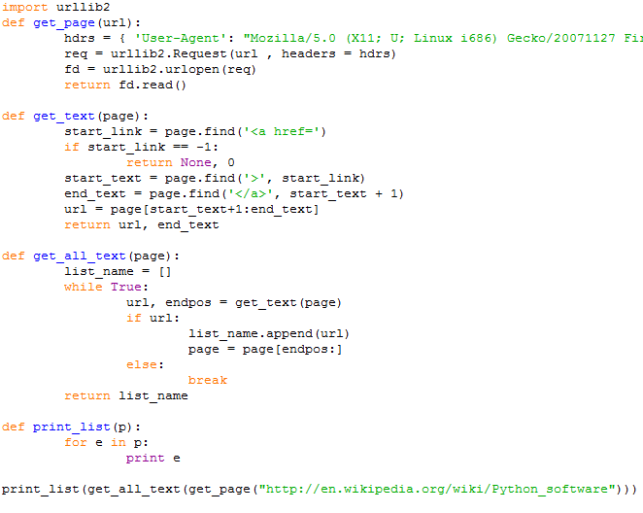

Slide 45
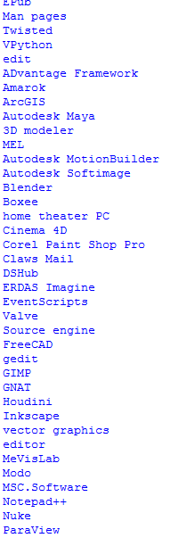
And voila! It gave me the list of what I needed.
(the list isn’t complete in the image)

Slide 46
I hope I was able to convince you about my views on Python.

Slide 47
Oh..One thing I forgot to tell. This is the final thing for sure..

Slide 48
What was that creepy image about in the start of the slide?

Slide 49
It was from a British Comedy show ‘Monty Python’ from which the Programming Language ‘Python’ got its name.

Slide 50
Thank you
(that completes 50 slides ;) )

