Slide 1

lecture13
Intro. to Google App Engine
Keke Chen
Based on Guido van Rossum’s presentation
Notes:
Enter Title of Presentation Here
Google Confidential

Slide 2
Outline
Introduction to Google AppEngine
Comparison with EC2
Notes:
Enter Title of Presentation Here
Google Confidential

Slide 3
Google App Engine
Does one thing well: running web apps
Simple app configuration
Scalable
Secure
Notes:
Enter Title of Presentation Here
Google Confidential

Slide 4
infrastructure vs. platform - What is “The Platform”?
Application-specific code
Libraries: shared by multiple applications
Platform: same for all applications
infrastructure: hidden by platform

Slide 5
App Engine Does One Thing Well
App Engine handles HTTP(S) requests, nothing else
  Think RPC: request in, processing, response out
  Works well for the web and AJAX; also for other services
App configuration is dead simple
  No performance tuning needed
Everything is built to scale
  “infinite” number of apps, requests/sec, storage capacity
  APIs are simple
Notes:
Enter Title of Presentation Here
Google Confidential

Slide 6
App Engine Architecture (python)
req/resp
stateless APIs
R/O FS
urlfech
Python
VM
process
stdlib
mail
app
images
datastore
stateful
APIs
memcache
Notes:
Enter Title of Presentation Here
Google Confidential

Slide 7
Services
URLFetch – fetch web resources/services
Images – manipulate images: resize, rotate, flip, crop
Google Accounts
Mail
XMPP – instant messages
Task Queue – message queue; allow integration with non-GAPPs
Datastore – managing data objects
Blobstore – large files, much larger than objects in datastore, use <key, object> to access
Notes:
Enter Title of Presentation Here
Google Confidential

Slide 8
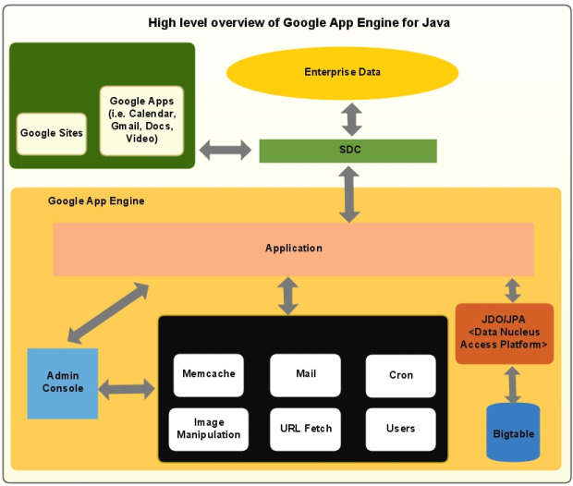

App Engine Architecture (java)
SDC:
Secure data connector
JDO: java data object
JPA: java persistent API
Notes:
Enter Title of Presentation Here
Google Confidential

Slide 9
Java or python?
Python: powerful python syntax, library, shorter code
Java: can use JDO/JPA
  Better portability if you need to use Bigtable to store data
Notes:
Enter Title of Presentation Here
Google Confidential

Slide 10
Why Not LAMP?
Linux, Apache, MySQL/PostgreSQL, Python/Perl/PHP/Ruby
LAMP is the industry standard
But management is a hassle:
  Configuration, tuning
  Backup and recovery, disk space management
  Hardware failures, system crashes
  Software updates, security patches
  Log rotation, cron jobs, and much more
  Redesign needed once your database exceeds one box
Notes:
Enter Title of Presentation Here
Google Confidential

Slide 11
Scaling
Low-usage apps: many apps per physical host
High-usage apps: multiple physical hosts per app
Stateless APIs are trivial to replicate
Datastore built on top of Bigtable; designed to scale well
  Abstraction on top of Bigtable
  API influenced by scalability
    No joins
    Recommendations: denormalize schema; precompute joins
Notes:
Enter Title of Presentation Here
Google Confidential

Slide 12
Automatic Scaling to Application Needs
You don’t need to configure your resource needs
One CPU can handle many requests per second
Apps are hashed onto CPUs:
  One process per app, many apps per CPU
  Creating a new process is a matter of cloning a generic “model” process and then loading the application code (in fact the clones are pre-created and sit in a queue)
  The process hangs around to handle more requests (reuse)
  Eventually old processes are killed (recycle)
Busy apps (many QPS query per sec) get assigned to multiple CPUs
  This automatically adapts to the need
    as long as CPUs are available
Notes:
Enter Title of Presentation Here
Google Confidential

Slide 13
Preserving Fairness Through Quotas
Everything an app does is limited by quotas, for example:
  request count, bandwidth used, CPU usage, datastore call count, disk space used, emails sent, even errors!
If you run out of quota that particular operation is blocked (raising an exception) for a while (~10 min) until replenished
Free quotas are tuned so that a well-written app (light CPU/datastore use) can survive a moderate “slashdotting”
The point of quotas is to be able to support a very large number of small apps (analogy: baggage limit in air travel)
Large apps need raised quotas
  currently this is a manual process (search FAQ for “quota”)
  in the future you can buy more resources
Notes:
Enter Title of Presentation Here
Google Confidential

Slide 14
Datastore (storage organization)
Data model
  Property, entity, entity group
  Schemeless: properties can have different types/meanings for different objects
  Allow (1) object query (2) SQL-like query
Transaction
Can be applied to a group of operations
Persistent store (check BigTable paper)
  Strongly consistent
  Not relational database
  Index built-in
Memcache
  Caches objects from bigtable, to improve performance
Notes:
Enter Title of Presentation Here
Google Confidential

Slide 15
Hierarchical Datastore
Entities have a Kind, a Key, and Properties
  Entity ~~ Record ~~ Python dict ~~ Python class instance
  Key ~~ structured foreign key; includes Kind
  Kind ~~ Table ~~ Python class
  Property ~~ Column or Field; has a type
Dynamically typed: Property types are recorded per Entity
Key has either id or name
  the id is auto-assigned; alternatively, the name is set by app
  A key can be a path including the parent key, and so on
Paths define entity groups which limit transactions
  A transaction locks the root entity (parentless ancestor key)
  Recall the chubby lock service in bigtable paper
Notes:
Enter Title of Presentation Here
Google Confidential

Slide 16
Indexes
Properties are automatically indexed by type+value
  There is an index for each Kind / property name combo
  Whenever an entity is written all relevant indexes are updated
  However Blob and Text properties are never indexed
This supports basic queries: AND on property equality
For more advanced query needs, create composite indexes
  SDK auto-updates index.yaml based on queries executed
  These support inequalities (<, <=, >, >=) and result ordering
  Index building has to scan all entities due to parent keys
Notes:
Enter Title of Presentation Here
Google Confidential

Slide 17
New features
Virtual machines (like EC2) are added

Slide 18
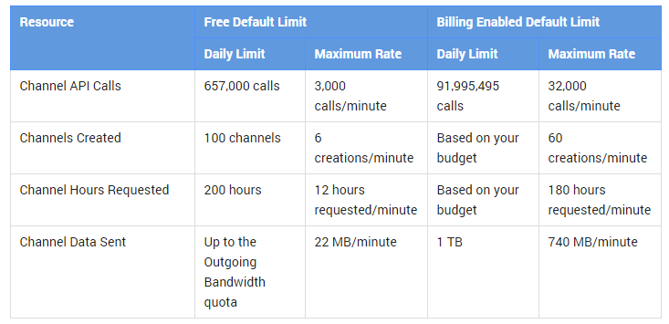
Free tier
First 5GB
Daily limits

Slide 19
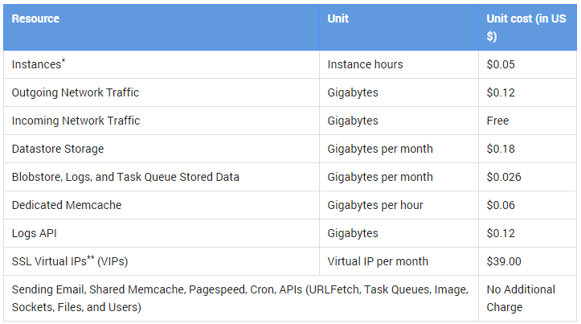
Pricing
The part exceeding the free quota
User defined budget

Slide 20
Security
Constrain direct OS functionality
  no processes, threads, dynamic library loading
  no sockets (use urlfetch API instead)
  can’t write files (use datastore)
  disallow unsafe Python extensions (e.g. ctypes)
Limit resource usage
  Hard time limit of 30 seconds per request
  Most requests must use less than 300 msec CPU time
  Hard limit of 1MB on request/response size, API call size, etc.
  Quota system for number of requests, API calls, emails sent, etc
  Free use for 500MB data and 5M requests per month
  10 applications per account
Notes:
Enter Title of Presentation Here
Google Confidential

Slide 21
Comparing Google AppEngine and EC2:
The Systems Today
AppEngine:
Higher-level functionality
(e.g., automatic scaling)
More restrictive
(e.g., respond to URL only)
Proprietary lock-in
EC2/S3:
Lower-level functionality
More flexible
Coarser billing model
Slide <number>
June 3, 2008

Slide 22
Making a Choice
Researchers will pick Amazon:
  Fewer restrictions
  Easier to try out new ideas
Application developers:
  If AppEngine meets all your needs, it will probably be easier to use.
  If AppEngine doesn’t meet your needs, it may be hard to extend.

Slide 23
A demo video
http://www.youtube.com/watch?v=bfgO-LXGpTM

