Slide 1
Content-
Introduction
History Of Java
Versions
Features
Applications
Disadvantages

Slide 2
Introduction of Java
Java is a computer programming language. It’s known as a high-level language because it can be read and written easily by humans.
Like English, Java has a set of rules that determine how the instructions are written. These rules are known as its syntax.
So, we can define Java as a:-
Java is a Class based high-level object oriented programming language.

Slide 3

History of java
Java was developed by James Gosling at Sun Microsystems (which is now merged with Oracle) and released in 1995. It is now maintained and distributed by Oracle. James Gosling and his team members started the project in the early '90s.
Initially, it was named as “Oak”. Oak was renamed as "Java" because it was already a registered trademark by Oak Technologies.
The first edition of Java was known as “Java 1.0” and was released on 1996 .
Each new version adds new features in Java and “Java 19” is the latest released version

Slide 4
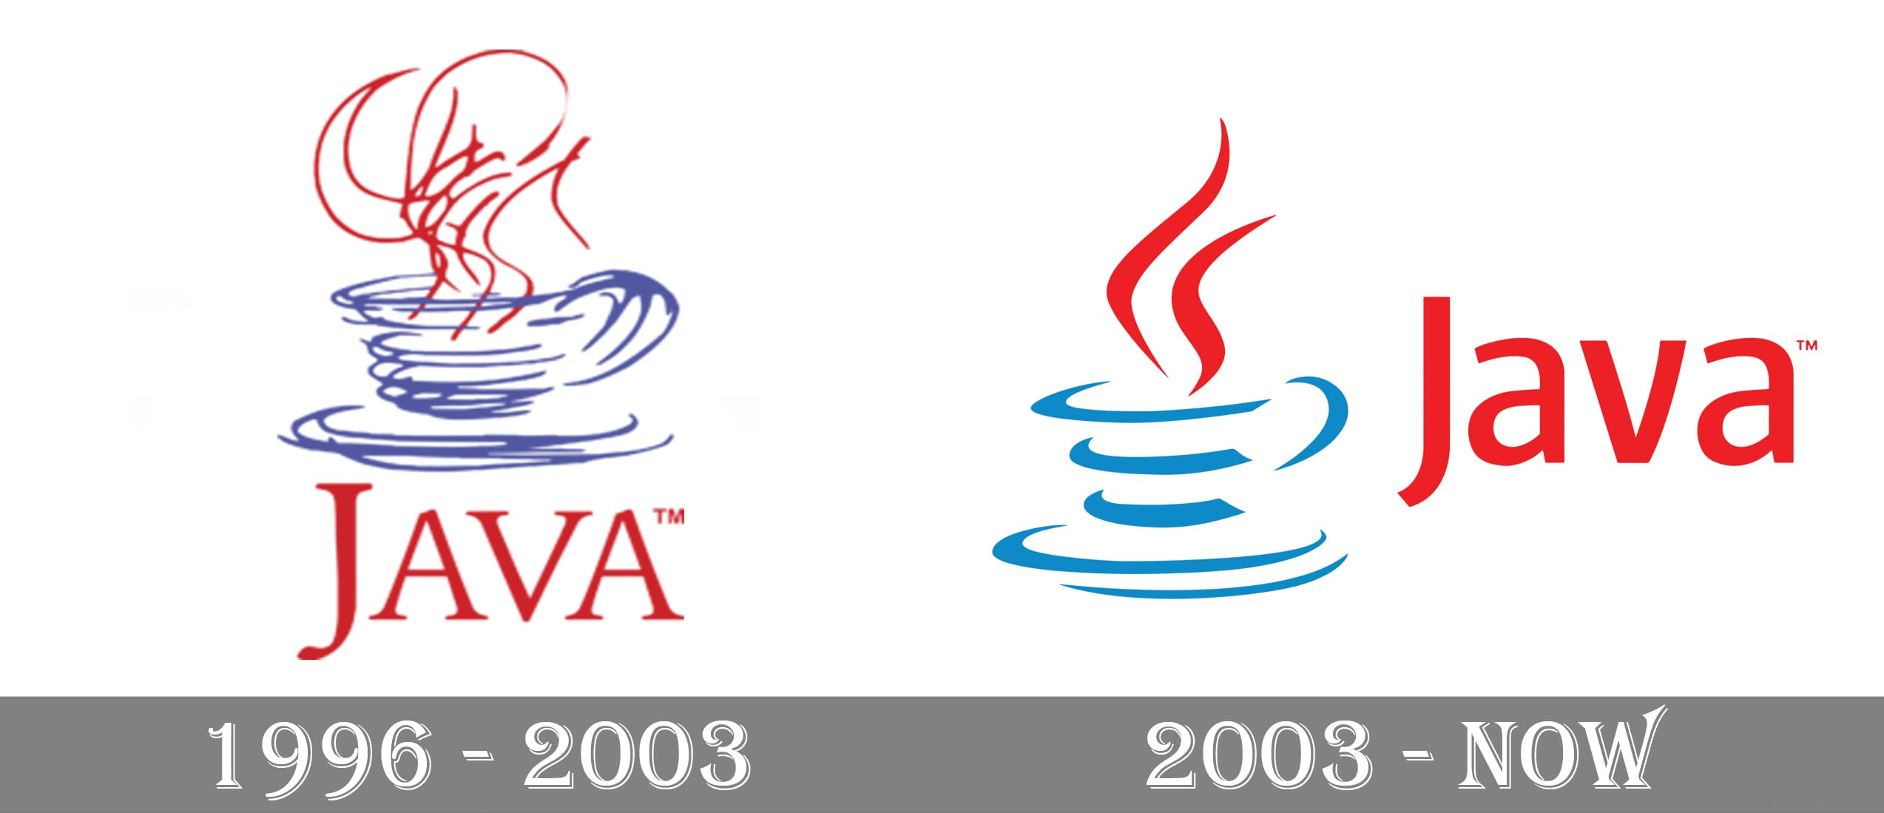
Evolution of Java Logo
The first Java logo was created in 1996.
The logo continued with the programming language for seven years i.e. 1996 to 2003.

Slide 5
Java Version
JDK Alpha and Beta (1995)
JDK 1.0 (23rd Jan 1996)
JDK 1.1 (19th Feb 1997)
J2SE 1.2 (8th Dec 1998)
J2SE 1.3 (8th May 2000)
J2SE 1.4 (6th Feb 2002)
J2SE 5.0 (30th Sep 2004)
Java SE 6 (11th Dec 2006)
Java SE 7 (28th July 2011)
Java SE 8 (18th Mar 2014)
Java SE 9 (21st Sep 2017)
Java SE 10 (20th Mar 2018)
Java SE 11 (September 2018)
Java SE 12 (March 2019)
Java SE 13 (September 2019)
Java SE 14 (Mar 2020)
Java SE 15 (September 2020)
Java SE 16 (Mar 2021)
Java SE 17 (September 2021)
Java SE 18 (to be released by March 2022)

Slide 6
Some Features of java
Java is open source .
It is a high-level language i.e., its syntax uses English like language.
Java is case sensitive language.
Object-oriented
Portable
Java is compiled and interpreted language.
Platform independent
It is robust and secure.

Slide 7
Applications Of Java
Some of the many applications of Java are:
Desktop Applications
Web applications
Mobile Applications
Gaming applications
Robotics
Enterprise Application
AI
Networking

Slide 8
Disadvantages
Memory consumption
Garbage Collection
Complex Code
No backup facility
However, due to the various disadvantages, Java is one of the most used programming languages due to its advantages, making it platform-independent, secure and a robust programming language.

