Slide 1
Control Flow Statements

Slide 2
Control Flow Statements
When a Java program is executed, it execute statement by statement. Generally, all statements are executed sequentially from top to bottom. Sometimes, we may need to execute statements conditionally, based on the some result .
Control flow statements help in the conditional execution of specific statements. All control flow statements are associated with a business condition – when true, the code block executes; when false it is not executed.
A programming language uses control statements to control the flow of execution of a program based on certain conditions.
Three types of control flow statements:-
Decision Making statements if statements
switch statement

Slide 3
Loop statements do while loop
while loop
for loop
for-each loop
Jump Statements break statement
continue statement

Slide 4
Decision-Making statements:
These statements basically have two parts- condition and execution statement.
Decision-making statements , control the program flow depending upon the result of the condition provided.
The decision-making statements are as follows:
if statement
if-else statement
if-else-if statement
multiple if statement
nested-if statement
switch-case

Slide 5
if statement: If a certain condition is true then a block of statement is executed otherwise not.
The if keyword is used to check the given expression is true or not.
Syntax- if(condition) {
statement 1; // all these statement is executed if the given condition is true
statement 2;
statement 3;
}
Syntax- if (condition)
statement 1;

Slide 6
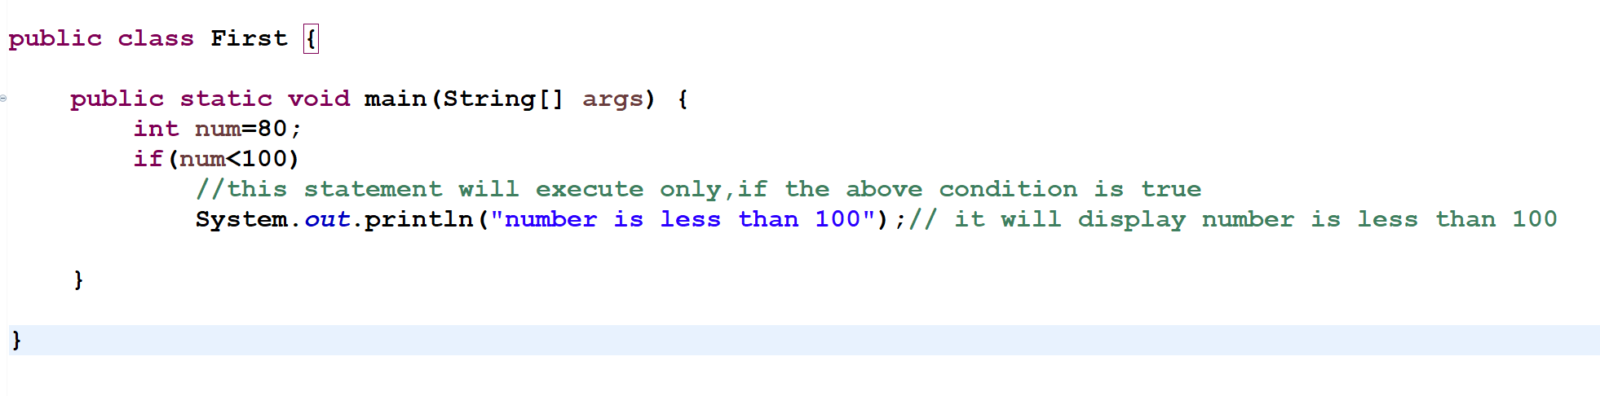
Examples-

Slide 7
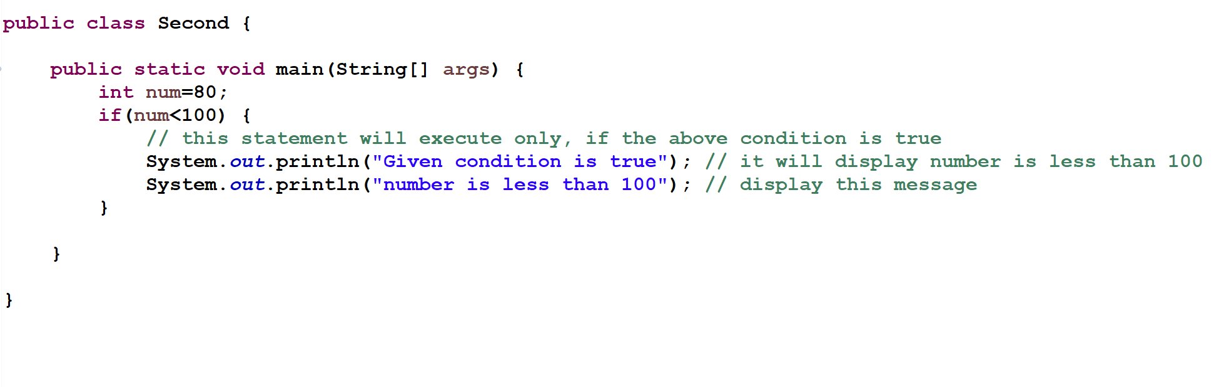

Slide 8
if-else statement: it has two part( If and else) .The statements inside “if” block execute if a given condition is true, and the statements inside “else” block would execute if the condition is false. We use the if and else keyword.
Syntax- if(condition) {
statement 1; // executes when given condition is true
}
else{
statement 2; // executes when given condition is false
}

Slide 9
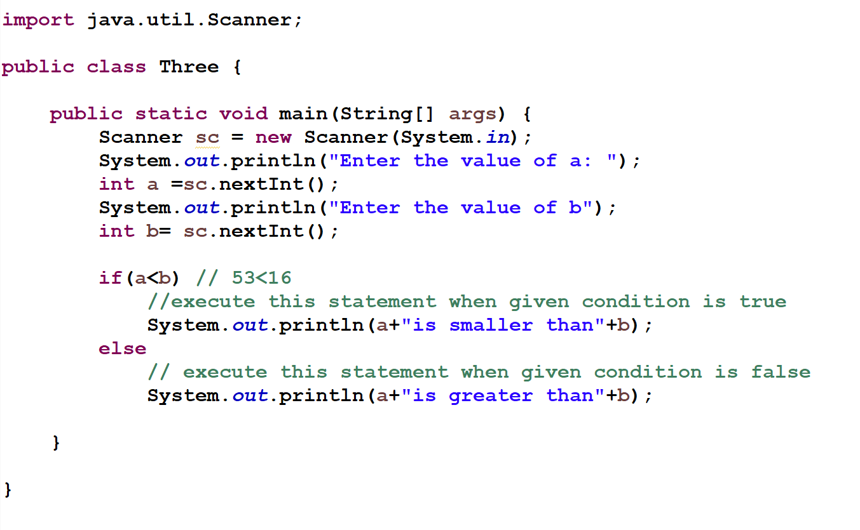
Example -

Slide 10
iii. if-else-if statement: It is used when we need to check multiple conditions.
Syntax- if (condition 1) { statement 1; // executes when condition 1 is true } else if (condition 2) { statement 2; // executes when condition 2 is true }
else if(condition 3){
statement 3; // executes when condition 3 is true
} else { statement 4; // executes when all the conditions are false }

Slide 11
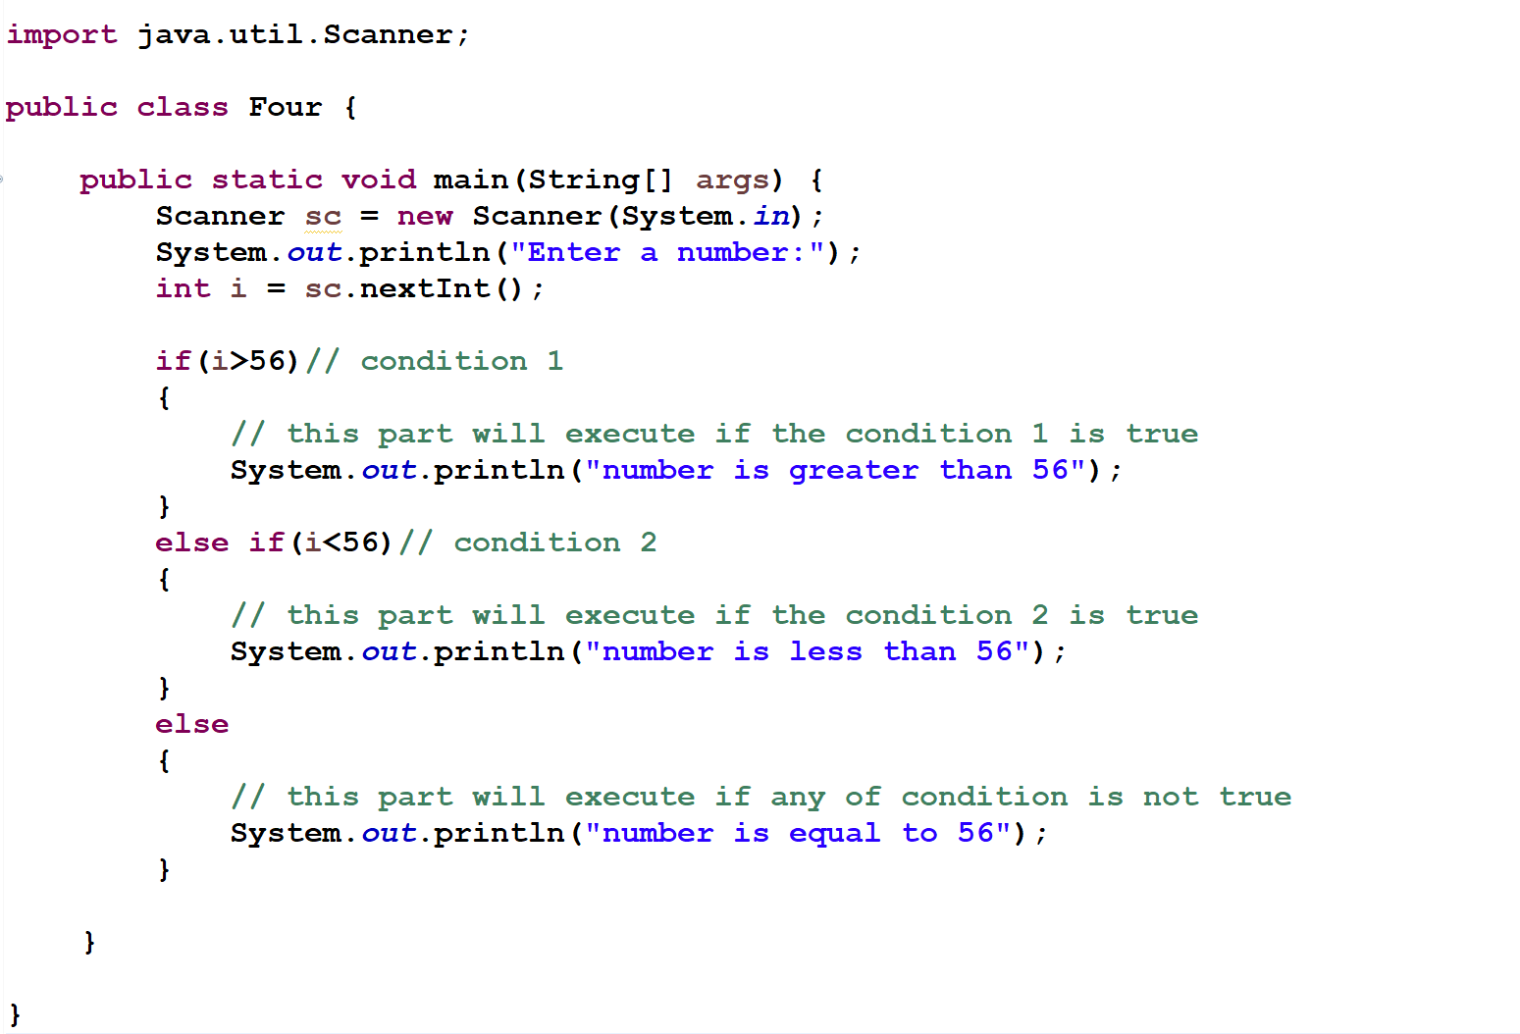
Example-

Slide 12
iv. Multiple if statement :
Syntax- if(condition1){
statement1;
}
if(condition 2){
statement 2;
}
if(condition 3){
statement 3;
}

Slide 13
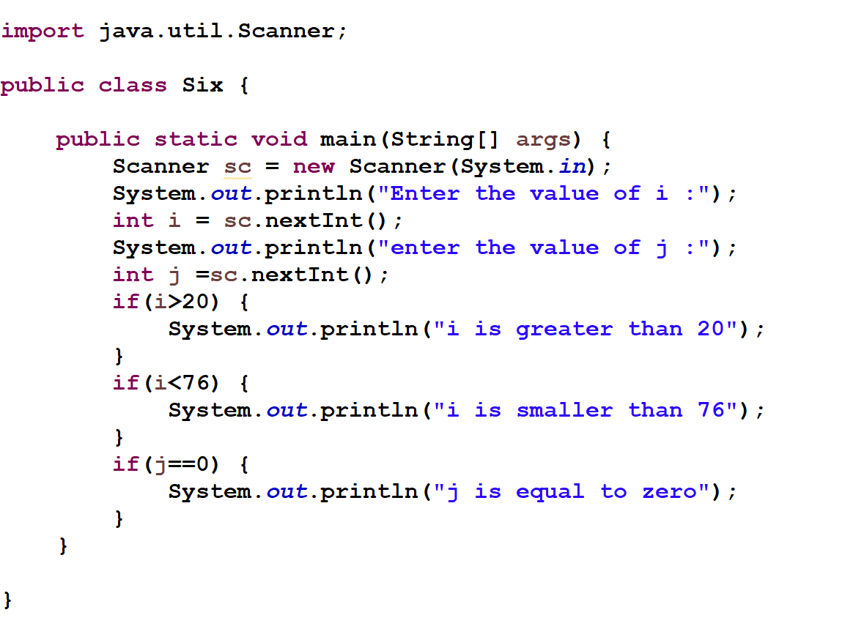
Example-

Slide 14
v. Nested-if statement: When there is an if statement inside another if statement then it is called the nested if statement.
Syntax-
if(condition 1) {
statement 1; //executes when condition 1 is true
if(condition 2) {
statement 2; //executes when both condition 1 and 2 is true
}
else{
statement 3; //executes when condition1 is true but condition 2 is false
}
}
else{
statement 4; // executes when all condition are false
}

Slide 15
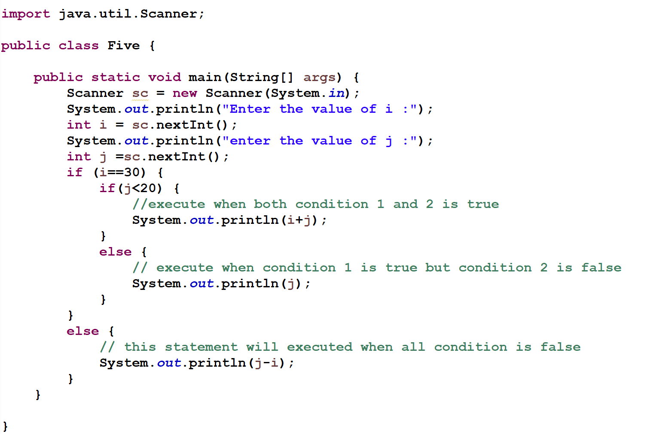
Example-

Slide 16
vi. Switch statement : It is used when we have number of options (or choices) and we may need to perform a different task for each choice.
Some points-
we must notice that the case (expression )will be of the same type as the variable
Cases cannot be duplicate.
Default statement is executed when any of the case doesn't match the value of expression.( It is optional)
Break statement terminates the switch block when the condition is satisfied. It is optional, if not used, next case is executed.

Slide 17
Syntax-
switch (expression)
{
case value1:
statement1;
break;
case value 2:
statement2;
break;
…………..
case value N:
statement N;
break;
default: //optional
default statement;
}

Slide 18
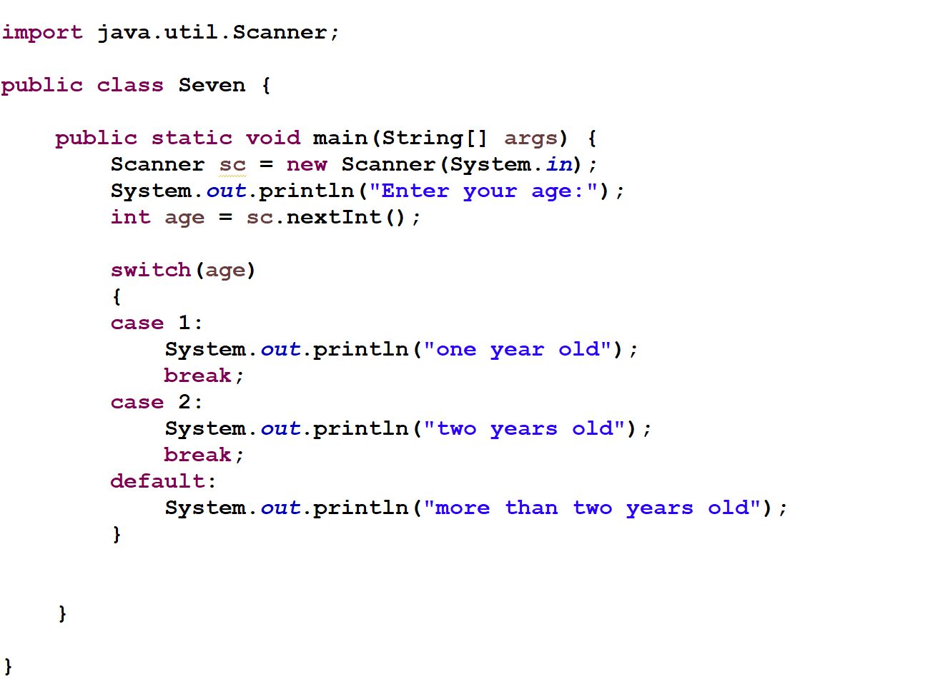
Example-

Slide 19
Loop Statements
In looping statements, we are making a decision and executing the block of code multiple times Until the condition is true.
Each time we will check if the result of our decision statement is true or not, until and unless the result is true, we will execute the same block of the code.
Types of loops in Java:-
while Loop
do-while Loop
for Loop
for each Loop

Slide 20
While Loop - The while loop continually executes a block of statements while a particular condition is true. Generally, a loop has four elements which are:
Initialization Expression
Condition(should be boolean type)
Body of the loop
Update Expression or change statement
The syntax to use while loop in java is as follows :-
variable initialization;
while(condition) { Statements;
change statement(increment or decrement statement); }

Slide 21
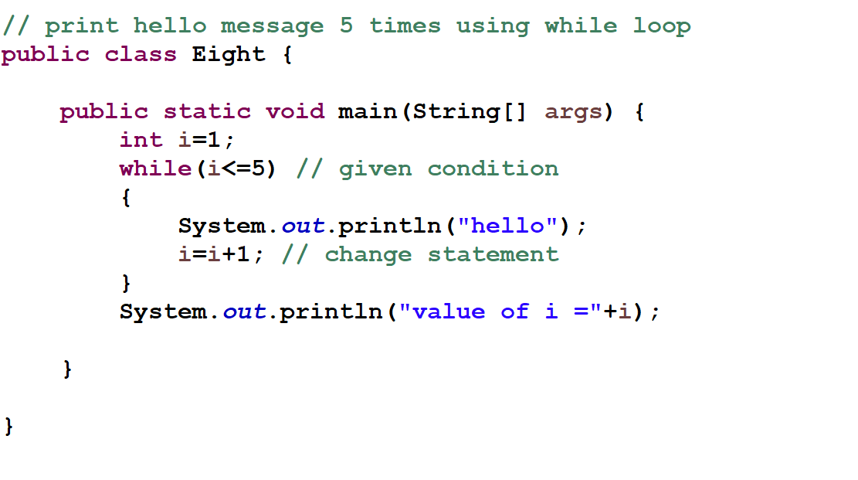
Example-

Slide 22
Do-while Loop -This loop checks the condition at the end of the loop after executing the loop statements at least once .
Syntax-
initialization statement;
do{ Statement; //code to be executed
change statement ; } while(condition);

Slide 23
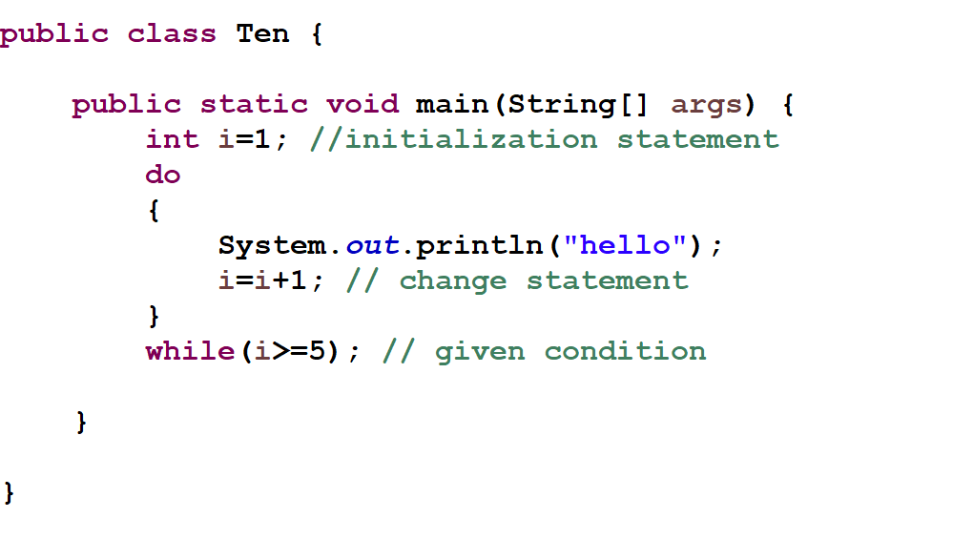
Example -

Slide 24
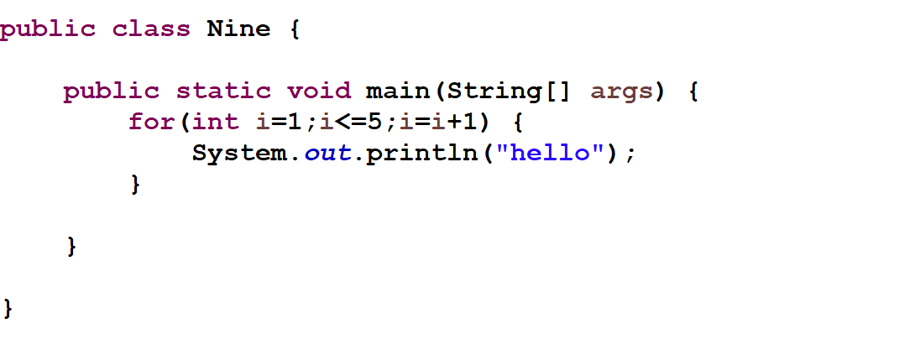
For Loop – A for loop executes a block of code as long as some condition is true.
Syntax-
for(initialization; condition; increment/decrement) { Statement ; }
Example-

Slide 25
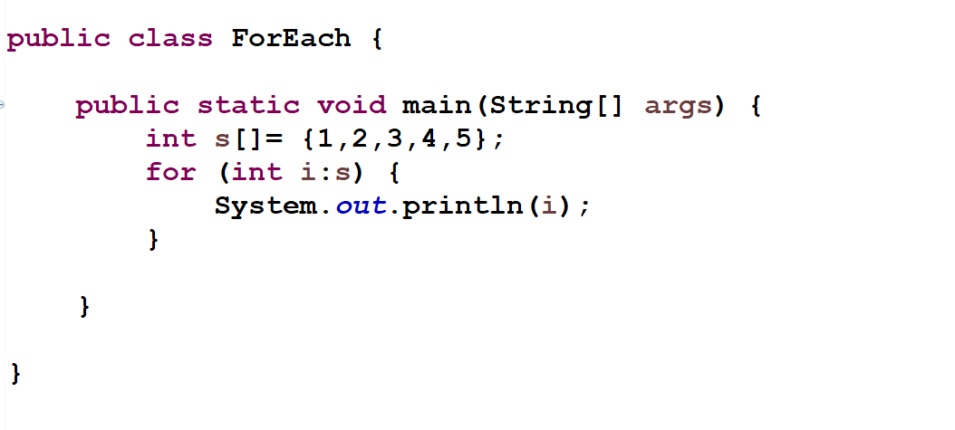
For each loop-
It is the enhancement of for loop that is specially designed to access data from any collection(like- array) .
Syntax-
for(data_type variablename : array_name/collection_name)
{
statements ;
}
Example-

Slide 26
Jump Statements
used to jump from a statement to another statement.
There are two types of jump statements in Java, i.e., break and continue.
break statement : break keyword is used to terminate the loops(for, while, do while ) and break the current flow of the program.It may also used to terminate a switch statement as we shown in the previous sections.
The break statement cannot be used independently in program, i.e., it can only be written inside the loop or switch statement or block.

Slide 27
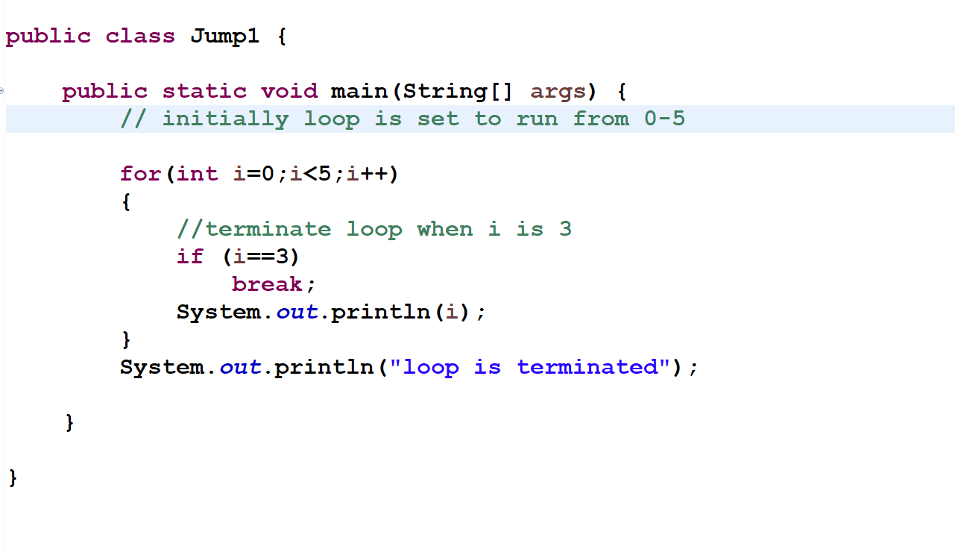
Example-

Slide 28
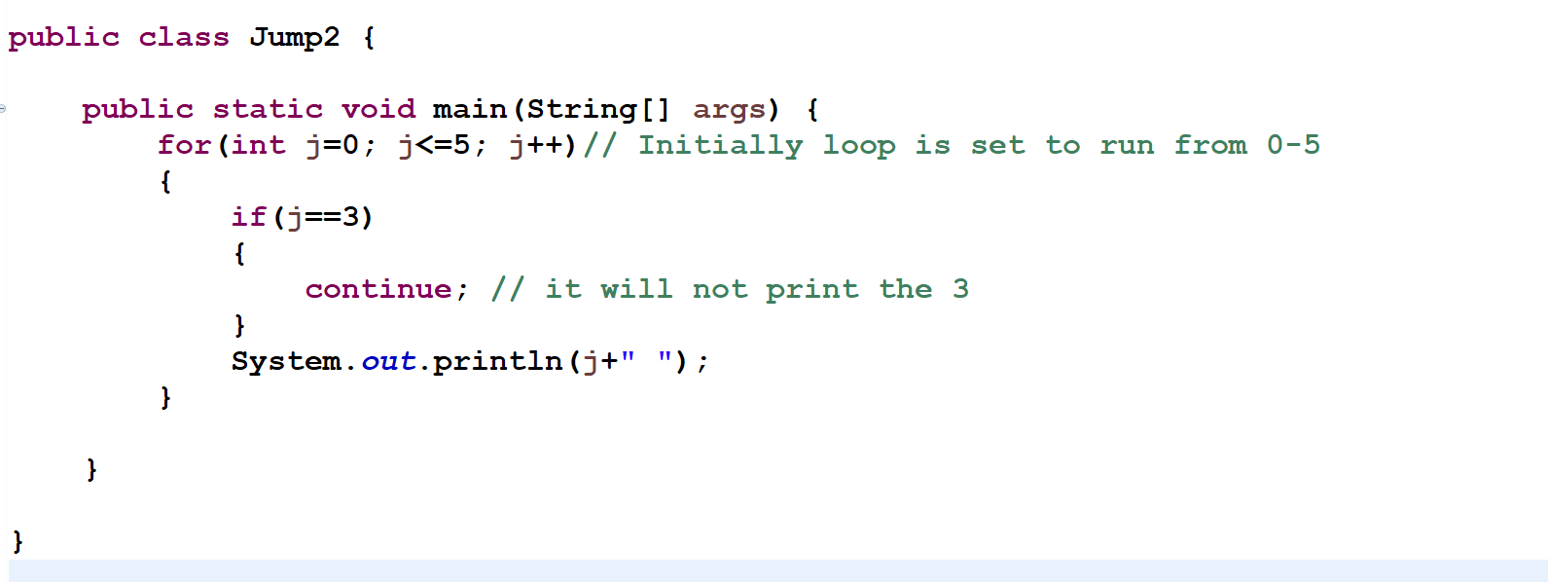
continue statement : - is used to skip the current iteration of the loop and continue with the next iteration of the loop.
The code after the continue statement will not be executed .
Syntax- continue word followed by semi colon.
continue;

