Slide 1
About JVM
JVM stands for Java Virtual Machine. It provides runtime environment in which java bytecode can be executed.
JVM calls the main method present in Java code.
JVM is platform dependent.
Some features of JVM are :
JVM converts byte code to machine language.
It enables you to run applications in your device.
JVM runs the program by using libraries and files given by the Java Runtime Environment.
It provides basic java functions like memory management, security, garbage collection, and more.
The main functions of JVM include loading, initializing, and compiling the program.

Slide 2
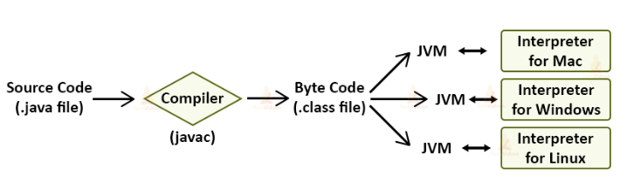

Slide 3
JVM Architecture –
It provides runtime environment in which java bytecode can be executed. i.e. (JVM is platform dependent)
The JVM performs following operation:
Loads code
Verifies code
Executes code
Provides runtime environment

Slide 4
JVM,JDK,JRE
There are three core technology packages used in Java Programming: JDK, JVM, and JRE

Slide 5
JDK
Compiler,Debugger &
other Development Tools
JVM
Libraries & compiled class files
JRE
JDK(Java Development Kit)

Slide 6
JDK
Java Development Kit (JDK) is a complete software environment for building applications. It allows to read, write, and execute the java program.
It is platform-dependent. Moreover, any user can easily install JDK on Operating systems like Unix, Mac, Windows, etc.
JDK = Development Tools + JRE (Java Runtime Environment)
JRE
JRE stands for Java Runtime Environment. JRE is software that includes JVM and class libraries to run java programs independently.
JRE = JVM + Class Libraries (For Running the Java Applications) and other files that JVM uses at runtime.

Slide 7
Difference between JVM, JRE, and JDK

Slide 8
Download and Install Java(JDK)

Slide 9
How to Set Path java(why we need to set the path)
There are two ways to set the path in Java:
Temporary
Permanent
Temporary –
Step 1. Save the java file in bin folder of JDK
Step 2. Open then command prompt
Step 3. Open path of the JDK/bin directory in command prompt.
Step 4. Finally compile the java program and execute it.
Permanent –

Slide 10
Download and Install IDE for Java

Slide 11
Run a simple Java Program and it’s Output

Slide 12
About main() method
Whether class contains main() method or not and whether main() method is declared according to requirement or not these things won't be checked by compiler. At runtime, JVM is responsible to check these things.
At runtime if JVM is unable to find required main() method then we will get runtime exception saying NoSuchMethodError:main
class Test
}
}
RuntimeException: NoSuchMethodError:main

Slide 13
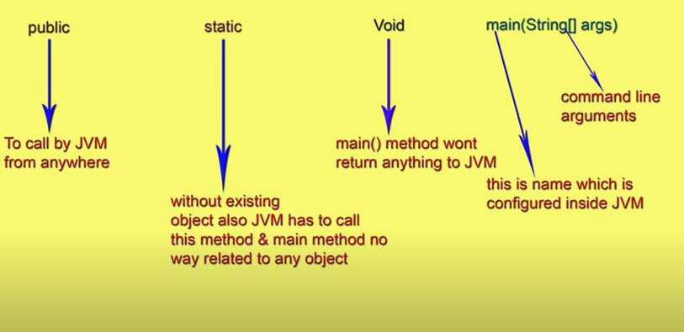
The above syntax is very strict if we perform any change we will get runtime
exception saying NoSuchMethodError:main.

Slide 14
Even though the above syntax is very strict the following changes are acceptable.
The order of modifiers is not important that is instead of "public static" we can take "static public" also.
2. We can declare "String" in any acceptable form.
main(String[] args)
main(String []args)
main(String args[])
3. instead of 'args' we can take any valid java identifier.
4. we can replace String[] with var arg perameter
main(String[] args) ==> main(String... args)

Slide 15
Which of the following are valid main method declarations?
public static void main(String[] args)
public static int main(String[] args)
public static void main(String args)
4. public static void main(String... args)

Slide 16
Case 1
Overloading of the main method is possible but JVM will always call String[] argument main method only.
The other overloaded method we have to call explicitly then it will be executed just a normal method call
class Test {
public static void main(String[] args)
{
System.out.println("String[]");
}
public static void main(int[] args)
{
System.out.println("int[]");
}
}

Slide 17
Case 2
From 1.7 version onwards to run a java program main method is mandatory. Hence, even though class contains static blocks they wont be executed if the class doesn't contain main() method.
Example
class Test
{
static
{
System.out.println(“static block");
}
}

Slide 18
1.6 version | 1.7 version
javac Test.java | javac Test.java
java Test | java Test
output: static block RE: NoSuchMethodError: main | Error: main method not found in class

Slide 19
Case 3
If the class contains main() method whether it is 1.6 or 1.7 version there is no change in execution sequence.
Example- s
class Test
{
static
{
System.out.println("static block");
}
public static void main(String[] args)
{
System.out.println(“main method");
}
}

Slide 20
1.6 version | 1.7 version
javac Test.java | javac Test.java
java Test | java Test
output: static block main method | output: static block main method

Slide 21
How to write comments in Java
Comments are used in programs to make the code more understandable
It makes easy to maintain the code and to find the errors easily.
Comments are ignored by the compiler while compiling a code.
There are three types of comments in Java:-
(i) Single Line Comment
(ii) Multi Line Comment
(iii) Documentation Comment

Slide 22
Single Line Comments:- It is used to comment only one line. Single line comments
starts with two forward slashes (//).
Syntax – // Single line comment here
Multi-line Comments:- It is used to comment multiple lines of code. Multi-line comments are placed between /* and */. Any text between /* and */ is not executed by Java.
Syntax- /*Comment line 1
comment line 2
Comment line 3*/
Documentation Comments:- This type of comments are usually used to write large programs for a project or software application that it helps to create documentation.
Syntax- /** Comment start
*
*comment ends*/

Slide 23
Identifiers
Any name that we see in a Java program it can be class name, function name or the variable name, etc each of them are identifiers.
Rules for using Identifiers:-
Allowed characters are (A to Z or a to z), numbers (0-9) and special characters that are dollar sign(‘$’) and the underscore(‘_’).
We can not start name of the identifiers with digits. That means, we cannot give name of variable as 67key. But we can use key67 as a valid .
Identifiers are case sensitive.
We cannot be used reserved words(keyword) as an identifier.

Slide 24
v. There is no any restriction on the length of the identifier in Java. But, it is advisable to keep the name of the identifier between 2 to 18.
vi. All predefined java class names we can use as identifiers.

