Slide 1
Content
Keywords
Data Type
Variables

Slide 2
Keywords
A Keyword is that which have a special meaning those already explained to the java language .
Keywords also are known as reserved words.
All the keywords are to be written into the lower case and Java has around 53 reserved words.
Java has a set of keywords that are reserved words that have special meanings to the compiler and that cannot be used as class names, variables, or method names, or any other identifiers.

Slide 3
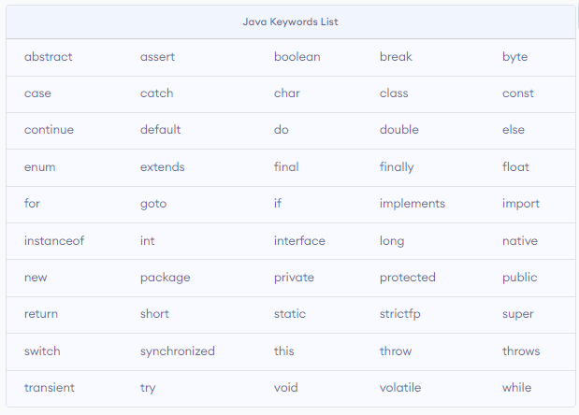

Slide 4
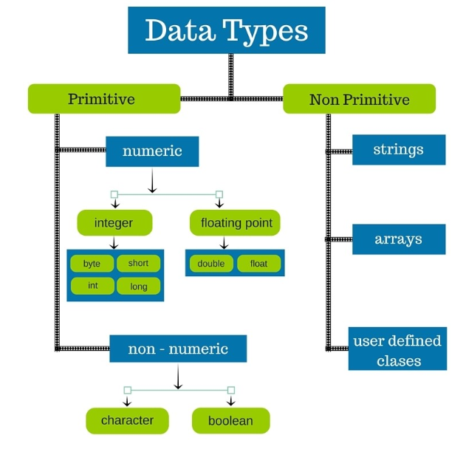
Data Types
Data types specify the different sizes and values that can be stored in the variable. It is used to define a variable before to use in the program.
There are two types of data types in Java:
Primitive data type
Non Primitive data type

Slide 5
Note: Java is a strictly or strongly typed programming language i.e. before using the variable, first we need to declare it using data type (either primitive or non-primitive data type).
Primitive Data Types:- byte , short , int ,long, boolean , float, double, char.
The primitive data types are also commonly referred to as simple data type.
The primitive data types can be divided in four groups:
Integers: includes byte ,short , int ,long ( Default values of all fours are zero)
Type | Bits | Value Range
byte | 1 byte(8-bits) | -128 to 127
short | 2 bytes(16-bits) | -32768 to 32767.
int | 4 bytes(32-bits) | -2147483648 to 2147483647
long | 8 bytes(64-bits) | -9,223,372,036,854,775,808 to 9,223,372,036,854,775,807.

Slide 6
For example:- byte b=21;
int i=467;
short s=1000;
long p =100012;
b. Floating-point numbers: includes float, double
Type | Bits
float | 4 bytes(32-bits) | Default value 0.0f.
double | 8 bytes(64-bits) | Default value 0.0d.

Slide 7
c. Boolean: The Boolean data type is used to store only two possible values: true and false
Example- boolean b= false;
d. char : It holds a single character( like letters and numbers.). size: 2 bytes(16-bits) and a single character should be enclosed by the single quotes.
Example- char c= ‘F';

Slide 8
2. Non Primitive Data Types:- A non-primitive data type is String ,Array etc .
or class known as the non-primitive data type. String is a class in Java.
String: Strings are defined as a sequence/ group of characters. String should be enclosed by double quotes i.e “New” ,”DDF34” etc.
Syntax-> String variable_name = “sequence of character”;
Example-> String s =“ Group”;

Slide 9
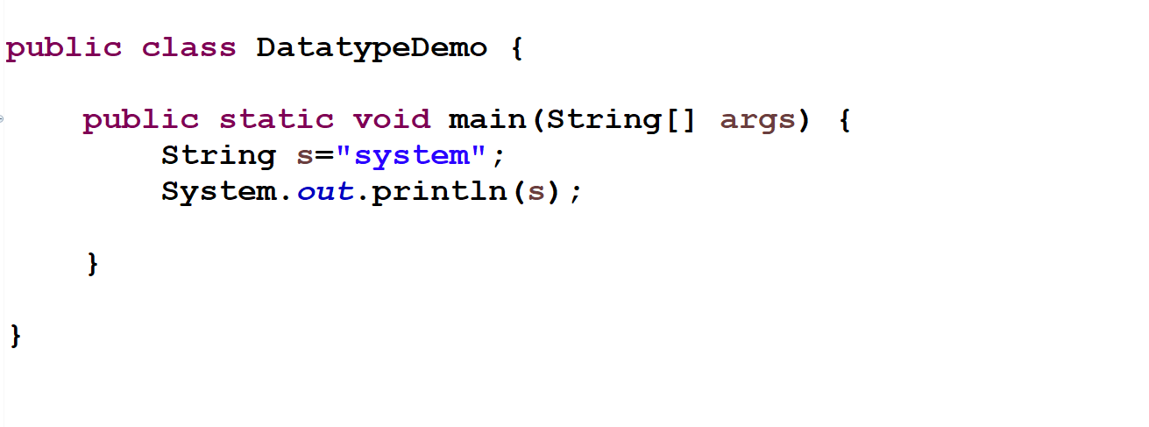

Slide 10
Variables
Variable is just like a container that stores the data values during program execution. The value of the container(variables) may change.
It is the name of a memory location. A variable is assigned with a data type.
Variables must be declared before they are used and the changes in variables make actual changes in the memory location.
Variable Declaration:-To declare a variable, we must specify their data type & then give the variable name .
Syntax- datatype variable name;
Example- (i) int a,b;
(ii) float r ;
Variable Initialization:- To initialize a variable, we assign it a value.
Syntax- variable name=variable value;
Example- a=100;
r=23.8f;

Slide 11
We can combine variable declaration and initialization(in one step).
Examples:- int a=100,b=4;
float r=23.8f, p=80.21f;
There are three types of variables in java:
Local variable
Instance variable
Static variable
Local Variable :-Local Variables are those variable that are declared inside the body of a method or function . You can use this variable only with in that method and the other methods aren't able to use that variable.
Instance variable :- Instance variables are those variable that are declared inside the class but outside the body of the method.
Static variable :-Static variables are initialized only once, at the start of the program execution. These variables are also declared inside the class but here , static keyword are used. Syntax:- static variable_name =variable_value;

Slide 12
For Example:-
class First{
int big=99; //instance variable
static int a=10; // static variable
void method1{
int small=1; //local variable
}
}

