Slide 1
Type Casting
Convert a value from one data type to another data type is known as type casting. By using casting data can not be changed but the data type is changed.
There are two types of casting:-
Implicit Casting (Widening casting)
Explicit Casting( Narrowing casting)
Implicit Casting- It convert lower data type into the higher one. It is also known as Widening Casting and it is done automatically.
byte->short->char-> int->long->float->double

Slide 2
Example-
public class Main{
public static void main(String[] args ){
int a=20;
long b=a;
double c=b;
System.out.println(a);
System.out.println(b);
System.out.println(c);
}
}
b. Explicit Casting- It convert higher data type into lower one. It is also known as Narrowing Casting and It is done manually by programmer. But if we fail to do casting then compiler give error.
double->float->long-> int->char->short->byte

Slide 3
Example-
public class Main{
public static void main(String[] args ){
double d=678.23 ;
long l = (long)d;
System.out.println(d);
System.out.println(l);
}
}

Slide 4
Operators
Operators is a symbol that is used to perform operations on variables and values. Each operator performs specific operations. Let us consider an example 5 + 1 = 6 here, 5 and 1 are operands, and the symbol + (plus) is called the operator.
Types of Operators in Java:-
Unary Operators
Arithmetic Operators
Relational Operators
Logical Operators
Assignment Operators
Shift Operators
Bitwise Operators
Instance of Operator

Slide 5
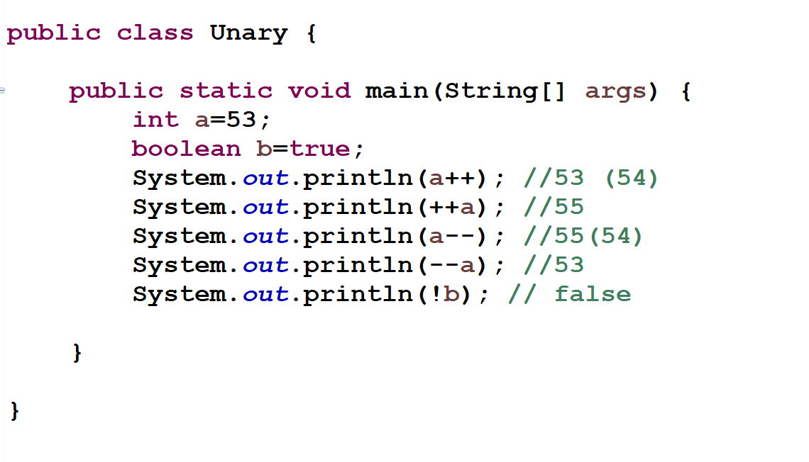
Unary Operators:- This operator requires only a single operand and this operator is used to increment or decrement the value, negating a value or inverting a boolean value. Unary operators are:
++(Increment operator) - Increments value by 1. There are two types of increment, i.e., post-increment (a++) and pre-increment (++a)
--(Decrement operator) - decrements value by 1.There are two types of decrement ,i.e., post-decrement(a--) and pre-decrement(--a)
!(Logical Not operator) - used for inverting a boolean value.
Example :-

Slide 6
2. Arithmetic Operators :- This operator requires at least two operand to perform operations. This operators are used to performing addition, subtraction, multiplication, division, and modulus. Arithmetic operators are:
Operators | Meaning
+(Addition) | add the value of the operands.
-( Subtraction ) | subtract second operands from first
*(Multiplication) | multiply the value of the operands.
/( Division) | This operator performs division and returns the quotient value of the division.( Divide the left hand operator with right hand operator)
%(Modulus) | This operator returns the remainder after dividing the two operands.(Divides left hand operand by right hand operand)

Slide 7
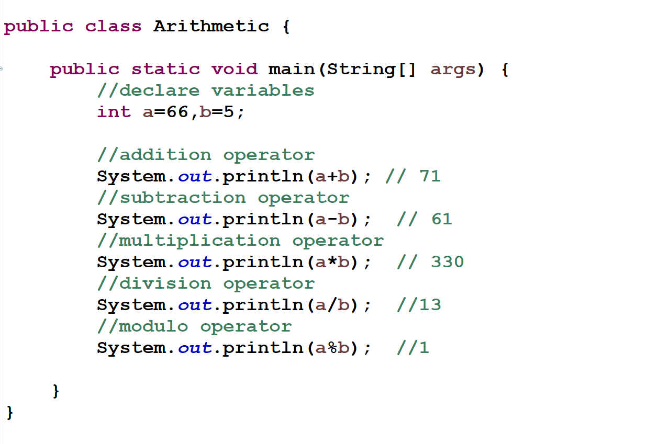
Example:-

Slide 8
3. Relational Operators :- This operators compare the values and returns a boolean value. Relational operators are:
Operators | Description
<(Less than) | it returns True, if the value of the left operand is less than the value of the right operand, else it returns False.
>(Greater than) | it returns True, if the value of the left operand is greater than the value of the right operand, else it returns False.
<=(Less than or equal to) | It returns True, if the value of the left operand is less than or equal to the value of the right operand, else it returns False.
>=(Greater than or equal to) | it returns True, if the value of the left operand is greater than or equal to the value of the right operand, else it returns False.
==(equals to) | it returns True, if two operands are equal, else it returns False.
!=(not equals to) | it returns True, if two operands are not equal, else it returns False.

Slide 9
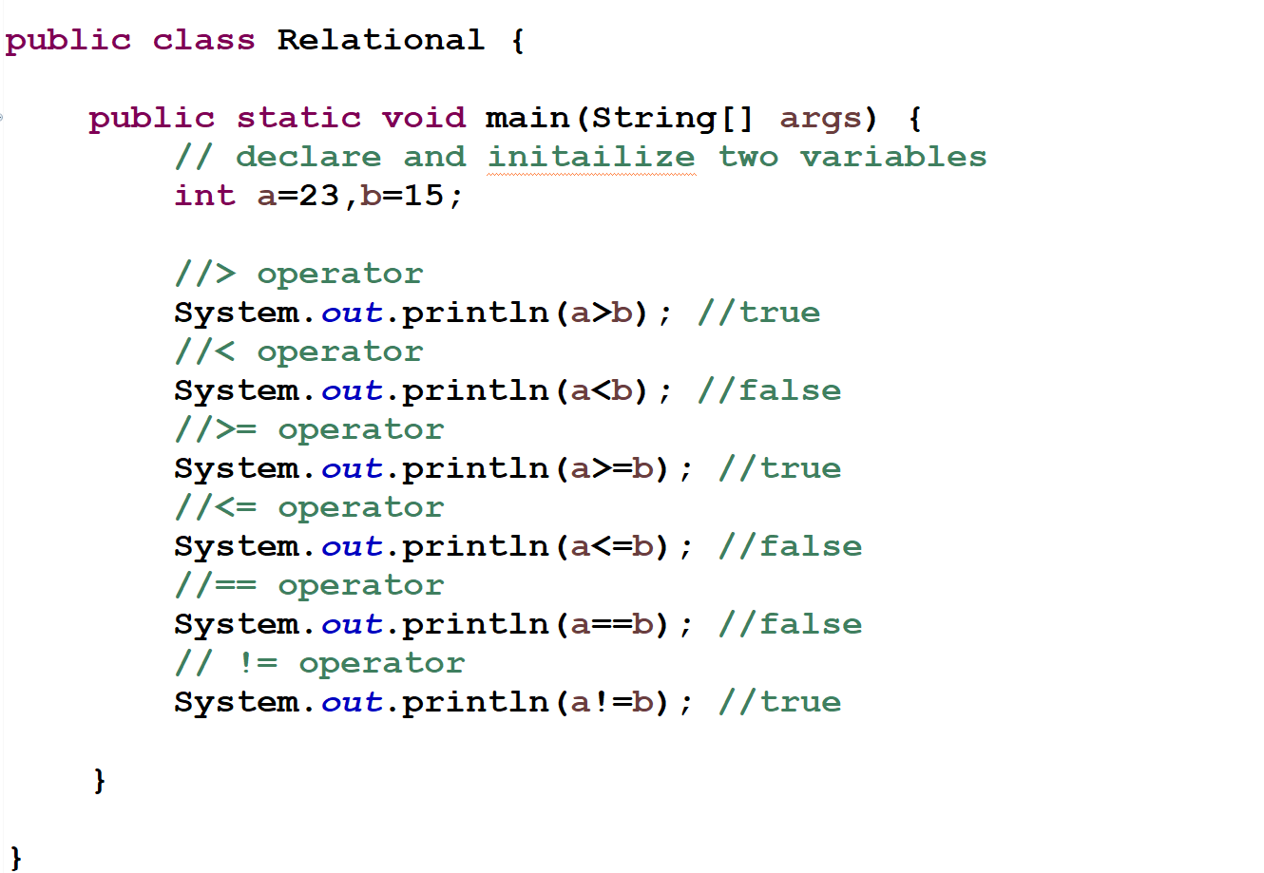
Example:-

Slide 10
4. Logical Operators :- Logical operators are used to performing logical operations (“AND”, “OR” and “NOT” operations). They are used in decision making. And it is combination of two or more than two relational operator. Logical operators are:
Operators | Description
&& (Logical AND) | returns True if both the operands are true, otherwise, it returns False.
||(Logical OR) | returns True if either one operand are true, otherwise it returns False.
! (Logical NOT) | Return True if an operand is false (complements the operand)

Slide 11
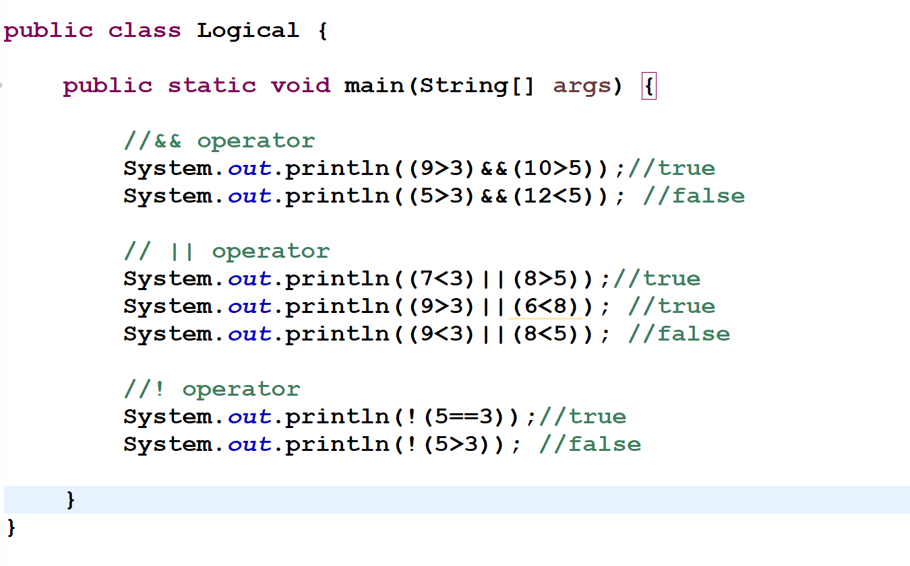
Example:-

Slide 12
5. Assignment Operators :-An Assignment Operator is an operator used to assign a new value to a variable. Assignment operators are:
= :- This operator is used to Assigns values from right side operands to left side operand.
+= :- This is a combination of + and = operators( a += b is equivalent to a = a+b ) Adding left operand with right operand and then assigning it to variable on the left.
-= :- subtracting right operand from the left and then assigning it to variable on the left.
*= :- multiplying left operand with right operand and then assigning it to the variable on the left.
/= :- dividing left operand by right operand and then assigning it to a variable on the left.
%= :- for assigning modulo of left operand by right operand (to divide the left-hand operator with right hand operator) and then assigning it to the variable on the left.

Slide 13
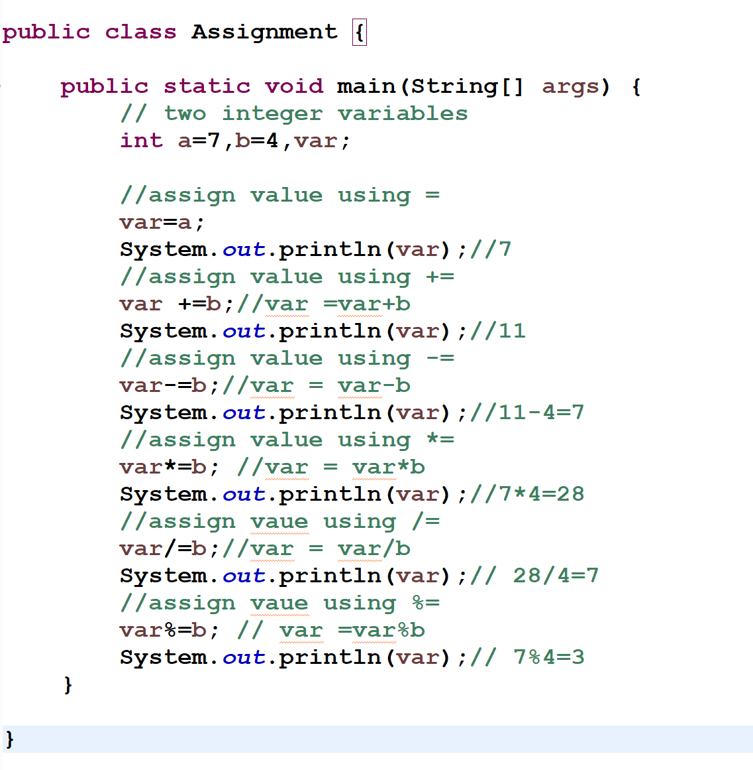
Example:-

Slide 14
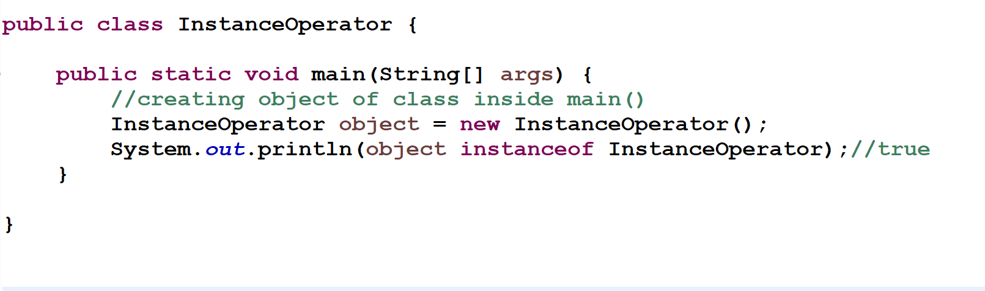
6.Instance of Operator :- This operator is used to test, that an object is belongs to a class or not. The word instance means ‘object’. It returns true if the object is a member of the class and false if not.
Example-

Slide 15
7. Bitwise Operators :- This operators are used to perform operations on individual bits. The individual bits of a number are considered in calculation and not the entire number itself. Bitwise operators are:
Operators | Description
& (Bitwise AND) | This operator takes two numbers as operands .If both of the bits is 1, it gives 1. If either one of the bits is not 1, it gives 0.
| (Bitwise OR) | This operator takes two numbers as operands . If either one of the bits is 1, it gives 1. If not, it gives 0.
^ (Bitwise XOR) | This operator takes two numbers as operands . If corresponding bits are different, it gives 1. If corresponding bits are the same, it gives 0.
~ (Bitwise Complement) | This operator takes one number as an operand and It inverts the bit pattern. It makes every 1 to 0 and every 0 to 1

Slide 16
Example-
Assume if x = 50 and y = 11; now in binary format as follows −
x = 00110010.
y = 00001011

Slide 17
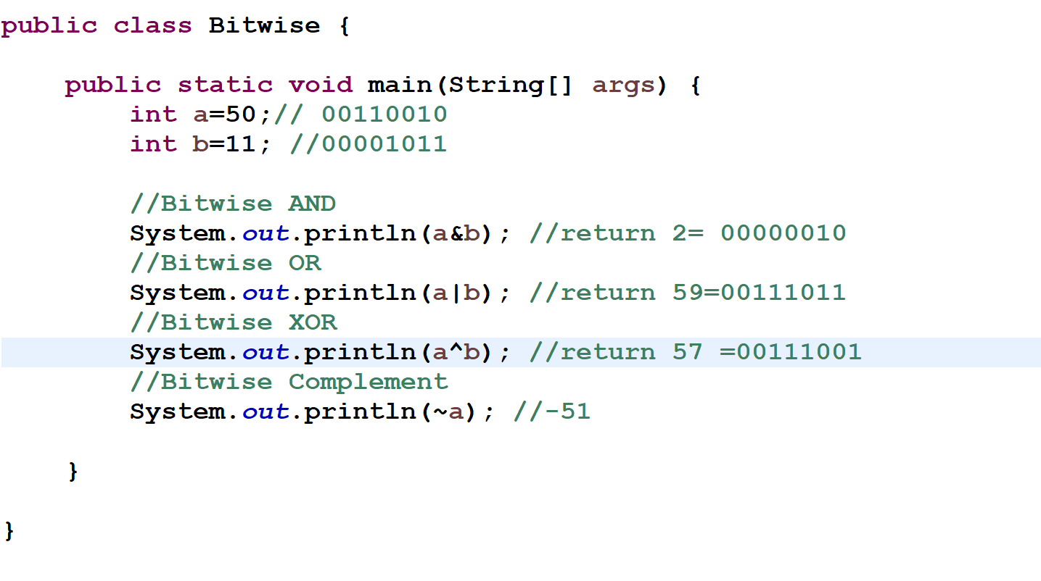

Slide 18
8. Shift Operators :- This operator is used to shift the bits of a number left or right by multiplying or dividing the numbers by two respectively. They can be used when we have to multiply or divide a number by two. Shift operators are:
Operators | Description
<< (Left Shift Operator) | The left operands value is moved left by the number of bits specified by the right operand. For example, num<<2, will shift the bits of num to the left by two positions.
>>(Right Shift Operator) | The left operands value is moved right by the number of bits specified by the right operand. For example, num >>2, will shift the bits of num to the right by two positions.

Slide 19
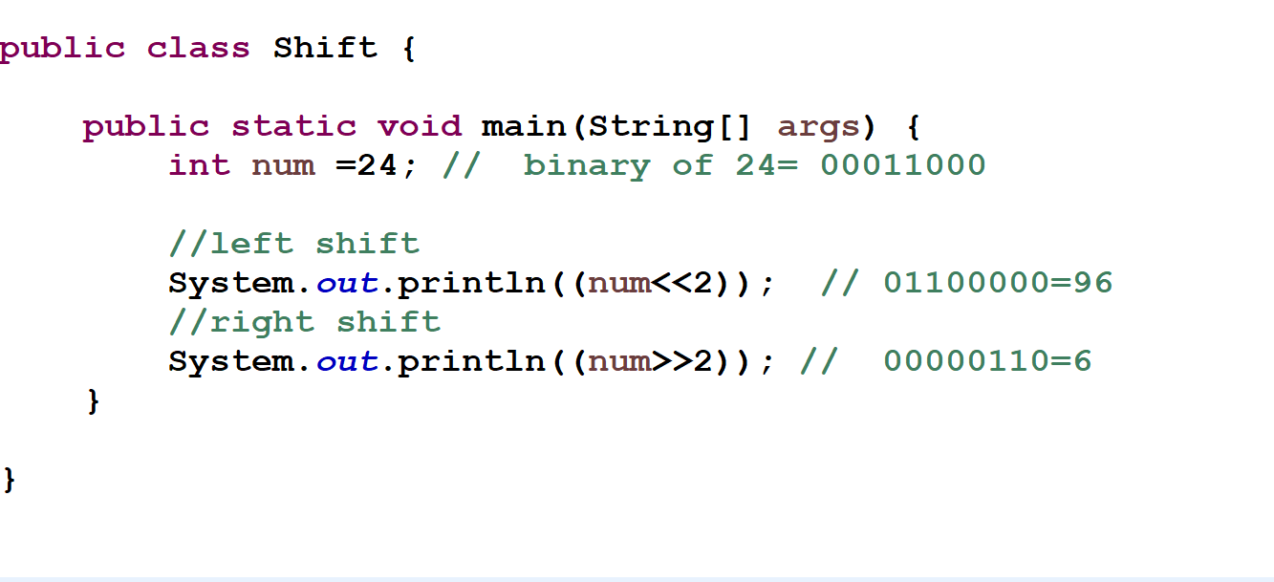
Example-

Slide 20
How to take input from user
Java provides three classes: BufferedReader, Scanner and Console - to take input from user.
1. Scanner- Java Scanner class allows the user to take input from the user. It belongs to java.util package. It is the easiest way to take input from user.
To use the Scanner we need to import the Scanner Class i.e belongs to java.util package.
Syntax- import java.util.Sacnner;
Then, we need to create an object of the Scanner Class with the new.We can use the object to take input from the user.
Syntax- Scanner object_name = new Scanner(System.in);
Example- Scanner sc = new Scanner(System.in);

Slide 21
Methods of Scanner Class
Method | Description
nextInt() | int value from the user
nextByte() | byte value from the user
nextShort() | short value from the user
nextLong() | long value from the user
nextFloat() | float value from the user
nextDouble() | double value from the user
nextBoolean() | boolean value from the user
next() | A character or word value from user
nextLine() | String value from the user

