Slide 1

600 x 400
INTERNSHIP REPORT
A report submitted in partial fulfillment of the requirements for the Award of Degree of Bachelor of Technology in Computer Science and Engineering
By: ASHWINI KUMAR
Roll no: CSE/58/24 | 4th Semester
SUBMITTED TO
DURATION & SUPERVISION
RVS College of Engineering and Technology, Jamshedpur
Under Supervision: Mr. Deepak Kumar (HOD, IT Dept., Jindal Steel, Patratu)
Duration: 1st June 2026 to 30th June 2026

Slide 2
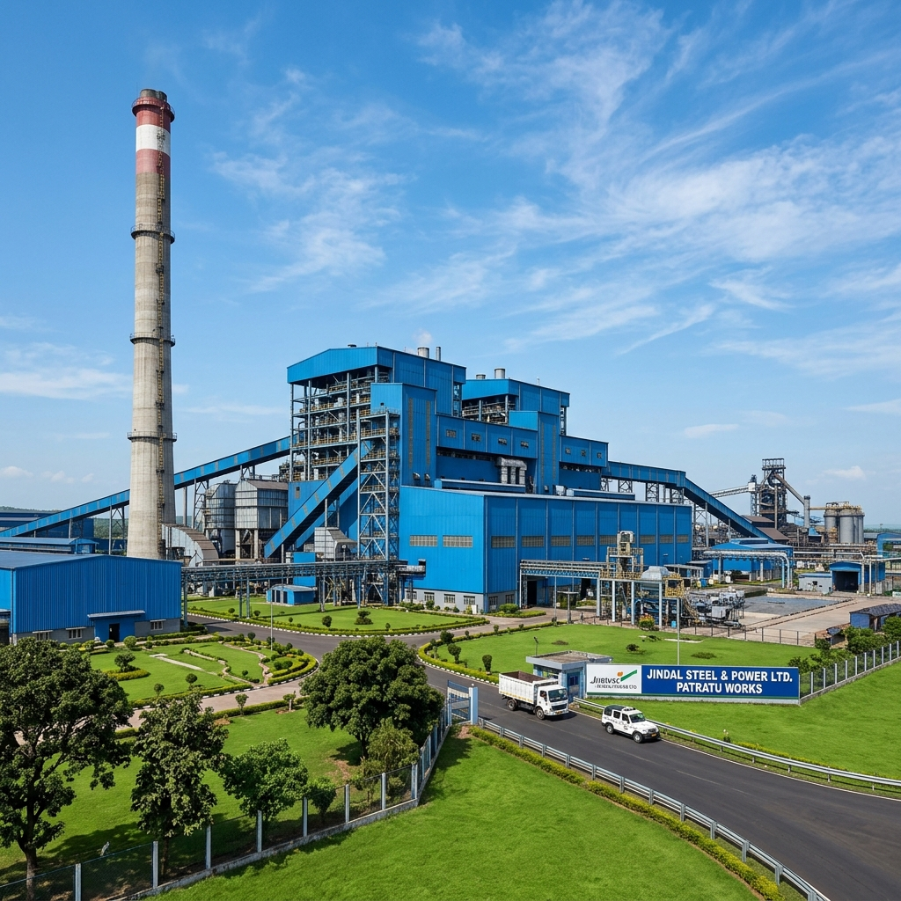
Plant Overview
The Jindal Steel Plant in Patratu is a facility focused on advanced steel production and downstream processing, integrating cutting-edge technology for industrial efficiency and safety.

Slide 3
Production: Bar & Wire Rod Mills
v
Bar Rod Mill (BRM):
High-capacity TMT production line for construction reinforcement.
v
Wire Rod Mill (WRM):
Specialized unit for precision wire rod manufacturing.
v
Quality Control:
Advanced rolling processes ensuring uniform material strength and quality.

Slide 4
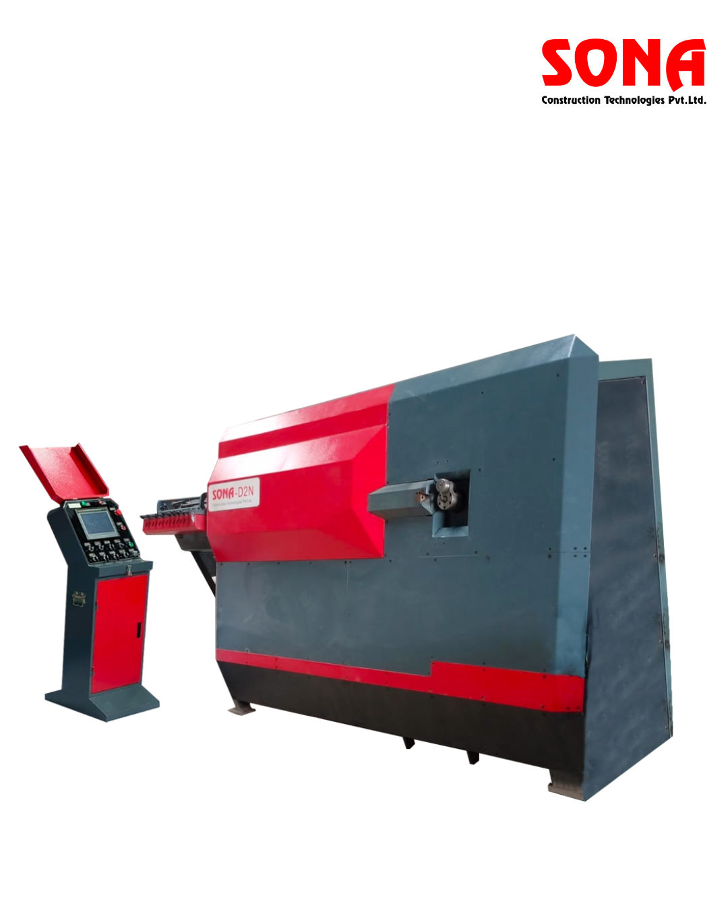
Downstream: Rebar Service Centre
*
Cut & Bend:
Fully customized, pre-processed rebar to site specifications.
*
Weld Mesh:
High-strength mesh support for civil infrastructure.
*
Supply Efficiency:
Optimizing site operations by reducing construction scrap significantly.

Slide 5
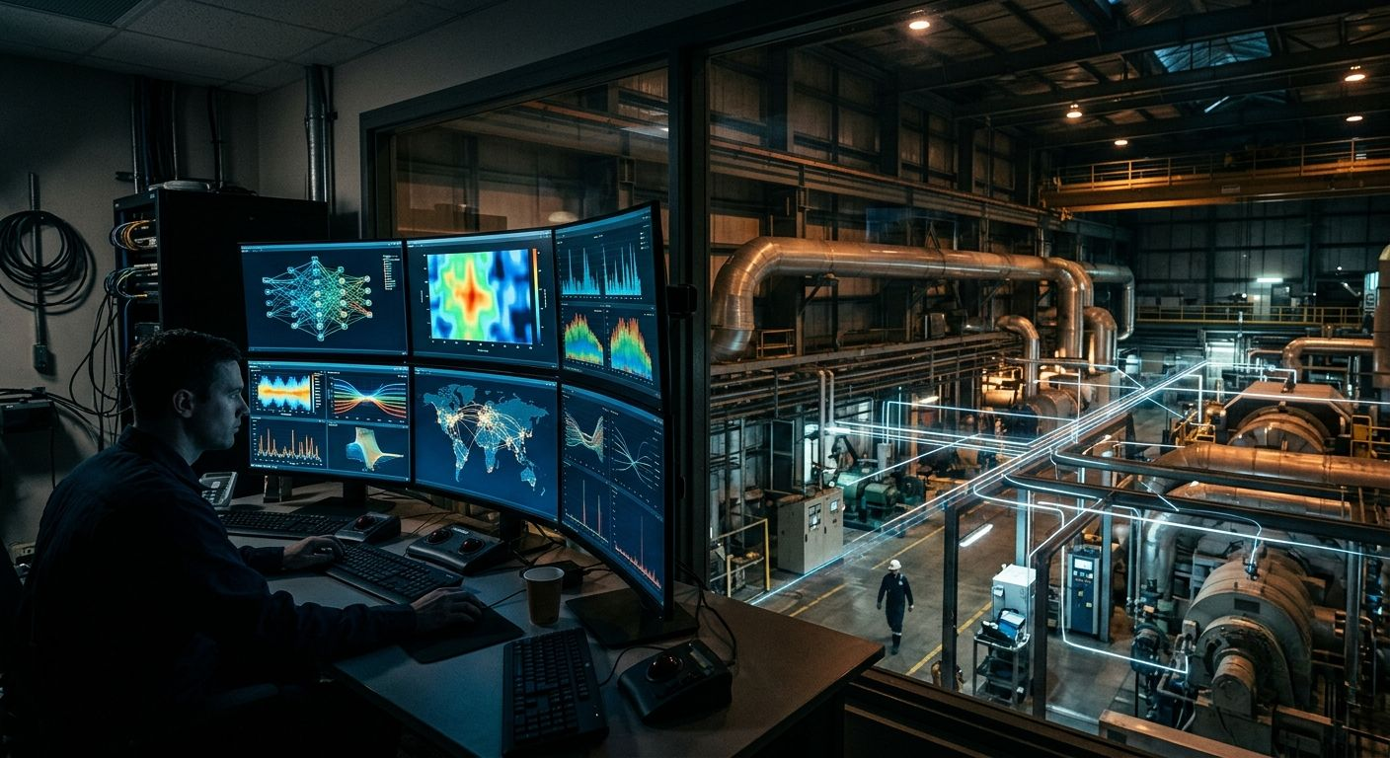
Department: IT Department
N
Network Infrastructure:
Managing the robust industrial communication network.
N
Enterprise Operations:
Supporting SAP, production scheduling, and inventory systems.
N
Cybersecurity:
Ensuring a secure environment for all OT/IT industrial data.

Slide 6
Department: Occupational Health Centres
+
Emergency Care:
On-site medical response teams available 24/7.
+
Wellness Monitoring:
Periodic industrial health screenings for all plant personnel.
+
Safety Standards:
Promoting industrial hygiene and proactive safety protocols.

Slide 7
Challenges of Manual OHC Operations (Before JSPulse)
!
Slow Patient Registration:
!
Delayed Health Surveillance:
Manual entry of employee details increases patient waiting times, leading to workflow inefficiency and delays.
Tracking mandatory periodic medical examinations (PME) manually is slow, causing employees to miss required check-ups.
!
Prescription Human Errors:
!
Difficulty in Report Generation:
Mistakes in manually transcribing patient information, dosages, and diagnoses affect treatment quality and safety.
Compiling monthly, quarterly, and annual statutory reports manually consumes significant manpower and clinical time.
!
Inventory Management Issues:
!
Compliance Challenges:
Manual monitoring of medicines can lead to critical stock shortages, overstocking, and unnoticed drug expiries.
Maintaining compliance with occupational health regulations is difficult without digital tracking and instant audit logs.

Slide 8


JSPulse OHMS
Occupational Health Management System
An Offline-First, Fully Automated Desktop Application for Industrial Plant Clinic Operations
Developed By
Ashwini Kumar
Intern ID: JSPL-2026-IT-042
B.Tech CSE
Host Organization
Jindal Steel & Power Ltd.
Raigarh & Patratu Plants
IT & OHC Medical Services
Technology Stack
Electron 42 + React 19
Vite + IndexedDB + Recharts
Offline NLP AI ChatBrain
Version 1.0.26 | Summer 2026 Internship | Windows x64 Native Installer

Slide 9
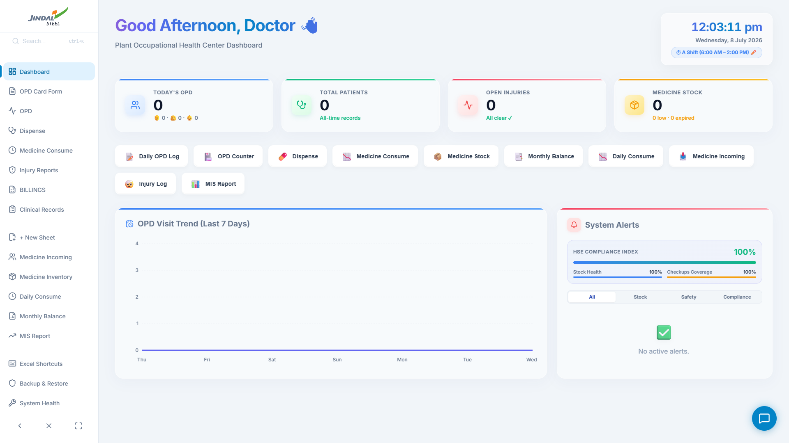
WHAT IS JSPulse OHMS? - THE DASHBOARD
JSPulse OHMS is an offline-first desktop application for Occupational Health Centers inside industrial steel plants. It replaces paper ledger books with an automated, interconnected digital system.
- Digital OPD form with auto-ID - 15 sec per entry
- Automated prescription sync every 10 seconds
- Real-time stock deduction with fuzzy matching
- Monthly reports auto-generated from live data
- One-click PDF/Excel compliance exports
- 100% offline - runs inside Electron shell
- Built-in drug interaction safety matrix
JSPulse OHMS Dashboard - Live KPIs, Charts & Alerts
BEFORE: Paper ledgers, 2 min/entry,
manual monthly reports (4-6 hours)
AFTER: 15 sec/entry, auto-sync pipeline,
one-click MIS reports, zero data loss
Manual stock counts, no safety checks,
cloud apps crash on plant intranet outage
100% offline, real-time stock deduction,
drug interaction safety, audit-ready exports

Slide 10
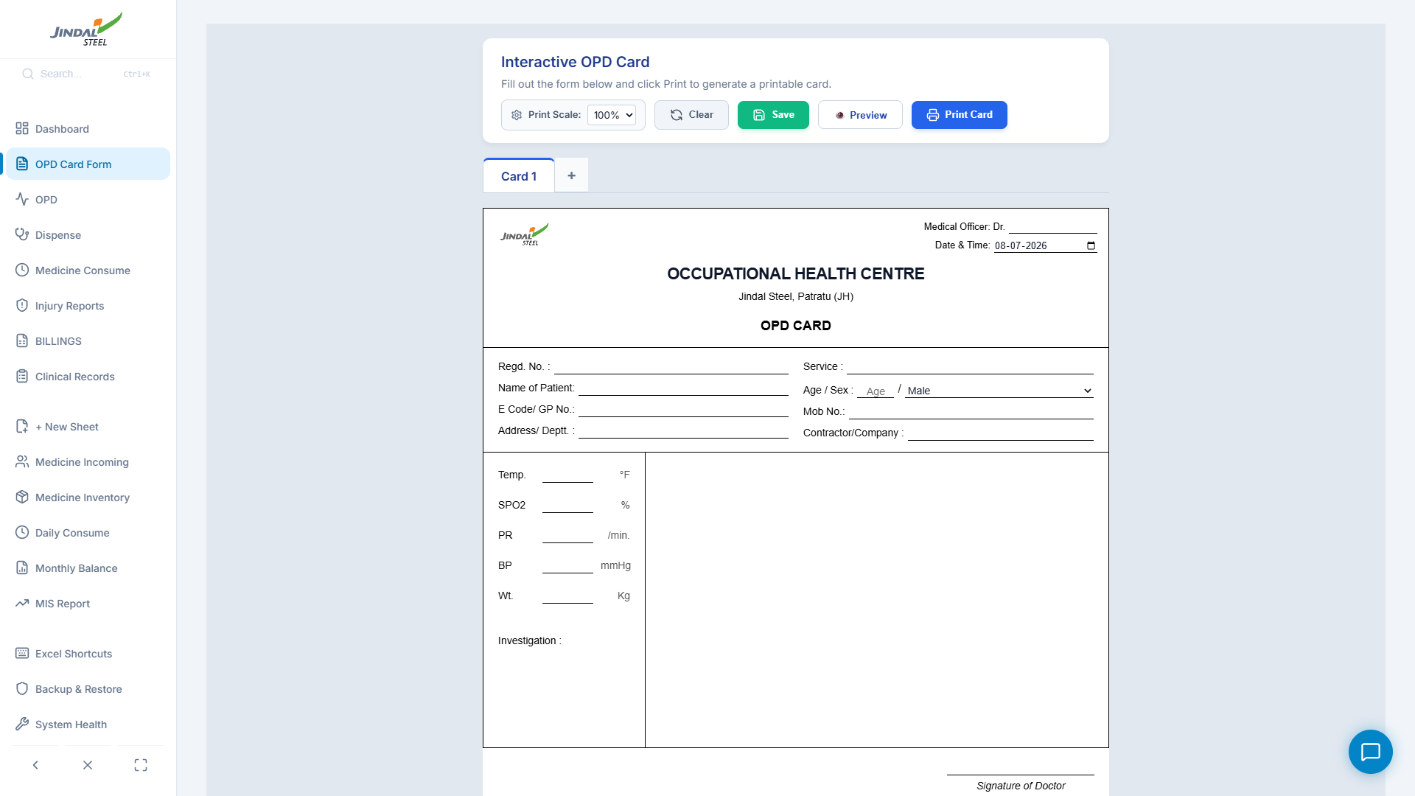
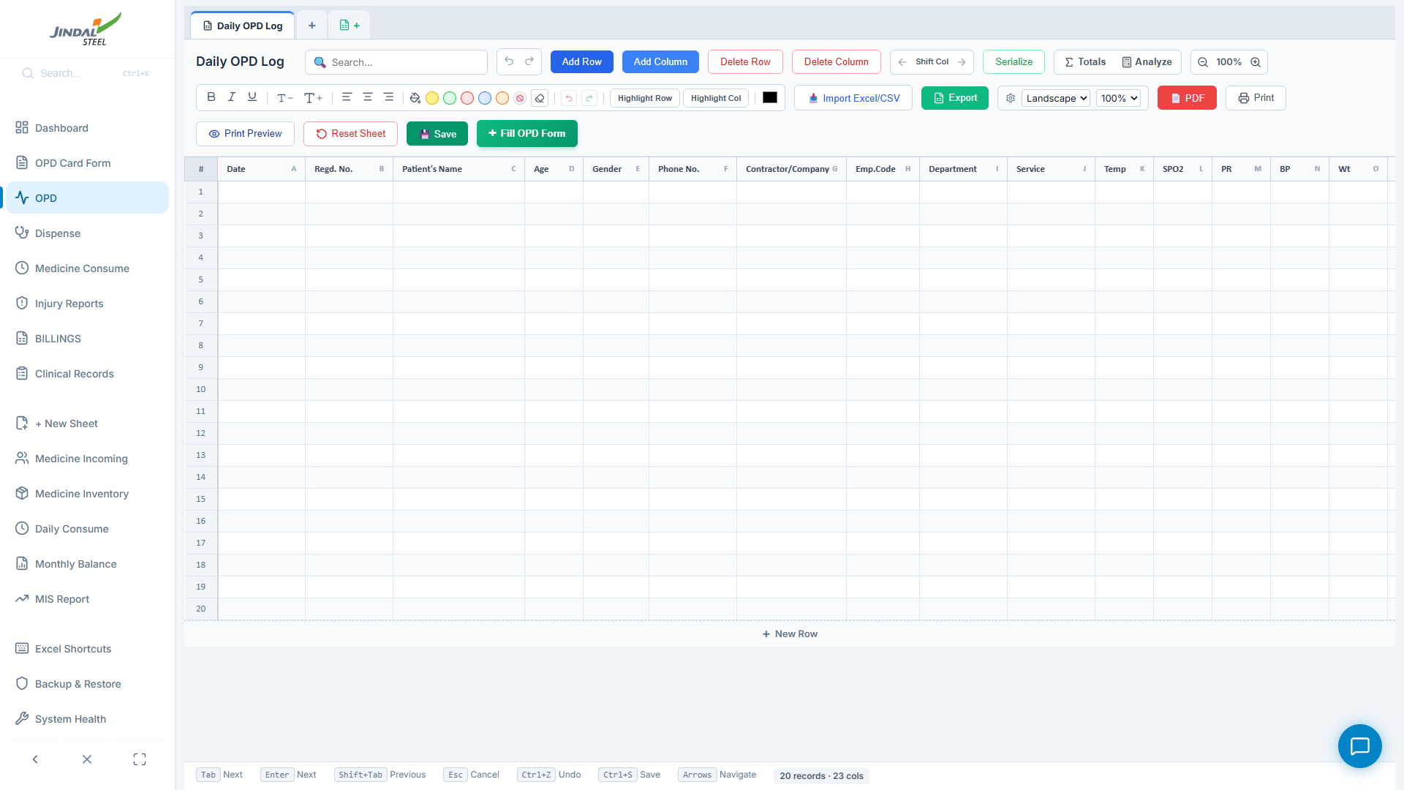
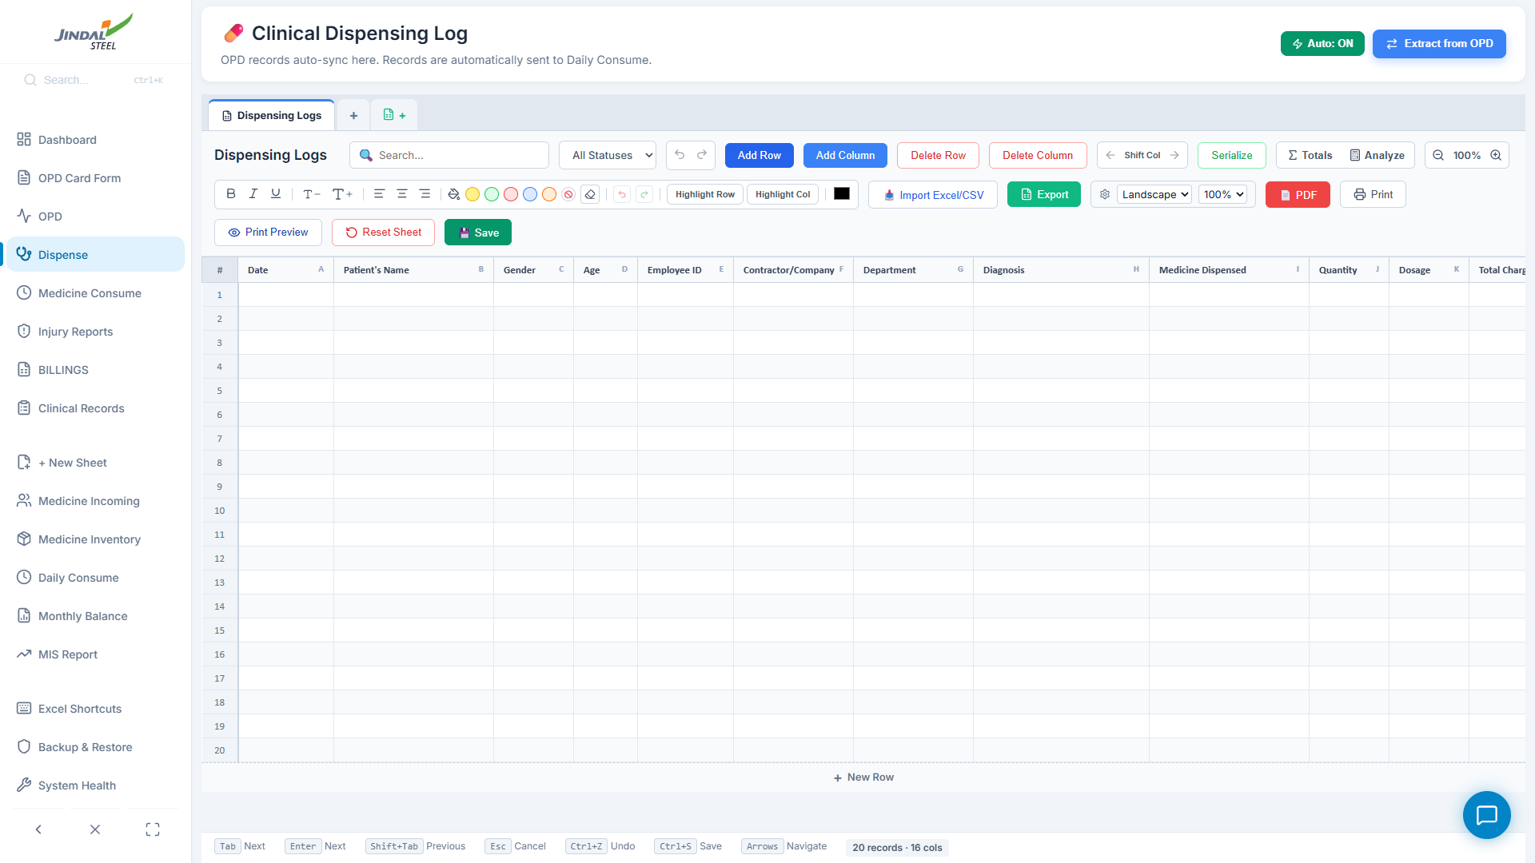
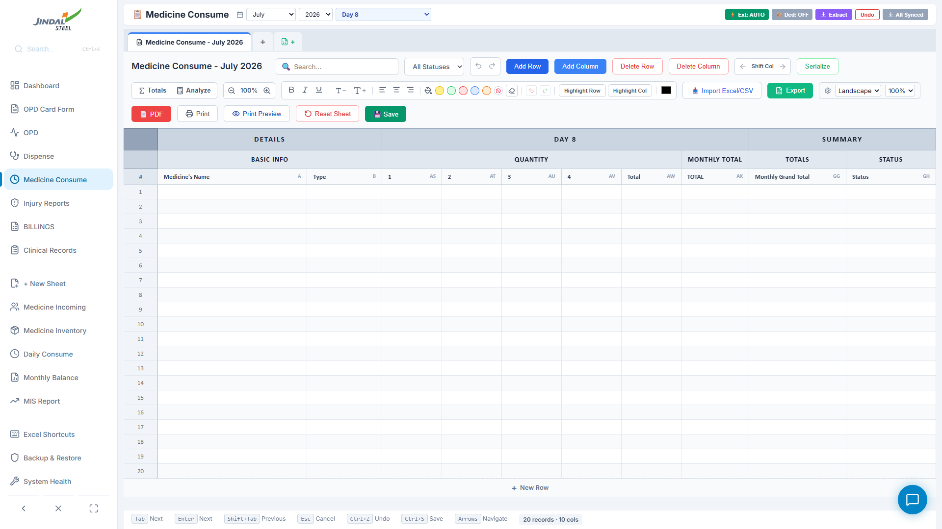
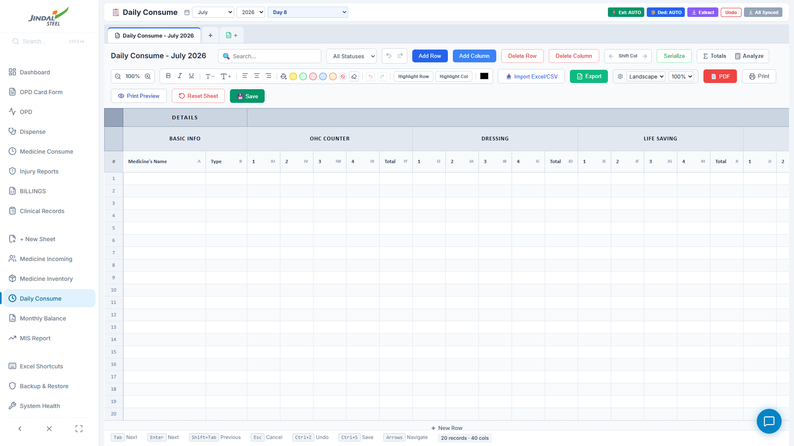
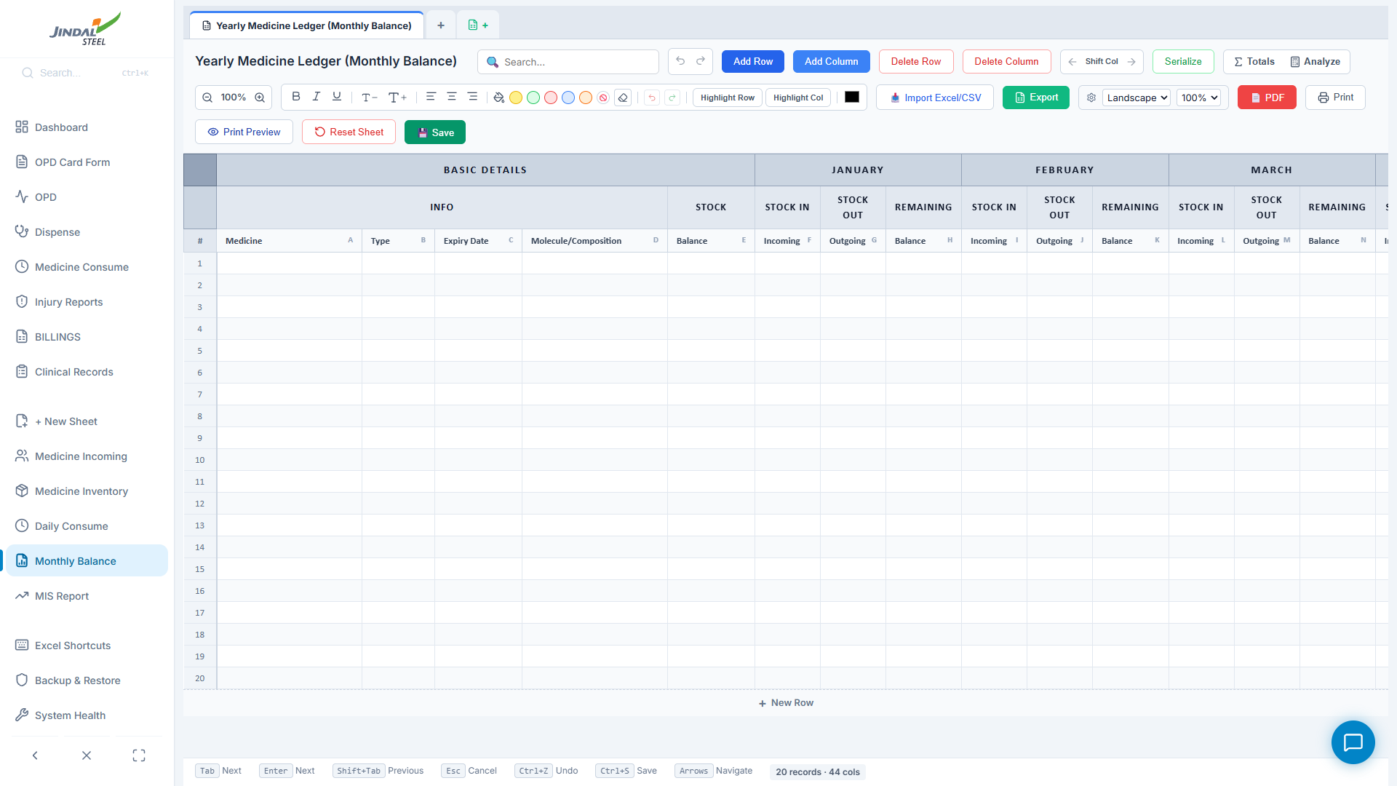
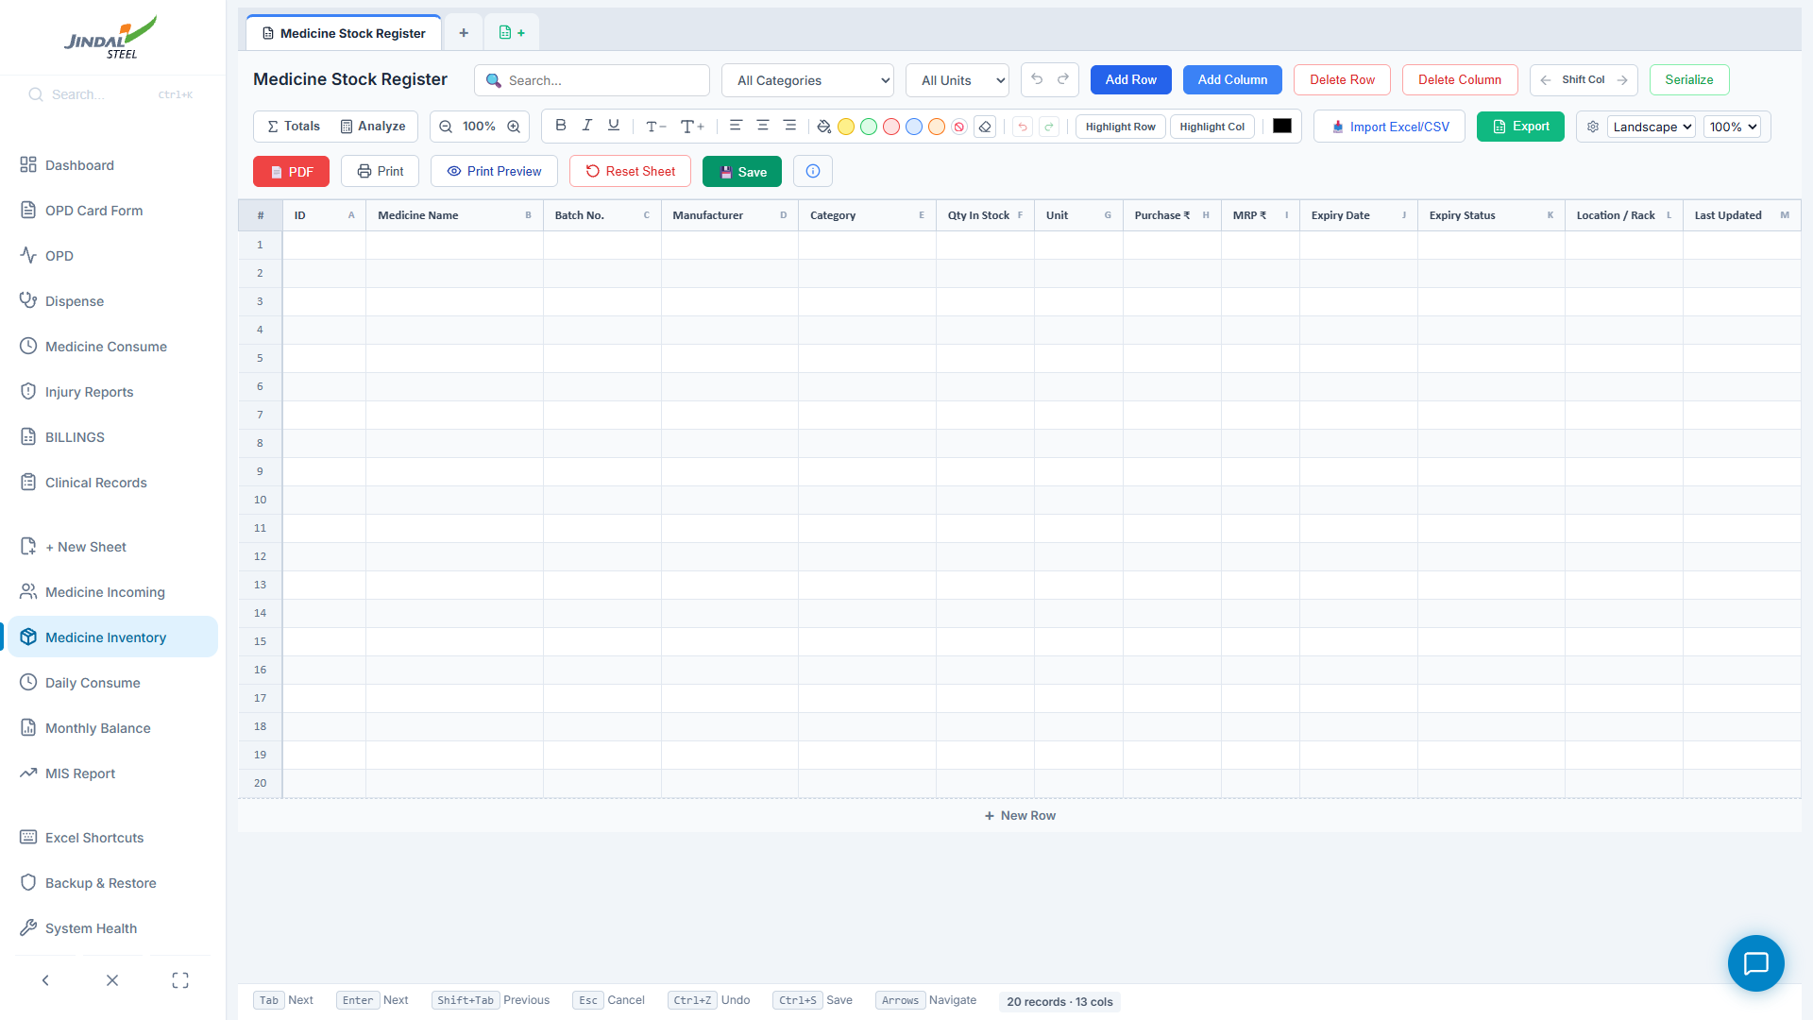
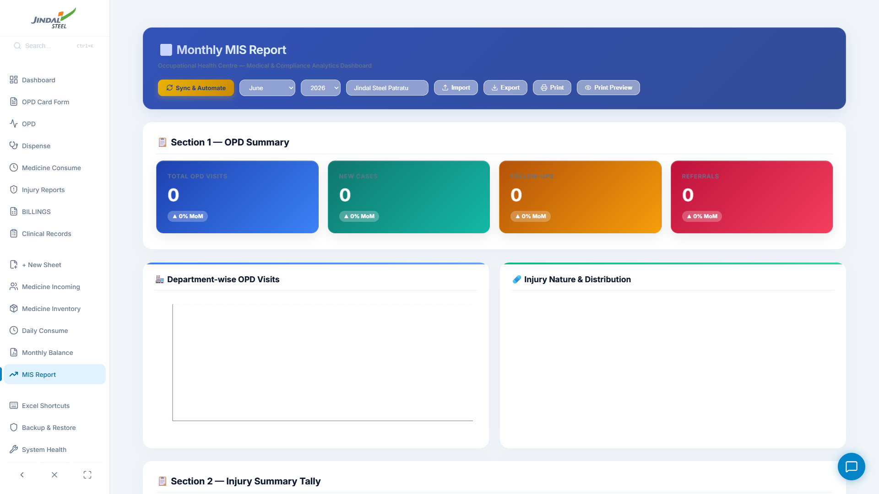
HOW DOES IT WORK? - COMPLETE DATA PIPELINE
Every patient visit triggers an automated chain reaction. Background sync threads poll every 10-15 seconds:
Step 1
OPD Card Form
Step 2
OPD Daily Tally
Step 3
Dispense Queue
Step 4
Medicine Consume
Step 5
Daily Consume
Auto-Sync
10 sec
Auto-Sync
10 sec
Patient Registration
Patient Log Sheet
Pharmacy Queue
Consumption Grid
Stock Deduction
Step 6
Monthly Balance
Medicine Stock
Register
Step 7
Monthly MIS Report
Yearly Ledger
Inventory Tracking
Analytics & Compliance

Slide 11
SCREEN: OPD CARD - PATIENT REGISTRATION FORM
Key Features:
- Auto-generates unique OPD-XXX IDs
- Captures 23 data fields per visit
- Vitals: Temp, SPO2, PR, BP, Weight
- Medicines with dosage parsing
- Auto-save with 1.5s debounce
- Printable card with Jindal logo
- Multi-card tabbed interface
- Regex quantity extraction
- Background sync to OPD Tally
- Sets extracted=false flag for
pharmacy auto-extraction
OPD Card Form - Patient vitals, diagnosis, medicines, and doctor assignment
OPD Card saves patient data
-> extracted = false
Auto-Sync extracts (10s)
-> Dispense Queue populated
Pharmacist sees pending items
-> Status: Pending/Pushed

Slide 12
SCREEN: OPD DAILY TALLY & DISPENSE QUEUE
Auto-Sync
10 sec
Daily OPD Tally - 30+ column patient register (ExcelGrid)
Dispense Medicine Queue - Auto-extracted prescriptions
The OPD Tally records every patient visit with 30+ columns (demographics, vitals, diagnosis, treatment). The Dispense Queue auto-extracts pending prescriptions every 10 seconds using the "extracted" boolean flag. Each prescription is extracted exactly once - re-editing an OPD card resets the flag for re-sync.
Data Fields Transferred:
Patient Name, Gender, Age, Emp ID, Company, Department, Diagnosis, Medicines, Qty, Dosage, Dr. Name, Charges, Date

Slide 13
SCREEN: CONSUMPTION GRID & DAILY STOCK DEDUCTION
Deduct
15 sec
Medicine Consumption Grid - 31-day x 7-section x 4-shift matrix
Daily Consume - Auto stock deduction & balance update
Section Classification:
Shift Detection:
OHC Counter:
Default prescriptions
Physiotherapy:
"physio", "therapy"
A: 06:00-14:00 | B: 14:00-22:00
C: 22:00-06:00 | General: Default
Dressing/Casualty:
"dress", "wound", "burn"
PME:
"checkup", "periodic"
Life Saving:
"emergency", "critical"
Expiry/Waste:
"expired", "waste"
First Aid:
"first aid", "minor"

Slide 14
SCREEN: MONTHLY BALANCE LEDGER & STOCK REGISTER
Monthly Balance - 12-month incoming/outgoing/balance per medicine
Medicine Stock Register - Inventory, batch, expiry tracking
The Monthly Balance Ledger tracks every medicine across 12 months with:
- Initial Balance + Monthly Incoming + Monthly Outgoing = Running Balance
- Auto-calculated from Daily Consume deductions
- Yearly grand totals computed automatically
The Stock Register provides real-time inventory with:
- Medicine Name, Batch No, Manufacturer, Category
- Quantity, Unit, Purchase Price, MRP
- Expiry Date + Auto-Status (Active/Near-Expiry/Expired)
- Color-coded expiry alerts (Green/Yellow/Red)

Slide 15
SCREEN: MONTHLY MIS REPORT & ANALYTICS
Auto-Aggregates from 8+ Sources:
Daily OPD Sheets
Medicine Stock
Monthly Consume
Medicine Incoming
Injury Reports
Ambulance Dispatch
BMW Waste Logs
Health Certificates
Outputs:
MIS Report - Auto-aggregated statistics, charts, and compliance data
- Bar Charts (Dept visits, 7-day trends)
- Trend Analysis (Month-over-month %)
- CSV / PDF Export (One-click compliance)
- Auto Observations (AI-generated text)

Slide 16
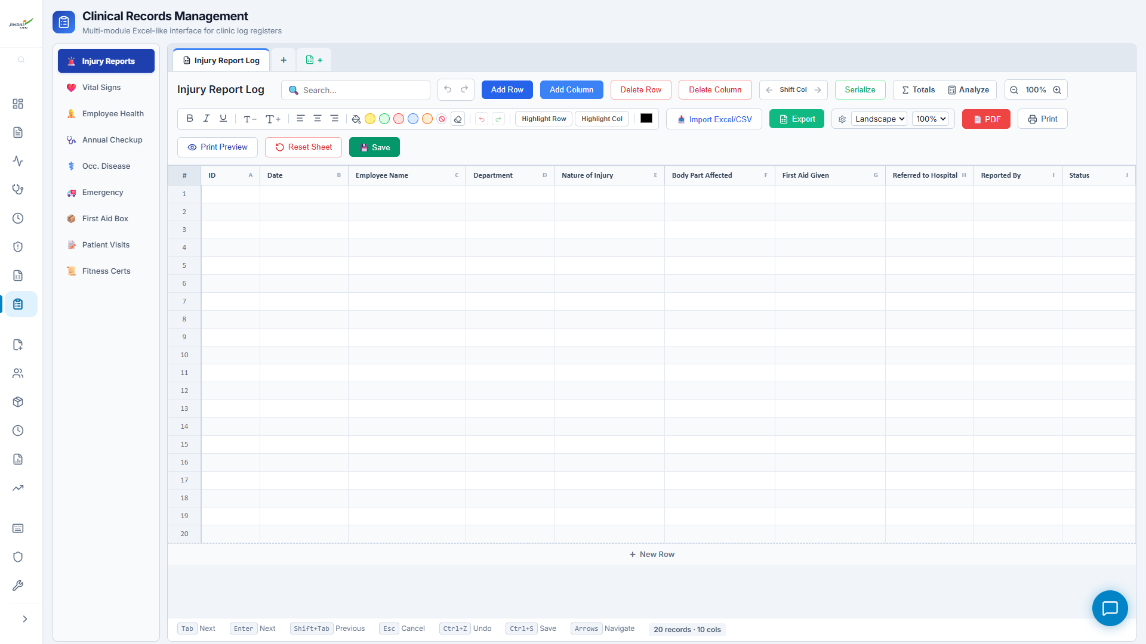
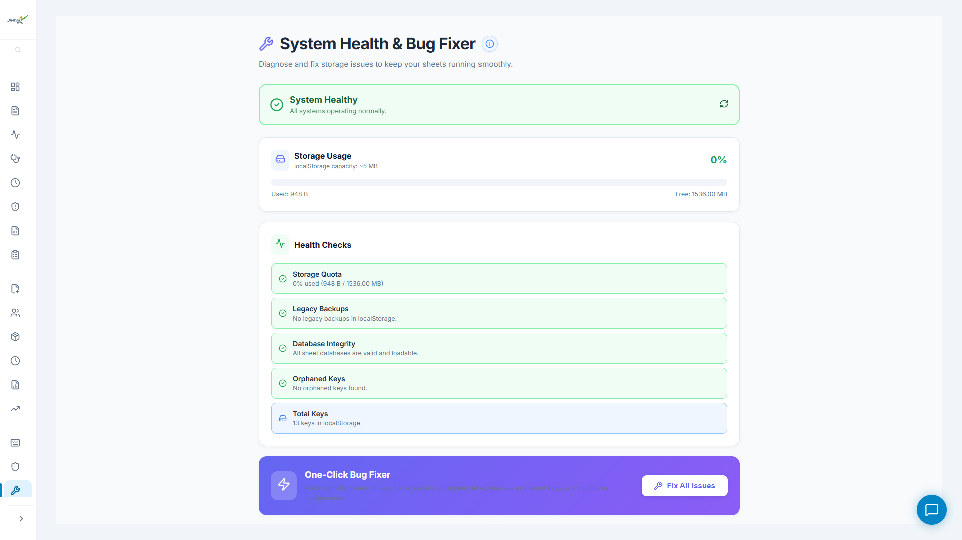
SCREEN: CLINICAL RECORDS & SYSTEM HEALTH
Clinical Records - 9 tabbed sub-modules for compliance registers
System Health Tool - Storage diagnostics & data flow visualization
Clinical Records hosts 9 compliance registers:
System Health provides:
Injury Reports | Vital Signs | Employee Health | Annual Checkup
Occ. Disease | Emergency Ambulance | First Aid Box | Patient Visits | Health Certificates
- Storage quota monitoring (70%/90% alerts)
- Data flow visualization diagrams
- IDB to localStorage migration tools
- Cleanup & optimization utilities

Slide 17
SPREADSHEET ENGINE: FORMULAS & DYNAMIC TOTALS
Virtual Grid Features:
• Custom Formula Engine:
Evaluates cell formulas dynamically on change (e.g., =SUM(A1:B20), =A1+B2) with circular reference protection.
• Real-time Calculations:
Auto-computes sums, average values, counts, and other metrics instantly across columns/ranges.
• Smooth Virtual Scroll:
Renders only cells within the viewport, maintaining 60fps interaction speeds with 10,000+ data rows.
• Complete Formatting Tools:
Supports inline cell edit, undo/redo, text style (bold, italic, underline), alignments, and column resize.
OPD Register - ExcelGrid spreadsheet featuring formula totals and cell resizing

Slide 18
COMPLIANCE EXPORTS: EXCEL (.XLSX) & PDF PRINTING
Export & Printing Capabilities:
• Binary Excel Export:
Compiles grid matrices directly into standard Excel binary streams utilizing the SheetJS (xlsx) library.
• Headless PDF Print Bridge:
Intercepts print actions and routes them to Electron native printToPDF engine to save clean, margin-adjusted local PDFs.
• Audit-Ready Compliance formats:
Standardizes all exports to match mandatory Factories Act, 1948 schedules for inspectors.
• Print-Optimized Slips:
Renders specialized printable sheets (like OPD prescription slips) with embedded corporate logos.
MIS Report - Instant export actions to generate Excel and PDF formats

Slide 19
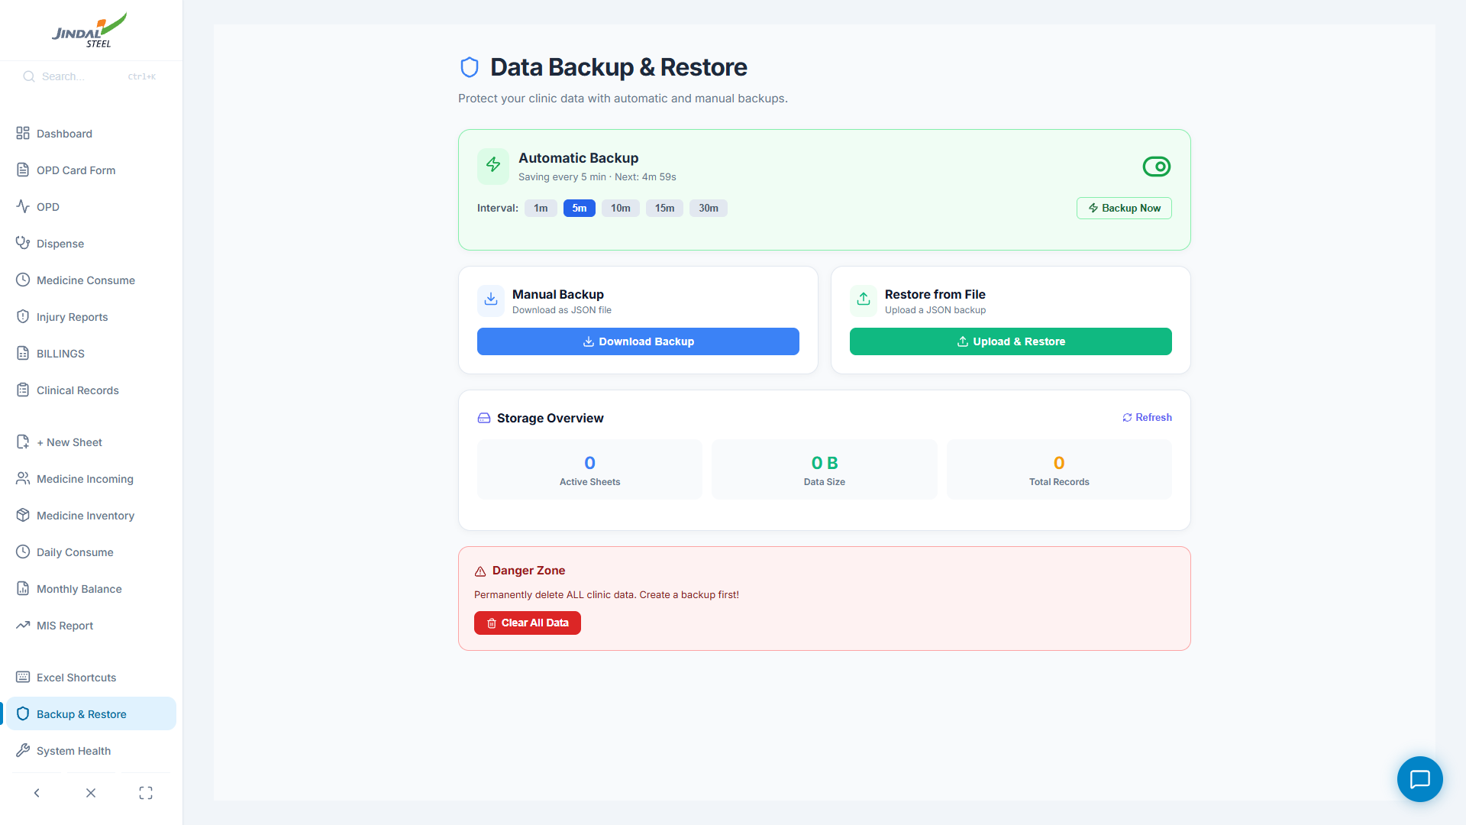
DATA SECURITY: OFFLINE BACKUP & RESTORE
Database Protection:
• Complete Database Dump:
Compresses and exports all 20+ IndexedDB and localStorage sheets into a single structured JSON file.
• Safe Import Validator:
Checks column headers, metadata, and auto-increment keys before restoring data to prevent corruption.
• Auto-Backup Safeguards:
Automatically saves DB snapshots in browser-isolated IndexedDB pools to safeguard against administrative errors.
• Seamless Database Migration:
Allows easy backup transfers of entire inventories and clinical history between clinical PCs offline.
Backup & Restore View - Single-file import and export operations

Slide 20
SYSTEM ARCHITECTURE: ELECTRON + REACT + INDEXEDDB
How user data flows securely from the clinical screen to the local database offline:
1. USER INTERFACE
React 19 & Vite 8
2. SECURITY BRIDGE
Preload IPC Bridge
3. DESKTOP MAIN
Electron Process
4. OFFLINE STORAGE
IndexedDB & Disk
• OPD Form & Grid: Captures vitals entry, patient details, and printer commands.
• Keystroke Engine: Binds keyboard shortcuts for quick cell navigation.
• Live Analytics: Local state updates the Dashboard & KPI counters instantly.
• Context Isolation: Blocks direct renderer access to Node.js for security.
• API Gatekeeper: Sanitizes and translates front-end UI data requests.
• IPC Channels: Safely routes messages between UI and Native desktop processes.
• Window Controller: Manages desktop windows, menus, and taskbar icons.
• Native Integrations: Triggers OS file dialogs (Save/Open) and print-to-PDF.
• Update Engine: Check auto-update flags and NSIS installer configs.
• sheetDB.js: Saves logs locally in browser-native IndexedDB database.
• Native fs System: Auto-saves data backup JSON files directly onto disk.
• Quota Bypass: Easily bypasses 5MB limits to store 100,000+ clinical logs.

Slide 21
PROGRAMMING LANGUAGES & DATA FORMATS USED
JavaScript (ES6+) | Primary Programming Language
JSX (React Syntax Extension) | Component UI Declarative Language
Used for Electron main process backend, preload script bridges, IndexedDB wrapper connection pools, automatic date parsing, and CSV/PDF export engines.
Defines the UI structure, reactive states, and DOM lifecycle operations across all 35 custom components, including the ExcelGrid spreadsheet and Dashboard panels.
HTML5 | Web Document Markup
CSS3 (Vanilla CSS) | Component Cascading Styles
Provides the application index document skeleton, links script assets, and handles native SVG vector graphics rendering (such as vector clinic logos).
Powers the complete layout design system, color themes, responsive layouts, active cell borders, sidebar hover effects, and printer output CSS rules.
JSON | Configuration & Data Structures
IndexedDB API / NoSQL queries | Local Database Manipulation
Used for application dependencies, build scripts, packaging configurations (package.json), local settings data caches, and backup exports.
Custom sheetDB.js connection pool schemas used for client-side logging, updating medicine stock registers, and aggregating MIS tables offline.

Slide 22
12 HEALTH & SAFETY COMPLIANCE REGISTERS
JSPulse OHMS digitizes every mandatory clinical register required under the Factories Act, 1948:
[OPD] Daily OPD Tally
[RX] Pharmacy Dispensing
[STK] Medicine Stock Register
Patient vitals, diagnosis, treatment per day.
Auto-synced prescription queue.
Inventory, batch, expiry alerts.
[QTY] Daily Consumption
[BAL] Monthly Balance Ledger
[PME] Annual Health Checkups
31-day x 7-section x 4-shift grids.
12-month running balance tracking.
PME records: vision, lung, audio.
[INJ] Injury Report Logs
[AMB] Ambulance Dispatch
[OCC] Occupational Disease
Incidents with department & nature.
Emergency callout timestamps.
Disease tracking & health records.
[BOX] First Aid Box Tracker
[CRT] Health Certificates
[WST] Biomedical Waste Log
Emergency kit audits.
Certification expiry & renewal.
BMW segregation (Y/R/B bags).

Slide 23
AUTOMATION ENGINE: BACKGROUND SYNC INTERVALS
JSPulse runs 6 independent background timer threads creating a chain-reaction automation pipeline:
Module | Interval | Action Performed | Data Source -> Target
OPD Counter | 10 sec | Reload today's patient count | cms_daily_opd_sheet -> Display
Dispense Medicine | 10 sec | Extract new prescriptions from OPD | cms_daily_opd_sheet -> cms_dispense_log
Daily Consume (Extract) | 10 sec | Pull pending items from Dispense | cms_dispense_log -> cms_monthly_consume
Daily Consume (Deduct) | 15 sec | Deduct from Stock + update Balance | cms_monthly_consume -> Stock + Balance
Daily Consume (Pending) | 2 sec | Check for pending deduction items | Internal state check
Dashboard | 30 sec | Reload all KPI metrics and alerts | All stores -> Dashboard display
Timeline (Per 30-Second Window):
0s
5s
10s
15s
20s
25s
30s
= Extract sync (10s)
= Stock deduct (15s)
= Dashboard refresh (30s)

Slide 24
PROJECT OUTCOMES: MEASURABLE IMPROVEMENTS
Operational Area | Before (Paper) | After (JSPulse OHMS) | Impact
OPD Patient Logging | 2 min per entry (handwritten) | 15 sec (digital form + auto-ID) | 87% faster
Prescription to Pharmacy | 60 sec manual copy + errors | Auto-sync every 10 seconds | 100% accurate
Stock Inventory Check | Physical inspection daily | Live counts + expiry alerts | Zero errors
Monthly MIS Report | 4-6 hours manual compilation | One-click auto-aggregation | 98% time saved
Compliance Audit | Hours of ledger searching | Instant PDF/Excel export | Audit-ready
Data Storage | Paper ledgers (fire/water risk) | IndexedDB + disk backup | Zero data loss
Network Dependency | Cloud apps crash on outage | 100% offline operation | Zero downtime
JSPulse OHMS eliminates 100% of paper transcription errors and ensures complete regulatory compliance under the Factories Act, 1948.

Slide 25
HOW JSPulse OHMS SOLVES OHC CHALLENGES
1. INSTANT REGISTRATION & SYNC
2. REAL-TIME STOCK & BALANCE
3. COMPLIANCE & OFFLINE RESILIENCE
• OPD Card Form: Auto-generates unique OPD IDs and scales to vitals entry in under 15 seconds.
• Automated Sync: Background threads automatically extract prescriptions from doctor logs every 10 seconds, pushing them to the pharmacy queue and eliminating transcription errors.
• Auto-Deduction: Pharmacy dispensing triggers live medicine stock deduction with fuzzy matching.
• Consumption Grids: 31-day x 7-section x 4-shift grid auto-sums daily consumption, instantly updating monthly balance sheets and preventing critical drug stockouts.
• One-Click Audits: Generate comprehensive MIS reports and PDF/Excel logs instantly to ensure Factories Act, 1948 audit compliance.
• Offline Desktop Shell: Runs locally in Electron, guaranteeing zero downtime and 100% data access during steel plant network or cloud server outages.

Slide 26
FUTURE SCOPE & RECOMMENDATIONS
- USB Barcode Scanners - Interface pharmacy barcodes with dispense queues
- OCR Prescription Scanner - Camera module to extract text from printed slips
- Encrypted Cloud Sync - Background upload when network is available
- Mobile Companion App - React Native app for doctors during ward rounds
THANK YOU
Ashwini Kumar | Jindal Steel & Power Ltd. | Summer 2026 Internship

Slide 27
Image Sources
https://www.rvscollege.ac.in/wp-content/uploads/2025/04/RVSCET-Website-295x80-Logo.png
Source: www.rvscollege.ac.in
https://blogger.googleusercontent.com/img/b/R29vZ2xl/...
Source: www.patratu.com
https://jindaltmt550.com/images/mp/manufacturing-process-stage-5-mob.webp
Source: jindaltmt550.com
https://ik.imagekit.io/sctpl/Untitled%20design%20-%202026-02-07T121813.187.png
Source: www.sonavibrators.com
https://framerusercontent.com/images/TfHUCkLw85zPq7NPdT2KvJC5CU.jpg
Source: shieldworkz.com
https://www.jindalstainless.com/wp-content/uploads/2026/04/Inaguration-collage.jpg
Source: www.jindalstainless.com

