Slide 1


INTERNSHIP REPORT
A report submitted in partial fulfillment of the requirements for the Award of Degree of Bachelor of Technology in Computer Science and Engineering
By: ASHWINI KUMAR
Roll no: CSE/58/24 | 4th Semester
SUBMITTED TO
DURATION & SUPERVISION
RVS College of Engineering and Technology, Jamshedpur
Under Supervision: Mr. Deepak Kumar (HOD, IT Dept., Jindal Steel, Patratu)
Duration: 1st June 2026 to 30th June 2026

Slide 2
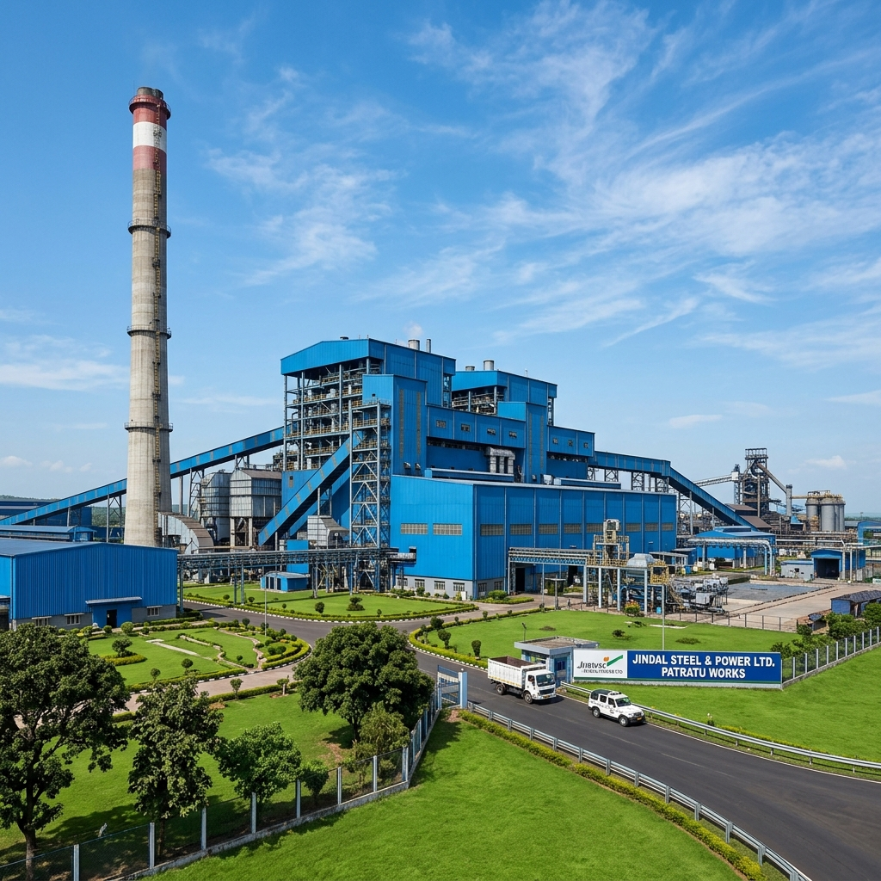
Plant Overview
The Jindal Steel Plant in Patratu is a facility focused on advanced steel production and downstream processing, integrating cutting-edge technology for industrial efficiency and safety.

Slide 3

Production: Bar & Wire Rod Mills
✓
Bar Rod Mill (BRM):
High-capacity TMT production line for construction reinforcement.
✓
Wire Rod Mill (WRM):
Specialized unit for precision wire rod manufacturing.
✓
Quality Control:
Advanced rolling processes ensuring uniform material strength and quality.

Slide 4
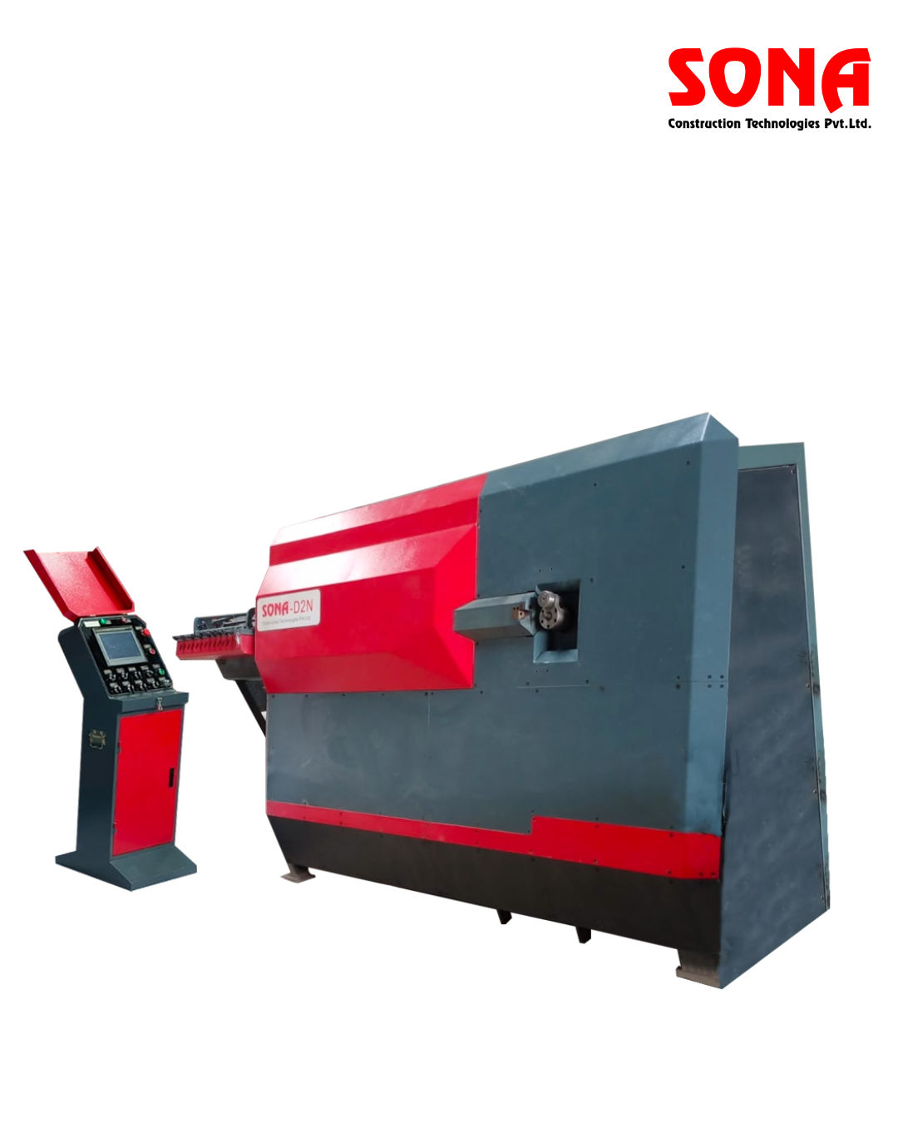
Downstream: Rebar Service Centre
⚙
Cut & Bend:
Fully customized, pre-processed rebar to site specifications.
⚙
Weld Mesh:
High-strength mesh support for civil infrastructure.
⚙
Supply Efficiency:
Optimizing site operations by reducing construction scrap significantly.

Slide 5
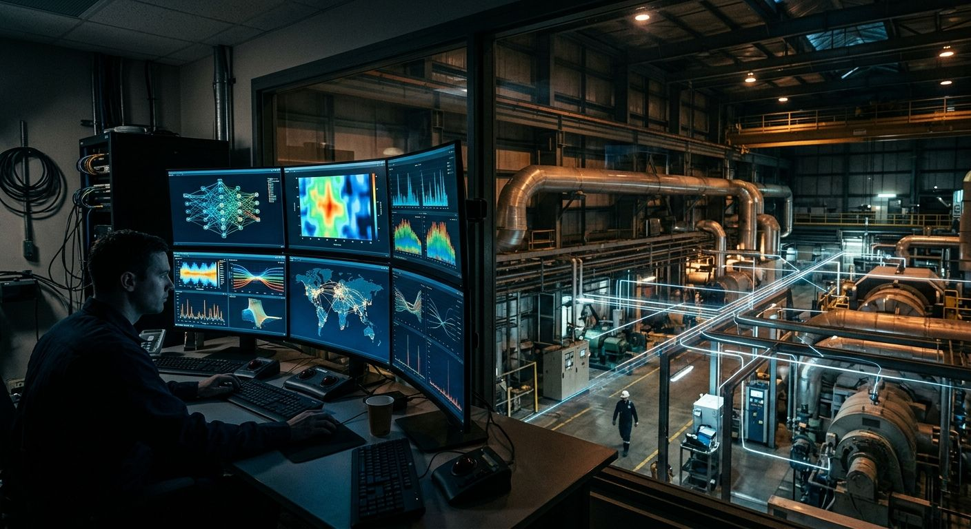
Department: IT Department
品
Network Infrastructure:
Managing the robust industrial communication network.
品
Enterprise Operations:
Supporting SAP, production scheduling, and inventory systems.
品
Cybersecurity:
Ensuring a secure environment for all OT/IT industrial data.

Slide 6
Department: Occupational Health Centres
✚
Emergency Care:
On-site medical response teams available 24/7.
✚
Wellness Monitoring:
Periodic industrial health screenings for all plant personnel.
✚
Safety Standards:
Promoting industrial hygiene and proactive safety protocols.

Slide 7


JSPulse OHMS
Occupational Health Management System
An Offline-First, Fully Automated Desktop Application for Industrial Plant Clinic Operations
Developed By
Ashwini Kumar
Intern ID: JSPL-2026-IT-042
B.Tech CSE
Host Organization
Jindal Steel & Power Ltd.
Raigarh & Patratu Plants
IT & OHC Medical Services
Technology Stack
Electron 42 + React 19
Vite + IndexedDB + Recharts
Offline NLP AI ChatBrain
Version 1.0.26 | Summer 2026 Internship | Windows x64 Native Installer

Slide 8
WHAT IS JSPulse OHMS?
JSPulse OHMS is an offline-first desktop application built specifically for Occupational Health Centers (OHCs) inside industrial steel plants. It replaces fragmented paper ledger books with an automated, interconnected digital system.
[THE PROBLEM] (Before JSPulse)
[THE SOLUTION] (JSPulse OHMS)
- OPD logs handwritten in paper registers - 2 minutes per entry
- Medicine dispensing copied manually from OPD ledger - errors and delays
- No automatic stock deduction - pharmacists physically count inventory
- Monthly consumption reports compiled manually from 30 days of ledger pages
- Compliance audits require hours of ledger searches
- Cloud-based apps crash when plant intranet goes down
- No drug interaction safety checks
- Digital OPD form with auto-ID generation - 15 seconds per entry
- Automated prescription extraction every 10 seconds
- Real-time stock deduction with fuzzy medicine matching
- Monthly reports auto-generated from live data
- One-click PDF/Excel exports for instant compliance
- 100% offline - runs locally inside Electron desktop shell
- Built-in drug interaction safety matrix

Slide 9
HOW DOES IT WORK? — THE COMPLETE AUTOMATED PIPELINE
Every patient visit triggers an automated chain reaction across 6 connected modules. Background sync threads poll every 10-15 seconds, creating a near-real-time data pipeline:
OPD Form
(Patient Registration)
OP
(Daily Patient Log)
Auto-Sync
10 sec
Dispense
(Pharmacy Queue)
Auto-Sync
10 sec
Medicine Consume
(Consumption Grid)
OPDCardPrintable.jsx
DailyOPDTally.jsx
DispenseMedicine.jsx
MedicineConsumptionGrid.jsx
Polls 30s
Polls 10s
Auto-Deduct 15 sec
Dashboard
(KPIs + Alerts)
OPD Counter
(Live Today Count)
Medicine Consumption
Grid (Manual Entry)
Daily Consume
(Stock deduction)
Monthly Balance
(Yearly Ledger)
auto-sync ->
DailyConsume.jsx
MonthlyBalance.jsx
Monthly Consume
(MIS Report & Analytics)
MonthlyMISReport.jsx

Slide 10
WORKFLOW DETAIL: OPD FORM → DISPENSE QUEUE
1. PATIENT ARRIVES
Nurse opens OPD Card
Fills vitals, diagnosis,
medicines prescribed
2. OPD CARD SAVES
Auto-generates OPD-XXX ID
Sets extracted = false
Auto-save with 1.5s debounce
3. OPD LOG STORES
Row added to
cms_daily_opd_sheet
23 data columns saved
4. AUTO-EXTRACTION (10s)
Background thread scans OPD
for extracted = false rows
Copies patient + medicine data
The "extracted" boolean is the critical transactional gate. It ensures:
• Each prescription is extracted exactly once (no duplicates)
• Re-editing an OPD card resets extracted = false, triggering re-sync
• The pharmacist sees only pending items, not already-processed ones
5. DISPENSE LOG CREATED
New DISP-XXX row with
status = "Pending"
Source OPD marked extracted
Data Fields Transferred:
Automation Details:
Patient Name, Gender, Age, Emp ID, Company,
Department, Diagnosis, Medicines, Quantity,
Dosage, Dr. Name, Charges, Date
- Regex parses medicine dosage strings
(e.g., "1 tab BD x 5 days" -> qty: 10)
- Auto-capitalize patient names on blur
- Fuzzy matching for medicine identification
- Legacy data migration from old field names

Slide 11
WORKFLOW DETAIL: DISPENSE → CONSUME → STOCK DEDUCTION
1. DISPENSE QUEUE
Pharmacist reviews
pending prescriptions
status = "Pending"
Auto 10s
2. DAILY CONSUME
Extracts from Dispense
Classifies by Section:
OHC/Dressing/LifeSaving
3. CONSUMPTION GRID
31-day x 7-section x 4-shift
Qty placed in correct cell
Auto-sums per section/day
4. SYNC & DEDUCT
Auto-deduct every 15s
Pushes to Stock Register
& Monthly Balance Ledger
Section Classification Logic:
Shift Detection:
OHC Counter
-> Default for standard prescriptions
Shift A: 06:00 - 14:00
Shift B: 14:00 - 22:00
Shift C: 22:00 - 06:00
General: Default fallback
Medicine Stock
cms_medstock_data
(qty decremented)
Monthly Balance
Outgoing updated
Balance recomputed
Dressing/Casualty
-> Keywords: "dress", "wound", "burn"
Life Saving
-> Keywords: "emergency", "critical"
First Aid
-> Keywords: "first aid", "minor"
Physiotherapy
-> Keywords: "physio", "therapy"
PME
-> Keywords: "checkup", "periodic"
Expiry/Waste
-> Keywords: "expired", "waste"

Slide 12
WORKFLOW DETAIL: MONTHLY REPORTING & MIS AGGREGATION
The Monthly MIS Report auto-aggregates data from 8+ clinical databases to generate a complete compliance report:
Daily OPD Sheets
cms_daily_opd_sheet
Medicine Stock
cms_medstock_data
Monthly Consume
cms_monthly_consume_*
Medicine Incoming
cms_medicine_incoming
Injury Reports
cms_injury_data
Ambulance Dispatch
cms_ambulance_data
BMW Waste Logs
cms_bmw_data
Health Certificates
cms_health_cert_data
MONTHLY MIS REPORT
Auto-Aggregates: OPD Stats | Injury Analysis | Medicine Consumption | Department Distribution | Compliance Index
Bar Charts
Department-wise visits
7-day trends
Trend Analysis
Month-over-month %
New vs Follow-up
CSV / PDF Export
One-click compliance
report generation
Auto Observations
AI-generated summary
narrative text

Slide 13
SYSTEM ARCHITECTURE: ELECTRON + REACT + INDEXEDDB
ELECTRON MAIN PROCESS
(Node.js Runtime)
ELECTRON RENDERER (React 19 + Vite)
• BrowserWindow manager
• Native file dialogs (Save/Open)
• Headless PDF print engine
• Desktop shell (taskbar, tray)
• NSIS installer packaging
• Auto-updater hooks
• fs.writeFileSync for exports
• System path resolution
ExcelGrid Engine
Virtual spreadsheet
OPD → Dispense Sync
Background pipeline
PRELOAD
BRIDGE
contextIsolation
window.electron
IPC channels
Sandbox guard
sheetDB.js
IndexedDB pool
Recharts Analytics
MIS visualizations
ChatBrain NLP
Offline AI assistant
InteractionChecker
Drug safety matrix
IPC
Bridge
Export Engine
Excel + PDF output
Global Search
Ctrl+K indexer

Slide 14
DATABASE SCHEMA: ENTITY RELATIONSHIP MAP
PATIENT_VISIT_LOG
DISPENSE_LOG
DAILY_CONSUME
cms_daily_opd_sheet
extracts
cms_dispense_log
pushes
cms_monthly_consume_*
id (PK), patientName, empId,
date, diagnosis, medicines,
extracted (sync flag)
id (PK), opdId (FK),
patientName, medicine,
qty, status (Pending/Pushed)
id (PK), medicineName,
day1..day31 x 7 sections,
monthlyGrandTotal, status
deducts
deducts
MEDICINE_STOCK
EMPLOYEE_HEALTH
MONTHLY_BALANCE
cms_medstock_data
cms_employee_health
cms_yearly_monthly_balance
id (PK), medicineName,
batch, category, quantity,
expiry, expiryStatus
empCode (PK), name,
department, bloodGroup,
checkupDate, status (Fit/Unfit)
id (PK), medicineName,
initialBalance, 12xincoming,
12xoutgoing, runningBalance

Slide 15
AUTOMATION ENGINE: BACKGROUND SYNC INTERVALS
JSPulse runs 6 independent background timer threads. Each module polls its data source at fixed intervals, creating a chain-reaction automation pipeline:
Module | Interval | Action Performed | Data Source → Target
OPD Counter | 10 sec | Reload today's patient count | cms_daily_opd_sheet → Display
Dispense Medicine | 10 sec | Extract new prescriptions from OPD | cms_daily_opd_sheet → cms_dispense_log
Daily Consume (Extract) | 10 sec | Pull pending items from Dispense | cms_dispense_log → cms_monthly_consume
Daily Consume (Deduct) | 15 sec | Deduct from Stock + update Balance | cms_monthly_consume → Stock + Balance
Daily Consume (Pending) | 2 sec | Check for pending deduction items | Internal state check
Dashboard | 30 sec | Reload all KPI metrics and alerts | All stores → Dashboard display
Timeline Visualization (Per 30-Second Window):
0s
5s
10s
15s
20s
25s
30s
= Extract sync (10s)
= Stock deduct (15s)
= Dashboard refresh (30s)

Slide 16
TECHNOLOGY STACK & COMPONENT OVERVIEW
Desktop Shell: Electron 42
UI Library: React 19
Wraps React into a native Windows .exe with full OS access, sandbox isolation, and IPC communication.
Component-based rendering with hooks (useState, useEffect, useMemo, useCallback) for reactive UI updates.
Build Tool: Vite 8
Database: IndexedDB (Custom)
Lightning-fast HMR dev server and optimized Rolldown production bundler with code-splitting.
sheetDB.js — custom connection pool with transaction retry, stale-connection recovery, and localStorage fallback.
Charts: Recharts (SVG)
Export Engine: SheetJS + jsPDF
Interactive bar charts, pie charts, and area graphs for Dashboard KPIs and MIS trend analytics.
Generates .xlsx spreadsheets and PDF documents with auto-table formatting and inline SVG logos.
AI / NLP: Custom ChatBrain
Installer: electron-builder + NSIS
Offline intent classifier with regex tokenizer, keyword routing, and fuzzy database search.
Packages into a signed Windows x64 installer (.exe) with auto-update support and custom branding.

Slide 17
10+ HEALTH & SAFETY COMPLIANCE REGISTERS
JSPulse OHMS digitizes every mandatory clinical register required under the Factories Act, 1948:
[OPD] Daily OPD Tally
[RX] Pharmacy Dispensing
[STK] Medicine Stock Register
Patient vitals, diagnosis, and treatment records per day.
Auto-synced prescription queue with status tracking.
Inventory levels, batch tracking, and expiry alerts.
[QTY] Daily Consumption
[BAL] Monthly Balance Ledger
[PME] Annual Health Checkups
31-day x 7-section x 4-shift consumption grids.
12-month running balance with incoming/outgoing tracking.
PME records: vision, lung capacity, audiometry tests.
[INJ] Injury Report Logs
[AMB] Ambulance Dispatch
[OCC] Occupational Disease Registry
Plant incidents with department, nature, and remarks.
Emergency callout logs with response timestamps.
Active disease tracking and occupational health records.
[BOX] First Aid Box Tracker
[CRT] Health Certificate Tracker
[WST] Biomedical Waste Log
Emergency kit audits across plant locations.
Certification expiry dates and renewal tracking.
BMW segregation tracking (Yellow/Red/Blue bags).

Slide 18
CUSTOM EXCELGRID SPREADSHEET ENGINE
Engine Capabilities:
# A B C D
• Arrow Key Navigation: Physical keyboard maps to cell coordinate shifts
• Formula Engine: Recursive evaluation of =SUM(A1:B10), cell references, with 50-depth circular guard
• DOM Virtualization: Only renders visible rows using spacer divs — handles 10,000+ rows lag-free
• Undo/Redo Stacks: 30-entry deep-cloned state history with JSON stringify isolation
• Cell Formatting: Bold, italic, underline, alignment, background colors, font sizing
• Find & Replace: Global search across all visible cells

Slide 19
STORAGE & SECURITY: INDEXEDDB + QUOTA BYPASS
React Component
calls localStorage
ES6 Proxy
intercepts call
Electron IPC
saveLocalData()
Node.js Main
fs.writeFileSync()
C:\OHSData
JSON on disk
Bypasses 5MB!
In-Memory Map()
Sync cache for UI
IndexedDB Connection Pool (sheetDB.js):
Security Features:
• Custom IndexedDB wrapper with singleton connection pool
• Auto-detects stale connections and triggers reconnect
• Stores 100,000+ clinical records without browser crashes
• Automatic localStorage → IndexedDB data migration
• Quota monitoring: Visual alerts at 70% and 90% capacity
• contextIsolation: true (no direct DOM access)
• nodeIntegration: false (sandboxed renderer)
• Preload bridge restricts available APIs
• No remote module usage
• Content Security Policy headers enforced

Slide 20
PROJECT OUTCOMES: MEASURABLE IMPROVEMENTS
Operational Area | Before (Paper) | After (JSPulse OHMS) | Impact
OPD Patient Logging | 2 minutes per entry (handwritten) | 15 seconds (digital form + auto-ID) | 87% faster
Prescription to Pharmacy | 60 sec manual copy + human errors | Auto-sync every 10 seconds | 100% accurate
Stock Inventory Check | Physical cupboard inspection daily | Live counts + expiry alerts | Zero stock errors
Monthly MIS Report | 4-6 hours manual compilation | One-click auto-aggregation | 98% time saved
Compliance Audit | Hours of ledger searching | Instant PDF/Excel export | Always audit-ready
Data Storage | Paper ledgers (fire/water risk) | IndexedDB + disk backup | Zero data loss risk
Network Dependency | Cloud apps crash on outage | 100% offline operation | Zero downtime
JSPulse OHMS eliminates 100% of paper transcription errors and ensures complete regulatory compliance under the Factories Act, 1948.

Slide 21
FUTURE SCOPE & RECOMMENDATIONS
- USB Barcode Scanners - Interface pharmacy stock barcodes with dispense queues to prevent medicine selection errors
- OCR Prescription Scanner - Camera module to extract text from printed prescription slips directly into OPD logs
- Encrypted Cloud Sync - Optional encrypted background sync to upload clinical data when network becomes available
- Mobile Companion App - React Native app for doctors to view patient histories on mobile during ward rounds
THANK YOU
Ashwini Kumar | Jindal Steel & Power Ltd. | Summer 2026 Internship

