Slide 1
End-to-End Retail Performance & Behavioral Analytics
- RetailNova Inc.
R. Ashwini

Slide 2
Introduction
RetailNova Inc - Retail & E-Commerce
Founded: 2016
Headquarters: Chicago, USA
Online platforms, 60+ Physical Stores
Sells Electronics, Apparel, Home & Kitchen, and Personal Care products

Slide 3
Problem Statement
Increase in product returns in recent periods
Customer churn
Declining profitability in certain regions and categories
Need for data-driven decisions

Slide 4
Objectives
Analyze sales and profit trends
Understand customer behavior and returns
Product & inventory optimization
Improve store and regional profitability

Slide 5
Methodology
Data Collection from CSV files
Data Cleaning and EDA using Python
Business Analysis using SQL
Dashboard Development in Power BI
Insights and Recommendations

Slide 6
Data Cleaning
Removed duplicates
Handled missing values
Created new columns such as Profit and Age Group
EDA using Python

Slide 7
SQL Analysis
Answer key business questions
calculate derived metrics profit, discount %, return percentage
Revenue analysis
Top products
Customer & store performance
Returns analysis

Slide 8
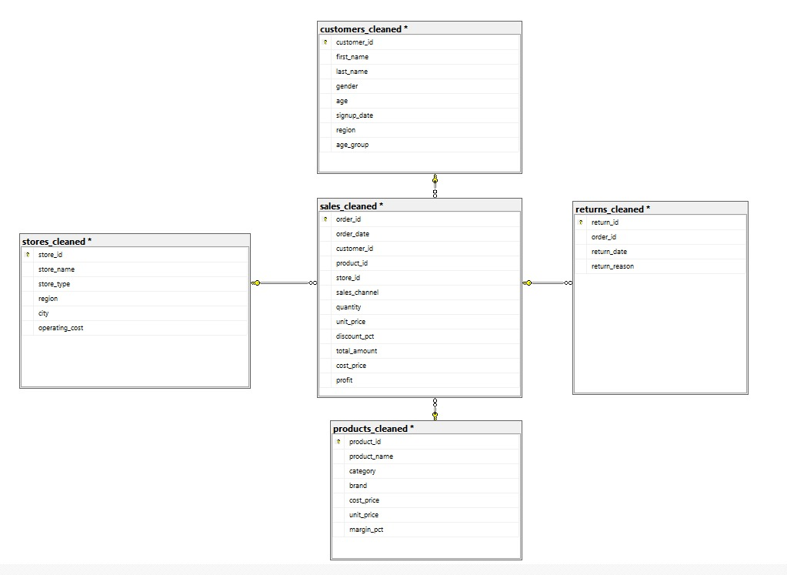
ER Diagram

Slide 9
Data Visualization
Interactive dashboards
Sales, Customers, Products, Stores, Returns
Tool: Power BI

Slide 10
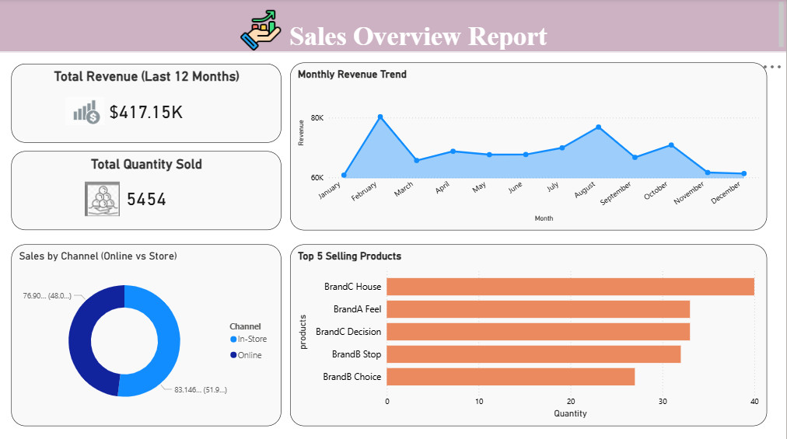
Sales dashboard

Slide 11
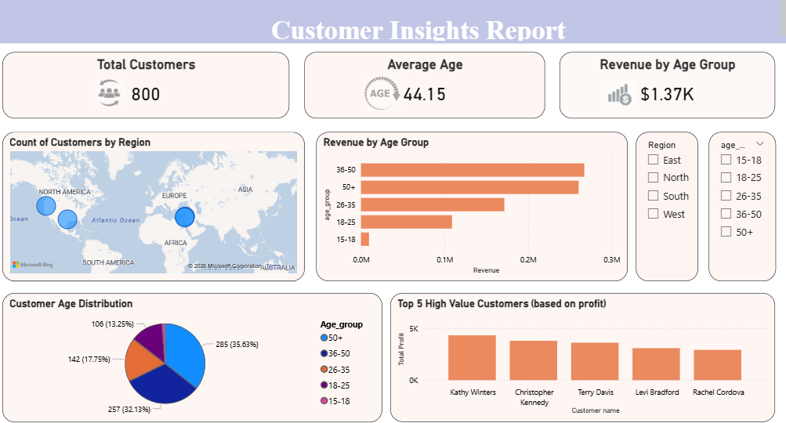
Customer dashboard

Slide 12
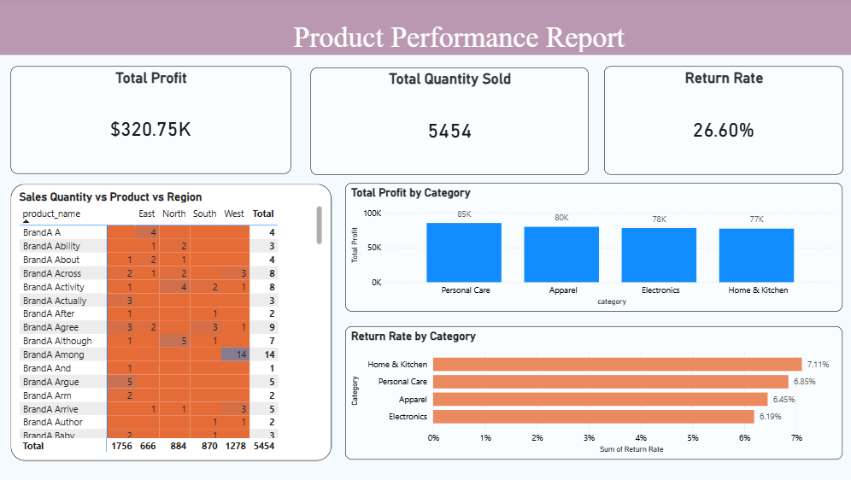
Product dashboard

Slide 13
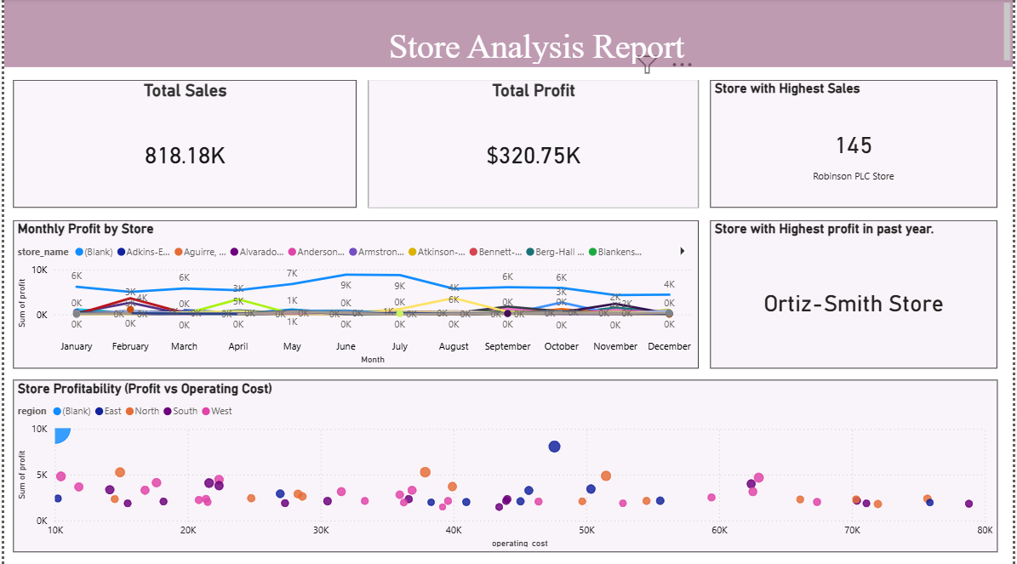
Store dashboard

Slide 14
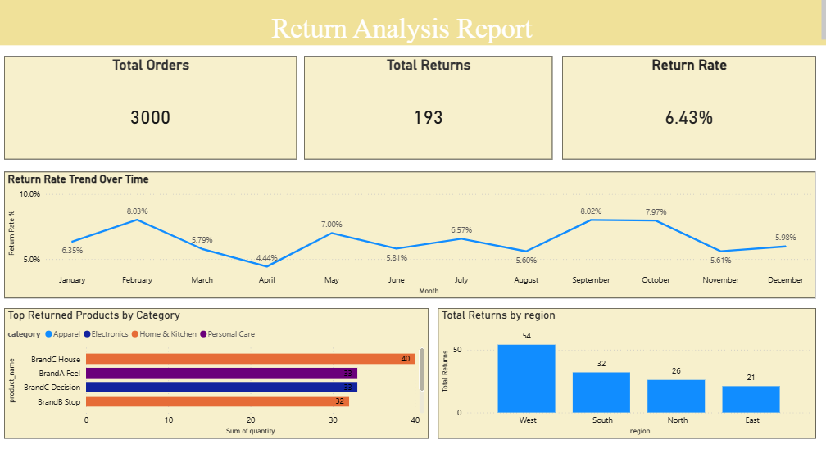
Return dashboard

Slide 15
Key Findings
Offline store sales exceed online, driving most revenue.
Middle-aged (36–55) customers contribute the largest revenue share.
Home & Kitchen products have the highest return rate.
Some stores have high sales but low profit due to costs.
Returns are concentrated in the west region.

Slide 16
Key Insights
Improve and expand online sales channels to boost revenue.
Target middle-aged/high-value customers with loyalty programs.
Address return causes to enhance profitability.
Optimize store operating costs to increase profit.
Use region- and category-specific strategies to reduce returns.

Slide 17
Challenges Faced
Foreign key issue between Sales & Stores
Missing online store record
Resolved by adding logical store

Slide 18
Conclusion
The analysis reveals that data-driven decision-making is essential for optimizing sales Trends ,customer behaviour ,product performance and improves store and regional profitability.

Slide 19
References
CSV Datasets
Python, SQL, Power BI

Slide 20
Thank You

