Slide 1
Used Cars Price Analysis
R. Ashwini

Slide 2
Introduction
The used car market has grown rapidly due to rising vehicle costs and changing consumer preferences, with many buyers choosing pre-owned cars for better value.
This project applies data cleaning, exploratory data analysis (EDA), and visualization techniques to convert raw data into meaningful insights on market trends and pricing patterns.

Slide 3
Problem Statement
Understanding how car prices vary across different brands.
Identifying high-quality cars available at lower prices.
Analyzing the influence of fuel type, distance driven, and manufacturing year on pricing.
Providing data-driven insights to support smarter purchasing decisions.

Slide 4
Objectives
The primary objectives of this project are:
To collect used car data using web scraping from trusted platforms.
To clean and preprocess the dataset for accurate analysis.
To perform exploratory data analysis to uncover trends and patterns.
To visualize key factors affecting used car prices.
To build an interactive dashboard for better decision-making.

Slide 5
Methodology
Data Collection from Web
Data Cleaning and EDA
Data Visualization

Slide 6
Data Collection From Web
Data was gathered through web scraping from reputable used car websites.
Important attributes collected include:
Brand
Price
Fuel Type
Manufacturing Year
Distance Driven
EMI
City

Slide 7
Data Cleaning and EDA
Removed duplicate records.
Handled missing and inconsistent values.
Eliminated unrealistic price outliers.
Converted columns into appropriate data types.
Standardized brand names and fuel categories.
Tools Used: Jupyter Notebook

Slide 8
Data Visualization
Power BI were used to create dashboards showing:
Average Price by Brand
Distance vs Price
Fuel Type Distribution
Price Trends by Manufacturing Year
Price Distribution by City
Tools Used: Power BI

Slide 9
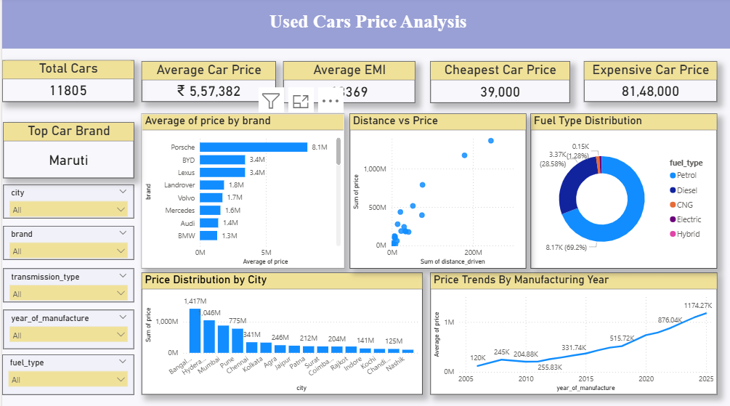
Dashboard

Slide 10
Key Findings
Used car prices vary significantly across different brands, with premium brands maintaining higher resale value.
Petrol cars dominate the used car market compared to diesel and other fuel types.
Cars with lower kilometers driven are generally priced higher than high-usage vehicles.
Newer manufacturing year cars command higher prices in the resale market.
EMI availability increases affordability and attracts more buyers in mid-price segments.

Slide 11
Key Insights
Buyers can get better value by choosing reliable mid-range brands instead of premium brands.
Petrol cars are the most practical and easily available option for urban buyers.
Selecting cars with moderate mileage offers a balance between price and condition.
EMI options make higher-priced used cars accessible to a wider audience.
Data-driven analysis helps identify fair pricing and avoid overvalued listings.

Slide 12
Challenges Faced
Extracting data through web scraping was complex due to dynamic website structures.
Some listings contained missing or inconsistent values.
Detecting and removing price outliers required careful filtering.
Combining datasets from multiple cities required additional preprocessing.

Slide 13
Conclusion
The Used Cars Price Analysis project successfully identified the major factors influencing used car prices. By leveraging web scraping, data preprocessing, and visualization techniques, the project converted raw data into actionable insights.
The analysis helps potential buyers understand market trends, compare options effectively, and make cost-efficient purchasing decisions. Additionally, the dashboard provides a user-friendly interface for exploring pricing patterns.

Slide 14
References
Cars24 – https://www.cars24.com

Slide 15
Thank You

