Slide 1

01
CAPSTONE PROJECT • SQL • POWER BI
DIGITAL BANKING
ANALYTICS
An End-to-End SQL & Power BI Analytics Solution
SQL / ETL / DATA ANALYSIS / BUSINESS INTELLIGENCE
Ashwini Dixit
Aspiring Data Analyst

Slide 2
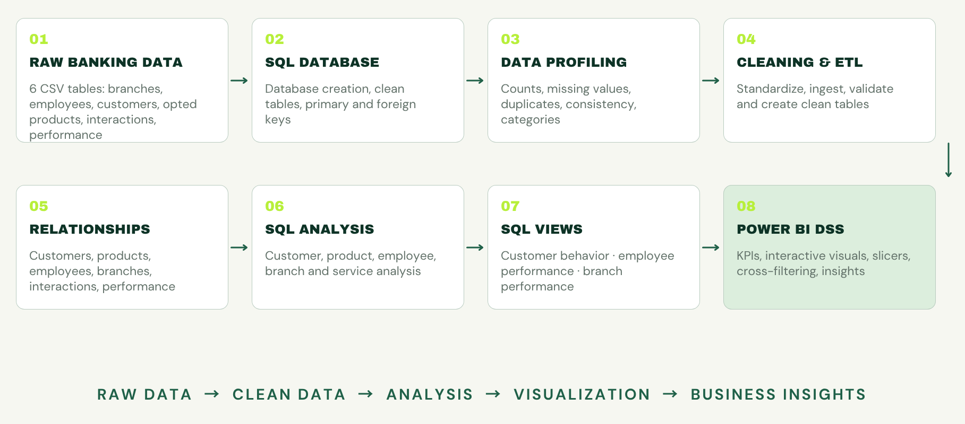
02 | PROJECT OVERVIEW

Slide 3
BUSINESS PROBLEM & OBJECTIVES
03
What business questions does the analysis answer?
CUSTOMER
PRODUCT
VALUE
EMPLOYEE
BRANCH
How are customers
segmented?
Which banking products
are most adopted?
What drives
product value?
How are employees
performing?
Which branches
require attention?
OBJECTIVE / Transform raw banking data into actionable business insights
DIGITAL BANKING ANALYTICS / BUSINESS QUESTIONS

Slide 4
DATASET & DATA ARCHITECTURE
04
Six tables. One relational view of the bank.
employees
customer_opted
emp_performance
branches
18,450 records
500 records
6,000 records
50 records
customers
emp_cust_interaction
10,000 records
65,000 records
PK / FK keys highlighted in lime • Branch → Customers / Employees / Interactions
DIGITAL BANKING ANALYTICS / RELATIONAL ARCHITECTURE

Slide 5
DATA PROFILING & QUALITY ASSESSMENT
05
Trust is built before analysis begins.
RAW DATA
PROFILING
CLEANING
VERIFIED DATA
✓ Checked record counts
✓ Identified missing values
✓ Checked duplicate records
✓ Validated primary keys
✓ Checked foreign-key consistency
✓ Reviewed data types and ranges
✓ Validated categorical values
✓ Standardized inconsistent fields
DIGITAL BANKING ANALYTICS / DATA QUALITY

Slide 6
DATABASE CREATION & CLEANING
06
A disciplined SQL foundation
CSV FILES
DATABASE
CLEAN TABLES
CONSTRAINTS
VALIDATED DATA
01 Created relational database
02 Clean analytical tables
03 Appropriate data types
04 Primary keys established
05 Foreign keys prepared
06 Data standardized
07 Tables ready for analysis
DIGITAL BANKING ANALYTICS / DATABASE BUILD

Slide 7
ETL & DATA INGESTION
07
Move data with control at every handoff
RAW CSVs
LOAD
CLEAN TABLES
VALIDATE
ANALYSIS-READY
DATABASE
Imported raw CSV datasets → Loaded clean SQL tables → Validated counts & relationships → Verified consistency → Prepared analytical queries
DIGITAL BANKING ANALYTICS / CONTROLLED INGESTION

Slide 8
RELATIONSHIPS & SQL ANALYSIS
08
One model. Four analytical lenses.
CUSTOMER ANALYSIS
INTERACTION ANALYSIS
Segmentation
Product adoption
Digital banking usage
Customer value
Interaction volume
CSAT
Resolution time
Issue severity
RELATIONAL MODEL
JOINS + KEYS
EMPLOYEE ANALYSIS
BRANCH ANALYSIS
Performance
Training
Attendance
Customer service
Customers
Product sales
Interactions
Branch performance
RELATIONSHIPS → JOINS → AGGREGATIONS → BUSINESS METRICS
DIGITAL BANKING ANALYTICS / SQL ANALYSIS

Slide 9
SQL VIEWS & POWER BI DATA LAYER
09
Curated views bridge engineering and insight.
vw_customer_behavior
vw_employee_performance
vw_branch_performance
Customer info • products opted • value
interactions • CSAT • resolution time
Sales target • training • attendance
performance • interactions • CSAT
Customers • products sold • total sales
interactions • CSAT • resolution time
SQL prepares + aggregates. POWER BI visualizes + invites exploration.
DIGITAL BANKING ANALYTICS / SEMANTIC DATA LAYER

Slide 10
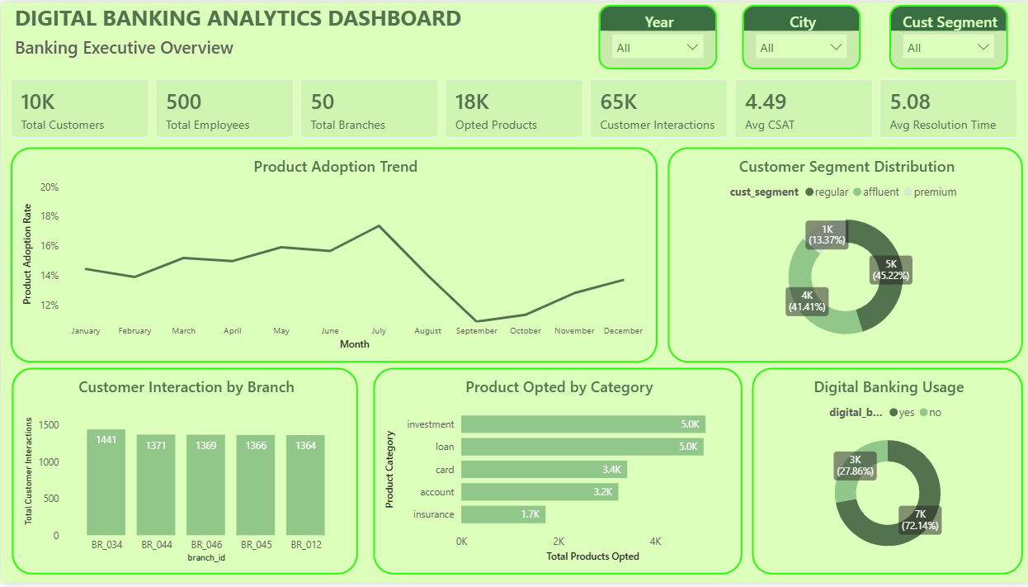
POWER BI REPORT 01
10
Executive Overview
KEY KPIs
Total Customers
Total Employees
Total Branches
Products Opted
Customer Interactions
Average CSAT
Avg. Resolution Time
KEY ANALYSIS
Product adoption trend
Customer segmentation
Digital banking usage
Product categories
Branch interactions
DIGITAL BANKING ANALYTICS / INTERACTIVE REPORTING

Slide 11
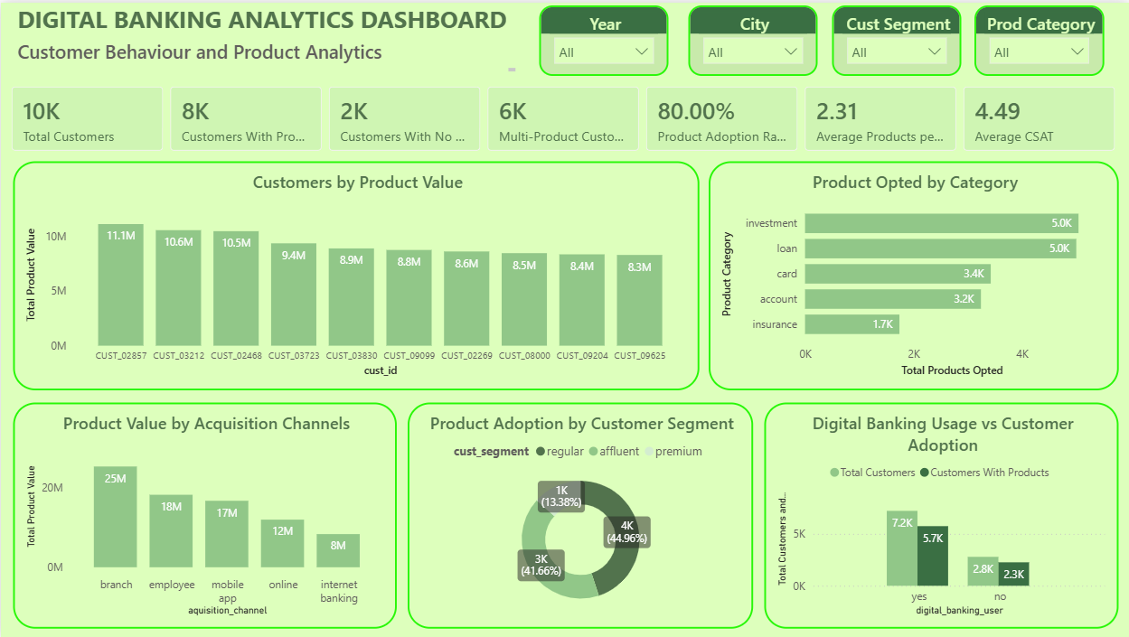
POWER BI REPORT 02
11
Customer Behaviour & Product Analytics
KEY KPIs
Total Customers
Customers With Products
Customers Without Products
Multi-Product Customers
Product Adoption Rate
Avg. Products / Customer
Average CSAT
KEY ANALYSIS
Product value by customer
Adoption by category
Acquisition channels
Customer segments
Digital banking usage
DIGITAL BANKING ANALYTICS / INTERACTIVE REPORTING

Slide 12
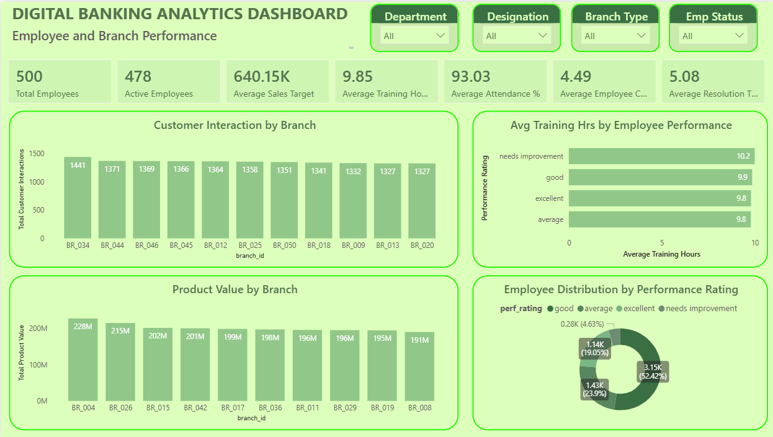
POWER BI REPORT 03
12
Employee & Branch Performance
KEY KPIs
Total Employees
Active Employees
Average Sales Target
Training Hours
Attendance
Employee CSAT
Resolution Time
KEY ANALYSIS
Interactions by branch
Training vs performance
Product value by branch
Performance ratings
Branch benchmarking
DIGITAL BANKING ANALYTICS / INTERACTIVE REPORTING

Slide 13
KEY BUSINESS INSIGHTS
13
Six lenses for better banking decisions
CUSTOMER
PRODUCT
DIGITAL
Strong product adoption across customer segments
Categories reveal distinct adoption patterns
Usage compared directly against product adoption
EMPLOYEE
BRANCH
SERVICE
Training and performance evaluated together
Benchmark sales, customers and interactions
CSAT and resolution time signal service quality
DIGITAL BANKING ANALYTICS / DECISION SIGNALS

Slide 14
CHALLENGES & LEARNINGS
14
Building capability from complexity
CHALLENGES
WHAT I LEARNED
SKILLS DEMONSTRATED
01 Understanding relational data
02 Data quality validation
03 Meaningful SQL aggregations
04 Business-ready views
05 Effective dashboards
01 End-to-end ETL workflow
02 Relational database design
03 SQL analytical thinking
04 Power BI data modeling
05 Business-focused storytelling
01 SQL
02 Data Cleaning
03 ETL
04 Data Profiling
05 Data Analysis
06 Power BI
07 Data Visualization
08 Business Intelligence
DIGITAL BANKING ANALYTICS / REFLECTION

Slide 15
RAW DATA
CLEAN DATA
SQL ANALYSIS
BUSINESS METRICS
POWER BI
DECISION SUPPORT
CONCLUSION &
FUTURE SCOPE
15
CONCLUSION
Built an end-to-end banking analytics solution
Integrated SQL engineering with Power BI
Created reusable analytical SQL views
Developed three business-focused dashboards
Converted raw data into actionable insights
FUTURE SCOPE
Real-time integration • churn prediction • product recommendation
customer lifetime value • branch forecasting • employee prediction • automated alerts
THANK YOU
Ashwini Dixit
Aspiring Data Analyst

