Slide 1
Death Rate Finder
Ashwini Giri
Isha Patil

Slide 2
Objectives
Web application to search the cause of death, occurrence of death, location of death
Search based on various facets
Parsing data and storing on Firebase
Authentication through Firebase
Provision of login for user
Storing the search history of the user for future reference

Slide 3
Workflow
Database
Storage
.
Implementing
Faceted Search
User Authentication & Search History
API
Implement
UI

Slide 4
Programming languages
• Firebase Js client for database handling
• HTML for web browser
• CSS
• Python for API

Slide 5
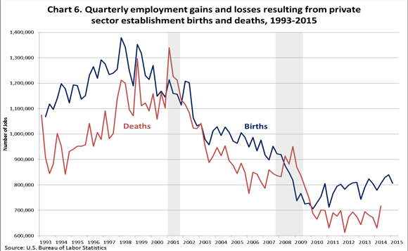
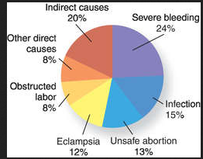
Real World Use of the Application
Medical research and scientists can use this application for their diagnosis
Government can make use of the application in census monitoring and population projections
Health and Wellness indicator
Mortality statistics provide information about the nature and efficacy of health care delivery systems
The application can be of use to any normal person for general informative purpose
Epidemiological studies

Slide 6
THANK YOU!

