Slide 1
DEATH RATE FINDER
Ashwini Giri
Isha Patil

Slide 2
Functionalities
Web application to search information about death based on state.
Search can be filtered based on cause of death, year of death and number of deaths.
Data stored on google firebase cloud storage.
User login, signup and logout using the email authentication provided by firebase.
Save searches for future reference.
Contact Us page for addressing user queries.

Slide 3
Workflow
.
Implementation of user interface
Database storage
API
Implementing faceted search
User authentication & search history

Slide 4
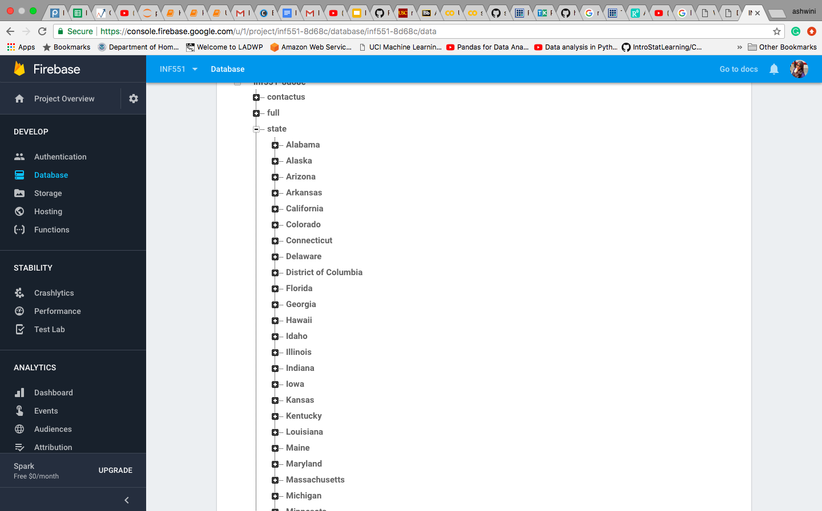
Database storage
The death data is fetched from https://catalog.data.gov/dataset/age-adjusted-death-rates-for-the-top-10-leading-causes-of-death-united-states-2013
The data is stored in firebase in the form of nodes and keys for easy access and search.
Created an inverted index on the state of death for implementation of search functionality.
DATA ATTRIBUTES-
Year {Facet}
Cause name {Facet}
Number of deaths {Facet}
Age adjusted death rate
Scientific cause name
State of death occurrence {Keyword search}

Slide 5
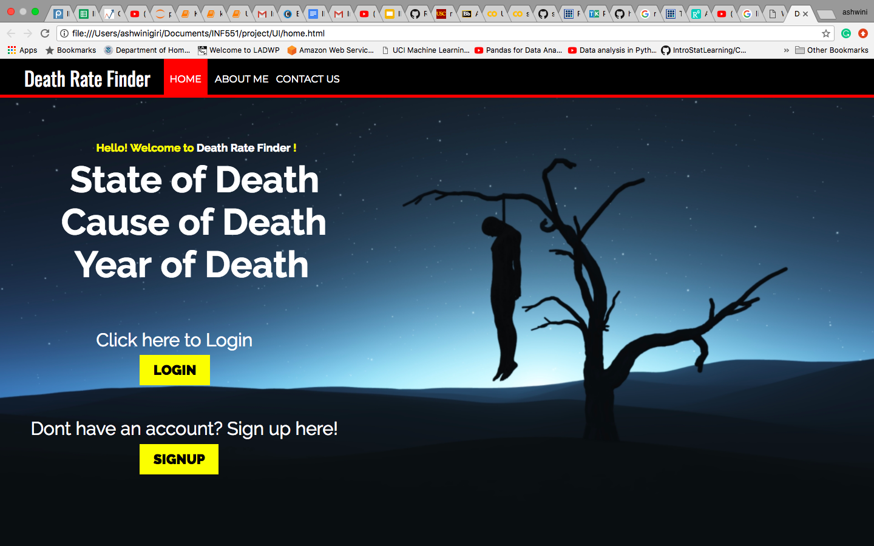
Home page & UI
Provided login and signup on the homepage.
The contact us page can also be addressed from the homepage.
The UI is implemented using basic HTML, CSS and JavaScript functions.

Slide 6
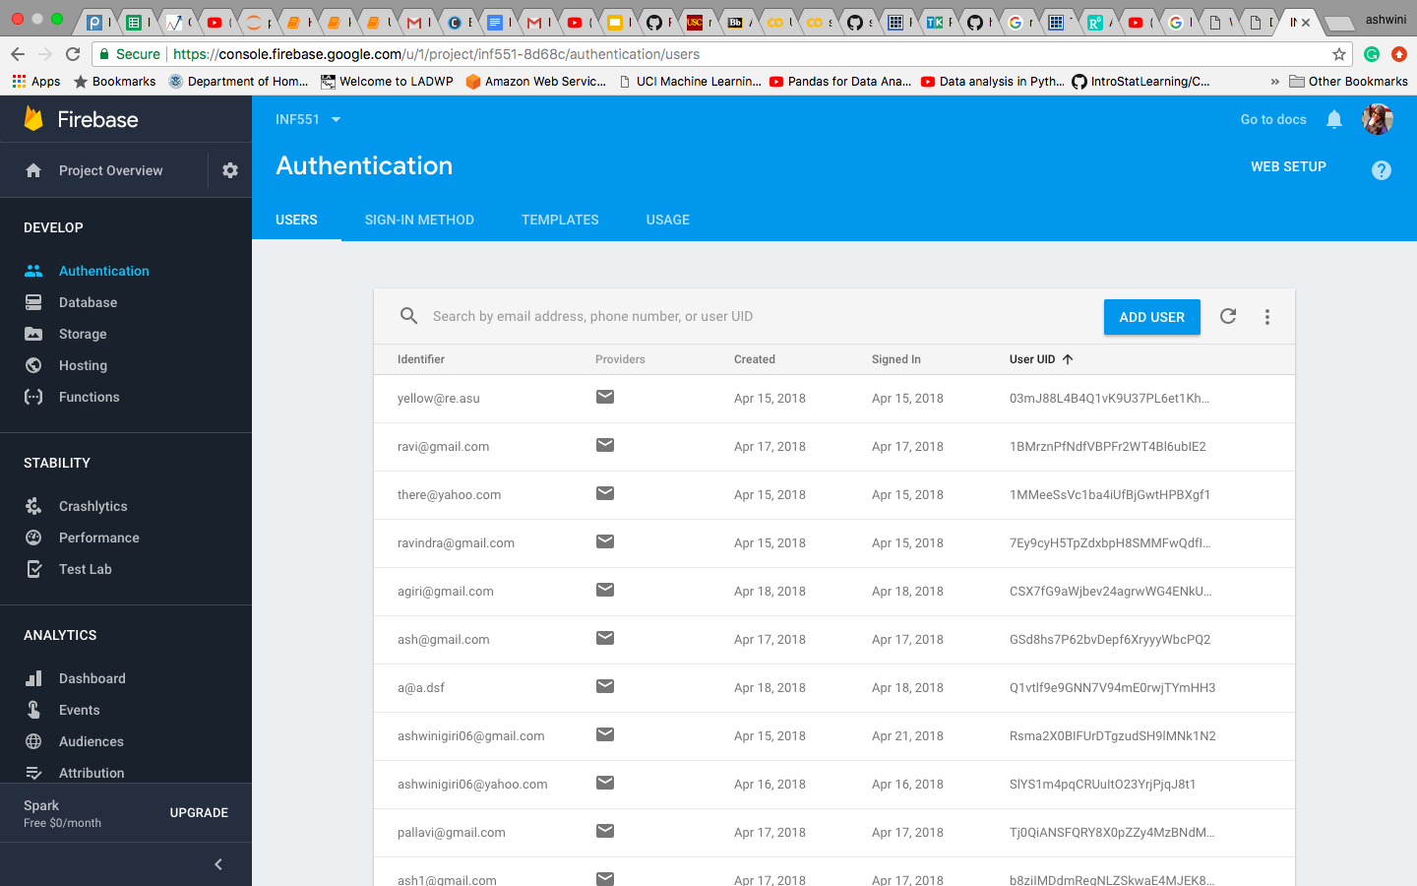
User Authentication
Users are authenticated using the email authentication provided by firebase.

Slide 7
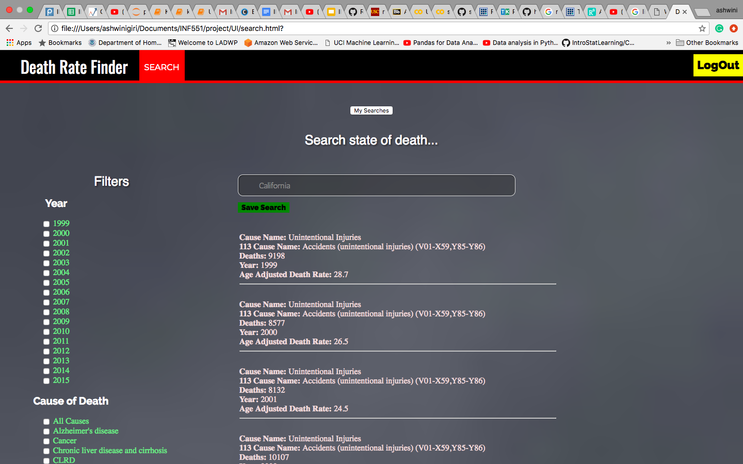
Faceted search
After user login the search provides 3 filters for data
Cause of death.
State of death.
Year of death/s.

Slide 8
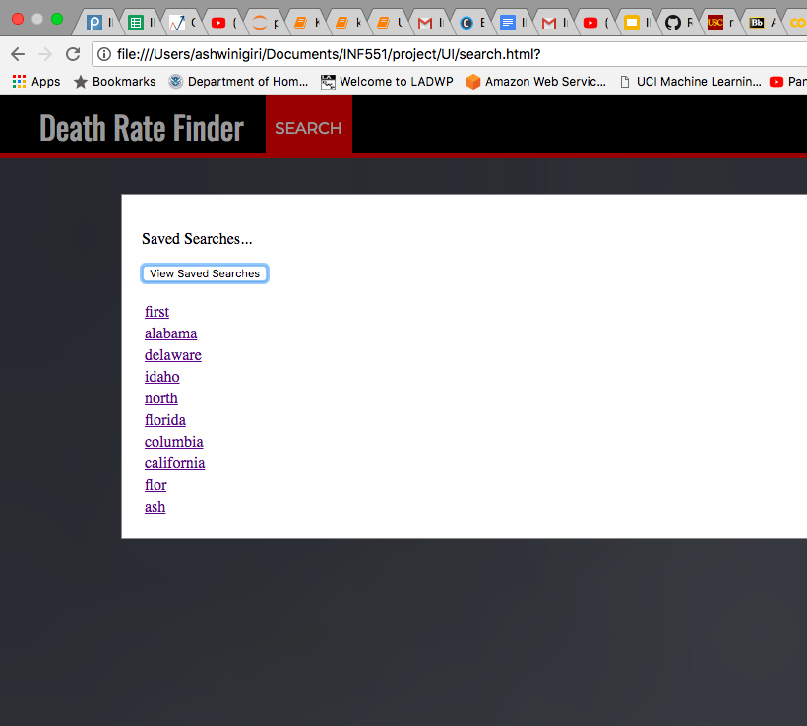
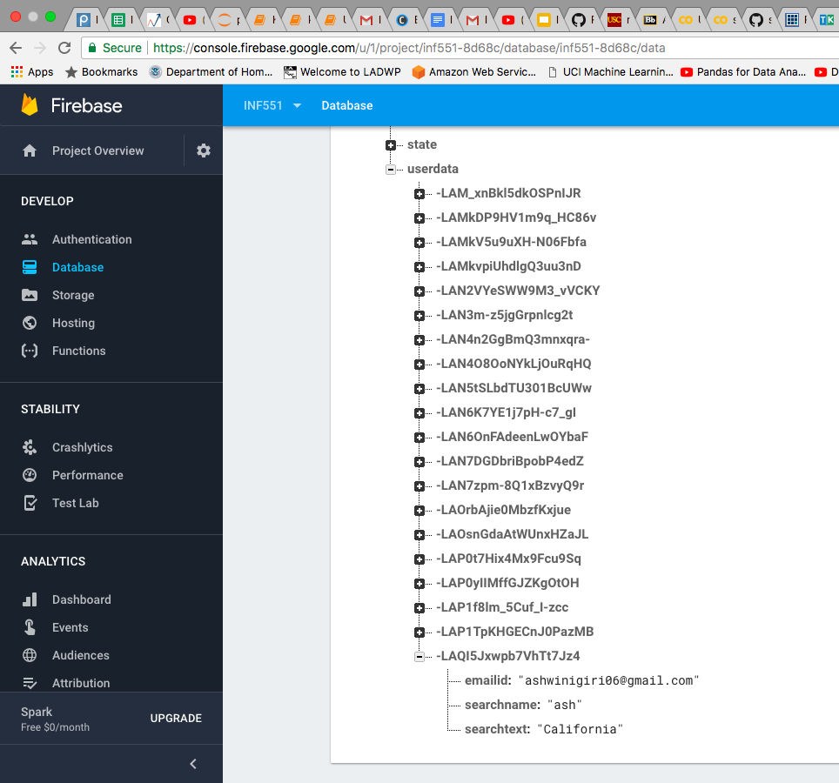
Save User Search History
The current logged in user can save the search and also retrieve already saved searches.
User’s search history is saved on firebase database.

Slide 9
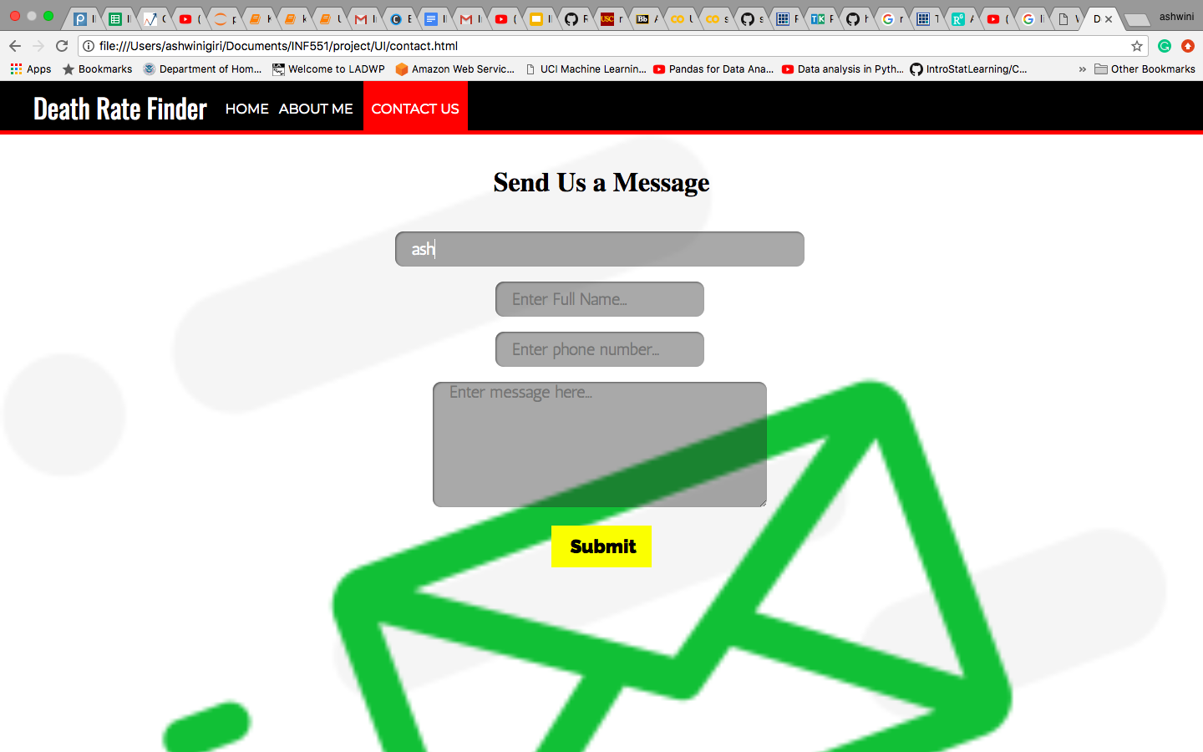
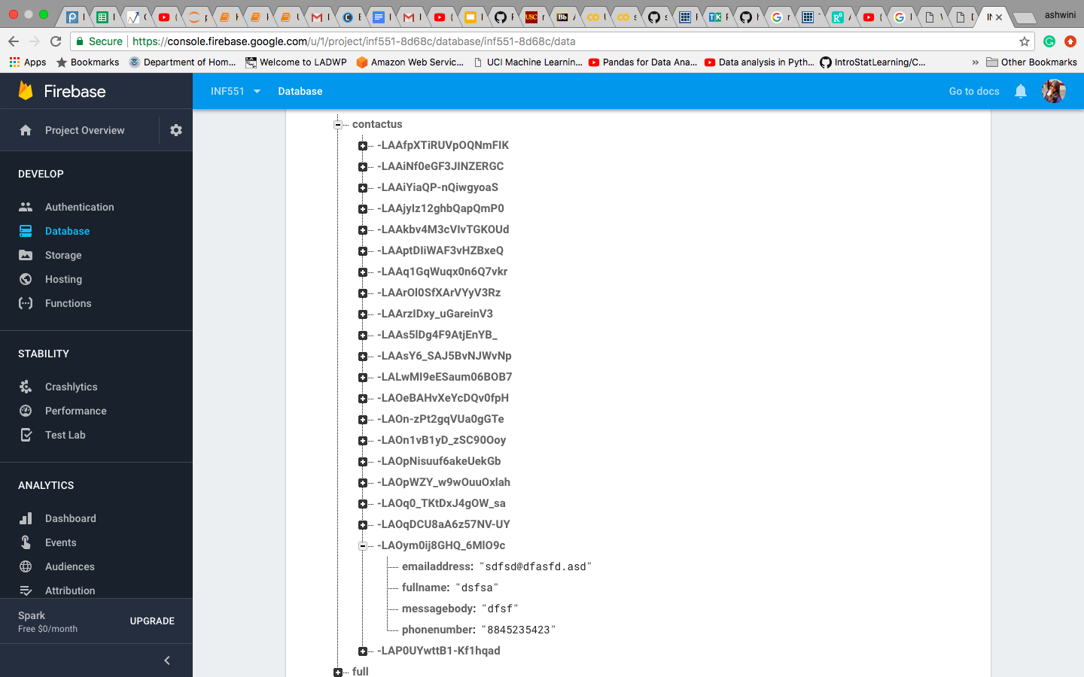
Contact Us
User can send their queries to the developer team.
Data is saved on firebase database.

Slide 10
Real World Use
Medical researchers may use this application for diagnosis.
Government may use the application for census monitoring and population information purposes (filter based on number of death)
Epidemiological surveys (filter based on cause of death)
The application may be used by general public for informative purposes
This application can be combined and used as a part of other applications.

Slide 11

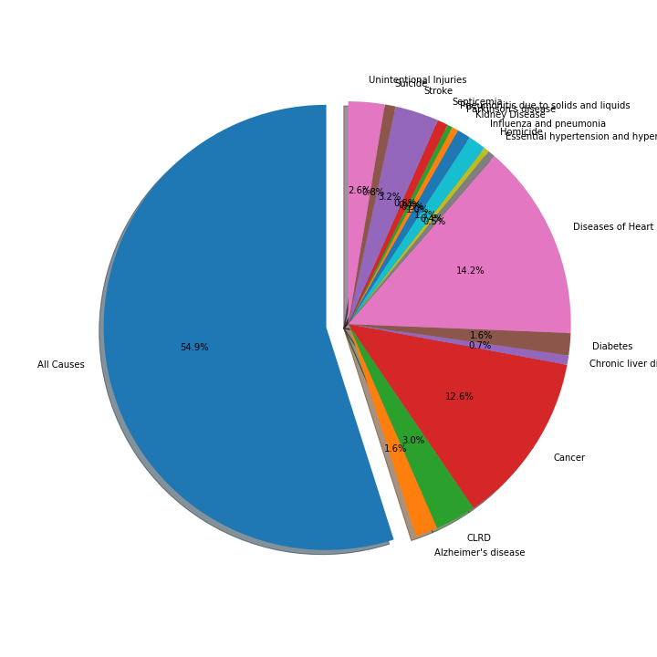
Some Data Inferences
Deaths by cause

Slide 12
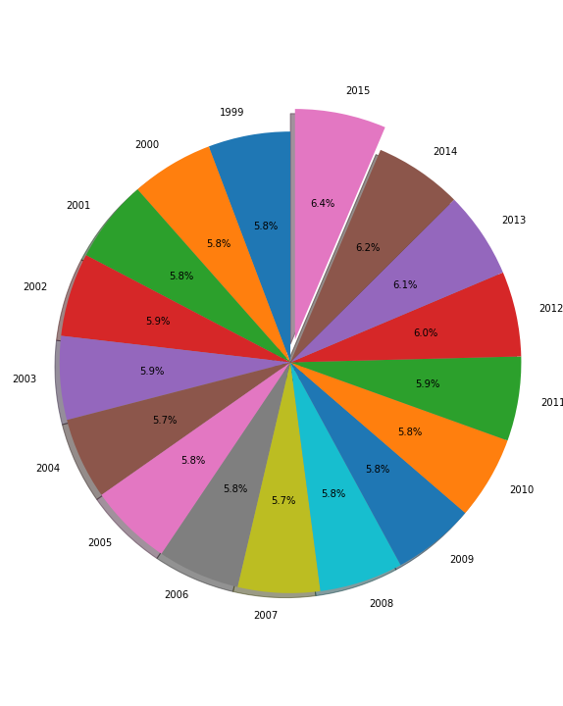
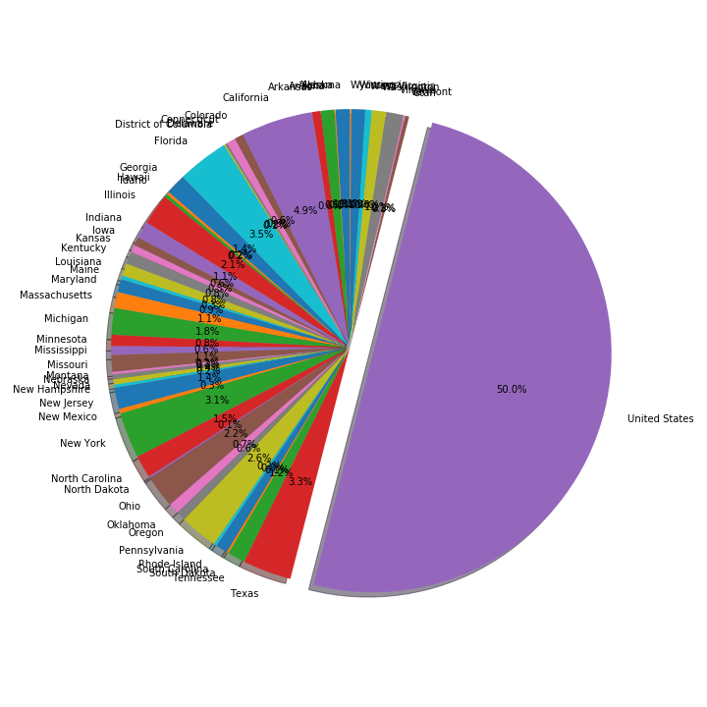
Deaths by years
Deaths by states

Slide 13
THANK YOU !!

