Slide 1
DEATH RATE FINDER
Ashwini Giri
Isha Patil

Slide 2
Functionalities
Web application to search information about death based on state
Search can be filtered based on cause of death, year of death and number of deaths.
Data stored on google firebase cloud storage.
User login, signup and logout using the email authentication provided by firebase
Save searches for future reference.
Contact Us for addressing user queries.

Slide 3
Workflow
Implementation of user interface
.
Database storage
API
Implementing faceted search
User authentication & search history

Slide 4
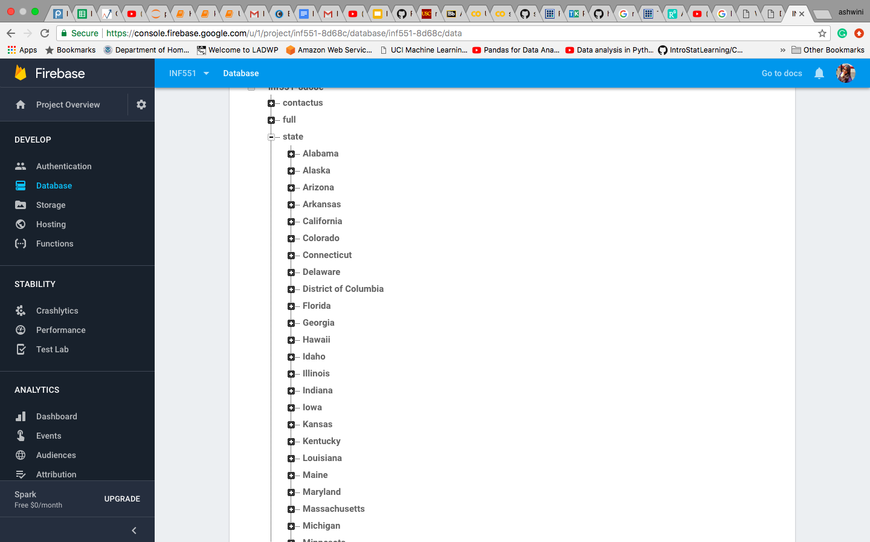
Database storage
The death data is fetched from https://catalog.data.gov/dataset/age-adjusted-death-rates-for-the-top-10-leading-causes-of-death-united-states-2013
The data is stored in firebase in the form of nodes and keys for easy access and search.
Created an inverted index on the state of death for implementation of search functionality.

Slide 5
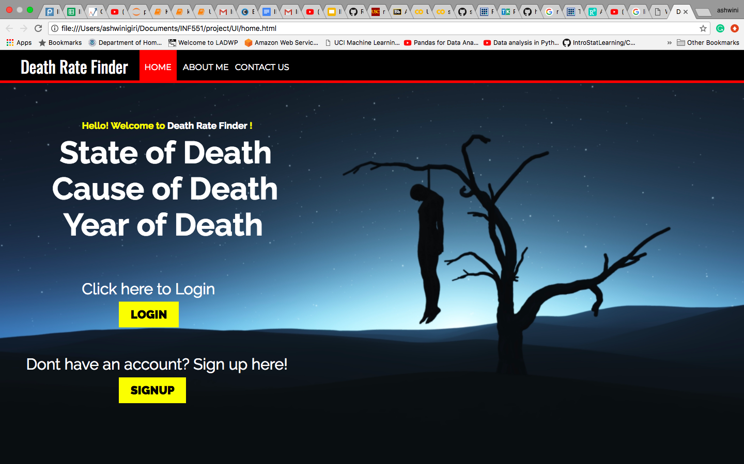
Home page & UI
Provided login and signup on the homepage.
The contact us page can also be addressed from the homepage
The UI is implemented using basic HTML,CSS and JavaScript functions

Slide 6
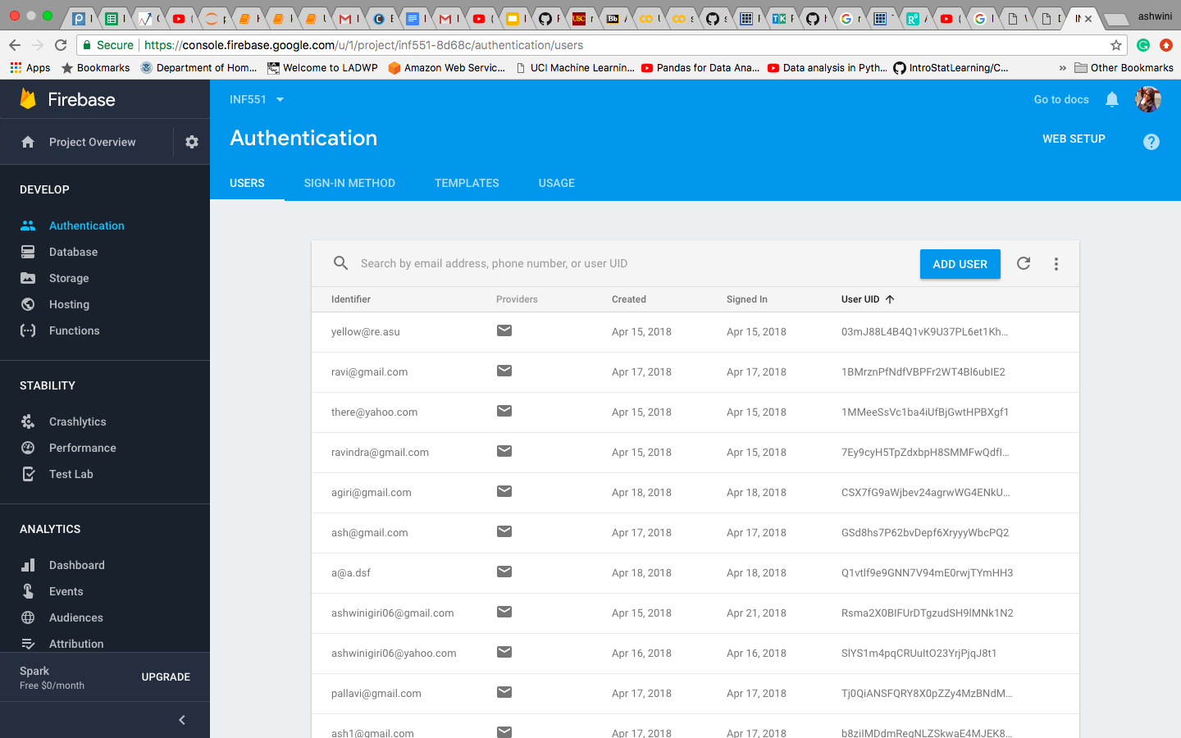
User authentication
Users are authenticated using the email authentication provided by firebase.

Slide 7
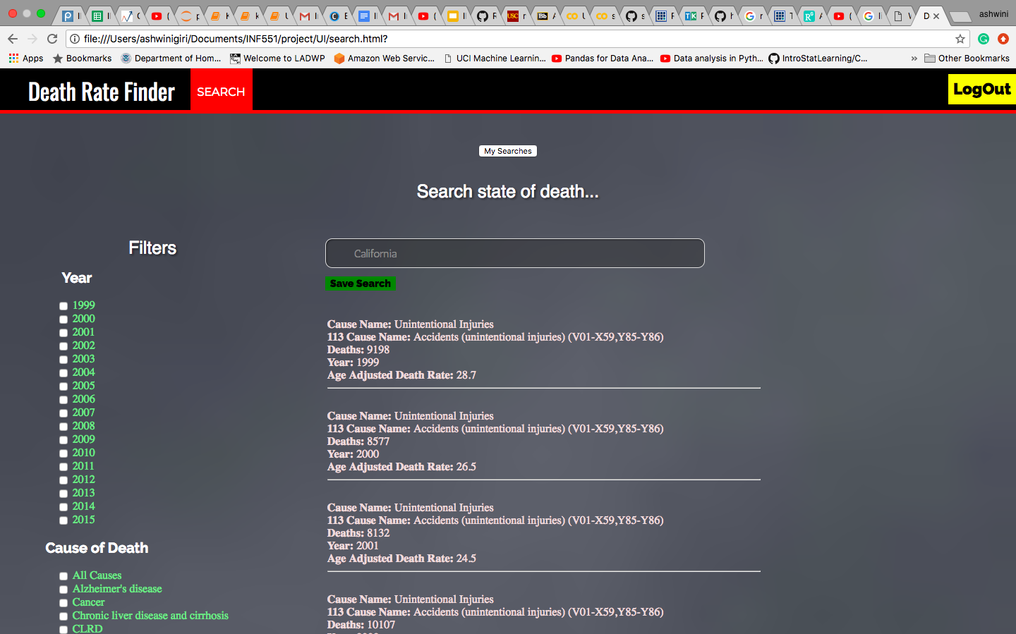
Faceted search
After user login the search provides 3 filters for data
Year
Cause of Death
Number of Deaths

Slide 8
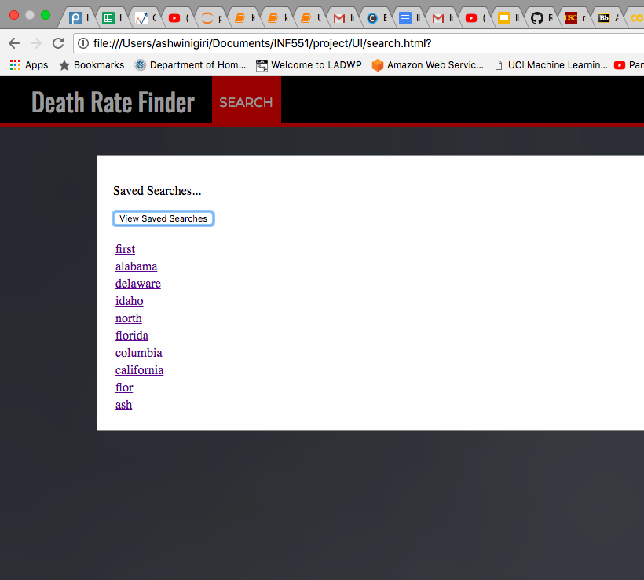
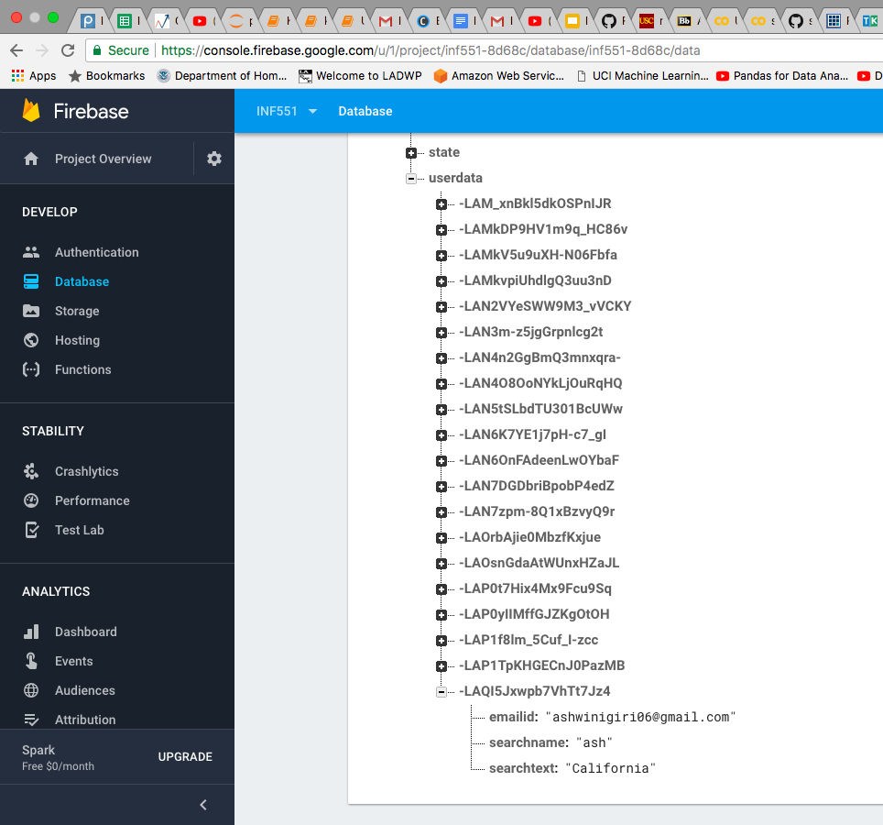
Save User search history
The current logged in user can save the search and also retrieve already saved searches.
User’s search history is saved on firebase database

Slide 9
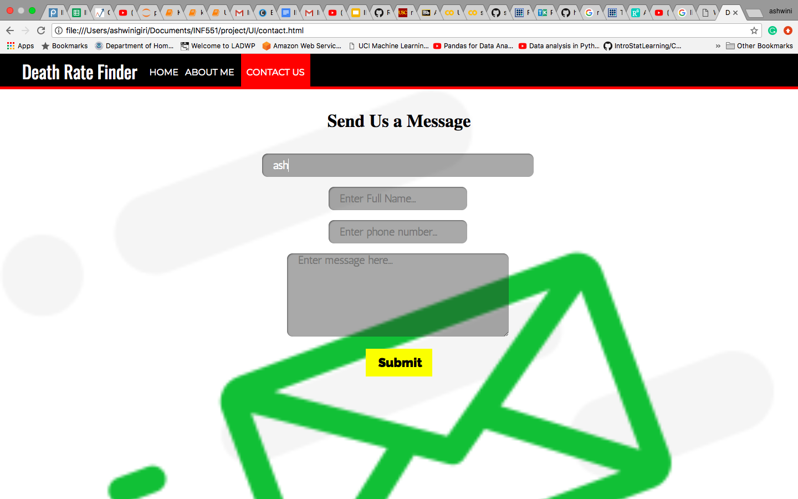
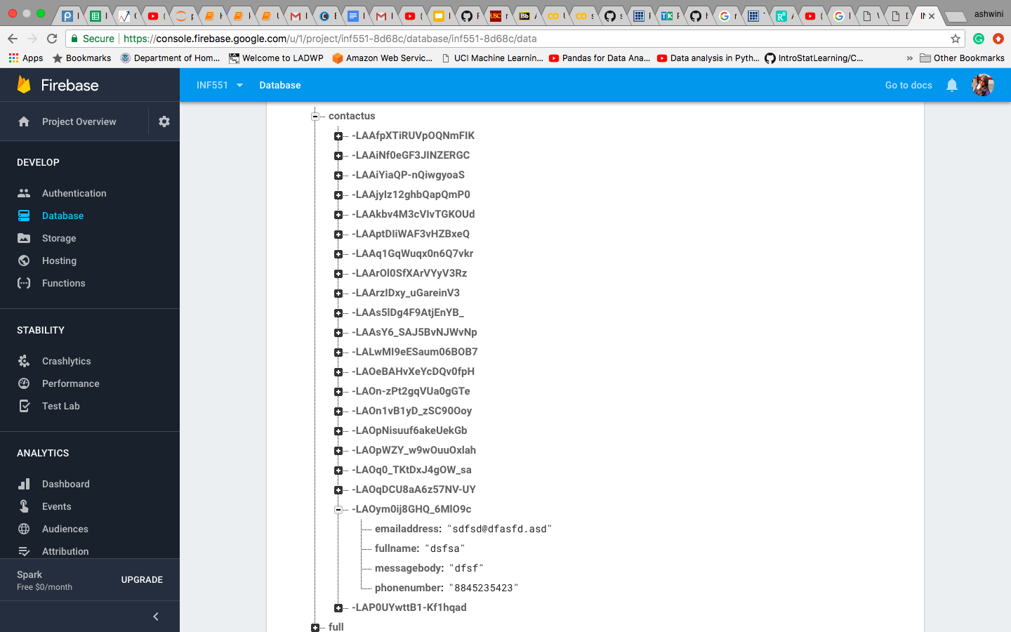
Contact Us
User can send their queries to the developer team.
Data is saved on firebase database

Slide 10
Real World Use
Medical researchers may use this application for diagnosis.
Government may use the application for census monitoring and population information purposes (filter based on number of death)
Epidemiological surveys (filter based on cause of death)
The application may be used by general public for informative purposes

