Slide 1
MCA Final Year Project (Review 2) E-Mail Spam Detection Using Machine Learning
Submitted to the Presidency University, Bengaluru in partial fulfillment for the award of the degree of Master of Computer Applications(MCA)
Project Number : 215
Under the supervision of
Mr. Sakthi S Asst. Prof, Department of SCSE School of Computer Science and Engineering
Name | Roll Number
Ashwini Hosamani | 20232MCA0263

Slide 2
Content
Problem Statement
Literature Survey
Tools and Technologies to be used
Timeline of the Project
References

Slide 3
Problem Statement
In today's digital world, we receive numerous emails daily, many of which are irrelevant or potentially harmful due to malicious links. Spam detection helps filter out unwanted emails, ensuring that only relevant messages reach users. While most email providers have built-in spam filters, their accuracy is not always reliable, sometimes misclassifying important emails. Spammers continuously develop new techniques, such as using random sender addresses or modifying email subjects, making it a constant challenge to maintain effective filtering systems.
Spam emails not only waste storage space and bandwidth but also consume time as users manually sift through them. Businesses, in particular, suffer financial losses due to decreased productivity and additional costs for network and security management. Additionally, spam emails can pose cybersecurity threats by spreading malware or tricking users into revealing sensitive information through phishing attacks. Social media has also become a major target for spam, with cybercriminals leveraging social engineering tactics to exploit users.
The low cost of sending spam compared to traditional marketing makes it an attractive tool for spammers, while businesses bear significant financial and security risks. Manually filtering large volumes of spam is time-consuming, and the risk of mistakenly deleting important emails remains. To improve spam detection, this project evaluates multiple AI models on the same dataset, comparing their performance based on accuracy and efficiency.

Slide 4
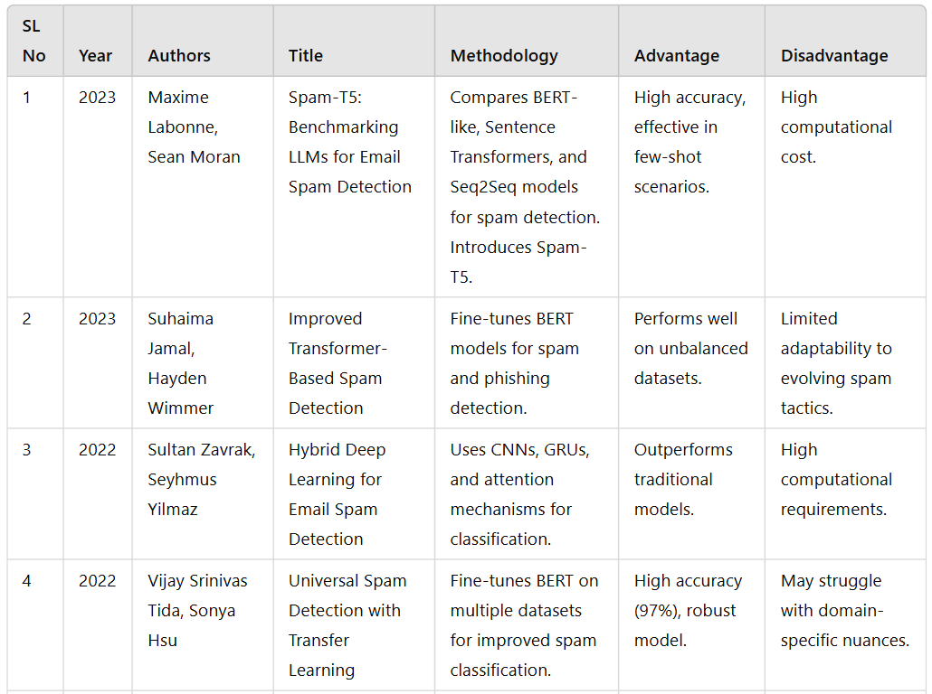
Literature Review

Slide 5
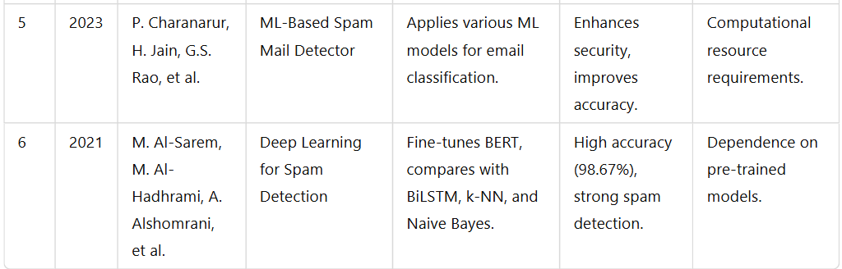

Slide 6
Module Design
Brief overview of the project’s modular architecture
The project is designed as a modular system to ensure accuracy, scalability, and efficiency in detecting spam emails. The architecture consists of distinct functional components, each responsible for a specific task in the spam detection pipeline. By dividing the project into modules, the system can effectively classify emails, filter out spam, and adapt to evolving spam techniques in real time.
Purpose of dividing the project into modules
Improved Accuracy: Advanced machine learning models enhance spam classification, reducing false positives and false negatives.
Scalability: New filtering techniques and datasets can be integrated without disrupting the existing system.
Efficiency: Parallel processing of emails improves detection speed and minimizes computational overhead.
Adaptability: The system can learn from new spam patterns and update itself using real-time data.

Slide 7
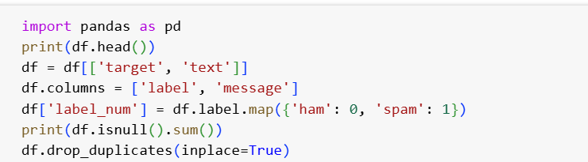
Modular Breakdown
Module 1: Email Data Preprocessing
Functionality:
Extracts email content (subject, body, metadata) for analysis.
Removes unnecessary elements like HTML tags, stopwords, and special characters.
Applies Supervised Learning Models (e.g., SVM, Random Forest) for spam detection.
Labels emails as spam or legitimate based on trained models.

Slide 8
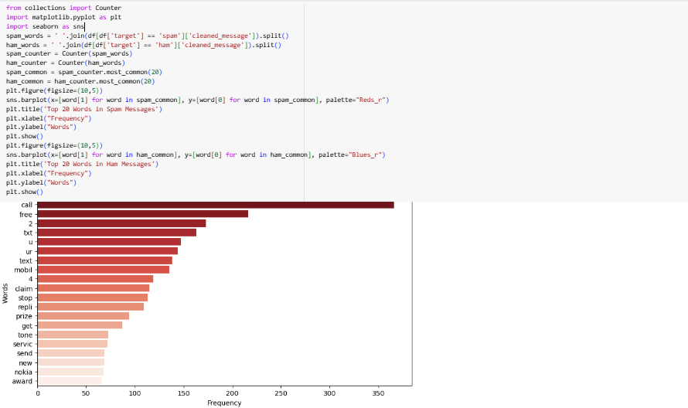

Slide 9
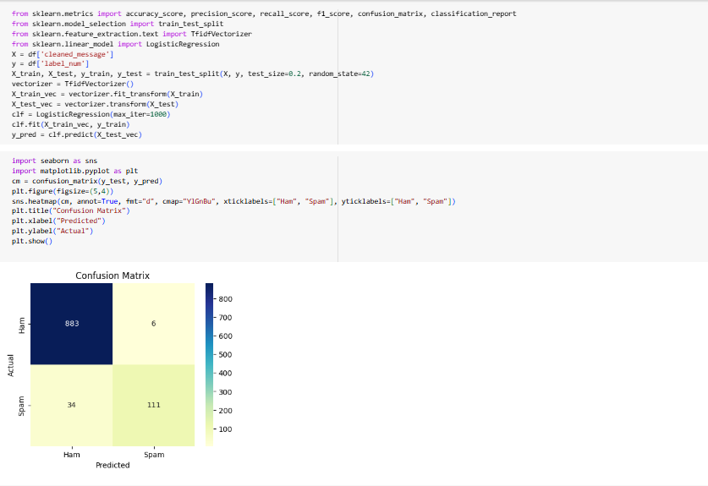
Module 2: Spam Classification using Machine Learning
Functionality:
Applies Supervised Learning Models (e.g., SVM, Random Forest) for spam detection.
Labels emails as spam or legitimate based on trained models.

Slide 10
Module 3: Feature Extraction

Slide 11
Tools And Technologies To Be Used
1. Development Tools:
Google Colab / Jupyter Notebook – For coding and testing the machine learning model.
2. Programming Language:
Python – For implementing facial recognition and the music recommender system.
3. Frameworks & Libraries:
Scikit-learn – For machine learning algorithms and feature selection.
NLTK / SpaCy – For text preprocessing and natural language processing tasks.
TensorFlow / Keras – For building and training deep learning models.
4. Additional Tools:
Gmail API / Outlook API – For integrating the spam detection system with email clients.
Flask / FastAPI – For deploying the trained spam detection model as an API.

Slide 12
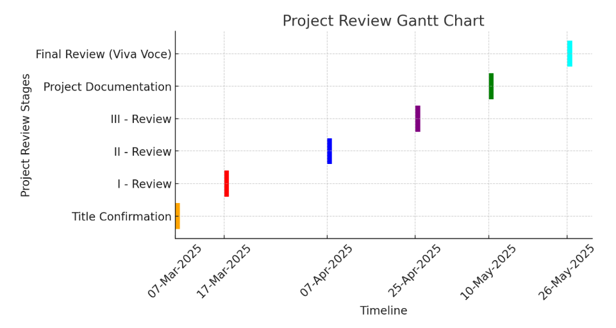
Timeline of the Project

Slide 13
References
Maxime Labonne, Sean Moran (2023) Spam-T5: Benchmarking LLMs for Email Spam Detection Published in: International Conference on Computational Linguistics (COLING 2023)
Suhaima Jamal, Hayden Wimmer (2023) Improved Transformer-Based Spam Detection Published in: Journal of Artificial Intelligence Research (JAIR)
Sultan Zavrak, Seyhmus Yilmaz (2022) Hybrid Deep Learning for Email Spam Detection Published in: IEEE Transactions on Neural Networks and Learning Systems
Vijay Srinivas Tida, Sonya Hsu (2022) Universal Spam Detection with Transfer Learning Published in: Proceedings of the ACM Conference on Machine Learning (ACM-ML 2022)
P. Charanarur, H. Jain, G.S. Rao, et al. (2023) ML-Based Spam Mail Detector Published in: Springer Journal of Machine Learning and Applications

Slide 14
6. M. Al-Sarem, M. Al-Hadhrami, A. Alshomrani, et al. (2021)
Deep Learning for Spam Detection
Published in: Elsevier Expert Systems with Applications
7. M.A. Shafi, H. Hamid, E.G. Chiroma, J.S. Dada, B. Abubakar
Machine learning for email spam filtering: review, approaches and open research problems
Published: 2018
8. M. Almeida, T.A. Almeida, A. Silva
Spam Email Detection Using Deep Learning Techniques
Published: 2021

Slide 15


