Slide 1

Team HEXA_BYTE
Ministry/Organization: Central Water Commission, Ministry of Jal Shakti
Problem Statement: Embankment Mapping and Crowd sourced Health Card for Preventive Structural Measures
Team Leader: Vaishnavi Jagtap
Problem Code: SK153
College Code: 1-3508432684

Slide 2
Problem Statement
The inspection and monitoring of health of embankment for preventive maintenance is a massive and intensive exercise which has huge financial ramifications. The manpower requirements for effectively carrying out such an important exercise is very high keeping in view large number of embankment protection works across river networks which are not easily accessible at times. Therefore, preventive maintenance of embankments needs a technological solution involving participation of locals to safeguard the public property and life.
One such solution may be through the use of embankment mapping and crowd sourced health card. Embankment mapping involves the development of GIS application to analyze the existing river embankment network. The crowd sourced data with images, Geo-location and time stamp can be used for the generation of health card of embankment and identifying the critical sections thereof for their preventive maintenance.
- Organization Central Water Commission, Ministry of Jal Shakti

Slide 3
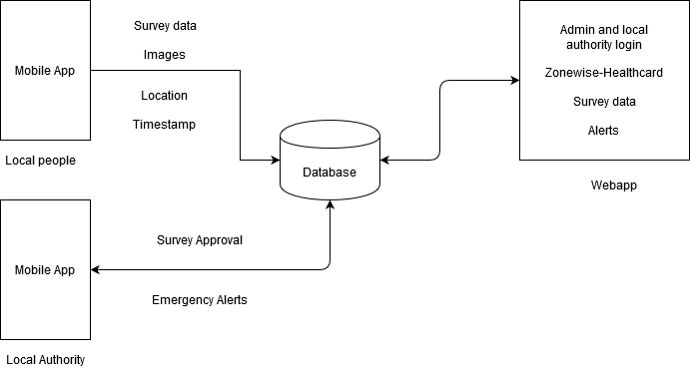
Work Flow Diagram

Slide 4
Literature Survey
An embankment(levee) is an artificial bank built along banks of a river for the purpose of protecting adjacent land from inundation by flood .Such type of structure is also called ‘embankment’, ‘stop-bank’, ‘bund’ or ‘dyke’.
Construction of embankment to control flood is an age-old practice and is still being followed due to its proven suitability.
Understanding the characteristics of an embankment, types of embankments, principal features of an embankment, general guidelines for inspection.
Factors affecting the health of embankment such as seepage, cracking, instability, sinkholes, depressions, vegetation and maintenance concerns have been identified.
References: [1]IS 12094: Guidelines for Planning and Design of River Embankment (Levees) [2]Inspection of Embankment Dams

Slide 5



Technology Stack
Applications: Flutter sdk ,ArcGIS
Flask, Python
HTML, CSS, javascript, jquery
Database: MongoDB

Slide 6
DAY 1
For Mobile App:
1. Local Authority Login
2. Collection of Survey data
For Web App:
Admin module
Login and Registration module for local authority.

Slide 7
DAY 2
For Mobile App:
Approval of surveys from local authorities
For Web App:
Depicting of base map
Calculation of distances and marker points
Depiction of embankments and water bodies

Slide 8
DAY 3
For Mobile App:
Survey module for admin
For Web App:
Zone creation module
Depiction of healthcard
Depiction of number of surveys on healthcard

Slide 9
Thank You
- Team Hexa_Byte

