Slide 1
Vehicle Insurance Management System
Name: Ashwini R
Trainer: Javeed

Slide 2
Introduction
A web-based application to manage vehicle insurance processes.
Automates policy creation, claims, and premium calculation.
Provides secure and user-friendly interface for customers and admins

Slide 3
Objectives
Simplify insurance policy management
Automate claim processing
Ensure secure authentication using JWT
Provide real-time premium calculation
Improve user experience with responsive UI

Slide 4
Technologies Used
Frontend:
React.js
Redux Toolkit
Axios
Backend:
Spring Boot
Spring Security (JWT)
Spring Data JPA
Database:
MySQL

Slide 5
Key Features
User Registration & Login
JWT-based Authentication (30 min session expiry)
Policy Management
Premium Calculation
Claim Handling System
Email Notification Service
Role-based Access (Admin/User)

Slide 6
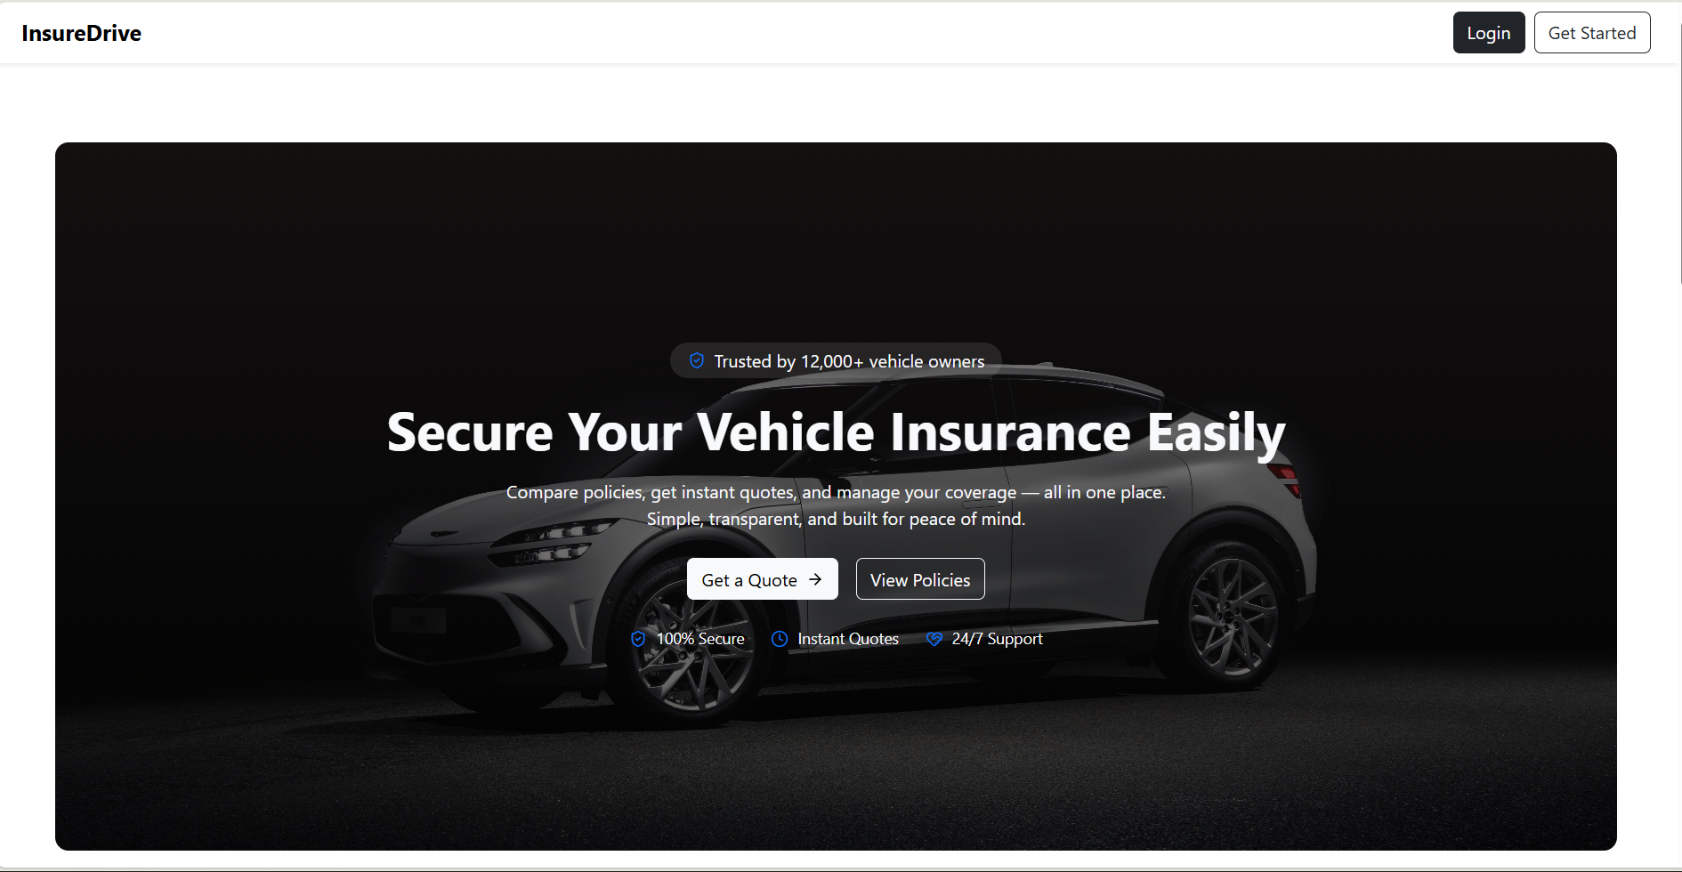

Slide 7
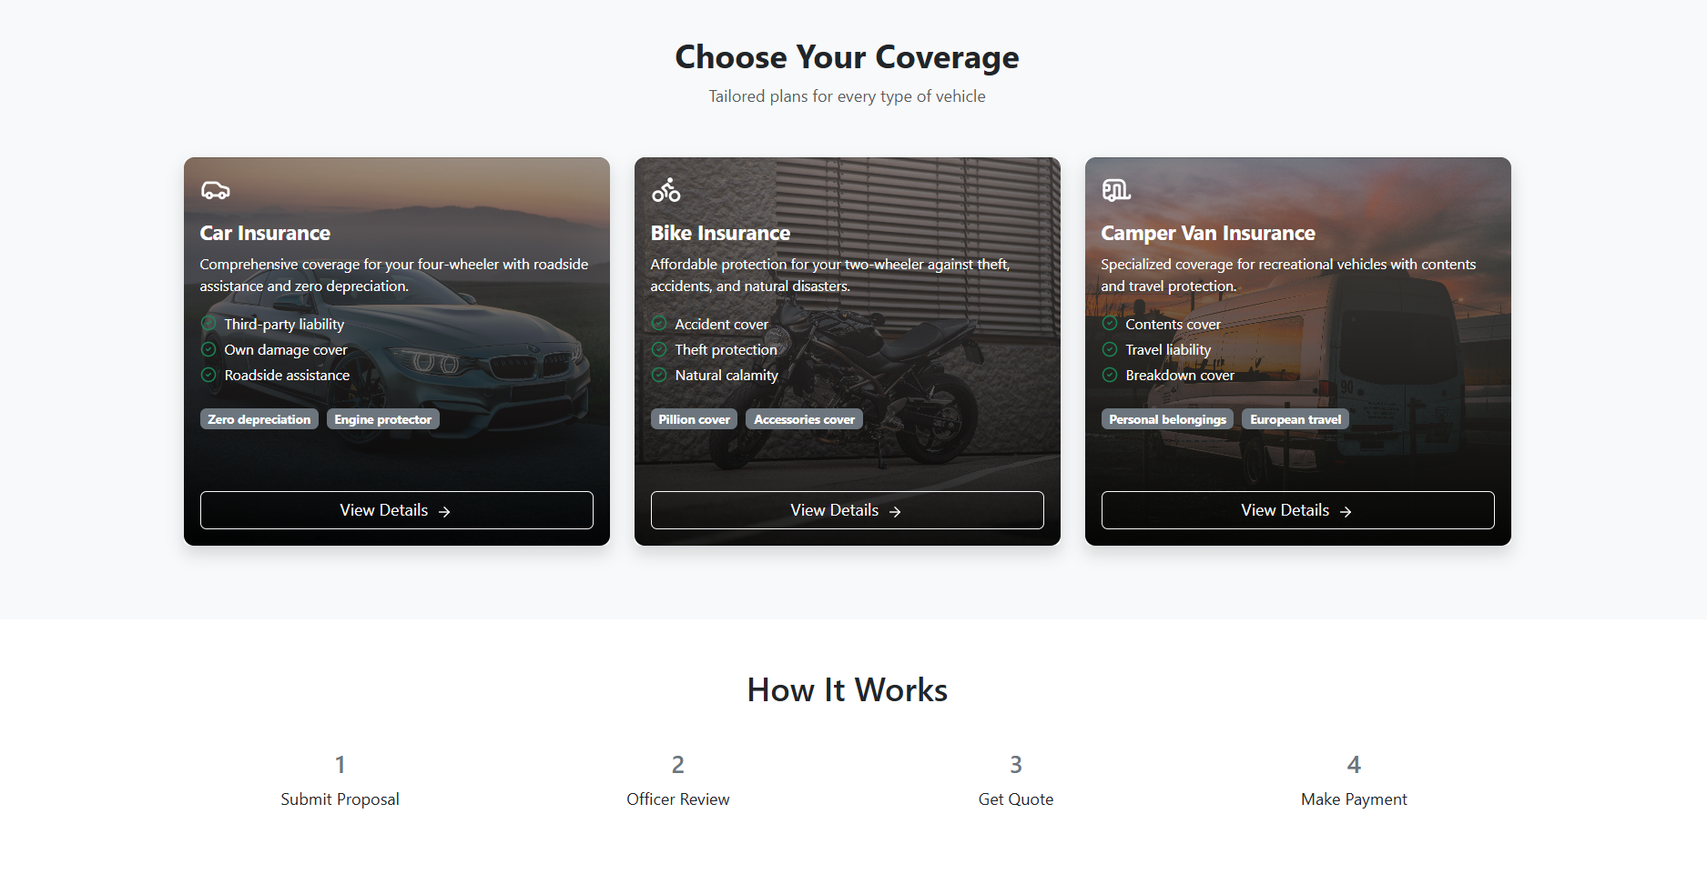

Slide 8
Modules
User Module
Policy Module
Proposal Module
Claim Module
Payment Module

Slide 9
Claim Management
Only one active claim allowed per policy
Tracks claim status (Pending / Approved / Rejected)
Prevents duplicate claims
Improves system reliability

Slide 10
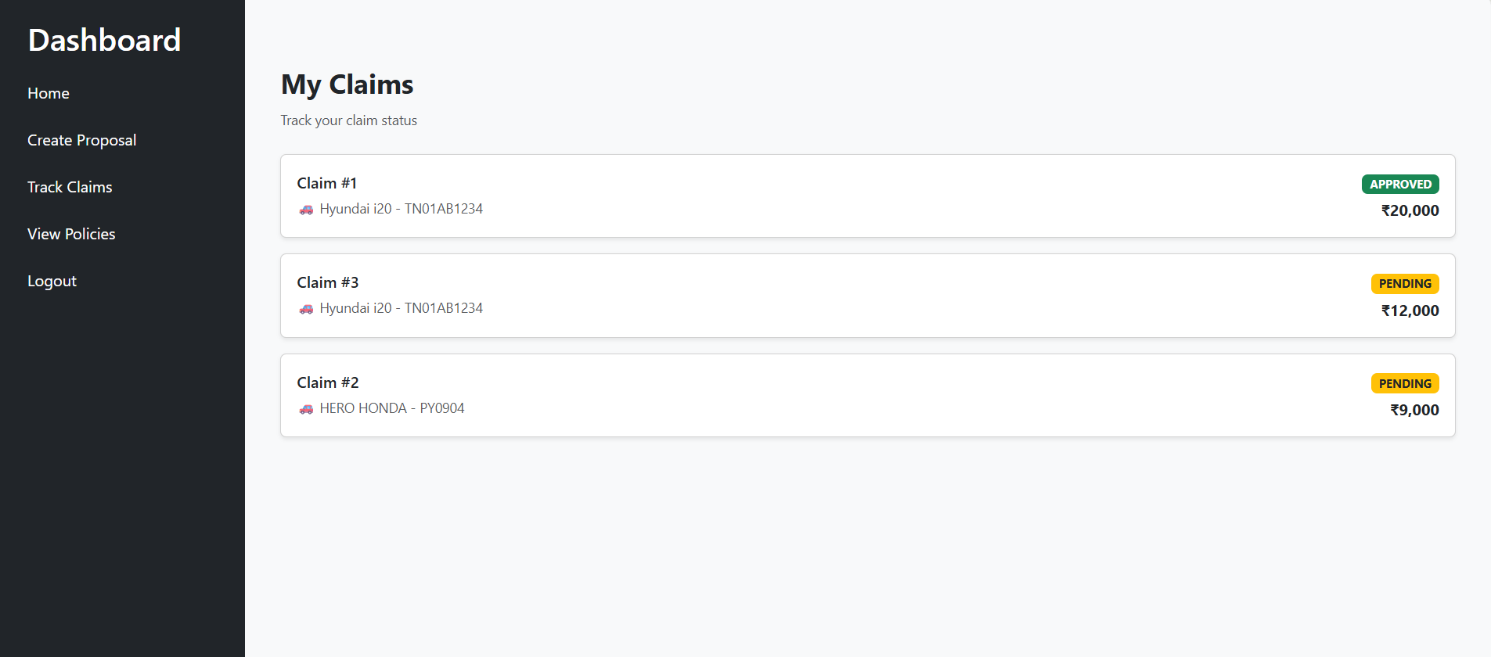

Slide 11
Security Implementation
JWT Token Authentication
Token expires in 30 minutes
Axios Interceptor used to:
Attach token automatically
Handle session expiry

Slide 12
Backend Features
RESTful APIs
DTO & Exception Handling
Validation implemented
JUnit Test Cases for services
Lombok for cleaner code

Slide 13
Frontend Features
Responsive UI using React
State management using Redux Toolkit
API integration using Axios
Navigation using React Router

Slide 14
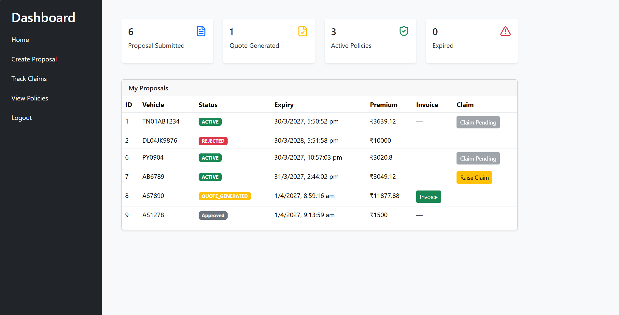
Dashboard

Slide 15
Database Design
Tables: User, Policy, Claim, Proposal, UserPolicy
Relationships maintained using foreign keys
Constraints added for data integrity

Slide 16
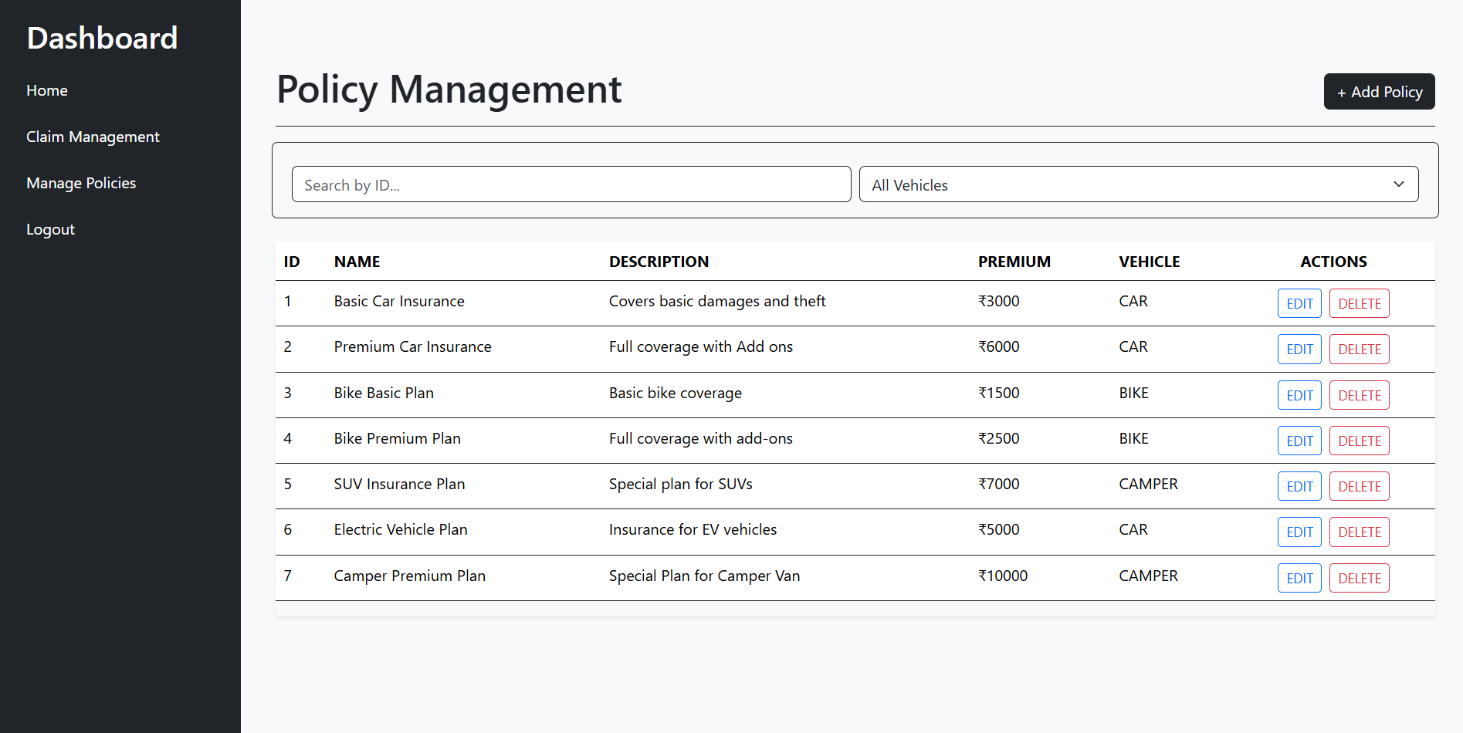

Slide 17
Conclusion
Successfully built a full-stack insurance system
Improved automation and security
Gained hands-on experience in real-world application development

Slide 18
THANK YOU

