Slide 1
Privacy-Aware Tag Recommendation for Image Sharing
Ashwini Tonge,
Cornelia Caragea
And
Anna Squicciarini

Slide 2
Outline
Why Image Privacy Prediction?
Background & Motivation
Proposed Approach
Dataset
Experiments and Results
Evaluation by Privacy Prediction
Cold start problem
Proposed approach vs. prior works
Quality Assessment of Recommended Tags
Conclusions & Future Directions

Slide 3
Outline
Why Image Privacy Prediction?
Background & Motivation
Proposed Approach
Dataset
Experiments and Results
Evaluation by Privacy Prediction
Cold start problem
Proposed approach vs. prior works
Quality Assessment of Recommended Tags
Conclusions & Future Directions

Slide 4

Why Image Privacy Prediction?
Rapid increase in social media cause threat to user’s privacy.
Many users share many private images without realizing the consequences of an unwanted disclosure.
Users rarely change default privacy settings, which could jeopardize their privacy.
Current social networking sites do not assist users in making privacy decisions.
Manually assigning privacy settings to each image can be cumbersome.
Image Privacy Prediction suggests privacy setting for images and can help avoid a possible loss of users’ privacy.

Slide 5
Outline
Why Image Privacy Prediction?
Background & Motivation
Proposed Approach
Dataset
Experiments and Results
Evaluation by Privacy Prediction
Cold start problem
Proposed approach vs. prior works
Quality Assessment of Recommended Tags
Conclusions & Future Directions

Slide 6
Motivation - I
Prior works [Zerr et al. 2012; Squicciarini et al. 2014, 2017; Tonge et al. 2016, 2018] on privacy prediction found that the tags associated with images are indicative of their sensitive content.
Tags are also important for image-related applications such as indexing, sharing, searching, content detection and social discovery.
Yet, the tags are at the sole discretion of users, and hence, they tend to be noisy and incomplete.
Many approaches to automatic image tagging have been developed.
However, these approaches do not consider the privacy aspect of an image while making the annotations and could not be sufficient for identifying images’ private content.

Slide 7
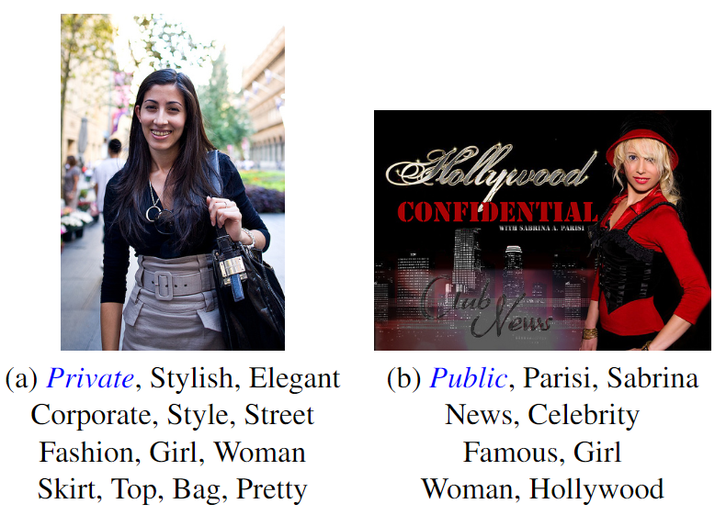
Motivation - II
Private: Private sphere (like self-portraits, family, friends, someone's home) or contain information that one would not share with everyone else (such as private documents).
Public: the remaining images.

Slide 8
Objective
Can we develop an automated approach to recommend accurate image tags that can also take into account the sharing needs of the users for images in questions?
Can this method make precise tag recommendations for newly uploaded images that have an incomplete set of user tags or no tags at all?
Can these recommended tags help improve the privacy prediction performance?

Slide 9
Contributions
Present a privacy-aware approach to image tagging.
Improve the quality of user tags.
Preserving the images’ original privacy sharing patterns.
Recommends potential tags for a target image by mining privacy-aware tags from the most similar images of a target image from a large collection.
To evaluate the recommended tags, we employ crowd-sourcing to identify relevancy of the suggested tags to images.
Although the user-input tags comprise noise or even some images do not have any tags at all, our approach is able to recommend accurate tags.
Investigate tag recommendation in a binary privacy setting.
Show that the predicted tags can exhibit relevant cues for specific privacy settings ( public or private ).
Can be used to improve the privacy prediction performance.

Slide 10
Background
Automatic Tag Recommendation
Many approaches to automatic image annotation have been proposed.
Chen et al. 2013 proposed an approach called “FastTag” to image annotation.
The authors learned two classifiers to predict tags:
one that reconstructs the complete tag set from the tags available during training
the other that maps image features to the reconstructed tag set.
We consider FastTag as one of our strong baselines.
Online Image Privacy
Tonge et al. 2016, 2018 automatically obtained image tags from the visual content using convolutional neural networks and also showed their performance for privacy prediction.
Yet, these tags depicted only objects or scenes given in the image and failed to capture the privacy characteristics of the image while generating the tags.

Slide 11
Outline
Why Image Privacy Prediction?
Background & Motivation
Proposed Approach
Dataset
Experiments and Results
Evaluation by Privacy Prediction
Cold start problem
Proposed approach vs. prior works
Quality Assessment of Recommended Tags
Conclusions & Future Directions

Slide 12
Privacy-aware Tag Recommendation
Our approach draws ideas from collaborative filtering (CF).
The analogy with conventional CF methods is that images correspond to users and tags correspond to items.
Base our models on the assumption that privacy-aware similar images possess similar tags.
Images can be represented using two different views or feature types:
image visual content
image tags

Slide 13
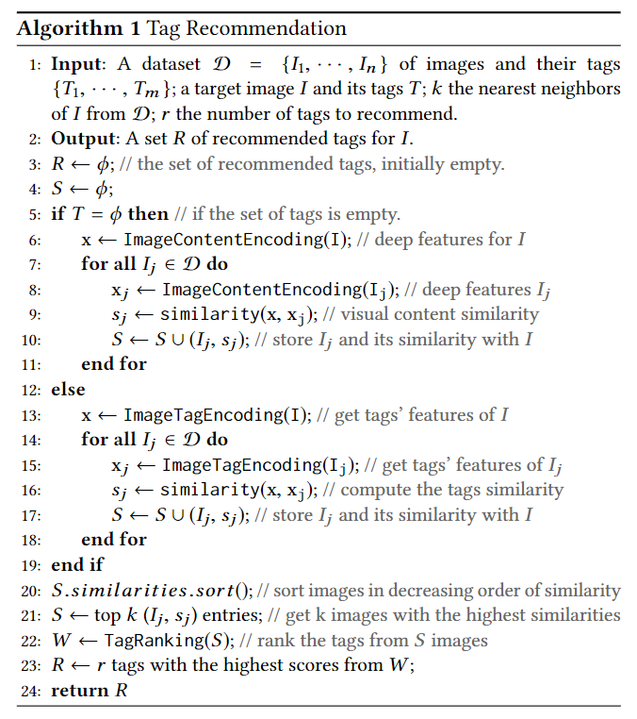
Algorithm

Slide 14
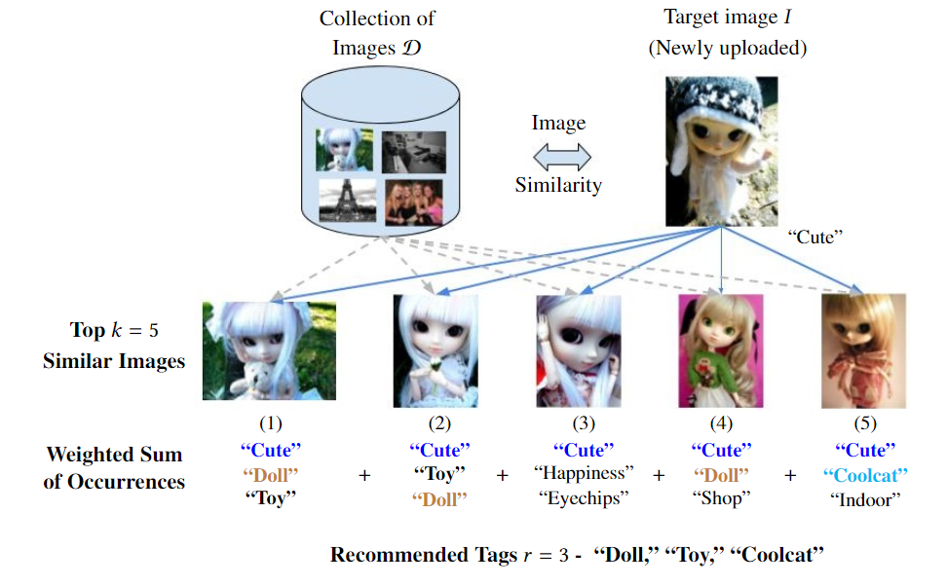
Algorithm Illustration - I

Slide 15
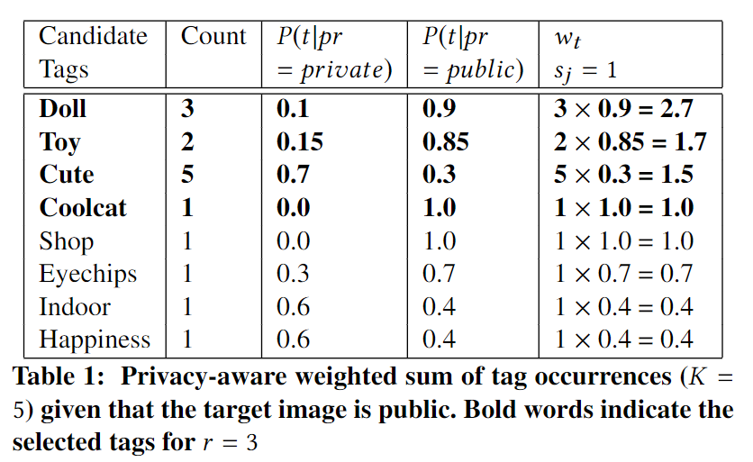
Algorithm Illustration - II

Slide 16
Outline
Why Image Privacy Prediction?
Background & Motivation
Proposed Approach
Dataset
Experiments and Results
Evaluation by Privacy Prediction
Cold start problem
Proposed approach vs. prior works
Quality Assessment of Recommended Tags
Conclusions & Future Directions

Slide 17
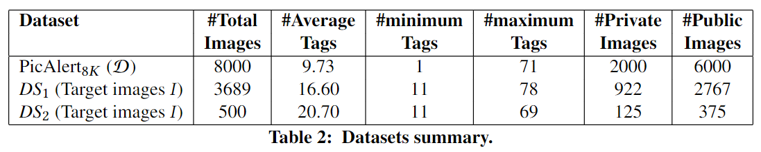
Dataset
Evaluated approach on the PicAlert dataset [Zerr et al. 2012].
Contains 32,000 Flickr images on various subjects.
Manually labeled as public or private by external viewers.
The public and private images are in the ratio of 3:1.

Slide 18
Outline
Why Image Privacy Prediction?
Background & Motivation
Proposed Approach
Dataset
Experiments and Results
Evaluation by Privacy Prediction
Cold start problem
Proposed approach vs. prior works
Quality Assessment of Recommended Tags
Conclusions & Future Directions

Slide 19
Experiments and Results
Quality of recommended tags is determined by:
whether these tags hint to specific image privacy settings.
whether these tags are good enough to describe the content of an image.
Adopt two evaluation mechanisms:
Examine the performance of models trained on the recommended tags combined with the original tags (when available) for privacy prediction.
Compare the recommended tags against the ground-truth, i.e., the hidden set of tags, and also evaluate their quality through crowd-sourcing.

Slide 20
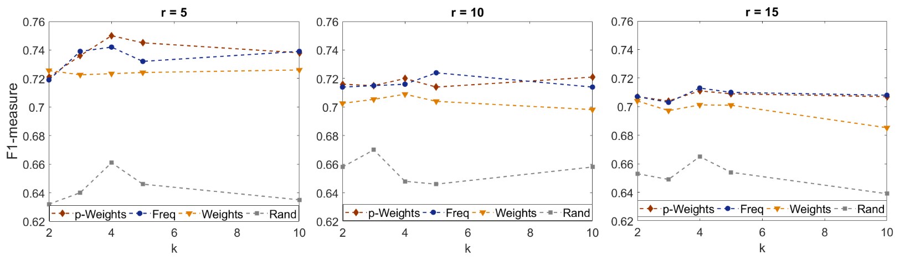
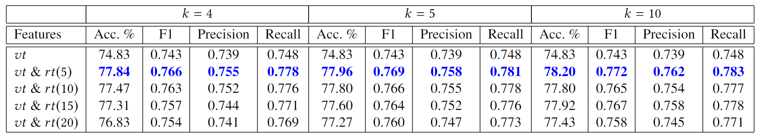
Evaluation by Privacy Prediction

Slide 21
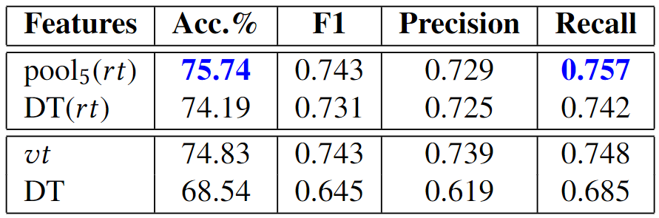
Cold Start Problem

Slide 22
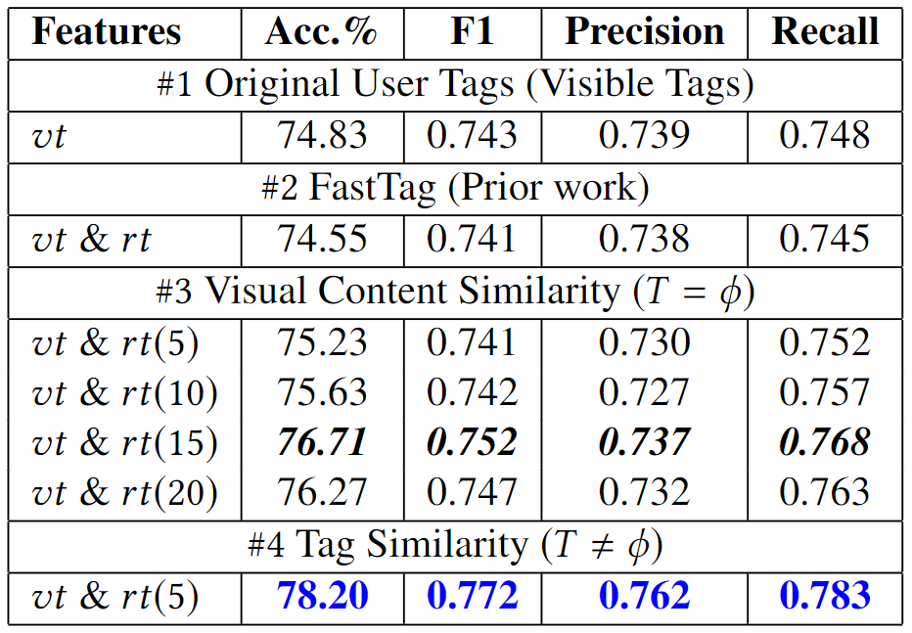
Proposed Approach Vs. Prior Work

Slide 23
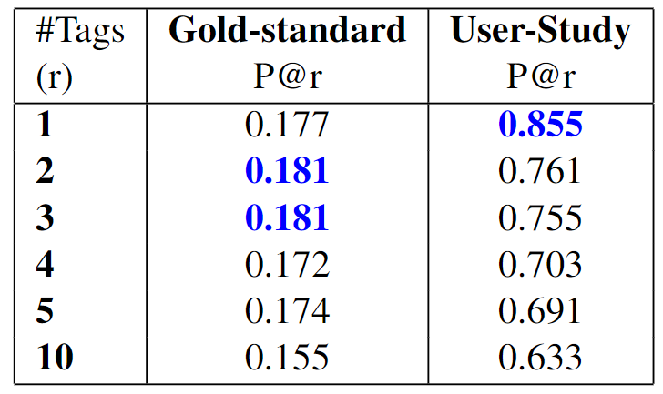
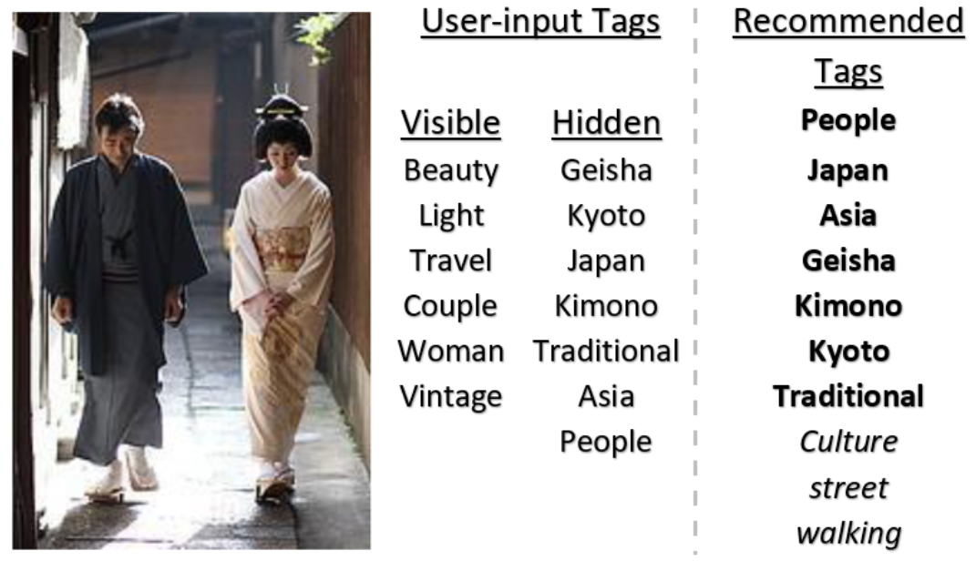
Quality Assessment of Recommended Tags

Slide 24
Outline
Why Image Privacy Prediction?
Background & Motivation
Proposed Approach
Dataset
Experiments and Results
Evaluation by Privacy Prediction
Cold start problem
Proposed approach vs. prior works
Quality Assessment of Recommended Tags
Conclusions & Future Directions

Slide 25
Conclusion & Future Directions
Improve the original set of user tags and preserve images’ privacy.
Draw ideas from collaborative filtering (CF).
Although the user-input tags are prone to noise, we were able to integrate them in our approach and recommend accurate tags.
Simulated the recommendation strategy for newly-posted images, which had no tags attached.
Challenging problem: the absence of items hinder the recommendations.
Achieved better performance for privacy prediction with recommended tags than the original set of user tags.
Indicate that the suggested tags comply to the image’s privacy.
Conducted a user evaluation of recommended tags to inspect the quality of privacy-aware recommended tags.
Results show that the proposed approach is able to recommend highly relevant tags.
Future directions
Multiple sharing needs of the user such as friends, family, and colleagues.
Computing images’ similarity by combining both tags and visual content.
Image-content features: scene and location.

Slide 26
References
Squicciarini, Anna C., Cornelia Caragea, and Rahul Balakavi (2014). “Analyzing Im-ages’ Privacy for the Modern Web”. In:Proceedings of the 25th ACM Conferenceon Hypertext and Social Media. HT ’14. Santiago, Chile: ACM, pp. 136–147. isbn:978-1-4503-2954-5.
Anna Squicciarini, Cornelia Caragea, and Rahul Balakavi. 2017. Toward Automated Online Photo Privacy. ACM Trans. Web 11, 1, Article 2 (April 2017), 29 pages.
Zerr, Sergej et al. (2012). “Privacy-aware image classification and search”. In:Proceedingsof the 35th international ACM SIGIR conference on Research and development ininformation retrieval. Portland, Oregon, USA: ACM.isbn: 978-1-4503-1472-5.
Kilian Q. Weinberger Minmin Chen, Alice Zheng. 2013. Fast Image Tagging. In ICML
Ashwini Kishore Tonge and Cornelia Caragea. 2016. Image Privacy Prediction Using Deep Features. In AAAI.
Ashwini Tonge and Cornelia Caragea. 2018. On the Use of "Deep" Features for Online Image Sharing. In Companion Proceedings of The Web Conference 1317–1321.
Ashwini Tonge, Cornelia Caragea, and Anna Squicciarini. 2018. Uncovering Scene Context for Predicting Privacy of Online Shared Images. In AAAI ’18.

Slide 27
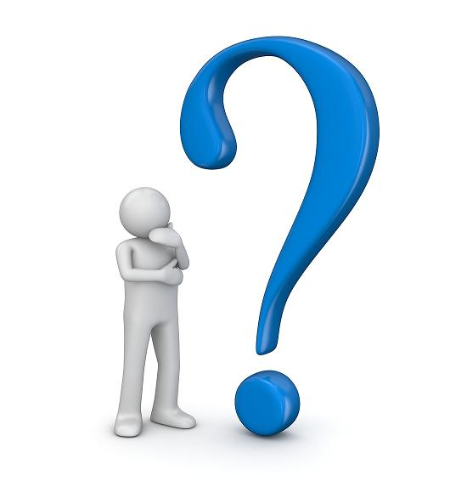
Thank you!
Please email your questions/suggestions at
atonge@ksu.edu
ccaragea@ksu.edu

Slide 28
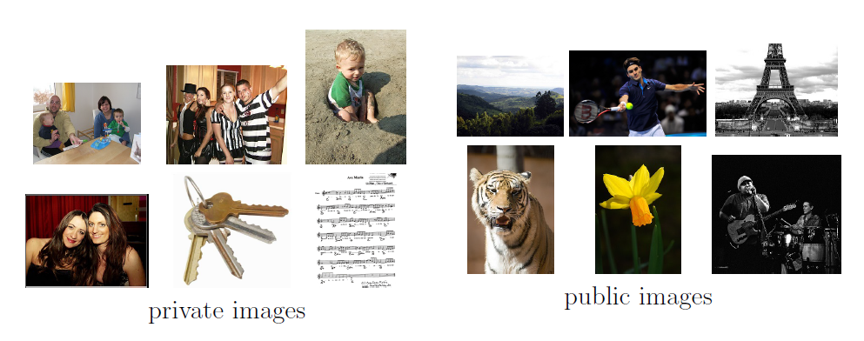
Examples of images manually identified as private and public

