Slide 1
Identifying Private Content for Online Image Sharing
Ashwini Tonge
Advisor: Dr. Cornelia Caragea
Committee: Dr. Doina Caragea, Dr. Daniel Andresen, Dr. Caterina Scoglio

Slide 2

Why Image Privacy Prediction?
Rapid increase in social media cause threat to user’s privacy.
Many users share many private images without realizing the consequences of an unwanted disclosure.
Users rarely change default privacy settings, which could jeopardize their privacy.
Current social networking sites do not assist users in making privacy decisions.
Manually assigning privacy settings to each image can be cumbersome.
Image Privacy Prediction suggests privacy setting for images and can help avoid a possible loss of users’ privacy.

Slide 3
Background
The feature representation used to encode the image data is crucial for the performance and the complexity of the learning algorithms.
Researchers explored binary prediction models of image privacy based on user tags and image content features such as SIFT (Scale Invariant Feature Transform) and RGB (Red Green Blue) (Zerr et al., 2012; Squicciarini, Caragea, and Balakavi, 2014).
More recently, Tran et al. (2016 ) and Tonge et al. (2016 ) investigated the use of features extracted from the fully connected layers of Convolutional Neural Networks (CNNs).
These features derived from CNNs pre-trained on millions of images are aimed at identifying the objects present in images and work remarkably well for image privacy prediction compared with traditional features such as SIFT and RGB.
Intuitively, the objects present in images greatly impact images' privacy.

Slide 4
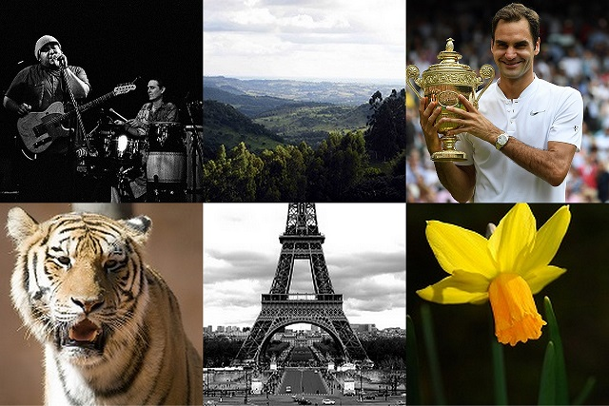
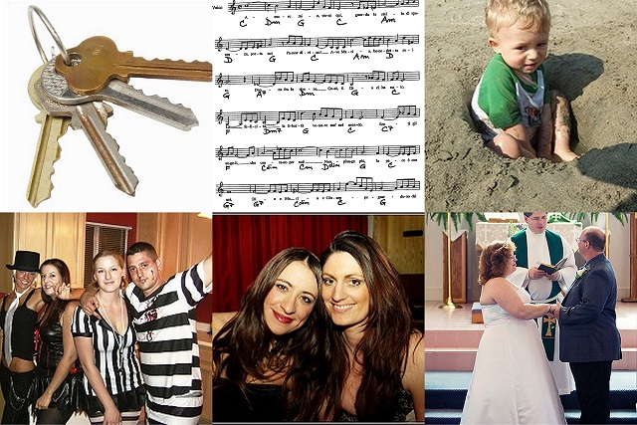
Examples of images manually identified as private and public
Public
Private

Slide 5
Research Objective
Can we generate a generic model that can provide prevalent privacy settings?
Can we leverage CNN to derive promising features that can identify private content in images shared online?
Do these features better discriminate between the public and private privacy classes than the existing features?
How well these features generalize over the unseen images?
Aim at deriving four types of features.
Deep features.
Semantic features.
Privacy-Aware user tags.
Fusion of multimodal features

Slide 6
Outline
Current Work
Deep features
Semantic features
Privacy-aware user tags
Results
Dataset
Experiments and Results
Research Plan
Fusion of multimodal features
Summary

Slide 7
Outline
Current Work
Deep features
Semantic features
Privacy-aware user tags
Results
Dataset
Experiments and Results
Research Plan
Fusion of multimodal features
Summary

Slide 8
“Deep” Features
Motivation:
CNN worked well.
Features extracted from pre-trained CNN is not entirely explored for privacy prediction.
The choice of the CNN architecture used in prior works is limited to AlexNet (Krizhevsky, Sutskever, and Hinton, 2012)
Given the strengths of deeper CNN architectures for object recognition (Szegedy et al., 2014; Simonyan and Zisserman, 2014), deeper feature representations exists.
Can these features potentially improve the performance of the image privacy prediction?

Slide 9
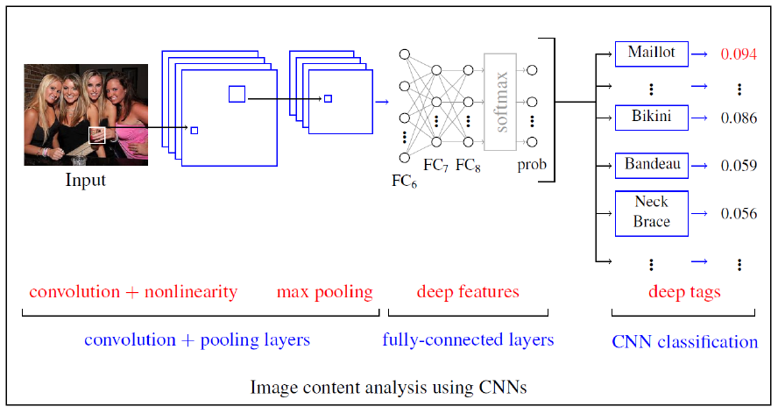
Feature Extraction

Slide 10
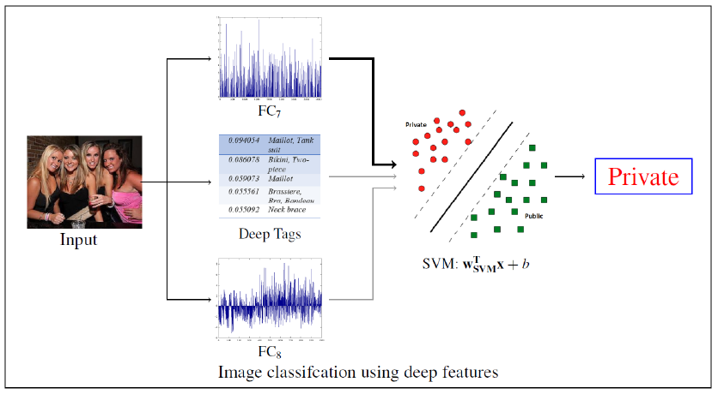
Feature Classification

Slide 11
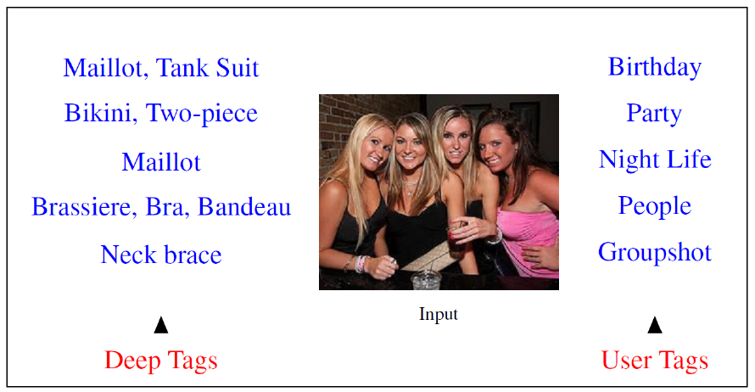
Deep Tag vs. User Tags

Slide 12
Outline
Current Work
Deep features
Semantic features
Privacy-aware user tags
Results
Dataset
Experiments and Results
Research Plan
Fusion of multimodal features
Summary

Slide 13
Dataset
Evaluated approach on a subset of 32,000 Flickr images sampled from the PicAlert dataset (Zerr et al., 2012).
PicAlert consists of Flickr images on various subjects, which are manually labeled as public or private by external viewers.
The dataset is split in train and test sets of 27000 and 5000 images, respectively.
The public and private images are in the ratio of 3:1 in both train and test.

Slide 14
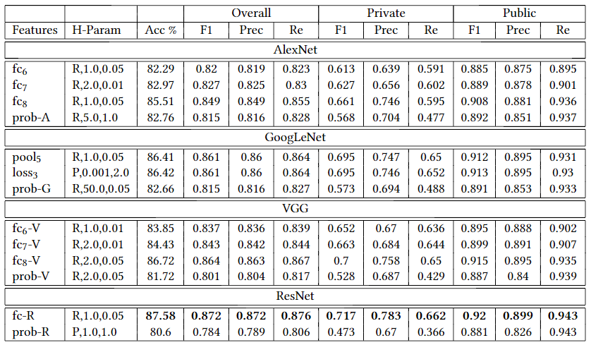
The impact of the network architecture on the privacy prediction
Experiments and Results

Slide 15
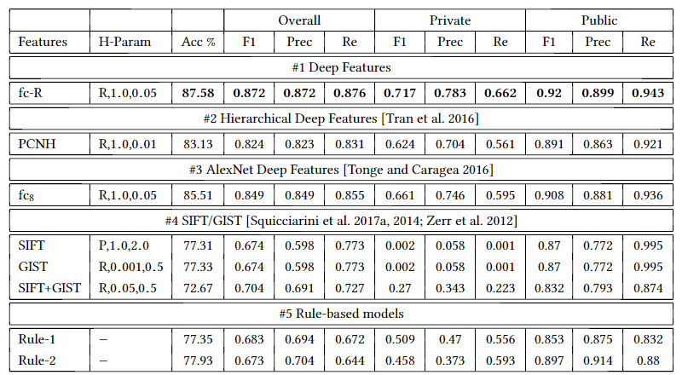
Deep features vs. Baselines

Slide 16
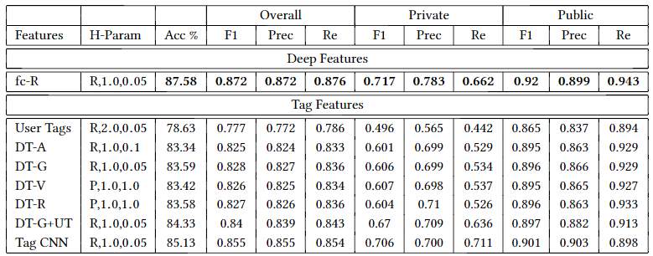
Evaluation of tag features for privacy prediction

Slide 17
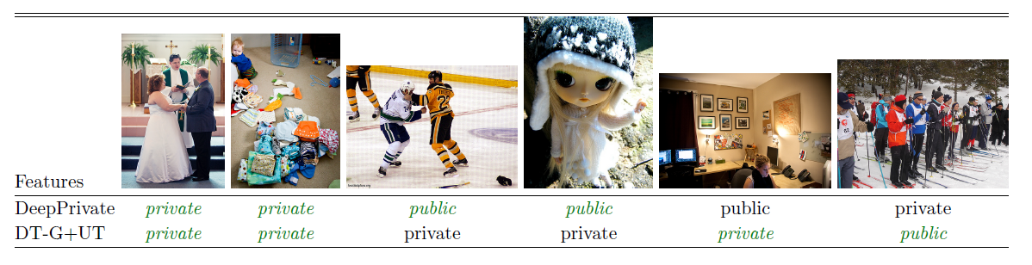
Privacy predictions obtained by image content encodings
(1)
(2)
(3)
(4)
(5)
(6)

Slide 18
Outline
Current Work
Deep features
Semantic features
Privacy-aware user tags
Results
Dataset
Experiments and Results
Research Plan
Fusion of multimodal features
Summary

Slide 19
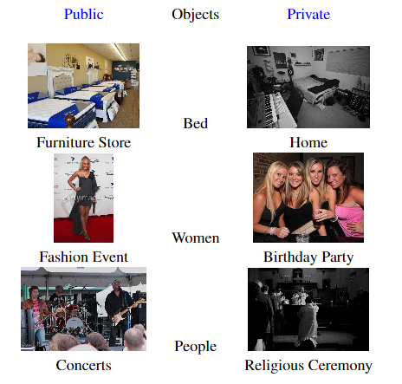
Uncovering Scene Context for Predicting Privacy of Images Shared Online
Motivation

Slide 20
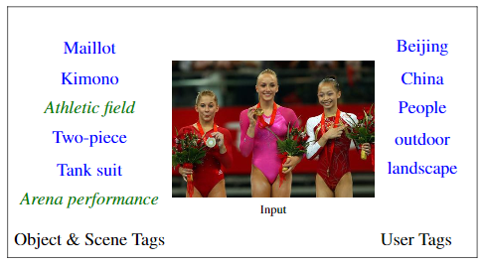
Semantic Features

Slide 21
Outline
Current Work
Deep features
Semantic features
Privacy-aware user tags
Results
Dataset
Experiments and Results
Research Plan
Fusion of multimodal features
Summary

Slide 22
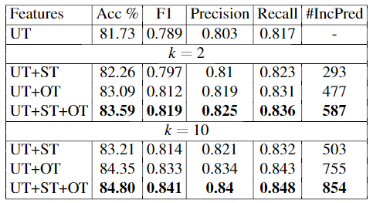
Object, Scene and User Tags

Slide 23
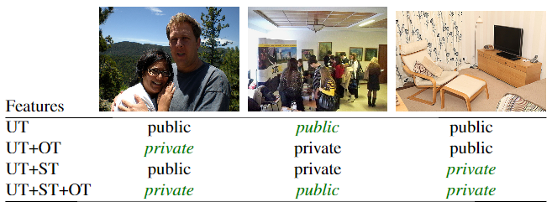
Results
(1)
(2)
(3)

Slide 24
Outline
Current Work
Deep features
Semantic features
Privacy-aware user tags
Results
Dataset
Experiments and Results
Research Plan
Fusion of multimodal features
Summary

Slide 25
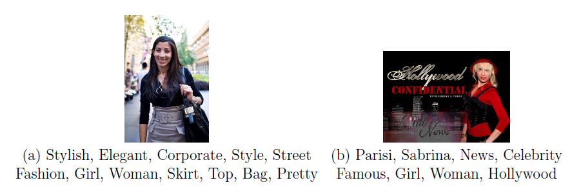
Privacy-Aware Tag Recommendation for Image Sharing
Motivation

Slide 26
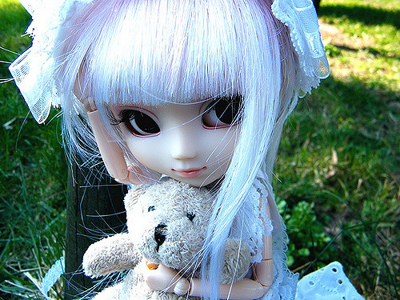

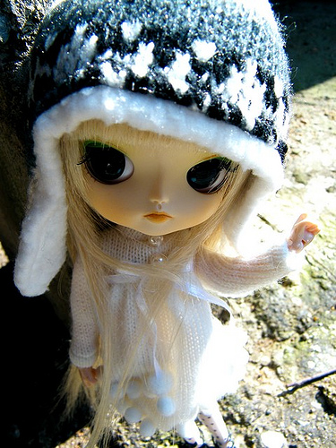

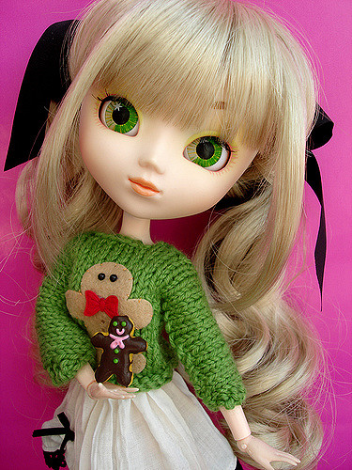

Privacy-aware User Tags
Cute, Doll, Toy
Cute, Toy, Doll
Cute, Happiness, Eyechips
Doll, Toy, Cute
Public
Cute
Cute, Doll, Shop
Private
Cute, Coolcat, Indoor

Slide 27
Proposed Algorithm
Our approach to recommend tags for newly posted images in online content sharing sites is based on Collaborative Filtering (CF) (Shi, Larson, and Hanjalic, 2014).
In item-item CF, items are recommended by finding items most similar to the set of articles previously purchased by a user.
Our approach leverages these relationships to exchange tags between similar images.
Analogy with CF.
Images correspond to users
Tags correspond to items.
Assumption: privacy-aware similar images would possess very similar tags.

Slide 28
Outline
Current Work
Deep features
Semantic features
Privacy-aware user tags
Results
Dataset
Experiments and Results
Research Plan
Fusion of multimodal features
Summary

Slide 29
Fusion of multi-modal features
I propose an algorithm to combine the strengths of
Tags features
Semantic (object and scene) features
Privacy-specific features
This work is currently under development

Slide 30
Outline
Current Work
Deep features
Semantic features
Privacy-aware user tags
Results
Dataset
Experiments and Results
Research Plan
Fusion of multimodal features
Summary

Slide 31
Conclusion
Employed deep features depicting multimodal information of an image derived through CNN networks.
Deep features performs better as compared to baselines.
In future, personalized image privacy prediction with varying degree of sensitivity can be explored.

Slide 32
References
Ashwini Tonge and Cornelia Caragea. "Uncovering Scene Context for Predicting Privacy of Online Shared Images." In: Proceedings of the 32nd American Association for Artificial Intelligence (AAAI 2018), Student Abstract and Poster Program, USA, 2018.
Ashwini Tonge and Cornelia Caragea. "Image Privacy Prediction Using Deep Features." In: Proceedings of the 30th American Association for Artificial Intelligence (AAAI 2016), Student Abstract and Poster Program, Phoenix, Arizona, USA, 2016.
Krizhevsky, Alex, Ilya Sutskever, and Geoffrey E. Hinton (2012). “ImageNet Classifica-tion with Deep Convolutional Neural Networks”. In:Advances in Neural InformationProcessing Systems 25. Ed. by F. Pereira et al. Curran Associates, Inc., pp. 1097–1105.
Russakovsky, Olga et al. (2015). “ImageNet Large Scale Visual Recognition Challenge”.In:IJCV, pp. 1–42.
Shi, Yue, Martha Larson, and Alan Hanjalic (2014). “Collaborative Filtering Beyond theUser-Item Matrix: A Survey of the State of the Art and Future Challenges”. In:ACMComput. Surv.issn: 0360-0300.doi:10.1145/2556270.
Simonyan, Karen and Andrew Zisserman (2014). “Very Deep Convolutional Networks forLarge-Scale Image Recognition”. In:CoRRabs/1409.1556.
Squicciarini, Anna C., Cornelia Caragea, and Rahul Balakavi (2014). “Analyzing Im-ages’ Privacy for the Modern Web”. In:Proceedings of the 25th ACM Conferenceon Hypertext and Social Media. HT ’14. Santiago, Chile: ACM, pp. 136–147.isbn:978-1-4503-2954-5.
Szegedy, Christian et al. (2014). “Going Deeper with Convolutions”. In:CoRRabs/1409.4842.Tran, Lam et al. (2016). “Privacy-CNH: A Framework to Detect Photo Privacy withConvolutional Neural Network Using Hierarchical Features”. In:Proceedings of theThirtieth AAAI Conference. Phoenix, Arizona, pp. 1317–1323.
Zerr, Sergej et al. (2012). “Privacy-aware image classification and search”. In:Proceedingsof the 35th international ACM SIGIR conference on Research and development ininformation retrieval. Portland, Oregon, USA: ACM.isbn: 978-1-4503-1472-5.
Zhou, Bolei et al. (2016). “Places: An Image Database for Deep Scene Understanding”.In:arXiv preprint arXiv:1610.02055.

Slide 33

Thank you!

