Slide 1
Compassion Alexa Skill
…brought to you by a few compassionate nerds

Slide 2
The Team
Shanthan Kesharaju, Fidelity
Product Manager and Alexa Conversational Flows
Ashwini Kumar, CapitalOne
Developer, Interaction Service (NodeJS)
Manoj Thakkar, Nutanix
Developer, Moderation Service (Python)
John Morton, Cal Poly San Luis Obispo
Architect (Diagrams and Documentation)

Slide 3
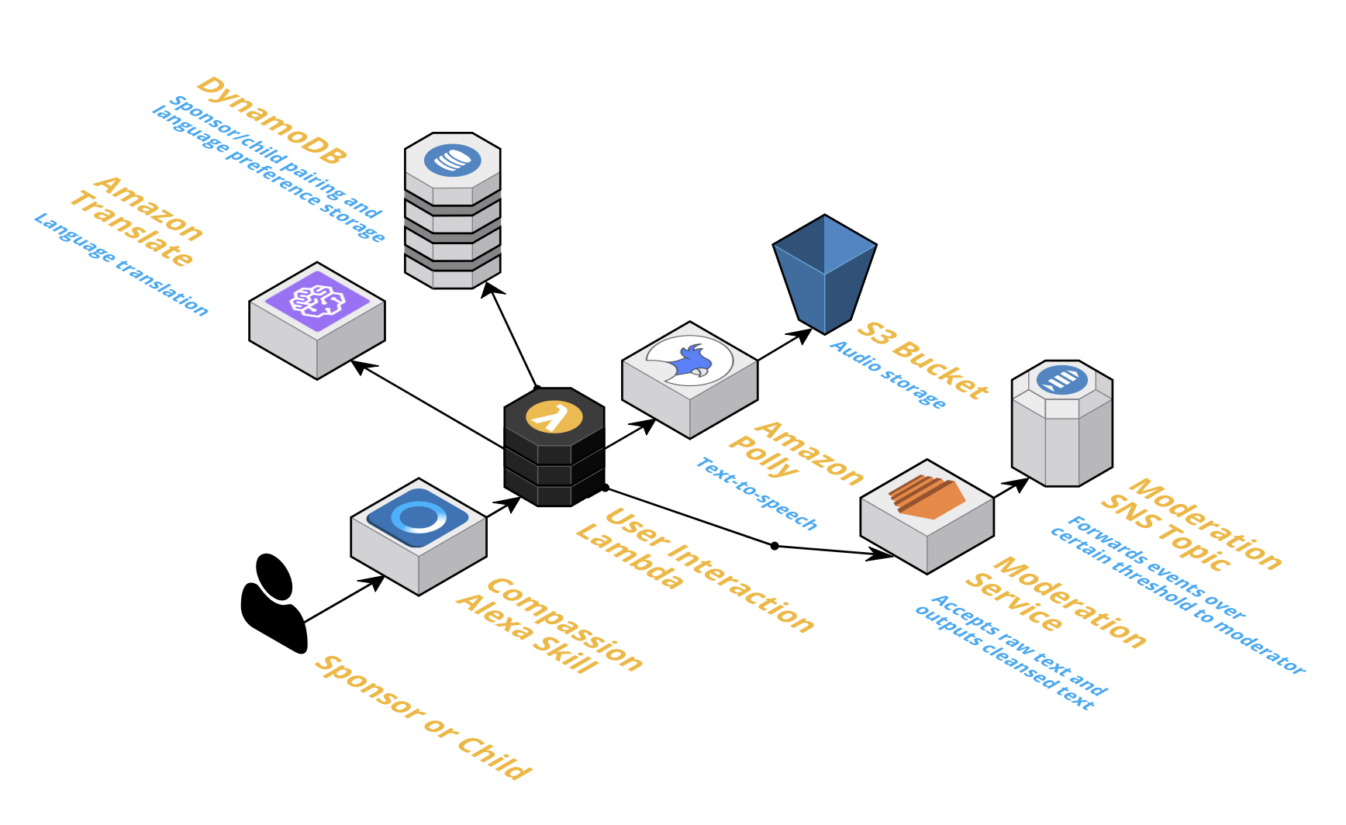
Architectural Diagram

