Slide 1
Compassion Alexa Skill
…brought to you by a few compassionate nerds

Slide 2
The Challenge
Build on the tradition of the pen-pal relationship between sponsor and child
Protect the child
Modernize communication
Drive down costs by reducing human interaction needed in translation and moderation
Increase frequency of contact between sponsor to drive outcomes
- More children in the program breaking the poverty cycle
- More sponsorships

Slide 3
Why Alexa?
Natural interface for sponsors and children alike
Benefit from Amazon’s agile release of Alexa refinements
Out of the box support for all target languages (English, French, Spanish) with Amazon adding others as time goes on
Affordable to deploy to partner churches
Easy to add additional frontend (e.g. web or mobile) while utilizing same backend services

Slide 4
We have met all Acceptance criteria
Minimum:
We have near real-time communication with very short delays on message availability (~3 seconds)
We translate communication to the receiver’s language (e.g. spoken in English, delivered in Spanish)
We handle filtering out of any usage of harmful words/phrases
We handle harmful things by replacing with silence
We handle false positives (i.e. single usage of potentially harmful word) by not terminating message, but rather translating the remainder (the portion not potentially-harmful) of the message
Stretch
We block communication on X usage of offensive language and reporting of the offender to the firm

Slide 5
The Team
Shanthan Kesharaju, Fidelity
Product Manager and Alexa Conversational Flows
Ashwini Kumar, CapitalOne
Developer, Interaction Service (NodeJS)
Manoj Thakkar, Nutanix
Developer, Moderation Service (Python)
John Morton, Cal Poly San Luis Obispo
Architect (Diagrams and Documentation)

Slide 6
This slide intentionally left blank

Slide 7
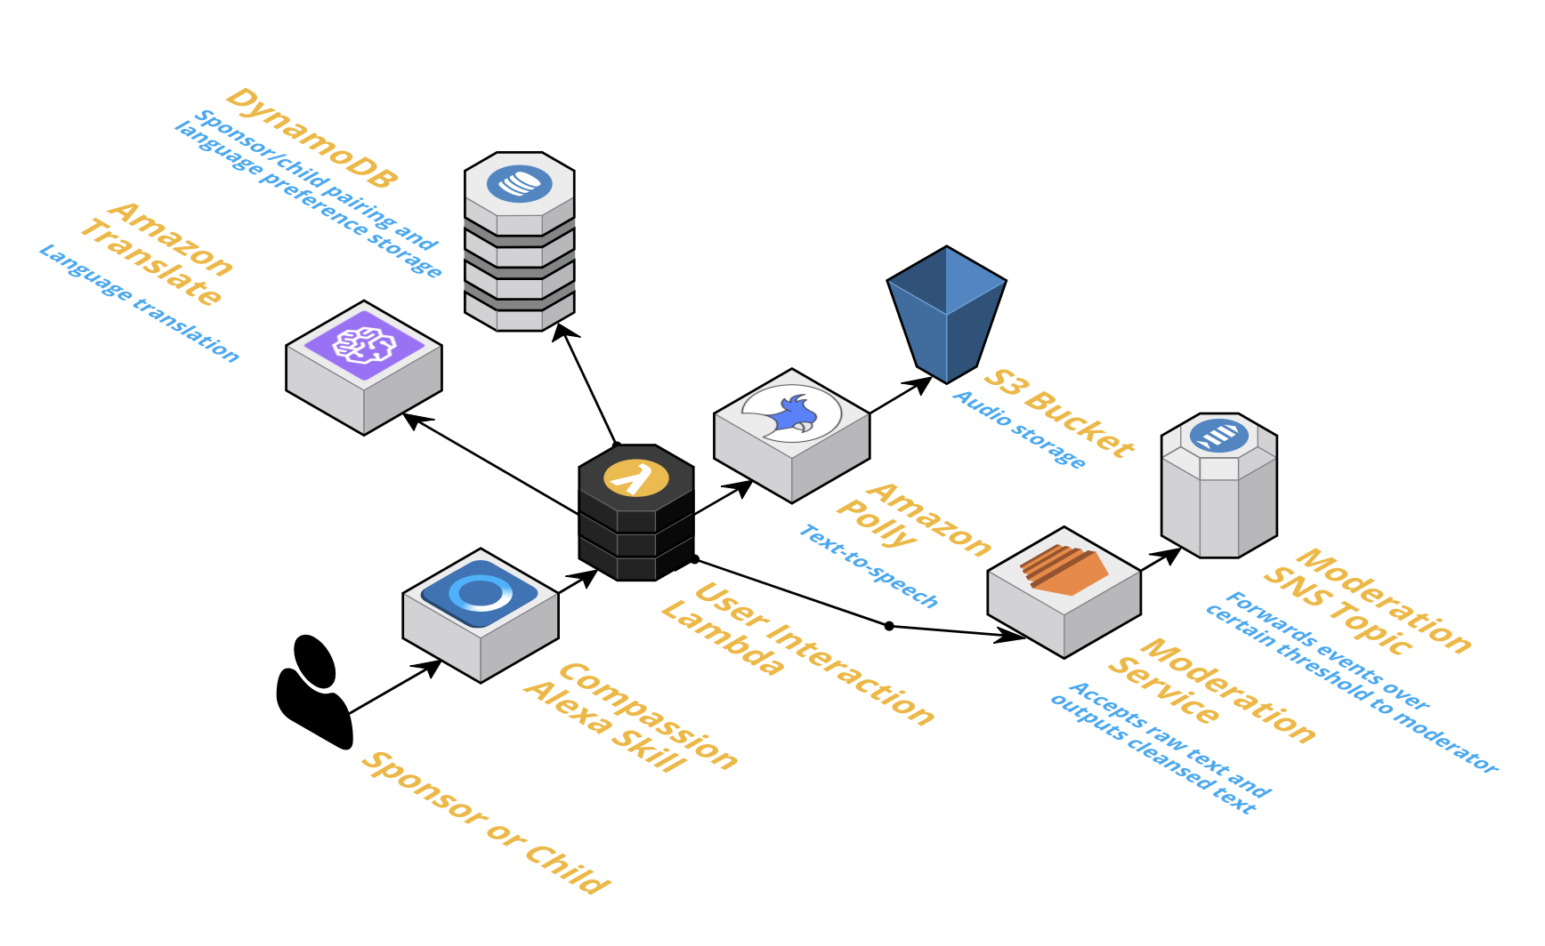
Architectural Diagram

