Slide 1
Compassion Alexa Skill
…brought to you by a few compassionate nerds

Slide 2
The Challenge
Build on the tradition of the pen-pal relationship between sponsor and child
Protect the child
Modernize communication
Drive down costs by reducing human interaction needed in translation and moderation
Increase frequency of contact between sponsor to drive outcomes
- More children in the program breaking the poverty cycle
- More sponsorships

Slide 3
Why Alexa?
Natural interface for sponsors and children alike
Benefit from Amazon’s agile release of Alexa refinements
Out of the box support for all target languages (English, French, Spanish) with Amazon adding others as time goes on
Affordable to deploy to partner churches
Easy to add additional frontend (e.g. web or mobile) while utilizing same backend services

Slide 4
The Team
Shanthan Kesharaju, Fidelity
Product Manager and Alexa Conversational Flows
Ashwini Kumar, CapitalOne
Developer, Interaction Service (NodeJS)
Manoj Thakkar, Nutanix
Developer, Moderation Service (Python)
John Morton, Cal Poly San Luis Obispo
Architect (Diagrams and Documentation)

Slide 5
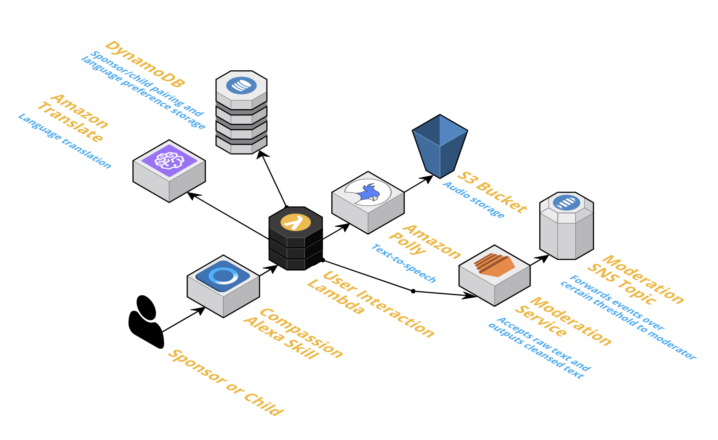
Architectural Diagram

