Slide 1
ROSSMANN SALES FORECASTING
Predicting Store Sales & Customer Demand
Machine Learning • Deep Learning • MLflow • Streamlit
1,017,209
41,088
1,115
Training records
Test records
Stores
Rossmann Sales Forecasting
1

Slide 2
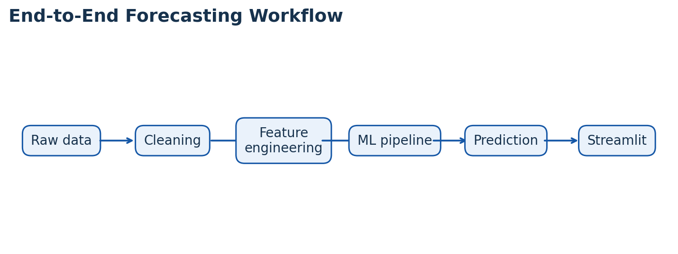
Business Problem
Why sales forecasting matters
• Forecast daily sales across multiple stores up to six weeks ahead.
• Sales are influenced by promotions, holidays, seasonality, customer traffic and competition.
• Build a repeatable forecasting pipeline rather than a one-time analysis.
• Connect analytics, prediction, model tracking and a user-facing dashboard.
Data → Insight → Forecast → Decision
Rossmann Sales Forecasting
2

Slide 3
Dataset & Project Scope
What was analysed
1,017,209
41,088
1,115
Train rows
Test rows
Stores
• Target: daily Sales.
• Demand signal: Customers.
• Calendar variables: Date, DayOfWeek, StateHoliday, SchoolHoliday.
• Store context: StoreType, Assortment, CompetitionDistance, Promo2.
• Operational signals: Open and Promo.
Rossmann Sales Forecasting
3

Slide 4
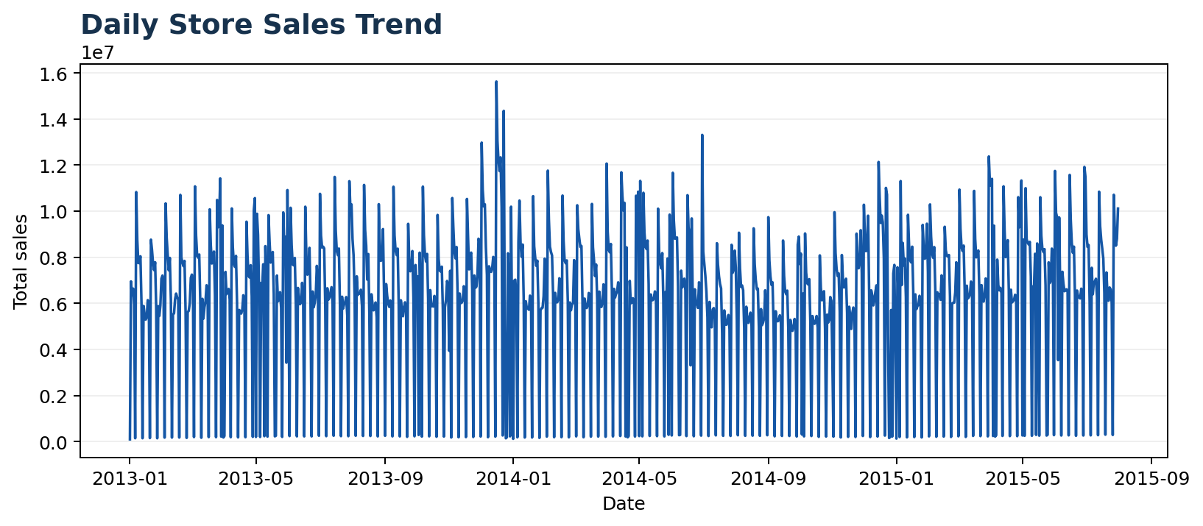
Exploratory Data Analysis
The first step was to understand sales behaviour
Key interpretation
• Sales change substantially over time.
• Calendar and seasonal features are therefore important model inputs.
• EDA provides the foundation for feature engineering.
Rossmann Sales Forecasting
4

Slide 5
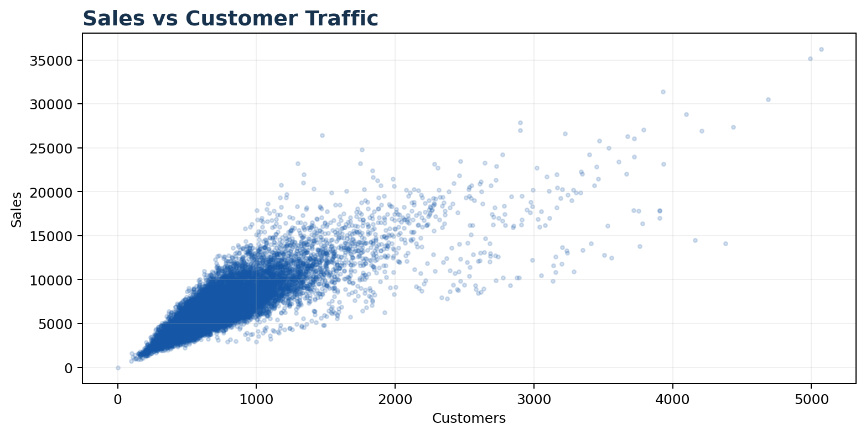
Sales & Customer Behaviour
Customer traffic is strongly associated with sales
0.824
6,956
763
Sales–customer correlation
Average daily sales
Average daily customers
• Higher customer traffic generally corresponds to higher sales.
• Customers are an important demand signal.
Rossmann Sales Forecasting
5

Slide 6
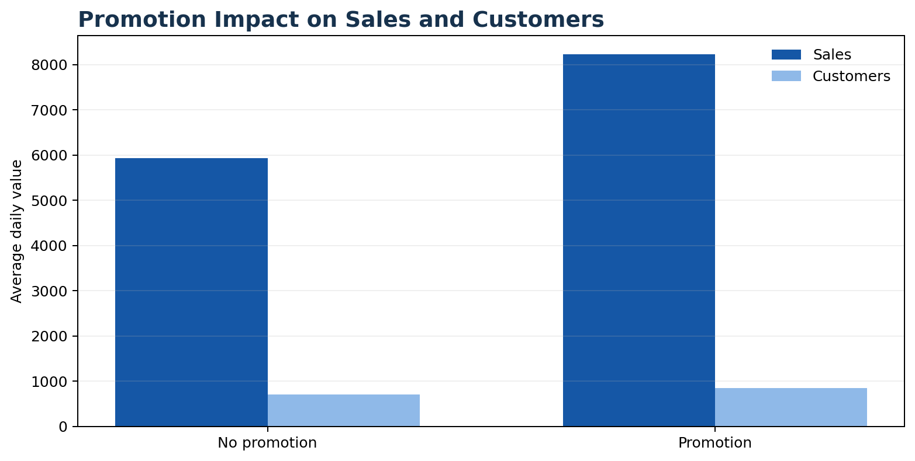
Promotion Impact
Promotional days show higher historical activity
Average Sales
5,929
No promotion
8,228
Promotion
Average Customers
697
No promotion
Rossmann Sales Forecasting
844
6
Promotion

Slide 7
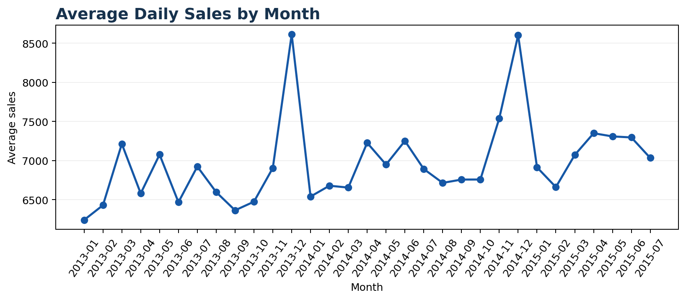
Seasonality & Calendar Effects
Monthly patterns reveal recurring demand behaviour
Key findings
• December average sales: ~8,609.
• Weekday average sales: ~7,172.
• Weekend average sales: ~5,932.
• Holiday and calendar effects are useful forecasting signals.
Rossmann Sales Forecasting
7

Slide 8
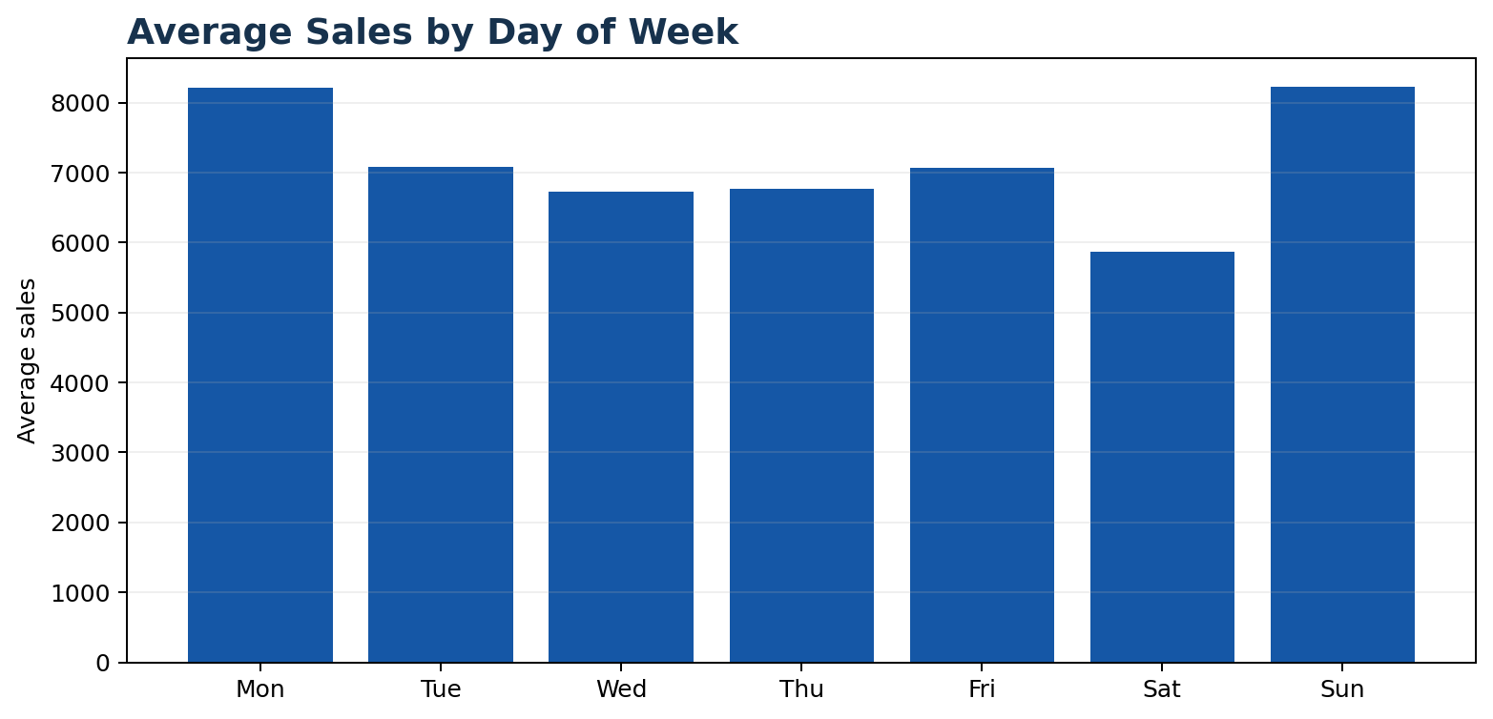
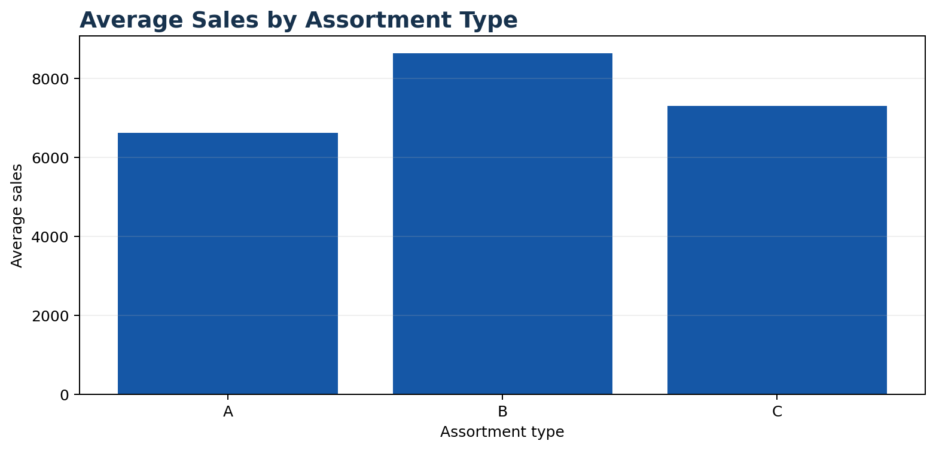
Weekday & Assortment Behaviour
Store operating patterns and assortment levels differ
Average sales by assortment: A ≈ 6,621 | B ≈ 8,639 | C ≈ 7,301
Rossmann Sales Forecasting
8

Slide 9
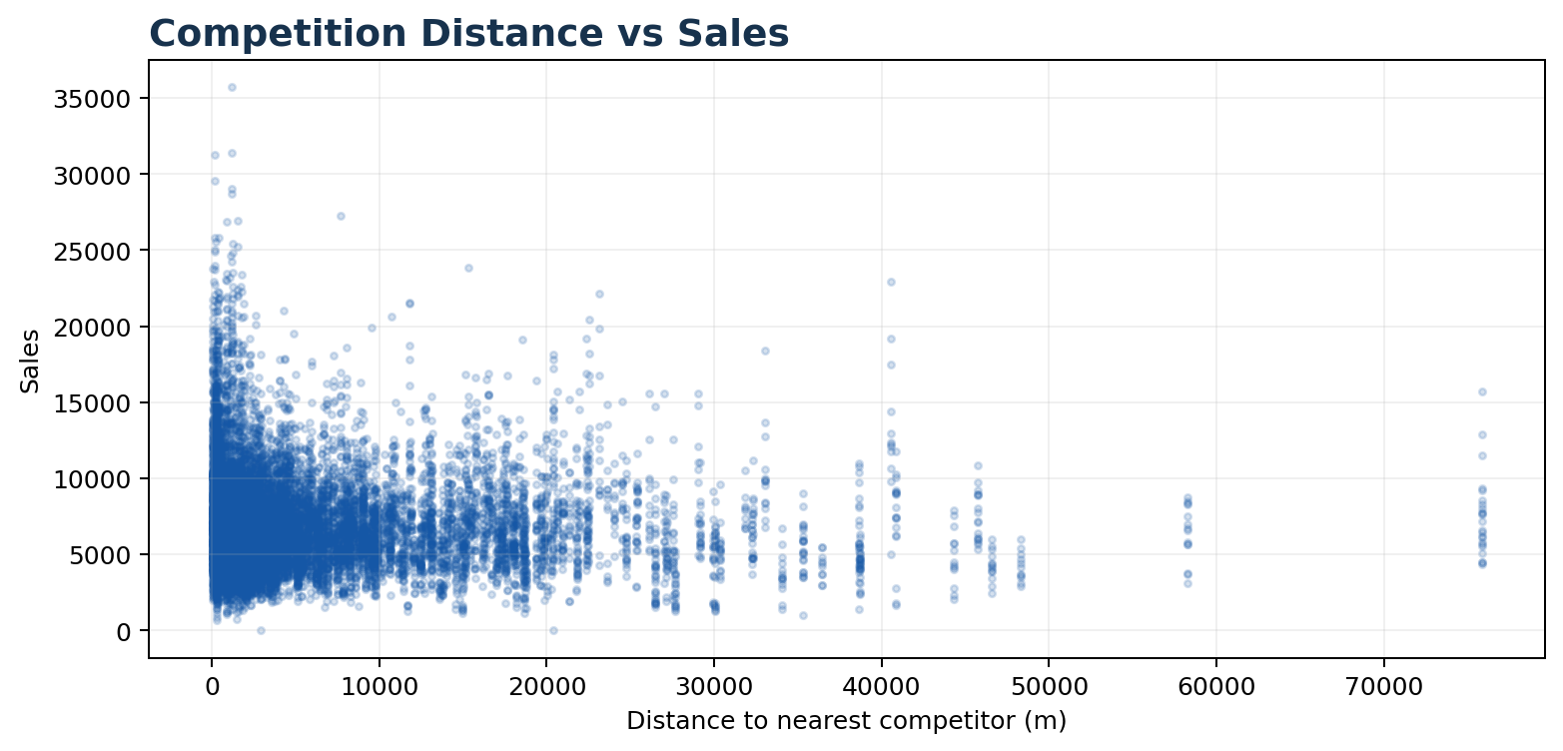
Competition Analysis
Testing whether local competitive context is informative
Data quality
2,325 m
Median competitor distance
3
Missing distance records
• Competition distance was included as a store-level feature.
• Competitor opening/reopening patterns were also analysed.
Rossmann Sales Forecasting
9

Slide 10
Data Cleaning & Feature Engineering
Making the dataset model-ready
• Converted Date to datetime.
• Merged daily sales with store characteristics.
• Handled missing competition information and checked data quality.
• Created Year, Month, Week, Day, Weekend and competition/promotion duration features.
• Prepared numeric and categorical variables through a reproducible preprocessing pipeline.
Reusable transformation flow
Rossmann Sales Forecasting
10

Slide 11
Machine Learning Approach
Random Forest with a scikit-learn pipeline
150
18
2
Trees
Maximum depth
Minimum samples / leaf
• Random Forest Regressor was used for sales prediction.
• A Pipeline combines preprocessing and modelling for consistent training and inference.
• Random Forest can capture nonlinear relationships and interactions.
• Feature importance provides an interpretable view of influential variables.
Rossmann Sales Forecasting
11

Slide 12
Model Evaluation & Prediction Analysis
Time-aware validation keeps the forecasting problem realistic
MAE
RMSE
Time-based
Mean Absolute Error
Root Mean Squared Error
Validation
• MAE is easy to interpret in sales units.
• RMSE places greater weight on larger prediction errors.
• The notebook includes actual-vs-predicted and residual analysis.
• An empirical prediction interval is included; it is not a formal statistical confidence interval.
Rossmann Sales Forecasting
12

Slide 13
Deep Learning — Two-Layer LSTM
A dedicated time-series workflow complements the ML model
• Isolate the sales series as time-series data.
• Check stationarity and difference the series where required.
• Inspect autocorrelation and partial autocorrelation.
• Create sliding-window supervised data and scale to (-1, 1).
• Train a two-layer LSTM regression model and compare RMSE with Random Forest.
Sales
Stationarity
Window
Scale
LSTM
Rossmann Sales Forecasting
13

Slide 14
MLflow & Model Versioning
Tracking experiments for reproducible model selection
• Track multiple Random Forest configurations such as RF_100, RF_150 and RF_200.
• Log parameters including number of trees and maximum depth.
• Track MAE and RMSE for each run.
• Timestamped model serialization supports daily model tracking.
• Include the actual MLflow dashboard screenshot in the final submission.
RF_100
100 trees | MAE | RMSE
RF_150
150 trees | MAE | RMSE
RF_200
200 trees | MAE | RMSE
Rossmann Sales Forecasting
14

Slide 15
Streamlit Prediction Dashboard
Turning the model into a practical interface
User inputs
Model inference
Outputs
• Store ID
• Date
• Promotion
• Holiday / Weekend
• Other model inputs
• Preprocessing
• Feature engineering
• Trained model
• Prediction
• Predicted Sales
• Predicted Customers
• Forecast chart
• CSV download
Insert the final Streamlit screenshot and deployed application link before submission.
Rossmann Sales Forecasting
15

Slide 16
Final Outcome & Business Value
From historical data to an end-to-end forecasting solution
Analytics
Prediction
MLOps
Deployment
Understand patterns
Forecast demand
Track models
Serve predictions
• EDA identifies the roles of customer traffic, promotions, calendar effects, store characteristics and competition.
• Feature engineering and a reusable pipeline prepare data for consistent inference.
• Random Forest and two-layer LSTM provide complementary modelling approaches.
• MLflow adds experiment tracking, while Streamlit makes predictions accessible to users.
Final submission: executed notebook • actual metrics • MLflow evidence • DVC evidence • Streamlit screenshot • deployed link
Rossmann Sales Forecasting
16

