Slide 1
2
MODULE 2 · CLICKHOUSE
Ingestion types
Data
Ingestion
3
Data source categories
The process of collecting, importing, and transferring data from multiple sources into a storage or processing system.
∞
Scalable throughput

Slide 2
DEFINITION
What is Data Ingestion?
"Data ingestion is the process of collecting, importing, and transferring data from multiple sources into a storage or processing system."
📥
🔄
💾
Collect
Import
Store
Gather raw data from diverse sources — databases, files, sensors, APIs
Transfer and convert data into the target system's format
Load into a storage or processing system ready for analysis

Slide 3
OVERVIEW
Types of Data Ingestion
Two main approaches — each suited to different use cases and latency requirements:
📦 Batch Ingestion
⚡ Real-Time / Streaming
Scheduled · Periodic · High Volume
Continuous · Low Latency · Live
Data is collected and processed at scheduled intervals. Ideal when real-time speed is not required and data can be accumulated before processing.
Data is ingested continuously as it is generated. Enables instant insights and real-time decision making for time-sensitive applications.

Slide 4
BATCH INGESTION
Batch Ingestion
Data is collected and processed at scheduled intervals.
📋 Examples
✅ Advantages
⚠️ Limitations
Daily sales reports
Simple to implement
Delayed insights
Payroll processing
Cost-effective
Not suitable for live monitoring
Monthly financial data
Good for large volumes

Slide 5
STREAMING INGESTION
Real-Time / Streaming Ingestion
Data is ingested continuously as it is generated.
📈 Stock market updates
🌡️ IoT sensors
🛡️ Fraud detection
📱 Social media feeds
✅ Advantages
⚠️ Limitations
Instant insights
More complex architecture
Low latency
Higher infrastructure cost
Enables live monitoring
Requires stream processing expertise
Real-time decision making

Slide 6
DATA SOURCES
Common Data Sources
🗄️
Structured Sources
📄
Semi-Structured Sources
🌐
Unstructured Sources
Well-defined schema, easy to query
Flexible schema, self-describing format
No predefined schema, requires preprocessing
Relational databases
JSON
Images & Videos
CSV files
XML
Emails
ERP systems
Log files
Social media

Slide 7
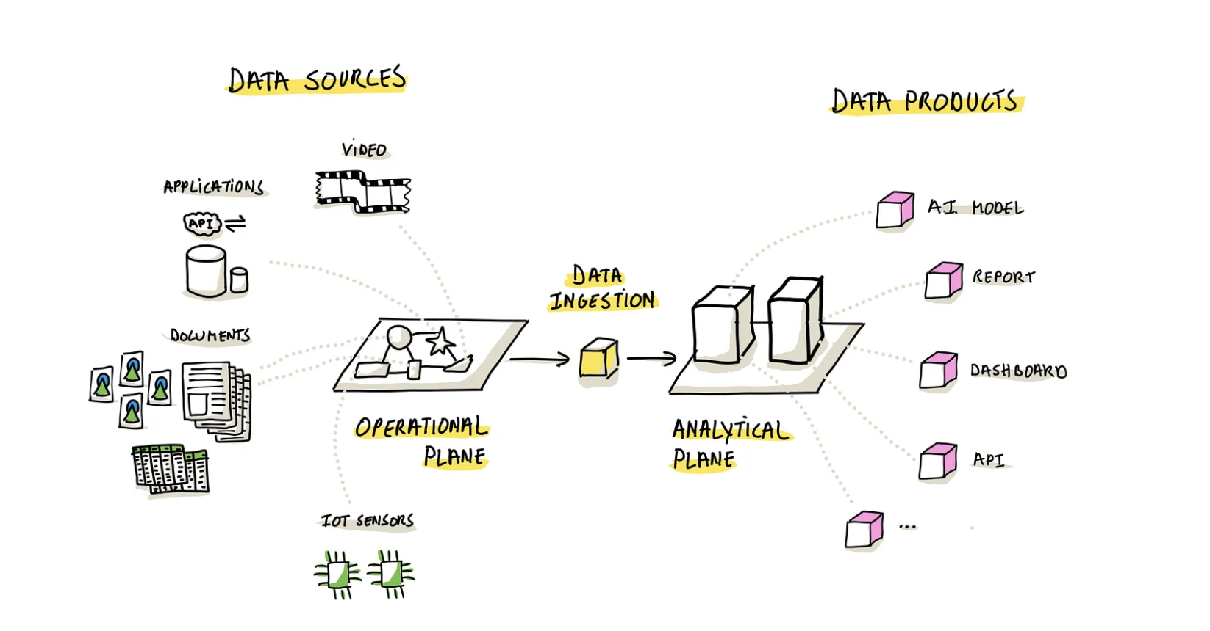
ARCHITECTURE
Data Ingestion Pipeline
From data sources through the operational plane via ingestion to the analytical plane — producing AI models, reports, dashboards, and APIs.

