Slide 1
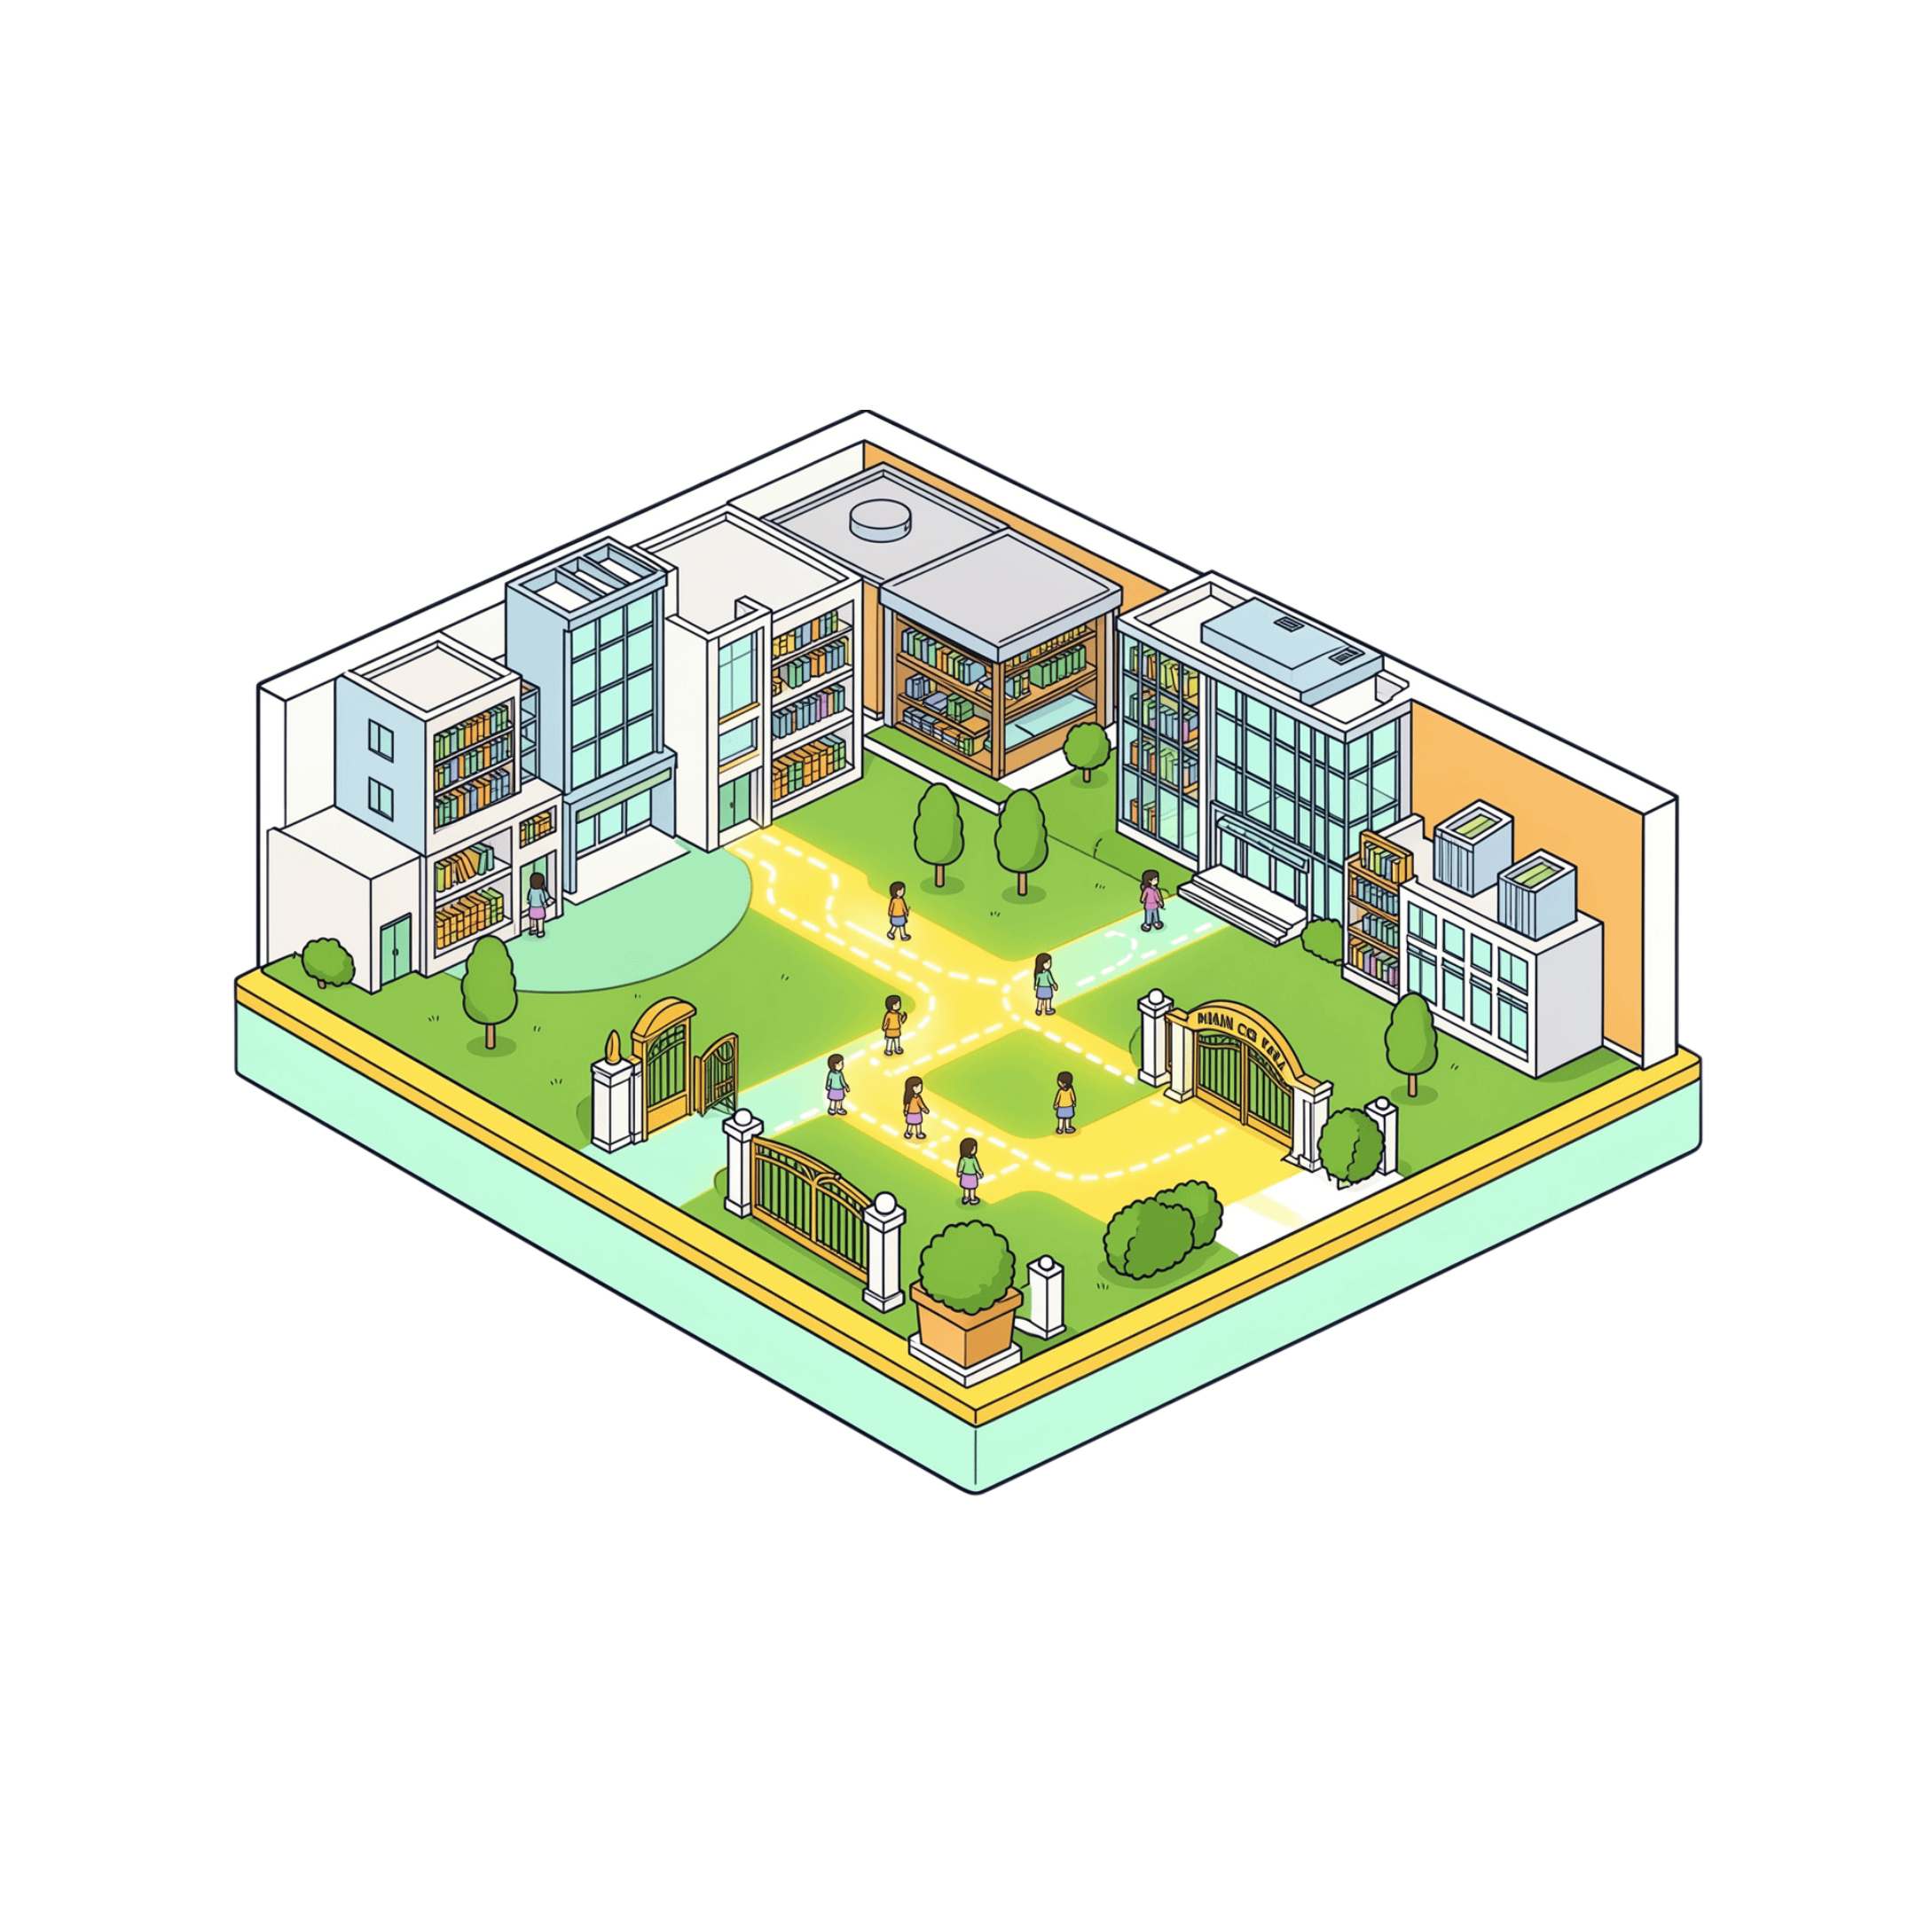
CS PROJECT PRESENTATION · ROUTING ENGINE
Campus Navigation Assistant
A web application that computes and visualizes the shortest walking route between buildings across campus.
GRAPH ALGORITHMS · FASTAPI · REACT · VIVA DEFENSE
Notes:
Good morning. Today I am presenting the Campus Navigation Assistant, an end-to-end web system designed to solve route discovery and navigation delays across expansive college campuses.

Slide 2
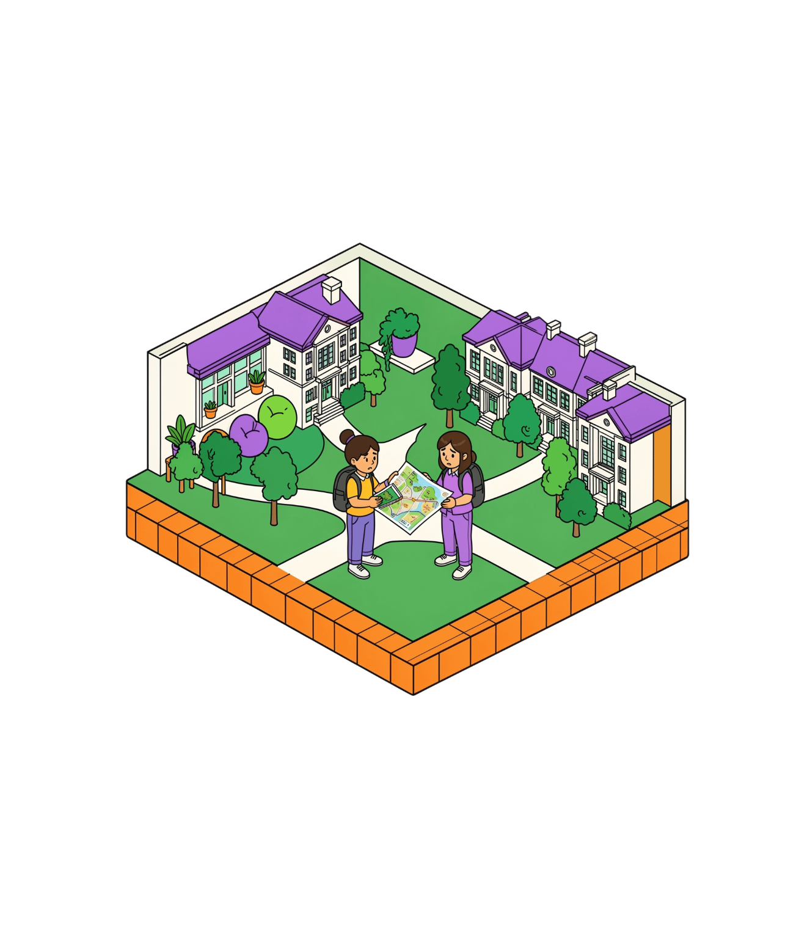
Campus navigation takes time without a digital guide
Current navigation challenges versus digital automated routing
Expansive campus layout
Large collegiate grounds with scattered department wings make unassisted walking confusing.
Unfamiliar visitor orientation
Freshmen, visiting faculty, and guest delegates struggle to locate interior labs and lecture blocks.
Manual route finding is slow
Asking pedestrians or deciphering static billboard signboards causes class and meeting delays.
Automated digital solution
Accepts source and destination, calculating the optimal walking trajectory and exact distance in milliseconds.
Notes:
Navigating modern university campuses is surprisingly time-consuming for new students and visitors. Physical notice boards are static, whereas our digital assistant instantly converts origin and destination coordinates into an optimal walking path.

Slide 3
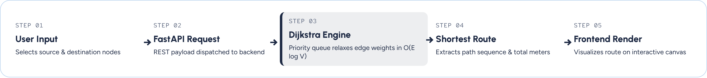
Dijkstra turns campus paths into a shortest-route problem
Graph modeling primitives and execution pipeline
GRAPH PRIMITIVE
GRAPH PRIMITIVE
GRAPH PRIMITIVE
Nodes (V)
Edges (E)
Weights (W)
Campus locations such as Main Gate, Admin Block, Library, and Computer Lab.
Physical connecting pathways, sidewalks, corridors, and paved pedestrian lanes.
Measured distance in meters or walking time between adjacent landmark nodes.
Notes:
We model the campus as an undirected weighted graph where nodes represent key landmarks and edge weights represent distance. Dijkstra's algorithm uses a min-priority queue to explore the lowest cumulative distance and guarantee the optimal route.

Slide 4
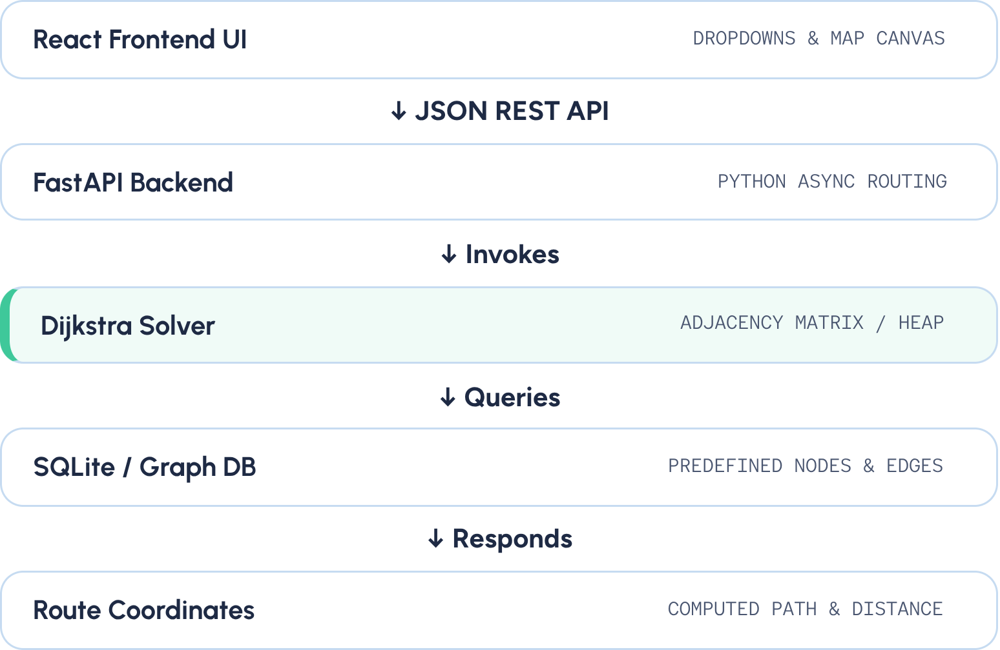
A lightweight web stack connects map input to route output
End-to-end architecture and technology tier breakdown
React.js Frontend
Interactive dropdown selections, real-time node highlighting, responsive HTML5/CSS3 interface.
FastAPI + Python Backend
Lightweight, high-concurrency asynchronous API handling route calculation requests with rapid serialization.
SQLite / MySQL Data Store
Stores verified campus coordinate tables, physical pathway relationships, and distance matrix lookups.
Git & GitHub Version Control
Structured collaborative codebase management, automated tests, and reproducible builds.
Notes:
Our architecture maintains clean separation of concerns. The React frontend captures origin-destination pairs and queries FastAPI endpoints. The backend pulls graph topology from SQLite, executes Dijkstra, and hands back formatted JSON for immediate display.

Slide 5
From Main Gate to Computer Lab, the system returns a clear route
Real-world scenario evaluation, roadmap extensions, and summary
VERIFIED ROUTE EXECUTION
Main Gate → Computer Lab
Optimal Path: Main Gate → Admin Block → Central Library → Science Block → Computer Lab
420 m
5.2 min
Shortest distance
Estimated walk time
PROJECT CONCLUSION
Deterministic Efficiency: Graph-based shortest-path algorithms eliminate campus orientation delays with sub-millisecond calculation times and zero external map dependencies.

