Slide 1
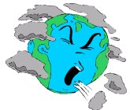
AIR POLLUTION
By,
S.Akhila Swetha,
Roll no:51,
4rth BDS.

Slide 2
Index:
Definition
Types of air pollution
Causes and effects of air pollution
Sources of air pollution
Effects of air pollution
Prevention of air pollution

Slide 3
Definition:
It is a broad term applied to all the physical, chemical, and biological agents that may modify the natural characteristics of the atmosphere and the environment.

Slide 4
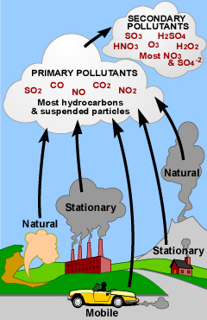
Types of air pollutants:
Primary air pollutant
Ex: CO
Secondary air pollutant
Ex:formation of ozone
in photochemical
smog

Slide 5
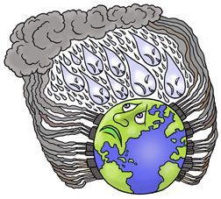
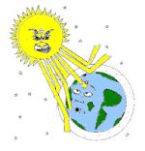

air pollution
Causes and effects
Acid rain
Black carbon pollution.
Particulate pollution.
Outdoor air pollution
Ozone depletion
Indoor air pollution
Greenhouse effect

Slide 6
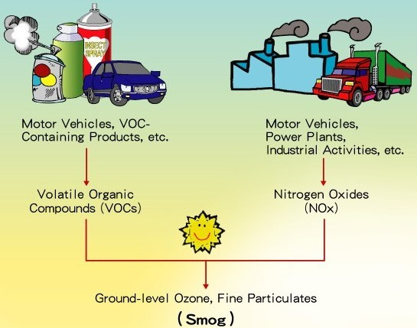
Out door pollution

Slide 7
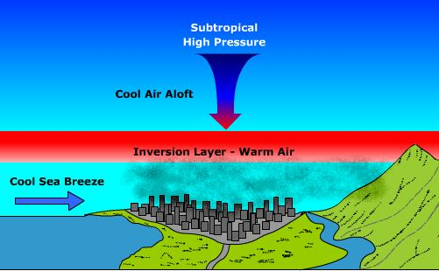
mechanism of air pollution due to smog:

Slide 8
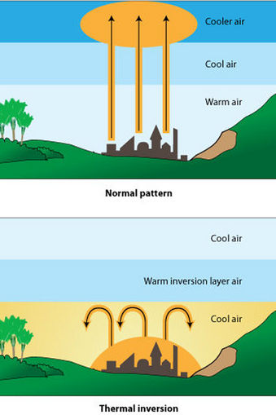

Temperature inversion:
Black carbon pollution

Slide 9
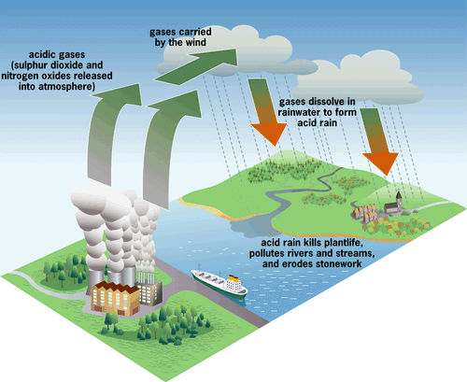
Acid rain:

Slide 10
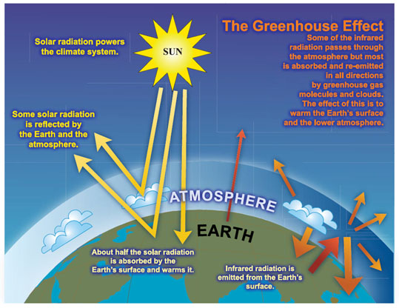

Slide 11
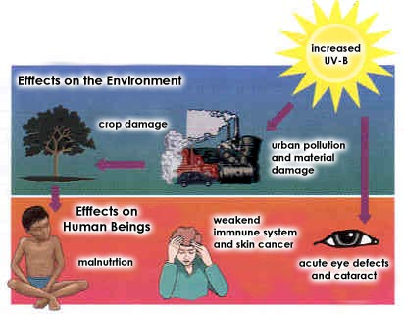
Ozone depletion
Chlorofluorocarbons
Ozone layer in Stratosphere effected

Slide 12
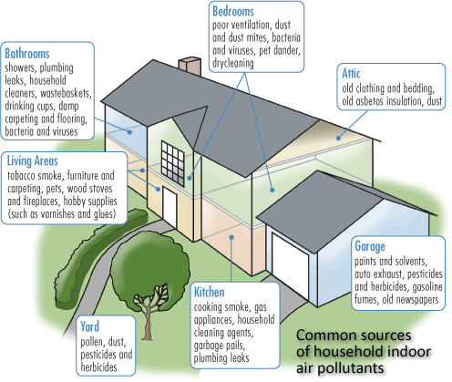
Indoor air pollution

Slide 13
Pollution sources:
Anthropogenic sources
Other anthropogenic sources
Natural sources
Contaminants

Slide 14
Anthropological sources:
combustion-fired powered plants
Vehicles with internal combustion engine
Devices powered by two-stroke cycle engines
Stoves and incinerators especially coal ones.
Wood fires burning inefficiently.
Farmers burning crop waste.

Slide 15

Other anthropological sources:
Aerosol sprays and refrigeration.
Dust and chemicals.
Military actions like testing of nuclear bombs,poisonous gases, germ warfare.
Waste deposition in landfills,which generate methane.

Slide 16
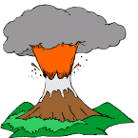
Natural sources:
Dust from natural sources.
Methane emitted from decomposition of animals and cattle.
Smoke and carbon monoxide from wildfires.
Volcanic activity, producing chlorine,sulphur,and ash particulates.

Slide 17
Contaminants:
Carbon monoxide.
Chlorofluorocarbons.
Hydrocarbons.
Lead and heavy metals.
Nitrogen oxides.
Sulphur dioxide.

Slide 18
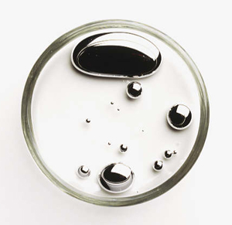
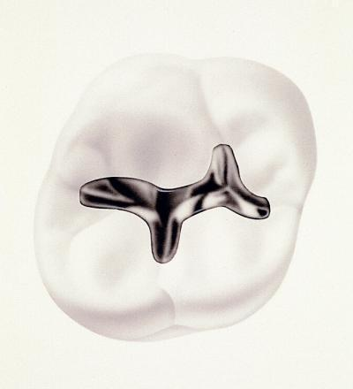

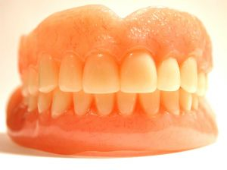
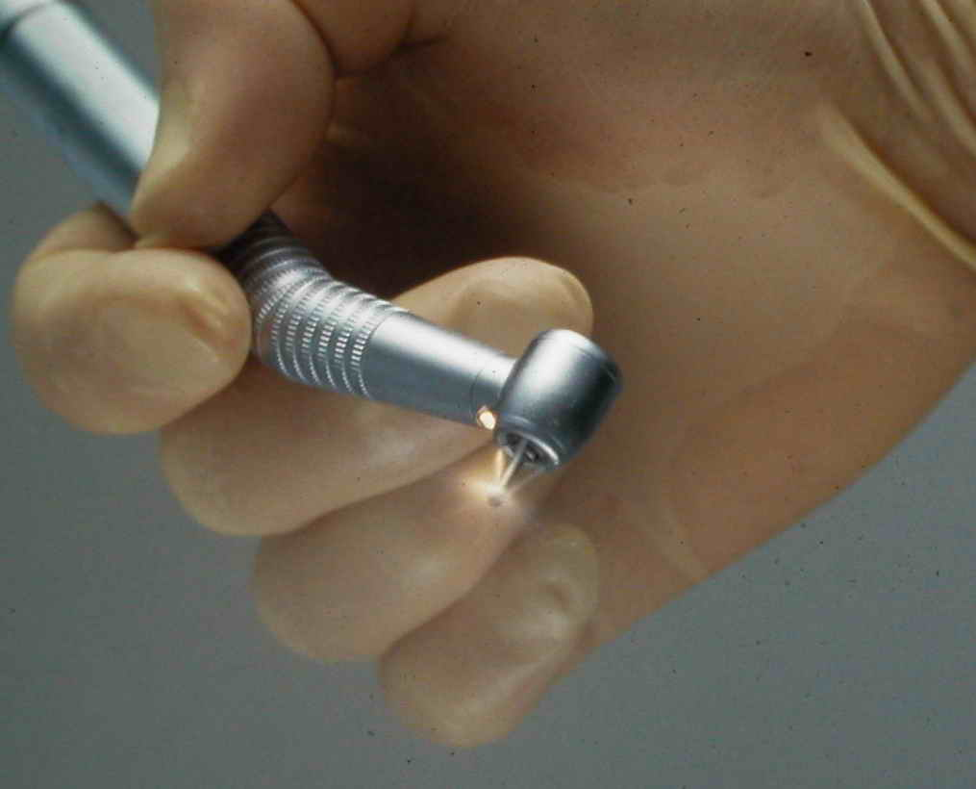
Mercury toxicity
alginate
DENTISTRY
Acrylic
aerosols

Slide 19
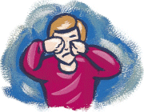
Effects of air pollution on health:
Short term effects:
Irritation to the eyes,nose and throat.
Upper respiratory infections.
Headache,nausea,and allergic reactions.
Asthma and emphysema

Slide 20
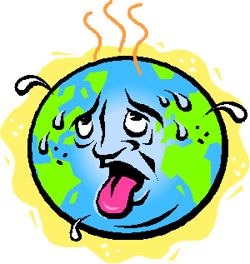
Long term effects:
Chronic respiratory diseases.
Lung cancer.
Heart diseases.
Damage to the brain,nerves,liver or kidneys.

Slide 21
Prevention of damaging effects of air pollution:
Assessments
Pollution emission for transportation vehicles and industry
Restricting smoking
Adequate ventilation

Slide 22


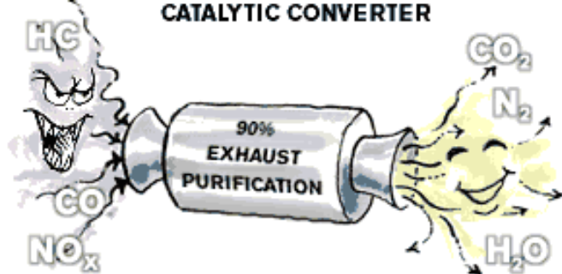
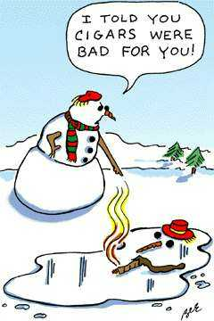
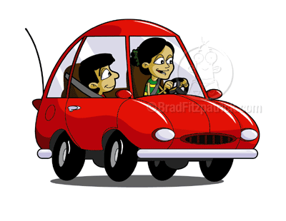

Prevention

Slide 23
References:
Text book of preventive and community dentistry
S.S.Hiremath.
Text book of preventive and social medicine- park and park.
www.google.com.

Slide 24

THANK YOU

