Slide 1

HELLO!
Half Engineers
Ashwin Karichannavar
Shreyas Halgekar
Lakshmi Kittur
Disha Pilankar
Aniket Navlur

Slide 2
1.
Intra Chat
Internal Chat, communication Platform for companies.
Technical Stack:
Php, MySQLdb
Bootstrap
JavaScript
Android Studio

Slide 3
Design
Sign up page for new employees.
Login for registered users.
Global chat feature facilitating inter department communication.
Personal Chat with all registered employees.
Supports Multimedia Sharing.
Supports files like Word, PDF, Excel, etc.

Slide 4
Major Points
Idea: To facilitate secured and private communication using intra-net facility of a company. Can also be used to share documents among employees easily.
Feasibility: Can be implemented reliably by using company's local server.
Technology: A powerful Web App using MySQL, PHP & JavaScript.
Future Scope: Mainly helpful for startup companies who find it hard to keep their ideas and business plans confidential within their employees.

Slide 5


Impact On Society
Prevents work crawling into our social media.
Marks a boundary between Professional and Personal life.

Slide 6
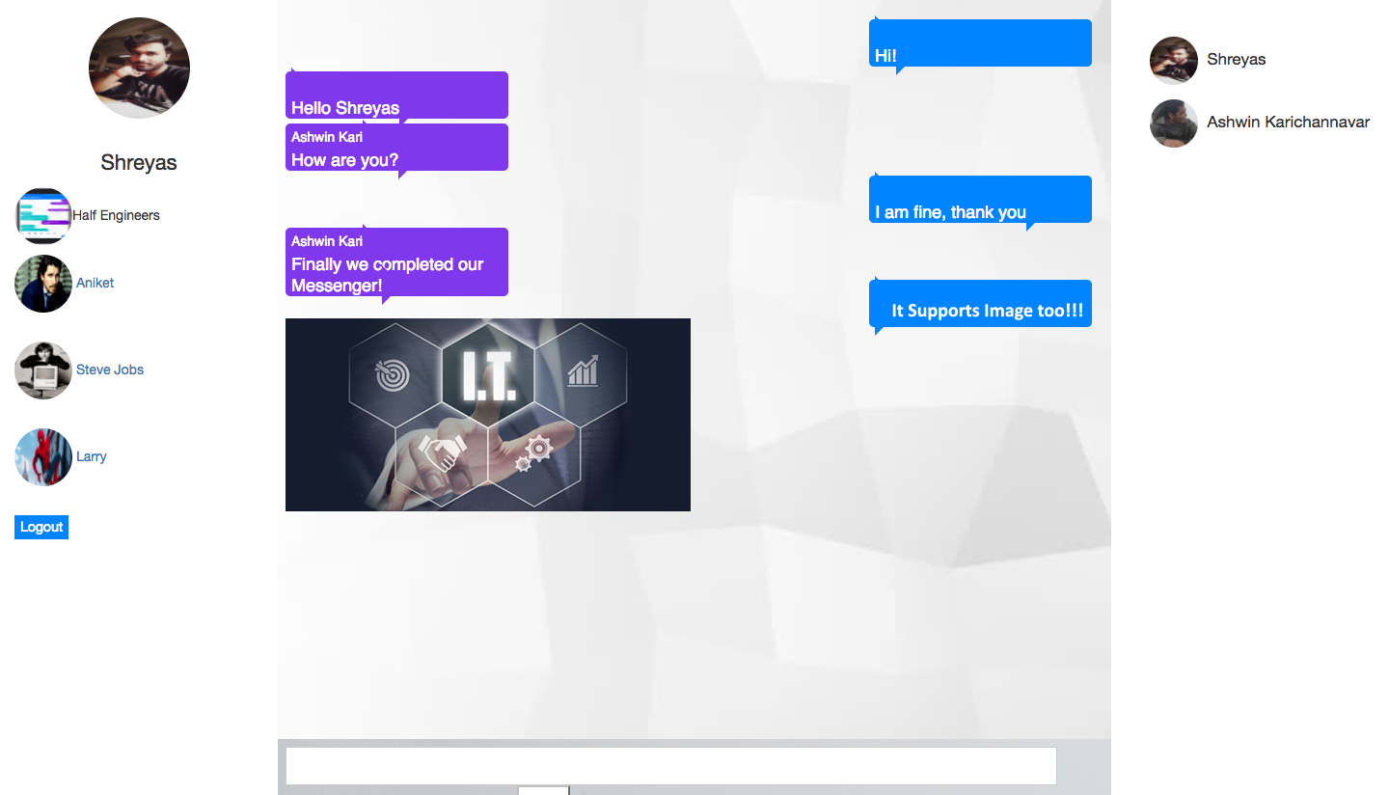
DESKTOP Interface
On login/signup the user is directed to the chat interface where he can participate in group chats or personal chats.
He can also see the list of users/colleagues currently active, on one side. The other side has his profile picture and allows him to log out.
Place your screenshot here

Slide 7
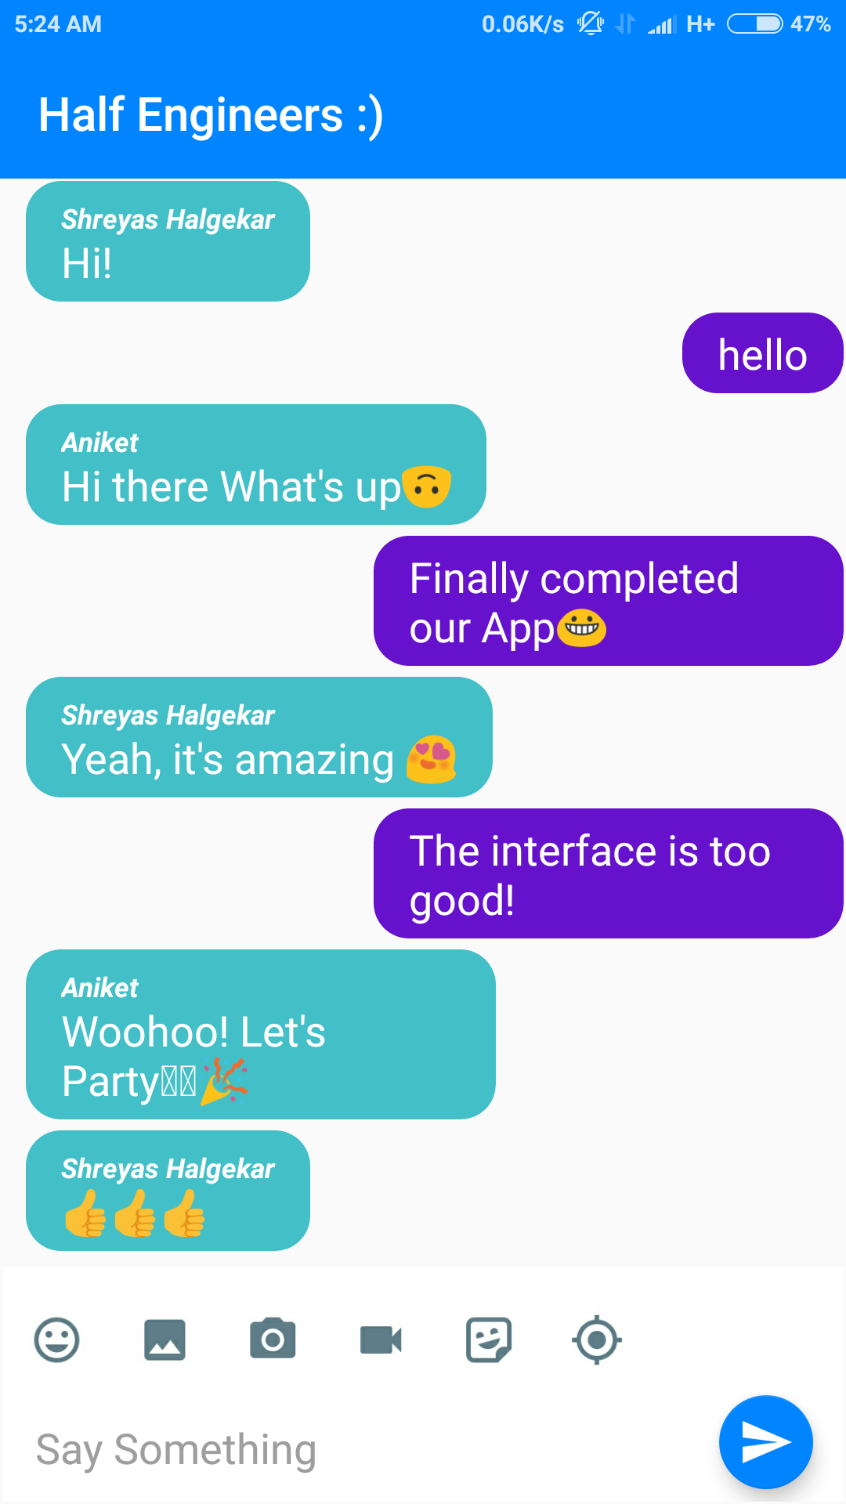
ANDROID Interface
A light weight, fast, reliable Android mobile app which help the company’s employees to stay connected with each other.
It has an amazing user interface!
Place your screenshot here

Slide 8
THANKS!
Any questions?
You can find me at
@Ashwin Karichannavar
ashwinkk.23@gmail.com

