Slide 1
Data Science Challenge
Gopalakrishnan Kalarikovilagam Subramanian
University of Cincinnati

Slide 2
Key Variables Used
duration
director_name
director_facebook_likes
actor_1_name
actor_1_facebook_likes
cast_total_facebook_likes
movie_facebook_likes
Genres
title_year
Gross
Budget
content_rating

Slide 3
Data Import and Cleaning
The data was imported into R Studio.
There were 5043 observations with 28 variables.
The data is checked for duplicates. The observations are reduced to 4998 after removing duplicates.
A new variable called profit is added. It is the difference of Gross and Cost.

Slide 4
Summary of the Data
It is overwhelmingly color movies.
The shortest film is 7 min and the longest is 511. 50% of the movies are in the
93 min to 118 min range.
Actor 1 has on an average more Facebook likes than other crew members.
The lowest amount grossed by a movie is 162 and the highest is more than 760 million.
Drama is the highest genre followed by comedy and comedy/drama.
Most of the movies are in English language, followed by French and Spanish. USA produces most movies, followed by UK and France.
Most of the movies are R rated, followed by PG-13.
The lowest budget movie is 218 which seems very small.
75% of the movies in the data set are released after 1999 .
The score of the movie range from 1.6 to 9.5.

Slide 5
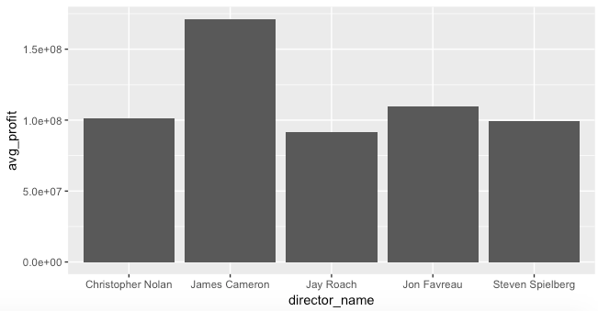
Average Profit for Top 5 directors with more than 5 movies
The top five reliable directors are :James Cameroon, Jon Favreau, Steven Spielberg, Christopher Nolan and Jay Roach

Slide 6
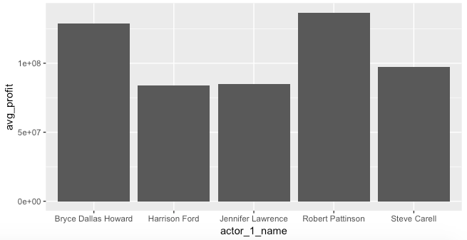
Top five profitable first actors with more than 5 movies
Robert Pattison, Bryce Dallas Howard, Steve Carell, Harrison Ford and Jennifer Lawrence.

Slide 7
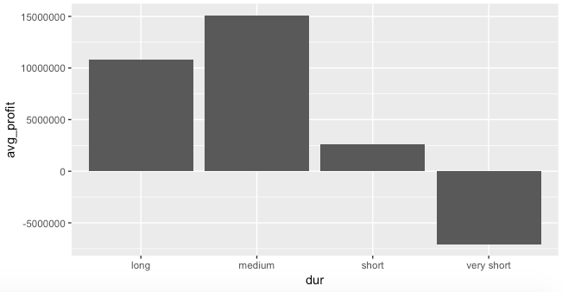
Classifying movies into different duration categories and seeing the variation of profit
The movies are classified into four categories : very small if it is less than an hour. Small is it is less than 2 hours, Medium if less than 3 hours and Long if more than 3 hours.
Very-short movies are not at all profitable. The most profitable are the medium duration movies followed by long duration and short duration.

Slide 8
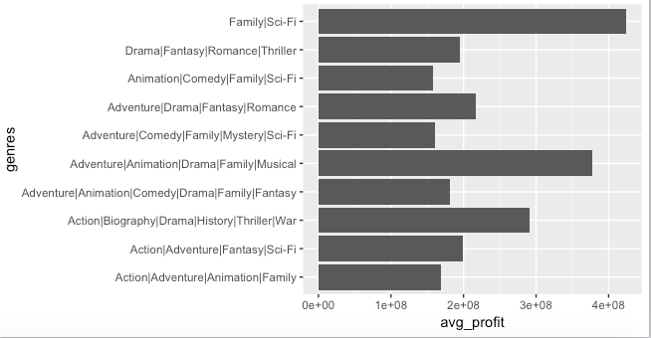
Dependency of Profit on the Genre of the Movie
The Sci-Fi|Family movies are the most profitable, followed by Adventure|Biography|Drama|Family|Musical.

Slide 9
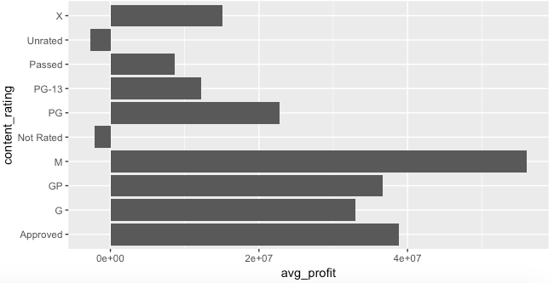
Profitability and Rating of Movies
M rated movies are the most profitable.
A movie without rating is not profitable.

Slide 10
Actor_1 with most Facebook likes
actor_1_name | Avg_likes
Darcy Donavan | 640000
Matthew Ziff | 260000
Krista Allen | 164000
Andrew Fiscella | 137000
Jimmy Bennett | 87000
Michael Joiner | 77000
Robin Williams | 49000
Craig Stark | 46000
Muse Watson | 45000
Tim Holmes | 44000

Slide 11
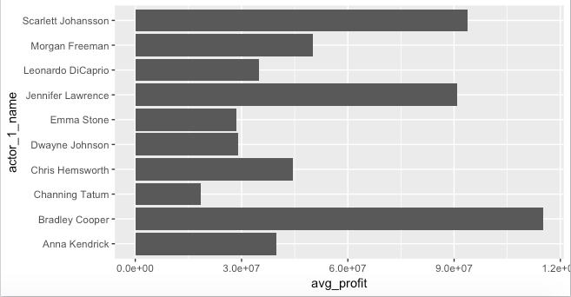
Classification of average profit based on actor_1 having 5 or more movies after 2006
Facebook was very famous after 2006.
Plot of top 10 profitable actors based on movies released aster 2006 is carried out.
Top actors are not people with highest number of Facebook likes.

Slide 12
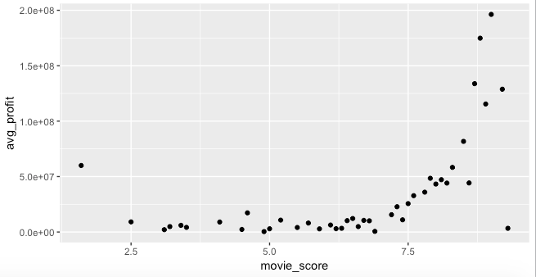
Profitability and movie score
Average Profit Increases exponentially with movie score.
It is an important parameter which determines the profitability of a movie.

Slide 13
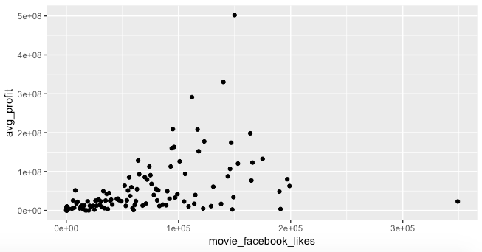
Profitability and movie_facebook_likes
No clear trend is visible.
Facebook likes does not have a bearing on the profitability of a movie.

Slide 14
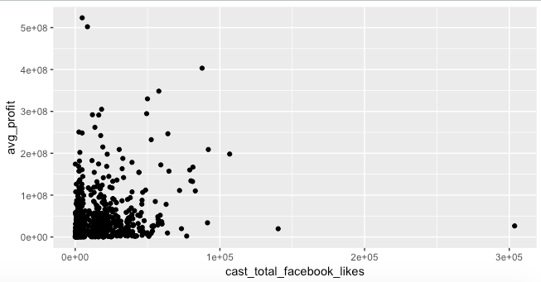
Profitability and cast_total_facebook_likes
No clear trend visible.
Cast Facebook likes does not seem to have an effect on the profitability of the movie.

Slide 15
Conclusion
James Cameroon, Jon Favreau, Steven Spielberg, Christopher Nolan and Jay Roach are top 5 profitable directors.
Robert Pattison, Bryce Dallas Howard, Steve Carell, Harrison Ford and Jennifer Lawrence are the top 5 profitable first actors.
Making a medium duration (1hr – 2 hr) movie is highly profitable.
Family|Sci-Fi is the most profitable genre.
M rated movies are the most profitable.
There is no relationship between Facebook likes and profitability. So cost spent on these platforms can be avoided.
Movie score is the most important factor determining the profitability of a movie.
If a movie ticks all the above boxes, it is sure to be profitable.

