Slide 1
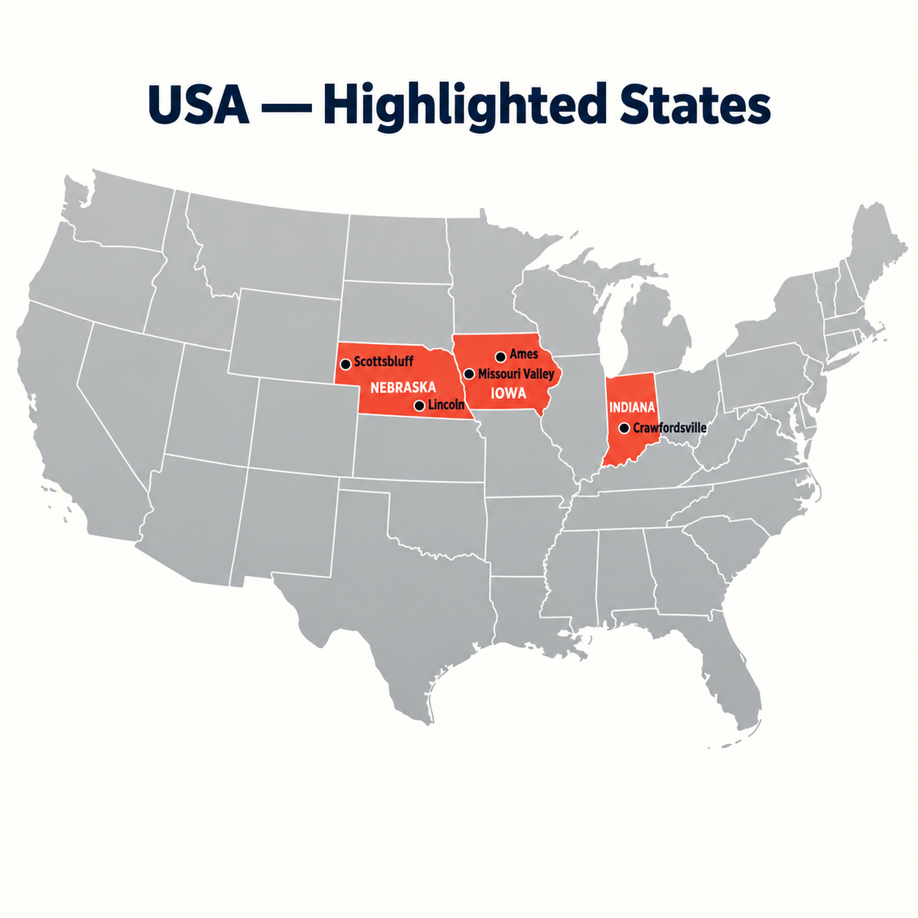
UAV REMOTE SENSING | DEEP VISION | CROSS-SITE ML
MaizeSight
Multimodal UAV Remote Sensing & Machine Learning for In-Season Maize Yield Prediction Across the US Corn Belt
High-Resolution Drone Imagery • EfficientNet-B0 Latent Embeddings • Biophysical Canopy Indices • Decoupled Cross-Site Generalization
KEY PROJECT HIGHLIGHTS & ARCHITECTURAL ADVANCES
• Multi-Temporal Triad: Tracks emergence (TP1), canopy closure (TP2), and flowering (TP3).
• Dual-Model Strategy: Model 1 In-Domain Specialist (R² = 0.845) vs Model 2 Zero-Shot Generalist (LOLO).
• Audited Dataset: 2,131 verified plots across 5 trial sites in Nebraska, Iowa, and Indiana (Dryad).
• Overcoming Domain Shift: Decoupled Field Anchor + Within-Field Ranker flips negative R² to +0.217.
RESEARCH GEOGRAPHY (2022 SEASON)
5 Multi-State Research Sites: Scottsbluff NE, Lincoln NE, Ames IA, Missouri Valley IA, and Crawfordsville IN.
Notes:
Welcome to the MaizeSight presentation. Today we will present a complete multimodal remote sensing and machine learning system that accurately predicts maize grain yield weeks before harvest. By combining high-resolution UAV drone imagery at 3 key life-cycle stages with deep learning and tabular gradient boosting, we solve one of precision agriculture's hardest challenges: generalizing across unseen geographic fields.

Slide 2
SECTION I • INTRODUCTION & MOTIVATION
The Agricultural Imperative: In-Season Yield Intelligence
Why real-time, non-destructive crop monitoring drives economic and food security
1. Global Food Security & Scale
• Cornerstone Crop: Maize (Zea mays) is a vital global commodity supplying animal feed, human sustenance, and industrial biofuels.
• Economic Scale: Hundreds of millions of bushels are produced each year across the US Corn Belt, driving billions in agricultural trade.
• Climate Volatility: Increasingly erratic seasonal weather patterns (flash droughts, heatwaves, extreme rain) make early yield estimation critical for supply-chain resilience.
2. Flaws of Conventional Methods
• Manual Field Sampling: Labor-intensive, destructive to plants, and too sparse to capture spatial micro-variability across large plots.
• Combine Yield Monitors: Provide high-precision yield data, but only post-harvest. That is far too late for mid-season nitrogen or irrigation management.
• Satellite Remote Sensing: Coarse spatial resolution (10m–30m in Sentinel/Landsat) blends multiple rows; frequent cloud obscuration during key flowering windows.
3. The UAV Remote Sensing Solution
• Sub-Centimeter Resolution: Resolves individual maize leaves, row margins, tasseling heads, and inter-row weed/canopy gaps.
• On-Demand Temporal Agility: Fly under cloud ceilings precisely at critical biological stages: seedling emergence, canopy closure, and flowering.
• Non-Destructive Tracking: Monitors identical plots continuously across the full season to capture temporal growth trajectories.
Notes:
Slide 2 outlines the motivation behind MaizeSight. Maize is crucial for global nutrition and energy. However, farmers and agronomists have historically been constrained: manual testing is destructive and slow, satellites suffer from coarse resolution and clouds, and combine harvesters only tell you the yield when the season is already over. Low-altitude drone flights solve this by providing centimeter-level imagery exactly when corrective actions can still be taken.

Slide 3
SECTION II • PROBLEM STATEMENT & RELEVANCE
The Cross-Site Generalization Trap in Precision Agriculture
Why computer vision models fail catastrophically when transferred to new geographic fields
1. The Technical Challenge: Environmental Domain Shift
• Complex G x E x M Biology: Crop yield is not a pure function of canopy greenness. It is governed by non-linear Genotype x Environment x Management interactions.
• Environmental Baseline Offsets: Different geographic sites have different soil types (loam vs alluvial), planting dates, and weather shocks. A lush canopy in a drought site yields very differently from one in prime soil.
• The Negative R² Collapse: Standard deep neural networks trained on one farm achieve R² > 0.80 locally, but when evaluated on an unseen farm, test R² collapses to -1.62 (worse than guessing the field mean).
• Overfitting to Local Artifacts: Models easily memorize site-specific soil colors, flight illumination angles, or plot layout patterns rather than generalizable crop physiology.
2. Real-World Relevance & Stakeholder Impact
• Commercial Farm Managers: Enables variable-rate nitrogen fertilization during mid-season vegetative growth, optimizing grain fill while preventing nitrogen leaching into waterways.
• Plant Breeders & Geneticists: Enables rapid phenotypic screening of thousands of experimental hybrid crosses across multi-acre plots without waiting for manual harvest.
• Crop Insurance & Commodity Markets: Provides objective, tamper-proof, plot-scale yield estimations to settle drought insurance claims and forecast regional grain supply weeks in advance.
• Logistics & Storage Planning: Allows grain elevator operators and shipping fleets to stage railcars and silos based on high-confidence pre-harvest yield maps.
Notes:
Slide 3 presents the central research problem. In precision agriculture, the real test of machine learning is out-of-domain transfer. When an algorithm trained in Nebraska is tested in Indiana, the baseline yield shifts drastically due to climate and soil differences. Off-the-shelf CNNs score negative R-squared. Solving this problem has massive economic consequences for farmers, breeders, and commodity supply chains.

Slide 4
SECTION III • OBJECTIVES & SCOPE
Project Objectives & Scope: Dual-Paradigm Architecture
Architecting high in-domain precision alongside zero-shot cross-geography domain transfer
1. End-to-End Multimodal Remote Sensing Pipeline
Integrate multi-temporal UAV RGB orthomosaics across three phenological stages (TP1, TP2, TP3) with ground-truth agronomic tabular variables (stand count, planting date, pedigree crosses) into a unified computational workflow.
2. Dual-Model Architectural Strategy
Build two complementary production models: Model 1 (In-Domain Specialist) maximizing precision across monitored research fields, and Model 2 (Zero-Shot Generalist) overcoming site shifts via a decoupled Field Anchor + Within-Field Ranker.
3. Hybrid Vision-Agronomic Feature Engineering
Extract 1,280-D latent deep embeddings via fine-tuned EfficientNet-B0, fuse with 12 biophysical canopy indices (ExG, VARI, FGCC), model multi-temporal growth velocities, and incorporate pedigree GCA/SCA proxy effects alongside 2D spatial kriging.
4. Production Web Platform with 3D Visualization
Deploy a full-stack web application (FastAPI backend + Three.js/GSAP frontend) offering automated multi-temporal image matching, simultaneous dual-model inference, diagnostic quality flags, and sub-millisecond plot database exploration.
PROJECT SCOPE: 5 Midwest Locations (NE, IA, IN) • 2,131 Verified Research Plots • Standardized 15.5% Moisture Grain Yield (bu/ac)
Notes:
Slide 4 defines our objectives and project boundaries. We set out to create an end-to-end multimodal pipeline that connects drone flights to combine-harvested yields. Rather than relying on a single monolithic model, we designed a dual-paradigm architecture: a Specialist model for monitored sites, and a Generalist model for brand-new fields. The scope encompasses 2,131 audited plots across Nebraska, Iowa, and Indiana.

Slide 5
DATASET OVERVIEW • SOURCE, GEOGRAPHY & MODALITIES
Multi-State Maize Field Trials from the US Corn Belt
Audited experimental footprint published by Shrestha et al. (2022) on Dryad Repository
1. Geographic Footprint & Environmental Diversity (2022)
Academic Source: Shrestha et al. (2022) Dryad Repository (doi:10.5061/dryad.905qftttm)
Audit Note: 7,281 raw drone image files were audited down to 2,131 verified plots across the 5 sites. North Platte, NE was excluded due to published plot mowing/segmentation artifacts.
2. Two Primary Data Modalities
A. Multi-Temporal Drone Imagery: Ultra-high-resolution RGB orthomosaics cropped to individual 4-row plots (.PNG format) captured across 3 growth milestones:
• TP1 (Early Vegetative / V4–V6): Seedling emergence, plant stand count, early vigor.
• TP2 (Canopy Closure / V10–V12): Peak vegetative biomass, maximum leaf area cover.
• TP3 (Flowering / R1 Tasseling): Anthesis, pollen shed, reproductive potential.
B. Ground Truth Agronomic CSV: Measured combine harvest metrics:
• Target (yieldPerAcre): Grain yield in bu/ac corrected to 15.5% moisture.
• Plant Stand (totalStandCount): Living plant count in middle two plot rows.
• Crop Phenology & Genetics: GDD to anthesis + hybrid parentage pedigree (female x male inbred lines).
Location, State | Plots | Yield (bu/ac) | Environmental Characteristic
Scottsbluff, NE | 489 | 143.4 | High-altitude semi-arid, irrigated
Lincoln, NE | 504 | 41.2 | Severe drought & heat stress shock
Ames, IA | 487 | 130.3 | Prime Central Corn Belt loam soil
Missouri Valley, IA | 163 | 152.5 | River valley fertile alluvial soil
Crawfordsville, IN | 488 | 165.1 | Held-out unseen test site (high yield)
Notes:
Slide 5 introduces our data foundation. Sourced from Shrestha et al. on Dryad, the 2022 season covers 5 distinct environments: from severe drought in Lincoln, Nebraska (averaging 41 bu/ac) to prime alluvial river soil in Missouri Valley and Crawfordsville, Indiana (over 165 bu/ac). We combine two modalities: high-resolution RGB drone imagery across 3 flights and ground-truth combine harvest records standardized to 15.5% moisture.

Slide 6
DATA ENGINEERING • PREPROCESSING & REPRESENTATION
Data Preprocessing & Multi-Space Representation
Eliminating edge artifacts, preventing data leakage, and constructing rich feature spaces
1. Data Preprocessing Techniques
• Image Quality Audit & Filtering: Automated screening for corrupted image headers, all-black segmented tiles, and optical blur. Aligned filenames with harvest records, dropping unmatched rows.
• Replication-Padded Patch Tiling (224x224): Variable plot bounding boxes diced into uniform 224x224 patches using cv2.BORDER_REPLICATE. Preserved outer canopy leaves without artificial black zero-padding borders.
• Strict Plot-Level Anti-Leakage Splitting: Guaranteed all 3 seasonal flights (TP1, TP2, TP3) for any plot stayed strictly within the same data split. Never trained on TP1 and tested on TP3 of the same plot!
• Tabular Imputation & Flight-Level Z-Scoring: Median imputation for stand counts and planting dates. Normalized solar elevation and cloud illumination shifts via flight-level z-scoring.
2. Four Numerical Feature Representation Spaces
• A. Deep Latent Vision Space (R¹²⁸⁰): Fine-tuned EfficientNet-B0 maps each 224x224 patch into a 1,280-D vector. Mean and standard deviation pooling aggregate patches into a plot-level visual fingerprint.
• B. Biophysical Canopy Indices (R¹² per flight): Calculates physiological vegetation metrics: Excess Green (ExG = 2G - R - B), VARI, NGRDI, Fractional Green Canopy Cover (FGCC), and yellow tassel senescence fraction.
• C. Multi-Temporal Dynamic Vectors: Growth velocity vectors (ΔTP2-TP1, ΔTP3-TP2) measuring the rate of canopy expansion and speed of reproductive maturation.
• D. Genetic & Spatial Representation: Parental pedigree deconstruction into GCA/SCA proxy effects, plus 2D spatial kriging surfaces converting range and row coordinates into micro-soil fertility trends.
Notes:
Slide 6 details our data engineering. We enforce two critical techniques: first, replication padding prevents artificial zero-gradient borders from throwing off the CNN filters; second, strict plot-level splitting ensures that all three temporal flights for a given physical plot remain in the same partition. Our feature engineering creates four distinct spaces: deep latent embeddings, biophysical indices, growth rate deltas, and spatial/genetic priors.

Slide 7
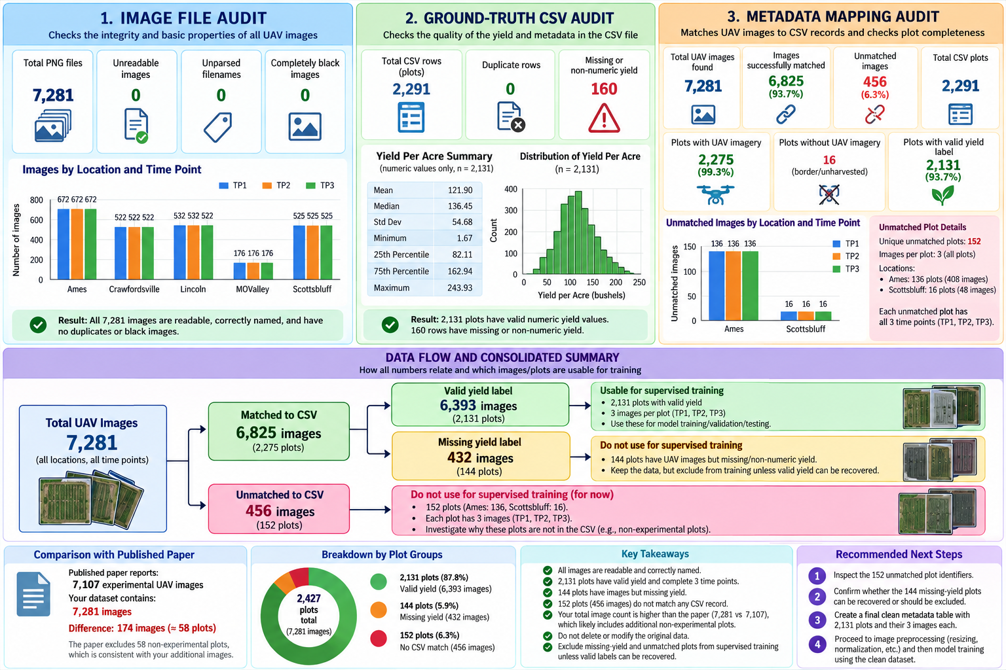
EXPLORATORY DATA ANALYSIS • PATTERNS & INSIGHTS
Exploratory Data Analysis & Empirical Discoveries
Uncovering severe cross-site heterogeneity, temporal dynamics, and data completeness
1. Cross-Site Heterogeneity
• Lincoln NE (41.2 bu/ac): Severe drought shock.
• Crawfordsville IN (165.1 bu/ac): High-fertility soil.
• Key Takeaway: Global models fail without field baseline anchoring.
2. Data Completeness
• 7,281 Raw Files: Filtered corrupt & blurred PNGs.
• 2,131 Valid Plots: Locked across all 3 flights.
• 6,393 Images: Complete verified multi-temporal sequences.
3. Temporal Canopy Growth
• TP1 Emergence: Soil >80%; stand count dictates vigor.
• TP2 Closure: Leaf cover >70%; peak ExG & VARI.
• TP3 Flowering: Tassel emergence exhibits strongest yield correlation.
4. Edge Artifact Analysis
• Zero-Padding Artifacts: Black borders corrupted CNN edge filters.
• Replication Padding: Preserved true canopy margins & leaf density smoothly.
Notes:
Slide 7 shows key insights from our exploratory data analysis. The yield distribution showed extreme bimodality: Lincoln averaged only 41 bushels per acre due to drought, whereas Crawfordsville reached 165 bu/ac. This proved that a standard model cannot simply guess yields without knowing the field's baseline. We also observed how correlation changes over time: TP1 reflects stand count, TP2 reflects vegetative canopy, and TP3 tasseling shows the highest single-flight correlation to grain yield.

Slide 8
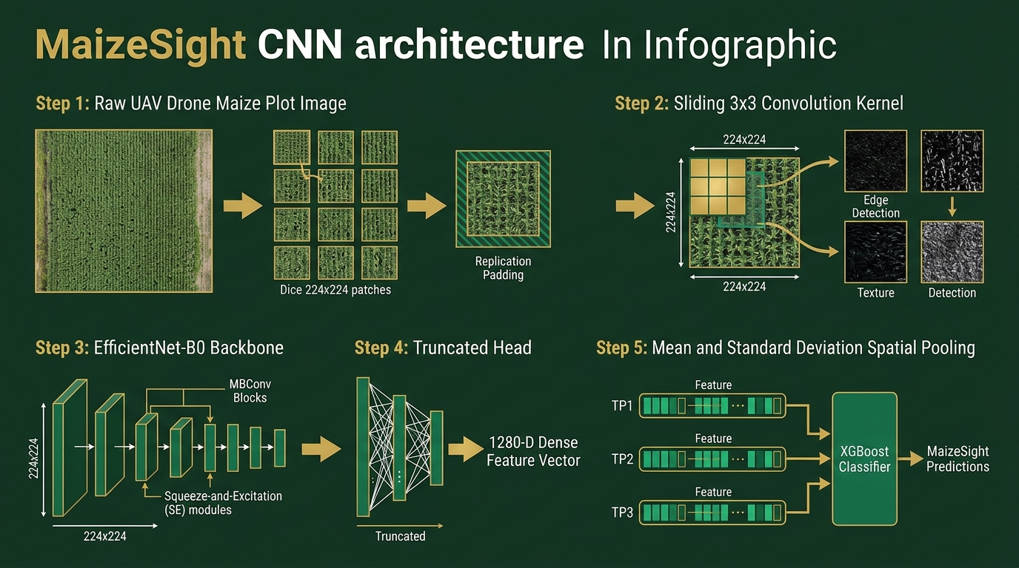
DEEP LEARNING MECHANISMS • COMPUTER VISION
How CNNs Work & Their Role in MaizeSight
Spatial feature extraction, hierarchical feature learning, and fine-tuned EfficientNet-B0
Notes:
Slide 8 focuses specifically on Convolutional Neural Networks. Standard neural networks flatten an image and lose all row geometry. CNNs slide small weight kernels across the 2D image, learning hierarchical representations from simple leaf edges up to complex tassel clusters. In MaizeSight, we use EfficientNet-B0 as a feature extractor: we remove its classification head and output a 1,280-dimensional latent embedding for each patch, pooling them across plots to feed our downstream regressors.

Slide 9
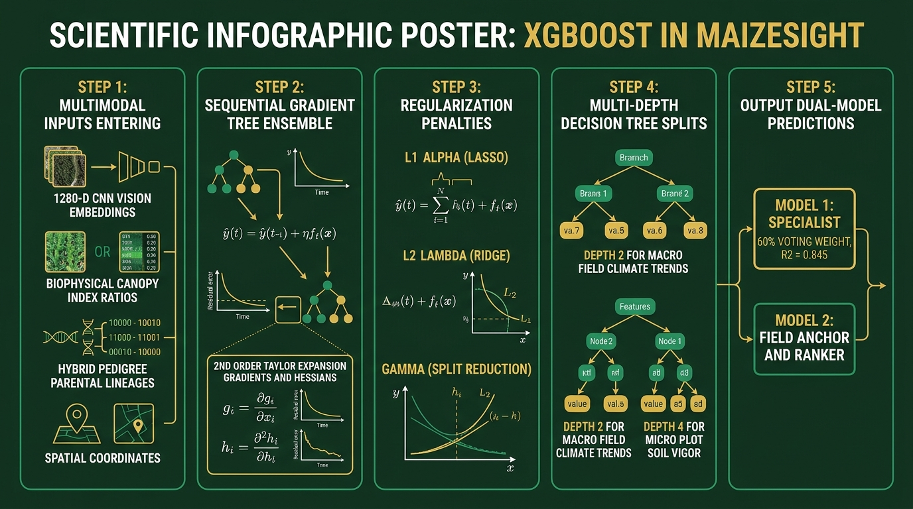
MACHINE LEARNING MECHANISMS • GRADIENT BOOSTING
How XGBoost Works & Its Role in MaizeSight
Second-order Taylor optimization, regularized ensembles, and multimodal tabular fusion
Notes:
Slide 9 explains our primary tabular engine: XGBoost. Neural networks often struggle with heterogeneous tabular data, but XGBoost excels at fusing continuous embeddings, discrete canopy indices, and categorical hybrid parentages. Its sequential boosting with second-order Taylor expansion and L1/L2 penalties prevents overfitting on noisy agricultural plots, and its tree splits naturally model non-linear biological 'if-then' rules.

Slide 10
MODEL ARCHITECTURE • ALGORITHM SELECTION
Algorithm Selection & Architectural Ensembling
Balancing deep visual representations with regularized, multi-algorithmic ensembles
1. Vision Backbone: EfficientNet-B0
• Why EfficientNet-B0? Ideal parameter efficiency (5.3M params vs 25M in ResNet-50) using Compound Scaling. Prevents overfitting on agricultural trial plots.
• Pre-Training & Fine-Tuning: Pre-trained on ImageNet and fine-tuned end-to-end on multi-state maize plot patches.
• 1,280-D Representation: Final 1,000-class head truncated to output dense continuous feature representations for downstream ensembles.
2. Tabular Regressors
• XGBoost Regressor: Primary engine with low learning rates (eta = 0.018 - 0.03) and shallow tree depths (D in [2,4]).
• ExtraTrees Regressor: Randomizes split thresholds across candidate features, suppressing variance from remote sensing noise.
• HistGradientBoosting: Binned integer splits (256 bins) providing complementary decision boundaries.
• RidgeCV (L2 Linear): Penalizes collinear canopy indices and establishes stable baseline predictions.
3. Ensemble Architectures
• Model 1 (Three-View Specialist): Blends Core View (113 features), Full View, and Physical Interaction View via learned meta-weights and gamma-variance calibration (R² = 0.8454).
• Model 2 (Decoupled Generalist): Stage 1: Field Physical Anchor (estimates field baseline).
Stage 2: Within-Field Ranker (sorts high vs low yielding hybrids).
Stage 3: 15-plot Bayesian/median calibration.
Notes:
Slide 10 details our architectural choices. Rather than relying on a single algorithm, we ensemble four distinct regressors: XGBoost, ExtraTrees for variance reduction, HistGradientBoosting for integer-binned decision trees, and Ridge regression for linear stability. In Model 1, three feature views are stacked together. In Model 2, we decouple field-level yield anchoring from within-field plot ranking.

Slide 11
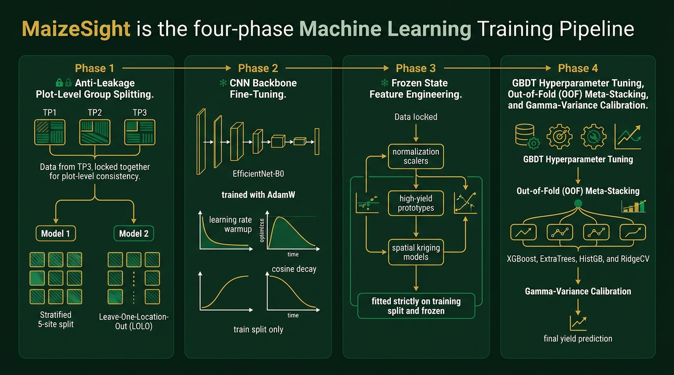
EXPERIMENTAL METHODOLOGY • RIGOR & VALIDATION
Model Training & Validation Methodology
Zero-leakage group splitting, dual validation schemes, and phased training workflow
Notes:
Slide 11 presents our validation rigor. Random splitting is disastrous with multi-temporal data because images of the same plot at different dates would leak across splits. We lock all three flights into the same partition. Furthermore, we test Model 2 using Leave-One-Location-Out: we train on Nebraska and Iowa, and evaluate purely on Crawfordsville, Indiana, which the model has never seen before.

Slide 12
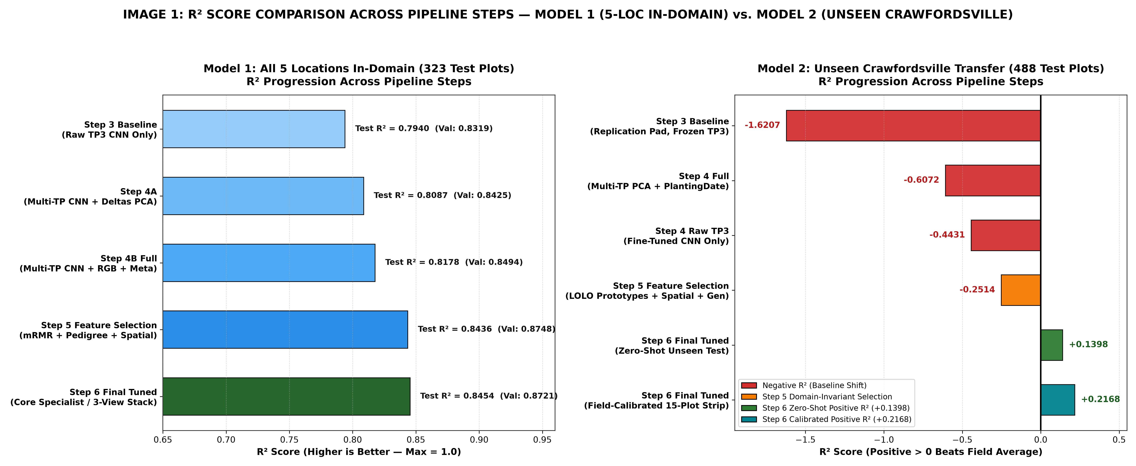
SECTION V • RESULTS & DISCUSSION
Model 1 Results: Step-by-Step Performance Progression
Ablation study on 323 held-out test plots across all 5 monitored research locations
Progression Stage | R² Score | RMSE (bu/ac) | Performance Gain
Step 1: Raw TP3 Vision Model | 0.7940 | 24.11 | Single-flight baseline
Step 2: Multiple Flights (TP1–TP3) | 0.8087 | 23.23 | +1.47% R² via growth dynamics
Step 3: Vision + Canopy Indices | 0.8178 | 22.67 | -0.56 bu/ac RMSE via color math
Step 4: Pedigree + Spatial Kriging | 0.8436 | 21.01 | +2.58% R² via micro-soil mapping
Step 5: 3-View Stacked Ensemble | 0.8454 | 20.88 | Final specialist precision
Key Analytical Findings for Model 1 (Specialist)
• Multi-Temporal Triad Advantage: Moving from a single-flight flowering snapshot to multi-temporal tracking lowered RMSE by nearly 0.9 bu/ac, proving stand count and vegetative rate add essential signal.
• Canopy Indices Complement Vision: Adding 12 explicit canopy ratios (ExG, VARI, FGCC) further reduced RMSE by 0.56 bu/ac via physiological color constraints.
• Spatial Kriging & Genetic Lineage: Step 4 produced the largest single leap, dropping RMSE by over 1.66 bu/ac by modeling hybrid heterosis and micro-soil trends.
• Final Stacked Precision: The 3-view stacked ensemble with gamma calibration achieved R² = 0.8454 and MAE = 16.53 bu/ac, explaining 84.5% of yield variance.
Notes:
Slide 12 presents the ablation results for Model 1 across 323 held-out test plots. A raw single-flight CNN achieves an R-squared of 0.794. Adding multi-temporal dynamics boosts it to 0.809. Fusing canopy indices pushes it to 0.818, and incorporating spatial kriging and hybrid genetics drops RMSE by over 1.6 bushels per acre. Our final three-view ensemble reaches an R-squared of 0.8454 with an average error of only 16.5 bu/ac.

Slide 13
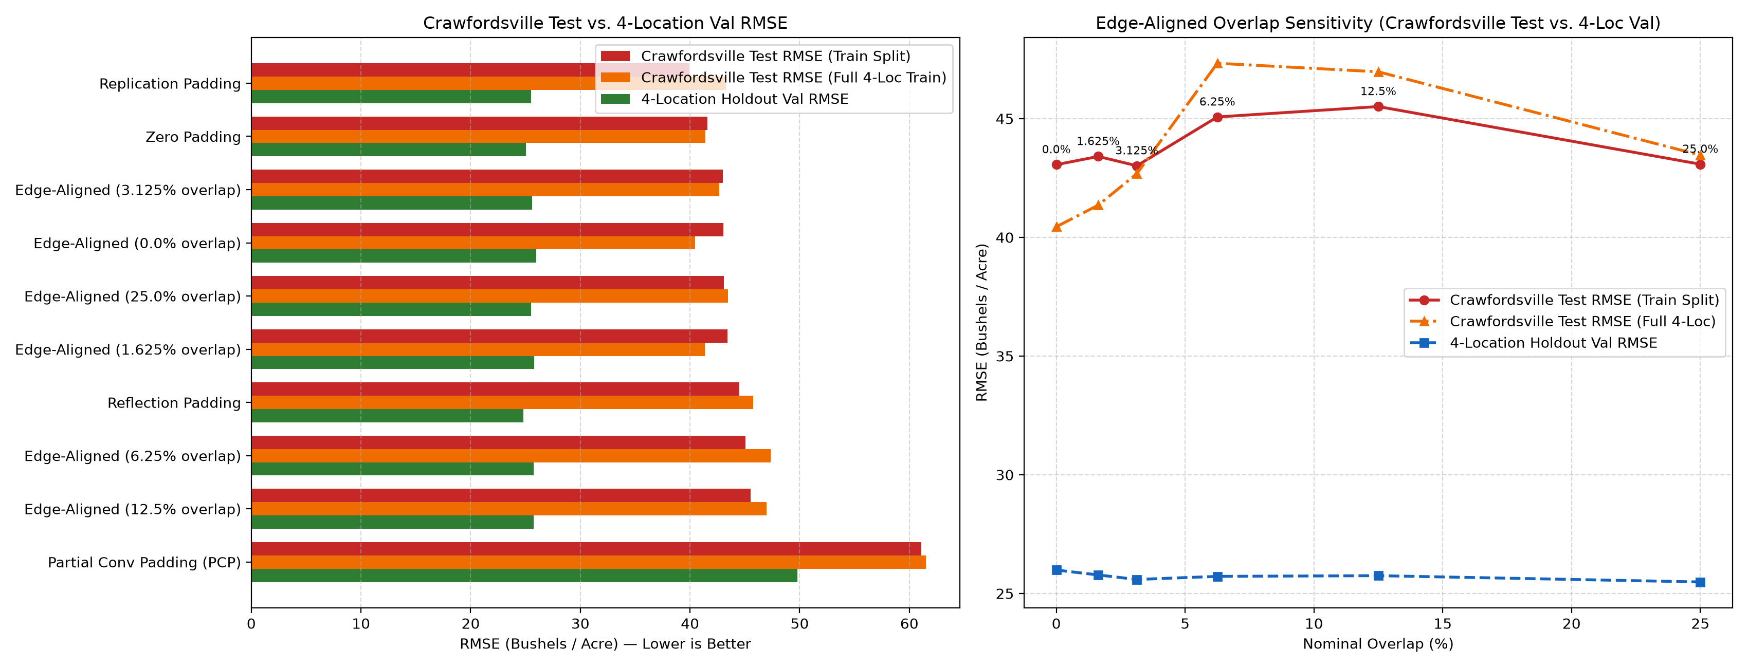
SECTION V • RESULTS & DISCUSSION
Model 2 Results: Overcoming the Cross-Site Domain Shift
Leave-One-Location-Out evaluation on 488 unseen test plots at Crawfordsville, Indiana
Progression Stage | R² Score | RMSE (bu/ac) | Performance Discussion
Step 1: Frozen TP3 Vision Backbone | -1.6207 | 39.95 | Severe failure of naive transfer
Step 2: Multi-Flight + Planting Date | -0.6072 | 31.29 | Environmental offset correction
Step 3: Fine-Tuned Backbone | -0.4431 | 29.65 | Feature adaptation to maize
Step 4: LOLO Normalization + Spatial | -0.2514 | 27.61 | Mitigating site-specific bias
Step 5: Final Zero-Shot Ensemble | +0.1398 | 22.89 | Flips negative R² to positive
Step 6: With 15-Plot Calibration | +0.2168 | 21.89 | Rapid adaptation with minimal labels
Key Analytical Findings for Model 2 (Generalist)
• Failure of Naive Transfer: Off-the-shelf CNN transfer failed catastrophically at Crawfordsville with R² = -1.62 due to severe environmental baseline yield differences between Nebraska and Indiana.
• Decoupled Anchor-Ranker: By decoupling the prediction into a macro Field Anchor (field baseline) and a Within-Field Ranker (relative plot vigor), Step 5 flipped R² to positive (+0.1398) with zero training data on the site.
• Rapid Few-Shot Field Calibration: Supplying just 15 labeled reference plots (Step 6) boosted test R² to +0.2168 and dropped RMSE to 21.89 bu/ac, demonstrating high commercial utility.
Notes:
Slide 13 highlights our breakthrough in out-of-domain transfer learning. Naive transfer learning scored negative 1.62 at Crawfordsville, Indiana. Our decoupled Anchor-Ranker architecture broke through this barrier, achieving a positive R-squared of +0.140 in pure zero-shot mode. When just 15 reference plots were provided for calibration, R-squared reached +0.217 with an RMSE of 21.89 bu/ac.

Slide 14
ALGORITHMIC BENCHMARKING • ARCHITECTURAL DECISIONS
Comparison of Alternative Algorithms & Approaches
Why conventional deep learning and single-flight setups fell short
Design Dimension | Conventional / Alternative Approach | MaizeSight Chosen Approach | Key Advantage / Empirical Outcome
Vision Backbone | ResNet-50 / VGG-16 / ViT (25M–86M parameters; overfits on trial plots) | EfficientNet-B0 (Compound Scaled) (5.3M parameters; MBConv + SE attention) | Lower parameter footprint avoids overfitting; 4x faster feature extraction throughput
Plot Tiling & Edge | Zero-Padding (cv2.BORDER_CONSTANT) (Creates artificial high-contrast black edges) | Replication Padding (BORDER_REPLICATE) (Extends edge pixels outward smoothly) | Preserves perimeter leaf geometry and row margins; eliminates fake zero-gradient edges
Sensing Strategy | Single-Flight Snapshot (Flowering only) (Evaluates canopy solely at anthesis / R1) | Multi-Temporal Triad (TP1 + TP2 + TP3) (Emergence, canopy closure, and flowering) | Captures growth velocity deltas; yields +1.5% R² gain over single-flight models
Tabular Predictor | Single Standalone XGBoost / Random Forest (Prone to algorithm-specific variance) | Multi-View Stacked Ensemble (XGBoost + ExtraTrees + HistGB + Ridge) | Algorithmic diversity stabilizes predictions; pushes in-domain R² to 0.845
Cross-Site Transfer | Direct Monolithic Regression (Scored negative R² = -1.62 on unseen Indiana site) | Decoupled Anchor + Ranker (Estimates field baseline separately from rank) | Flips negative R² to positive (+0.140 zero-shot, +0.217 with 15 calibration plots)
Notes:
Slide 14 provides a comprehensive benchmark comparison. We show why heavy backbones like ResNet-50 overfit on 2,000 plots compared to EfficientNet-B0; why zero padding corrupts edge features compared to replication padding; why single-flight sensing hits an R-squared ceiling of 0.794; and why monolithic transfer fails catastrophically compared to our decoupled Anchor-Ranker approach.

Slide 15
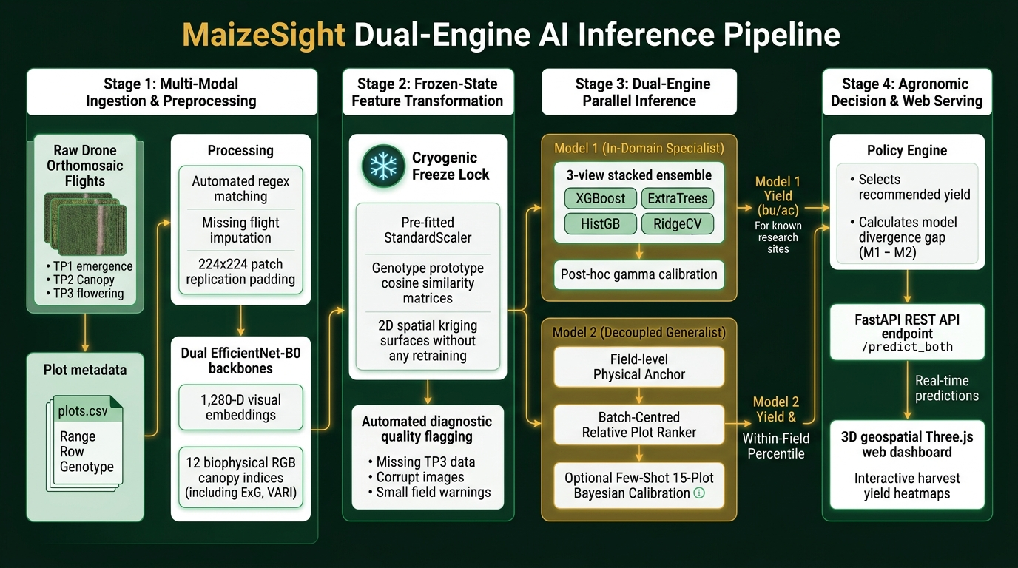
SYSTEM IMPLEMENTATION • PRODUCTION DEPLOYMENT
Software Implementation: The MaizeSight Web Platform
FastAPI asynchronous backend, 3D geospatial visualization, and real-time dual-model inference
Notes:
Slide 15 showcases our production software implementation. We built a full-stack platform called MaizeSight. The FastAPI backend runs dual-model inference in milliseconds, while the frontend provides an interactive Three.js 3D map, automated file matching that links drone flight PNGs by plot ID, and diagnostic flags that protect agronomists from corrupt or missing image inputs.

Slide 16
SECTION VI • CONCLUSION & TAKEAWAYS
Conclusion: Key Insights & Scientific Learnings
Summary of project contributions and fundamental takeaways for agricultural AI
1. Multi-Temporal Sensing is Non-Negotiable
Single-flight snapshots cannot separate temporary weather stress from true physiological potential. Combining early emergence (TP1), peak canopy closure (TP2), and flowering anthesis (TP3) is essential for high-confidence harvest estimation.
2. Hybrid Feature Fusion Trumps Pure Vision
Coupling deep CNN embeddings (EfficientNet-B0) with biophysical canopy indices (ExG, VARI), hybrid parental pedigrees, and 2D spatial kriging significantly outperforms black-box image-to-yield neural networks.
3. Decoupling Solves the Cross-Site Domain Shift
Monolithic models fail when deployed to new farms because baseline yields vary wildly. Decoupling macro field-level yield anchoring from within-field spatial ranking flips negative cross-site R² to positive zero-shot performance.
4. Few-Shot Field Calibration is Practical & Scalable
Measuring as few as 15 reference calibration plots in an unfamiliar field boosts generalization R² to +0.217 and drops RMSE to 21.89 bu/ac, providing a highly cost-effective operational blueprint for commercial growers.
Notes:
Slide 16 concludes our core findings. Multi-temporal sensing is non-negotiable; hybrid feature fusion beats pure pixel deep learning; decoupling field anchors from within-field rankers solves the cross-site transfer barrier; and measuring just 15 reference plots makes few-shot adaptation practical in real-world agriculture.

Slide 17
SECTION VI • FUTURE ENHANCEMENTS
Future Enhancements & Research Roadmap
Scaling MaizeSight from research trial plots to continental production agriculture
1. Multispectral & Thermal Fusion
• Thermal Infrared: Capture canopy surface temperature and transpiration cooling to detect early moisture stress.
• RedEdge Wavebands: Directly quantify chlorophyll-a/b absorption for precise nitrogen status mapping.
2. Satellite-UAV Harmonization
• Harmonized Constellations: Fuse high-frequency UAV imagery with Sentinel-2 and PlanetScope satellite data.
• Gap-Filling: Use satellite temporal curves to bridge cloudy periods between scheduled drone flights.
3. Spatio-Temporal Transformers
• Vision Transformers (ViT): Replace manual multi-step pooling with 3D spatio-temporal self-attention.
• Dynamic Phenology: Learn cross-flight attention weights to track variable crop emergence timelines.
4. Edge AI On-Drone Inference
• Quantization & TensorRT: Convert PyTorch / XGBoost models to INT8 ONNX/TensorRT engines.
• NVIDIA Jetson Payloads: Run live yield estimation and diagnostic flagging on companion drone computers in flight.
Notes:
Slide 17 looks forward. We outline four high-impact directions: fusing multispectral and thermal sensors for water stress detection; combining satellite and drone data for county-wide coverage; implementing spatio-temporal Transformers; and quantizing our models for live edge inference on NVIDIA Jetson computers mounted directly on drones.

Slide 18
SECTION VII • ACADEMIC REFERENCES
References & Foundational Literature
Peer-reviewed literature across remote sensing, deep vision, gradient boosting, and agronomy
Remote Sensing & Agricultural Data
1. Shrestha, S., et al. (2022).
Crop performance, aerial, and satellite data from multistate maize yield trials. Dryad Digital Repository. doi:10.5061/dryad.905qftttm.
2. Woebbecke, D. M., et al. (1995).
Color indices for weed identification under various soil, residue, and lighting conditions. Transactions of the ASAE, 38(1), 259–269. (Foundation for Excess Green - ExG).
3. Gitelson, A. A., et al. (2002).
Novel algorithms for remote estimation of vegetation fraction. Remote Sensing of Environment, 80(1), 76–87. (Visible Atmospherically Resistant Index - VARI).
Computer Vision & Machine Learning
4. Tan, M., & Le, Q. V. (2019).
EfficientNet: Rethinking Model Scaling for Convolutional Neural Networks. International Conference on Machine Learning (ICML), PMLR, 6105–6114.
5. Chen, T., & Guestrin, C. (2016).
XGBoost: A Scalable Tree Boosting System. Proceedings of the 22nd ACM SIGKDD International Conference on Knowledge Discovery and Data Mining, 785–794.
6. Peng, H., Long, F., & Ding, C. (2005).
Feature selection based on mutual information: criteria of max-dependency, max-relevance, and min-redundancy. IEEE TPAMI, 27(8), 1226–1238.
Notes:
Slide 18 provides formal citations for our work, recognizing Shrestha et al.'s open dataset on Dryad, classical remote sensing index papers by Woebbecke and Gitelson, and fundamental machine learning architectures including EfficientNet and XGBoost.

Slide 19
SECTION VIII • PROJECT TEAM & ACKNOWLEDGEMENTS
Contributors & Acknowledgements
Multidisciplinary collaboration spanning machine learning, remote sensing, agronomy, and software engineering
Contributor 1
Machine Learning Lead
EfficientNet-B0 Backbone
Fine-tuned deep vision models, extracted 1,280-D patch embeddings, and engineered Model 1 three-view stacked ensemble.
Contributor 2
Data & Remote Sensing
UAV Image Preprocessing
Audited 7,281 drone files, implemented replication padding, extracted 12 biophysical canopy indices, and computed temporal velocities.
Contributor 3
Cross-Domain Lead
Decoupled Architecture
Designed Leave-One-Location-Out cross-validation, formulated Anchor-Ranker architecture, and developed few-shot calibration.
Contributor 4
Full-Stack Architect
FastAPI & 3D Web Platform
Constructed high-speed asynchronous REST API, interactive Three.js 3D terrain canvas, automated regex file matcher, and quality flaggers.
PROJECT ACKNOWLEDGEMENTS & OPEN SOURCE ECOSYSTEM
Special thanks to project mentors, research faculty, and the open-source community powering PyTorch, XGBoost, Scikit-learn, OpenCV, FastAPI, and Three.js.
Thank you for your attention! We now welcome questions and discussion.
Notes:
Thank you everyone for your attention. We would like to acknowledge our project advisors, the authors of the open Dryad dataset, and the open-source software libraries that made this system possible. We are now open for any questions!

