Slide 1
Develop Specification, Implementation and Verification of Asynchronous FIFO
TEAM1
Mahidhar Regalla
Ashwin Sivakumar
Monica pinnamaneni

Slide 2
TOPICS:
Introduction.
Participation of each member of the group.
Brief description.
Design-style.
Approach to verifying our design.
Verification techniques used to verify our design.
Code / functional coverage / assertions etc.
Test matrix.
Simulation results.
Issues faced/ challenges.
Challenges Resolved.
Conclusion.
Future work.
Citations.

Slide 3
Introduction of team members and their quarter at PSU and mention level of expertise in verification and UVM field
MONICA PINNAMANENI
Email id : monicap@pdx.edu
PSU ID : 904689129
TERM : 4th term
TRACK : Design verification and validation
Expertise in verification and UVM Field : Intermediate
MAHIDHAR REGALLA
Email id : mahidhar@pdx.edu
PSU ID : 951927746
TERM : 2nd term
TRACK : Design verification and validation
Expertise in verification and UVM Field : Intermediate
ASHWIN SIVAKUMAR
Email id : ashwins@pdx.edu
PSU ID : 977214327
TERM : 2nd term
TRACK : Design verification and validation
Expertise in verification and UVM Field : Intermediate

Slide 4
Participation of each member of the group
MONICA PINNAMANENI
MAHIDHAR REGALLA
ASHWIN SIVAKUMAR
DESIGN
FIFO Full
FIFO Top
SystemVerilog Environment
Env
Interface
Test
UVM Environment
UVM_TB
Agent
Interface
Transaction
Direct Testcases
HLDS Document
PPT
Verification Plan
DESIGN
FIFO Read to Write Pointer
FIFO Empty
SystemVerilog Environment
Driver
Monitor_in
Monitor_out
UVM Environment
Monitor
Sequence_item
Test
Assertions
HLDS Document
PPT
Verification Plan
DESIGN
FIFO mem module
FIFO write to read pointer
SystemVerilog Environment
Scoreboard
Testbench
Generator
Run.do
UVM Environment
Sequence
Driver
Scoreboard
Sequencer
Functional/Code Covergae
HLDS Document
PPT
Verification Plan

Slide 5
BRIEF DESCRIPTION:
The Async FIFO module is an integral part of a larger digital system, contributing to the seamless integration of components that operate with different clock domains. It acts as a communication bridge, facilitating the transfer of data between a producer module (clk1=250Mhz) and a consumer module (clk2=100Mhz), each operating with its own clock frequency. The Async FIFO is designed to work ideally under clock frequency settings, supporting various requirements such as a 50% duty cycle, maximum write burst size 150, and number of idle cycles between succeeding writes and reads is 0 and 2 with minimum depth as 130 respectively.
Developed High-Level Design Specification (HLDS) for Asynchronous FIFO, implemented that design in SystemVerilog and verified it using Class based/UVM based environment.
Developed Verification Plan.
Verified Functionality of FIFO using various Functional Verification Strategies such as Directed and Randomized Tests.
Added SystemVerilog Assertions to find early stage bugs.
Implemented Code Coverage and Functional Coverage.

Slide 6
DESIGN-STYLE:
Use of Gray Code: Design utilizes Gray code for pointer synchronization, which is a good practice for reducing metastability issues when crossing clock domains.
Pointer Incrementation: The write pointer always points to the next word to be written, and after writing to a memory location, it is correctly incremented to point to the next location. This ensures sequential writing behavior.
Full and Empty Conditions:
Empty Condition: The FIFO is considered empty when the read and write pointers are both equal.
Full Condition: Design correctly identifies the FIFO as full when the write pointer has wrapped around and caught up to the read pointer.The write pointer will increment the unused MSB while setting the rest of the bits back to zero.
This is achieved by comparing the MSB (Most Significant Bit) of the pointers after converting them to Gray code.
Additional Bit for Full and Empty Conditions: Design uses an extra bit to analyze the full and empty conditions, which is a good approach for robustness and clarity in the design.
Reset Behavior: On reset, both read and write pointers are set to zero, ensuring a consistent starting point for the FIFO operation.

Slide 7
VERIFICATION TECHNIQUES:
White Box Testing.
Simulation-based verification: This involves running simulations using specialized tools such as Verilog or VHDL simulators. Simulation allows designers to observe the behavior of the asynchronous FIFO under different conditions, inputs, and stimuli. Various scenarios and corner cases can be tested through simulation to ensure correct functionality.
Assertion-based verification: Assertions are statements that specify expected behavior or properties of the design. Assertion-based verification involves embedding assertions within the design code to check for correct operation during simulation or formal verification. Assertions can help detect violations of design specifications and aid in debugging.
Coverage-driven verification: Coverage metrics are used to measure the extent to which the design has been exercised by the verification process. Coverage-driven verification involves setting coverage goals and tracking verification progress using coverage metrics. This technique helps ensure that the asynchronous FIFO design has been adequately tested and that no important scenarios have been overlooked.
Constraint-based random testing: This technique involves generating random stimulus or test cases for the asynchronous FIFO design, subject to certain constraints

Slide 8
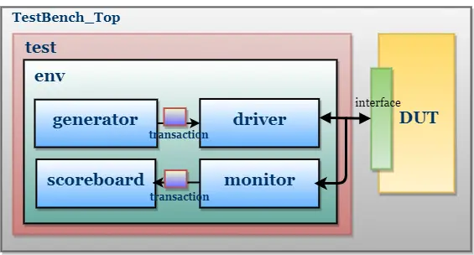
SYSTEM VERILOG VERIFICATION ENVIRONMENT
Mailbox
Mailbox
Monitor out
Monitor in

Slide 9
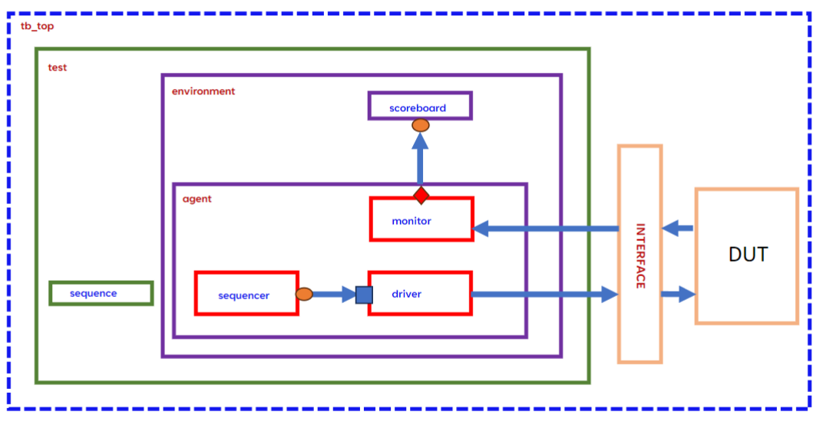
UVM VERIFICATION ENVIRONMENT:

Slide 10
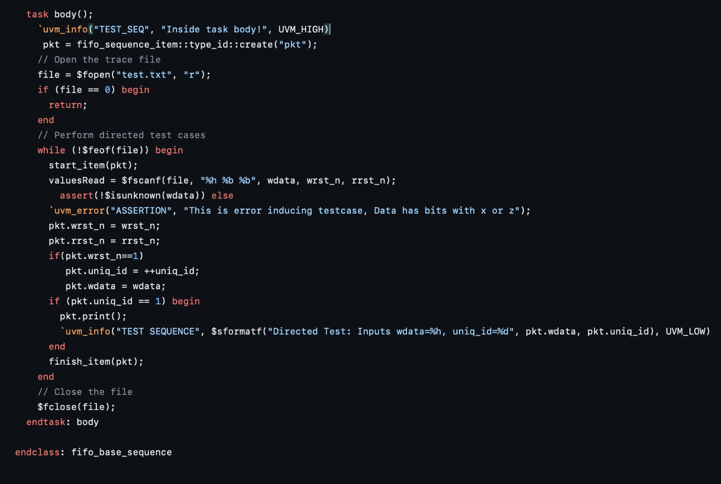
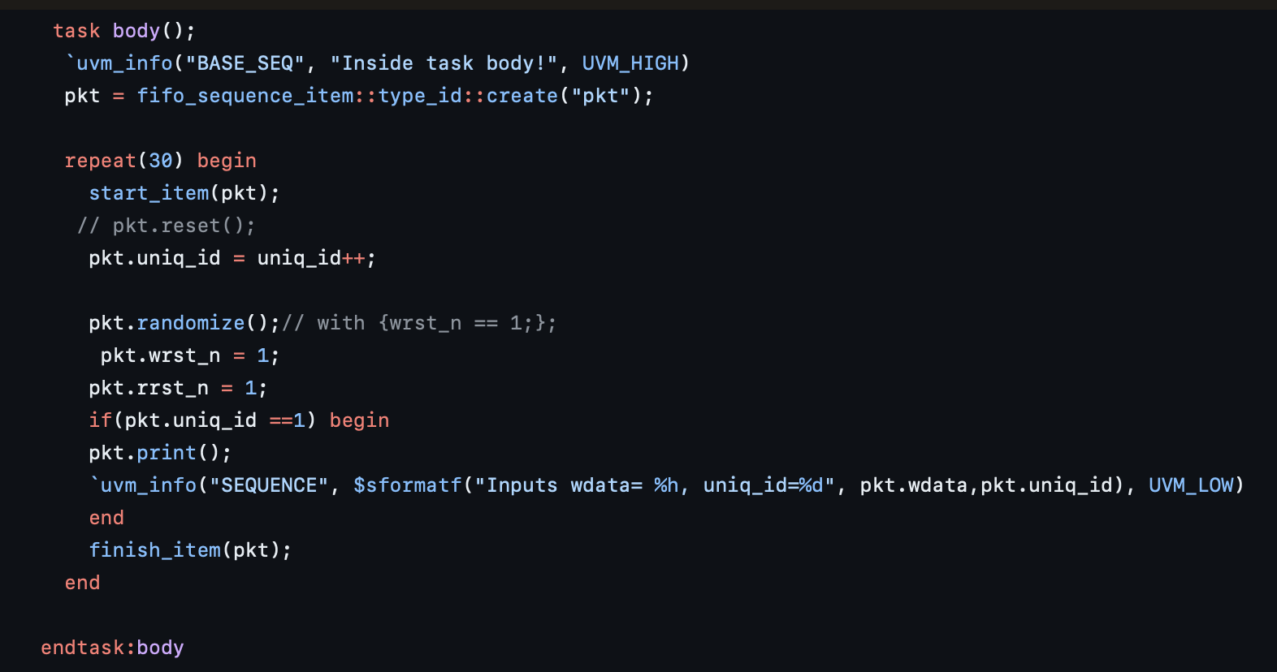
SEQUENCE:

Slide 11
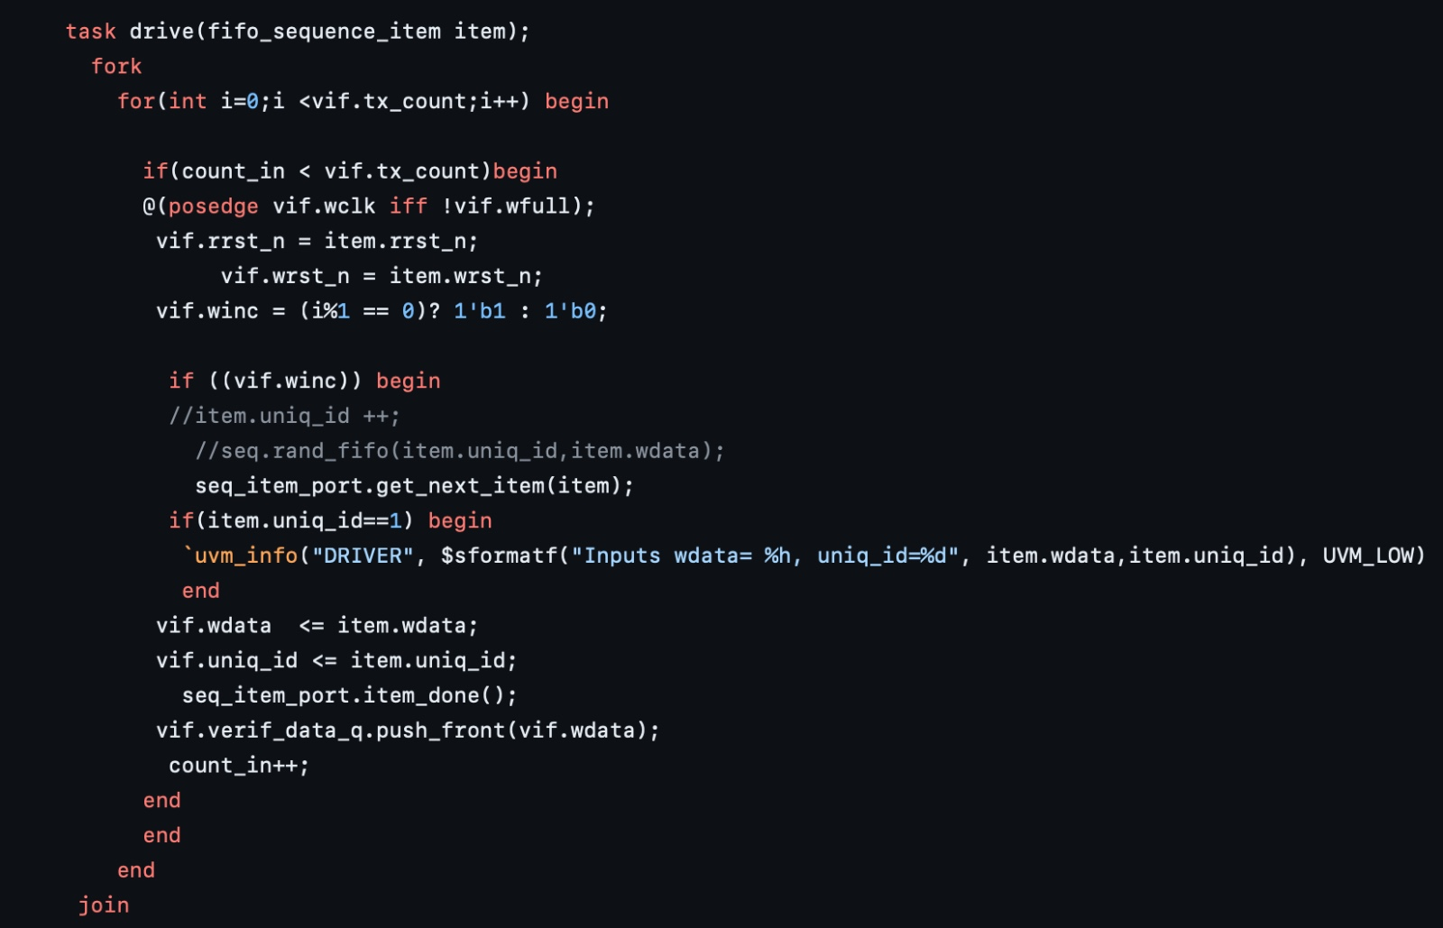
DRIVER:

Slide 12
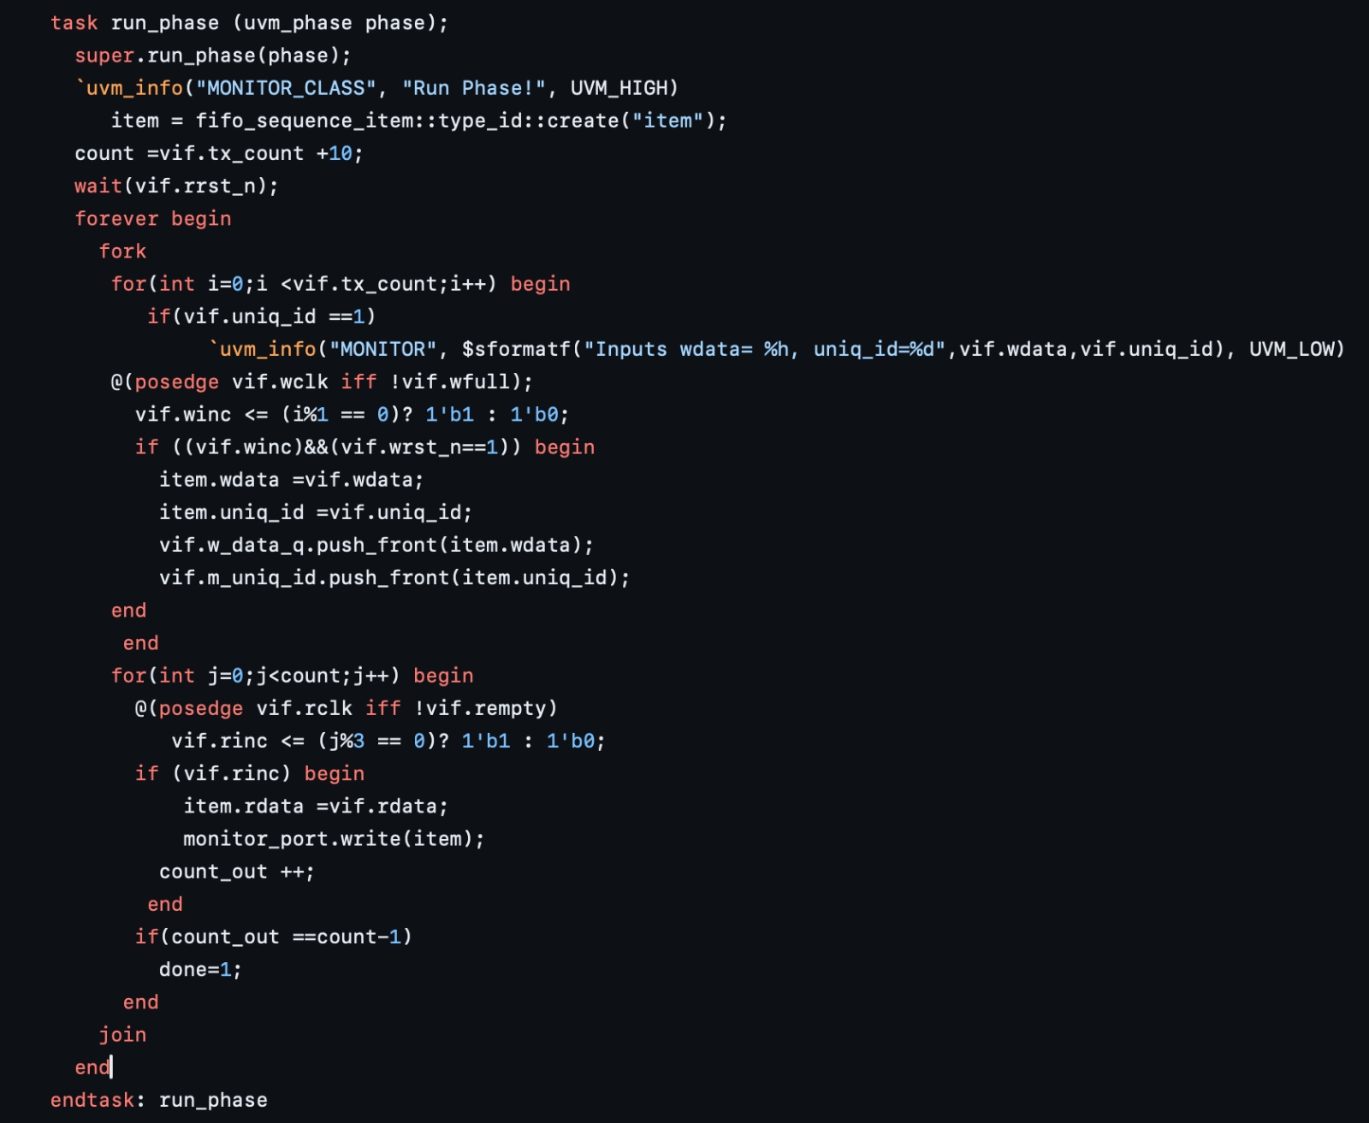
MONITOR:

Slide 13
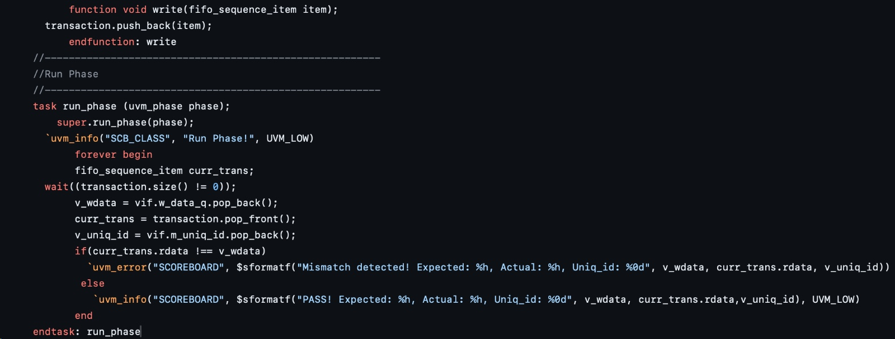
SCOREBOARD:

Slide 14
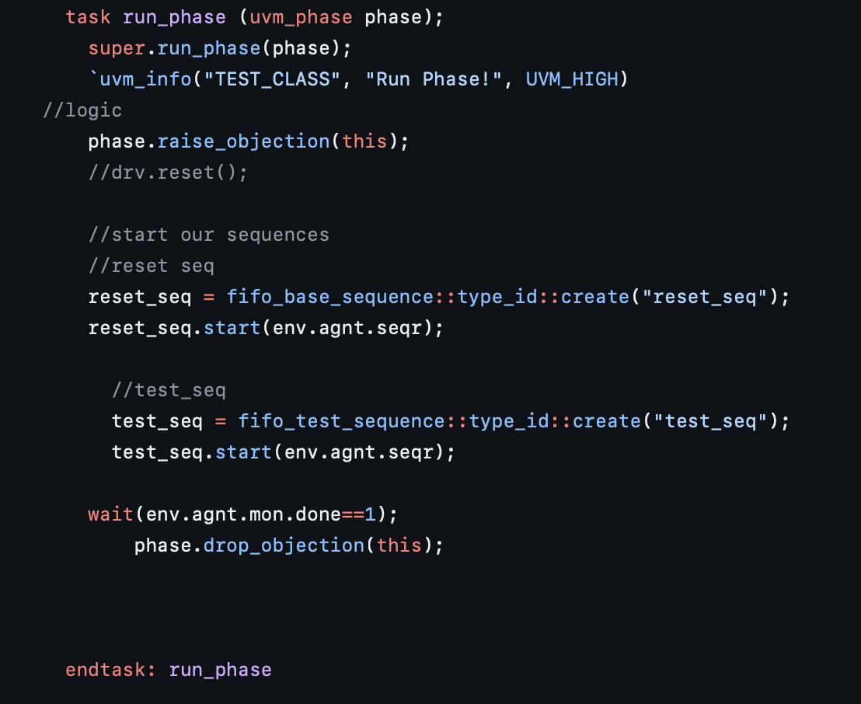
Test

Slide 15
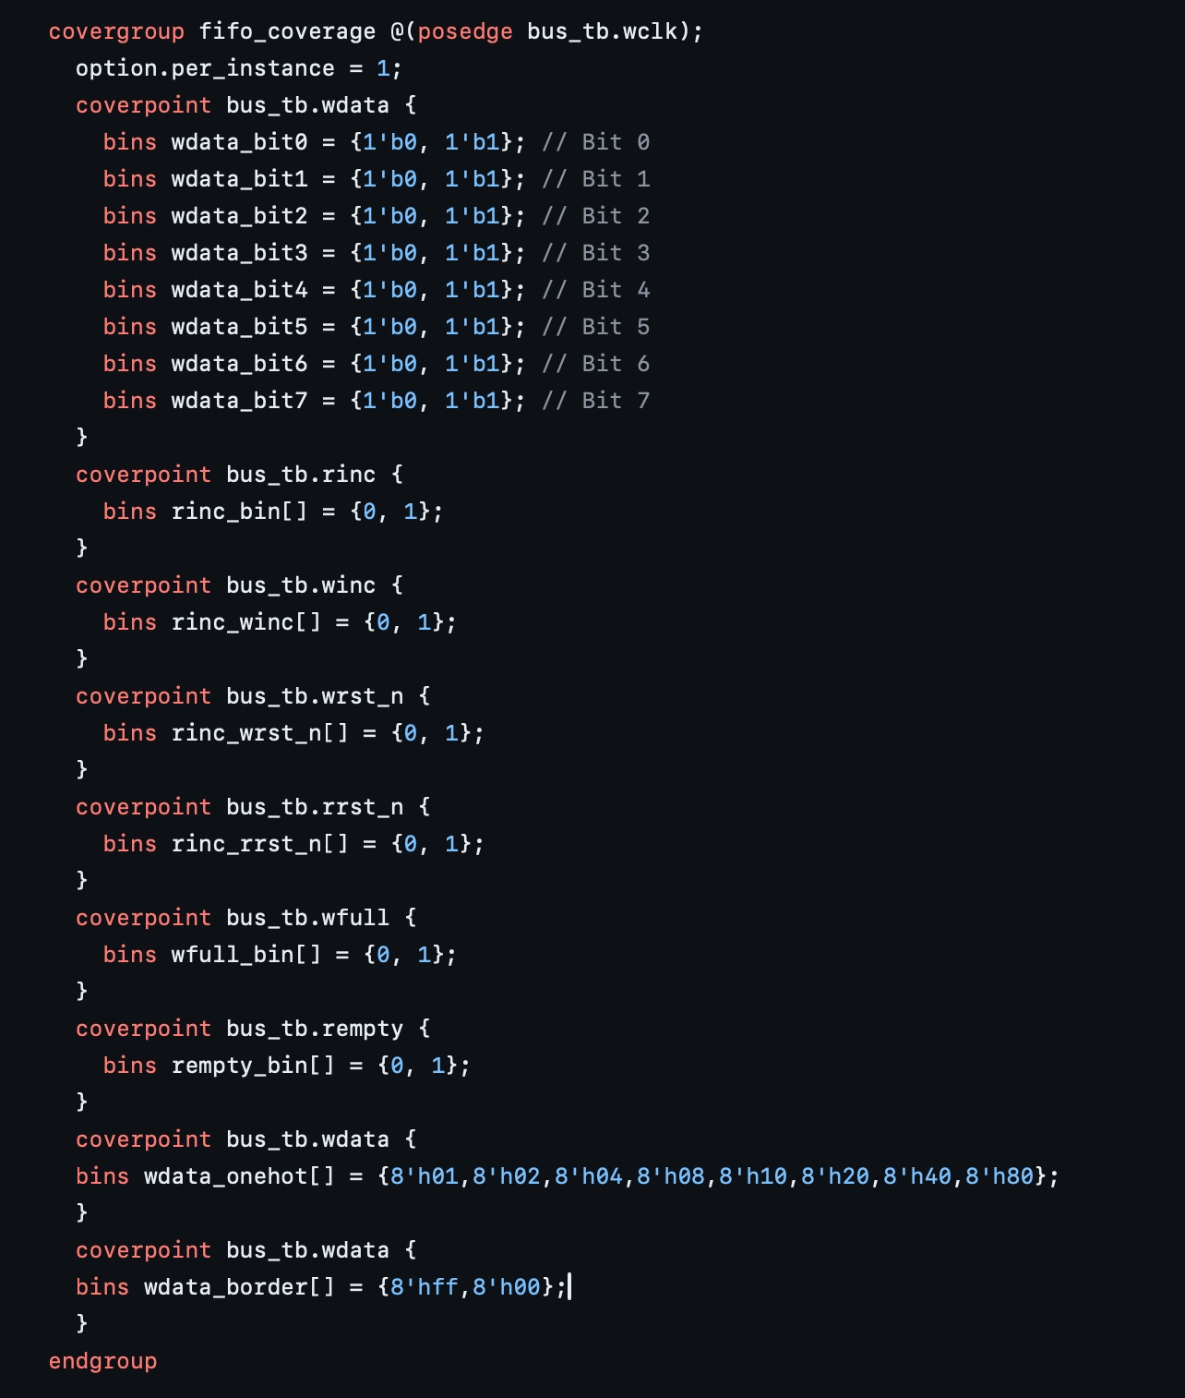
COVERAGE:

Slide 16
Coverage:
Bit Coverage of bus_tb.wdata:
• Define bins for each bit of bus_tb.wdata separately.
• Bins: wdata_bit0, wdata_bit1, ..., wdata_bit7.
• Each bin should cover both 0 and 1 values.
Control Signals (rinc, winc, wrst_n, rrst_n):
• Define bins for each control signal.
• Bins: rinc_bin, winc_bin, wrst_n_bin, rrst_n_bin.
• Each bin should cover both 0 and 1 values.
FIFO Full (wfull) and Empty (rempty) Signals:
• Define bins for wfull and rempty.
• Bins: wfull_bin, rempty_bin.
• Each bin should cover both 0 and 1 values.
Specific Data Patterns in bus_tb.wdata:
• Define bins for specific data patterns.
• Bins: wdata_onehot, wdata_border.
• Ensure that each bin covers the specified data patterns comprehensively

Slide 17
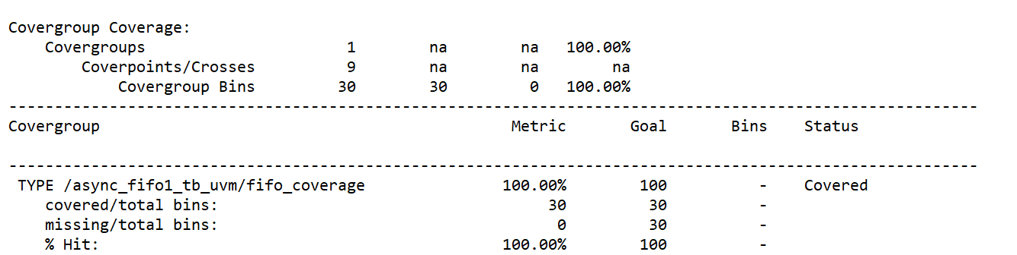
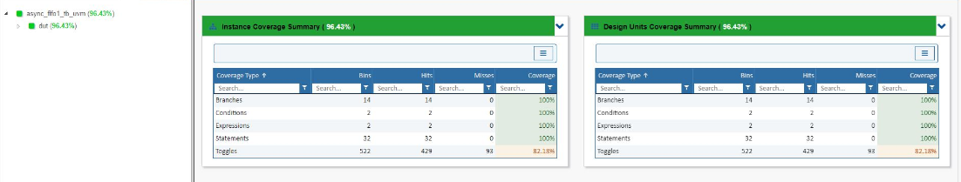
Functional and Code Coverage reports:
Initially the functional coverage was 74.56 % where w_rst and r_rst , fifo full and some bit positions were not enabled, border cases like ff ,00 was missing from the report added more direct testcase
to handle those coverage cases and achieved 100% functional coverage coverage.

Slide 18
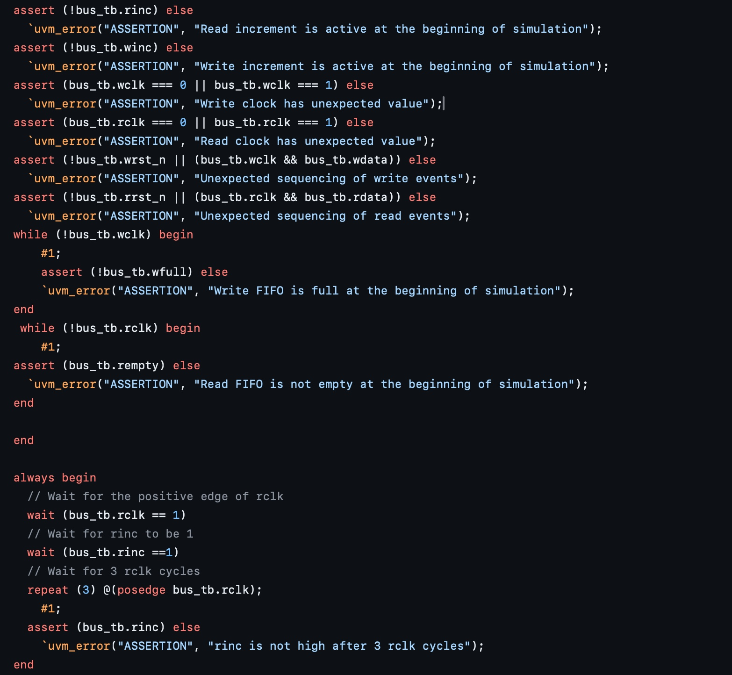
ASSERTIONS:

Slide 19
Assertions:
Ensure that the read, write increment is not active at the beginning of the simulation.
Check if the write clock, read clock are enabled has expected
assert (!bus_tb.wrst_n || (bus_tb.wclk && bus_tb.wdata)) else ...: Validate the sequencing of write events by checking that either the write reset is inactive, or if active, the write clock and write data are in a valid state. This ensures that write events are correctly sequenced.
assert (!bus_tb.rrst_n || (bus_tb.rclk && bus_tb.rdata)) else ...:
Check the wfull is not enabled in the starting of simulation and empty is enabled at the start
Wait for rinc to be asserted. After rinc is active, wait for 3 rising edges of the read clock (rclk) and check the rinc is enabled only after 3 cycles according to the specification given
Assert if the input values are driven x, z

Slide 20
TEST MATRIX:
Basic read operation.
Basic write operation.
Reset Operation.
FIFO full condition.
FIFO empty condition.
Stress Testing: Back to back continuous testcases.
Stress Testing: Back to back same values.
Randomization.
Edge Cases: Wdata check for ff and 00.
Wdata check one hot bits.
Sequential pattern.
Error inducing test cases

Slide 21
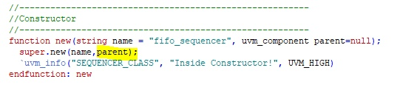
CHALLENGES FACED AND RESOLVED:
Premature Assertion of rinc-Resolved by Changing wdata Transfer to Non-blocking.
Incorrect UVM Hierarchy Due to Missing Parent Assignment in Sequencer Class.

Slide 22
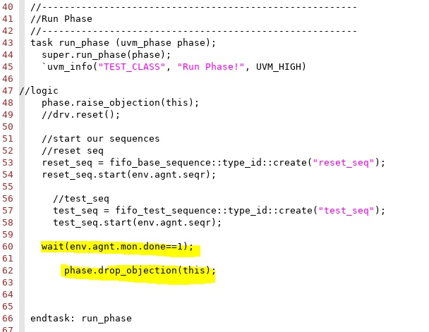
Early Simulation Completion Before Full Reception of rdata

Slide 23
Scoreboard Write and Read Timing Mismatch. Resolved by Implementing a mechanism to push wdata into the FIFO at the rising edge of wclk and pop rdata from the FIFO at the rising edge of rclk and when rinc is enabled resolved this issue.
Mismatch in rdata due to clock data Error. Resolved by enabling rinc with a non-blocking assignment during clocking to ensure synchronized read operations.
Unique ID Generation Issue. Resolved by Maintaining a separate variable to store the uniq_id and pass this variable to both the sequence and update the actual pkt.uniq_id afterward. This ensures consistent handling of uniq_id across direct and randomized test cases.
Simulation Looping Due to Mismatched Inputs. Resolved by Increasing the expected inputs in the testbench to accommodate the actual inputs provided. Ensure that the testbench can handle a larger set of inputs without entering an infinite loop.

Slide 24
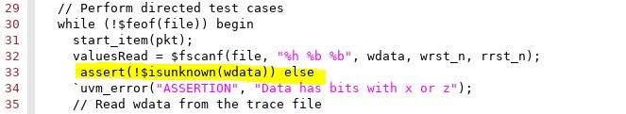
Unhandled 'X' and 'Z' Values in Testbench Inputs. Resolved by adding an assertion as shown below.

Slide 25
CONCLUSION:
.
Design and verification of asynchronous FIFO using SV and UVM ensure correctness and reliability.
Techniques include code functional coverage, assertions, and meticulous design implementation.
SV and UVM facilitate modularity, reusability, and scalability in verification.
Directed testing targets critical scenarios, while random testing uncovers edge cases.
Integration of these techniques ensures the design meets requirements and operates reliably.
The coverage achieved in this project is around 97% including code and functional coverage.
.

Slide 26
FUTURE WORK:
Advanced Verification Techniques: Research and implement advanced verification techniques, such as formal verification or machine learning-based verification, to enhance the effectiveness and efficiency of the verification process.
Automation:Python based automated testbench.
Assertions:Need to include more Assertions in Design and Verification.
Coverage: Need to add more functional coverage ,get 100% code coverage and improve the metrics on toggle coverage.

Slide 27
CITATIONS:
1. S. Cummings, "FIFOs: Fast, predictable, and deep," in Proceedings of SNUG, 2002. [Online]. Available:http://www.sunburst-design.com/papers/CummingsSNUG2002SJ_FIFO1.pdf
2. S. Cummings, "FIFOs: Fast, predictable, and deep (Part II)," in Proceedings of SNUG, 2002. [Online]. Available: http://www.sunburst-design.com/papers/CummingsSNUG2002SJ_FIFO2.pdf
3. Putta Satish, "FIFO Depth Calculation Made Easy," [Online]. Available: https://hardwaregeeksblog.files.wordpress.com/2016/12/fifodepthcalculationmadeeasy2.pdf
4. A. Author et al., "Title of the Paper," in Proceedings of the Conference, 2015, pp. 123-456. [Online]. Available: https://ieeexplore.ieee.org/abstract/document/7237325.
5. M. Last Name et al., "Designing Asynchronous FIFO," [Online]. Available: https://d1wqtxts1xzle7.cloudfront.net/56108360/EC109-libre.pdf.
6. A. Author et al., "Title of the Paper," in Proceedings of the Conference, 2011, pp. 789-012. [Online]. Available: https://ieeexplore.ieee.org/stamp/stamp.jsp?arnumber=6041338
7. “Youtube," [Online]. Available: https://www.youtube.com/watch?v=UNoCDY3pFh0 8. Open AI, "Chat GPT," [Online].
8. [1] Chip Verify. [Online]. Available: https://www.chipverify.com

