Slide 1
Saying “Yes” to NoSQL
Overview:
  The Relational Model
  Structured Query Language (SQL)
  The “original” NoSQL Movement
  NoSQL Today

Slide 2
The Relational Model
E.F. Codd: (1923-2003)
  Developed the relational model while at IBM San Jose Research Laboratory
  IBM Fellow 1976
  Turing Award 1981
  ACM Fellow 1994
  British, by birth
Notes:
"Microarrays allow us to see if a particular gene is on or off in a particular tissue. The colors on this picture correspond to whether or not the gene is expressed. So each row is a gene, and each column is a particular experiment, for example a particular type of tissue. If you see a red spot for some gene for breast tumors, that means this gene is expressed in breast cancer. But that same gene is not expressed in the brain, for example."

Slide 3
The Relational Model
“A Relational Model of Data for Large Shared Data Banks,” E.F. Codd, Communications of the ACM, Vol. 13, No. 6, June, 1970.
“Further Normalization of the Data Base Relational Model,” E.F. Codd, Data Base Systems, Proceedings of 6th Courant Computer Science Symposium, May, 1971.
“Relational Completeness of Data Base Sublanguages,” E.F. Codd, Data Base Systems, Proceedings of 6th Courant Computer Science Symposium, May, 1971.
Plus others…
Notes:
Codd actually doesn’t say “relational algebra,” but rather focuses on tuple calculus when he talks about DB operations.
Does not discuss normal forms beyond 1NF.

Slide 4
The Relational Model
The basic data model:
  Relations, tuples, attributes, domains
  Primary & foreign keys
  Normal forms
Query model:
  Relational algebra – cartesian product, selection, projection, union, set-difference
  Relational calculus
A primary theme:
  Physical data independence
“Employee”
ID Last-Name Date-of-Birth Job-Category
    15394 Jones 11/3/75 Software
21621 Smith 6/24/69 Management
17852 Brown 8/14/72 Hardware
32904 Carson 10/29/64 Software
:
:
Notes:
Codd actually doesn’t say “relational algebra,” but rather focuses on tuple calculus when he talks about DB operations.
Does not discuss normal forms beyond 1NF.

Slide 5
Relational Database Management Systems (RDBMS)
Database Management Systems Based on the Relational Model:
  System R – IBM research project (1974)
  Ingres – University of California Berkeley (early 1970’s)
  Oracle – Rational Software, now Oracle Corporation (1974)
  SQL/DS – IBM’s first commercial RDBMS (1981)
  Informix – Relational Database Systems, now IBM (1981)
  DB2 – IBM (1984)
  Sybase SQL Server – Sybase, now SAP (1988)
Notes:
"Microarrays allow us to see if a particular gene is on or off in a particular tissue. The colors on this picture correspond to whether or not the gene is expressed. So each row is a gene, and each column is a particular experiment, for example a particular type of tissue. If you see a red spot for some gene for breast tumors, that means this gene is expressed in breast cancer. But that same gene is not expressed in the brain, for example."

Slide 6
Structure Query Language (SQL)
SQL is a language for querying relational databases.
History:
  Developed at IBM San Jose Research Laboratory, early 1970’s, for System R
  Credited to Donald D. Chamberlin and Raymond F. Boyce
  Based on relational algebra and tuple calculus
  Originally called SEQUEL
Language Elements:
  Clauses, expressions, predicates, queries, statements, transactions, operators, nesting etc.
select o_orderpriority, count(*) as order_count
from orders
where o_orderdate >= date '[DATE]‘ and o_orderdate < date '[DATE]' + interval '3' month
and exists (select * from lineitem
where l_orderkey = o_orderkey and l_commitdate < l_receiptdate)
group by o_orderpriority
order by o_orderpriority;
Notes:
"Microarrays allow us to see if a particular gene is on or off in a particular tissue. The colors on this picture correspond to whether or not the gene is expressed. So each row is a gene, and each column is a particular experiment, for example a particular type of tissue. If you see a red spot for some gene for breast tumors, that means this gene is expressed in breast cancer. But that same gene is not expressed in the brain, for example."

Slide 7
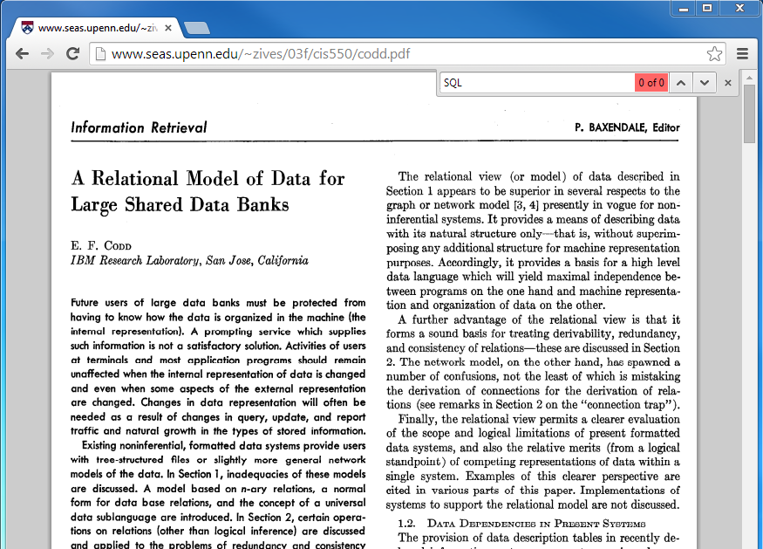
SQL and the Relational Model
A text search of E.F. Codd’s early papers for “SQL” (or SEQUEL) reveals:
Notes:
We tend to conflate relational database systems and SQL.

Slide 8
Relational Query Languages
Other Relational Query Languages:
  Datalog
  QUEL
  Query By Example (QBE)
  SQL variations
  shell scripts, with relational extensions
Notes:
"Microarrays allow us to see if a particular gene is on or off in a particular tissue. The colors on this picture correspond to whether or not the gene is expressed. So each row is a gene, and each column is a particular experiment, for example a particular type of tissue. If you see a red spot for some gene for breast tumors, that means this gene is expressed in breast cancer. But that same gene is not expressed in the brain, for example."

Slide 9
The NoSQL RDBMS
One of first uses of the phrase NoSQL is due to Carlo Strozzi, circa 1998.
NoSQL:
  A fast, portable, open-source RDBMS
  A derivative of the RDB database system (Walter Hobbs, RAND)
  Not a full-function DBMS, per se, but a shell-level tool
  User interface – Unix shell
  Based on the “operator/stream paradigm”
  http://www.strozzi.it/cgi-bin/CSA/tw7/I/en_US/nosql/Home%20Page
Notes:
"Microarrays allow us to see if a particular gene is on or off in a particular tissue. The colors on this picture correspond to whether or not the gene is expressed. So each row is a gene, and each column is a particular experiment, for example a particular type of tissue. If you see a red spot for some gene for breast tumors, that means this gene is expressed in breast cancer. But that same gene is not expressed in the brain, for example."

Slide 10
Operator/stream Paradigm
Commonly referenced papers:
  “The Next Generation,” E. Schaffer and M. Wolf, UNIX Review, March, 1991, page 24.
  “The UNIX Shell as a Fourth Generation Language,” E. Schaffer and M. Wolf, Revolutionary Software.
  Regarding Database Management Systems:
  “…almost all are software prisons that you must get into and leave the power of UNIX behind.”
  “…large, complex programs which degrade total system performance, especially when they are run in a multi-user environment.”
  “…put walls between the user and UNIX, and the power of UNIX is thrown away.”
In summary:
  Relational model => yes
  UNIX => big yes
  Big, COTS, relational DBMS => no
  SQL => no
Notes:
"Microarrays allow us to see if a particular gene is on or off in a particular tissue. The colors on this picture correspond to whether or not the gene is expressed. So each row is a gene, and each column is a particular experiment, for example a particular type of tissue. If you see a red spot for some gene for breast tumors, that means this gene is expressed in breast cancer. But that same gene is not expressed in the brain, for example."

Slide 11

The NoSQL RDBMS
Getting back to Strozzi’s NoSQL RDBMS:
  Based on the relational model
  Based on UNIX and shell scripts
  Does not have an SQL interface
In that sense, and interpreted literally, NoSQL means “no sql,” i.e., we are not using the SQL language.
Notes:
"Microarrays allow us to see if a particular gene is on or off in a particular tissue. The colors on this picture correspond to whether or not the gene is expressed. So each row is a gene, and each column is a particular experiment, for example a particular type of tissue. If you see a red spot for some gene for breast tumors, that means this gene is expressed in breast cancer. But that same gene is not expressed in the brain, for example."

Slide 12
NoSQL Today
More recently:
The term has taken on different meanings
One common interpretation is “not only SQL”
Most modern NoSQL systems diverge from the relational model or standard RDBMS functionality:
The data model: relations documents
tuples vs. graphs
attributes key/values
domains
normalization
The query model: relational algebra graph traversal
tuple calculus vs. text search
map/reduce
The implementation: rigid schemas vs. flexible schemas
(schema-less)
ACID compliance vs. BASE
In that sense, NoSQL today is more commonly meant to be something like “non-relational”
Notes:
"Microarrays allow us to see if a particular gene is on or off in a particular tissue. The colors on this picture correspond to whether or not the gene is expressed. So each row is a gene, and each column is a particular experiment, for example a particular type of tissue. If you see a red spot for some gene for breast tumors, that means this gene is expressed in breast cancer. But that same gene is not expressed in the brain, for example."

Slide 13
NoSQL Today
Motivation for recent NoSQL systems is also quite varied:
“…there are significant advantages to building our own storage solution at Google,” Chang et. al., 2006
Scalability, performance, availability, flexibility
Speculation - $$$, control
MySQL vs. MongoDB:
  http://www.youtube.com/watch?v=b2F-DItXtZs
How “big” is the NoSQL movement?
Will they eventually eliminate the need for relational databases?
Is this another grand conspiracy by the government and, you know, that guy….
Notes:
"Microarrays allow us to see if a particular gene is on or off in a particular tissue. The colors on this picture correspond to whether or not the gene is expressed. So each row is a gene, and each column is a particular experiment, for example a particular type of tissue. If you see a red spot for some gene for breast tumors, that means this gene is expressed in breast cancer. But that same gene is not expressed in the brain, for example."

Slide 14
NoSQL Today
(a partial, unrefined list)
Hbase Cassandra Hypertable Accumulo Amazon SimpleDB SciDB Stratosphere flare
Cloudata BigTable QD Technology SmartFocus KDI Alterian Cloudera C-Store
Vertica Qbase–MetaCarta OpenNeptune HPCC Mongo DB CouchDB Clusterpoint ServerTerrastore
Jackrabbit OrientDB Perservere CoudKit Djondb SchemaFreeDB SDB JasDB
RaptorDB ThruDB RavenDB DynamoDB Azure Table Storage Couchbase Server Riak
LevelDB Chordless GenieDB Scalaris Tokyo Kyoto Cabinet Tyrant Scalien
Berkeley DB Voldemort Dynomite KAI MemcacheDB Faircom C-Tree HamsterDB STSdb
Tarantool/Box Maxtable Pincaster RaptorDB TIBCO Active Spaces allegro-C nessDBHyperDex
Mnesia LightCloud Hibari BangDB OpenLDAP/MDB/Lightning Scality Redis
KaTree TomP2P Kumofs TreapDB NMDB luxio actord Keyspace
schema-free RAMCloud SubRecord Mo8onDb Dovetaildb JDBM Neo4 InfiniteGraph
Sones InfoGrid HyperGraphDB DEX GraphBase Trinity AllegroGraph BrightstarDB
Bigdata Meronymy OpenLink Virtuoso VertexDB FlockDB Execom IOG Java Univ Netwrk/Graph Framework
OpenRDF/Sesame Filament OWLim NetworkX iGraph Jena SPARQL OrientDb
ArangoDB AlchemyDB Soft NoSQL Systems Db4o Versant Objectivity Starcounter
ZODB Magma NEO PicoList siaqodb Sterling Morantex EyeDB
HSS Database FramerD Ninja Database Pro StupidDB KiokuDB Perl solution Durus
GigaSpaces Infinispan Queplix Hazelcast GridGain Galaxy SpaceBase JoafipCoherence
eXtremeScale MarkLogic Server EMC Documentum xDB eXist Sedna BaseX Qizx
Berkeley DB XML Xindice Tamino Globals Intersystems Cache GT.M EGTM
U2 OpenInsight Reality OpenQM ESENT jBASE MultiValue Lotus/Domino
eXtremeDB RDM Embedded ISIS Family Prevayler Yserial Vmware vFabric GemFire Btrieve
KirbyBase Tokutek Recutils FileDB Armadillo illuminate Correlation Database FluidDB
Fleet DB Twisted Storage Rindo Sherpa tin Dryad SkyNet Disco
MUMPS Adabas XAP In-Memory Grid eXtreme Scale MckoiDDB Mckoi SQL Database
Oracle Big Data Appliance Innostore FleetDB No-List KDI Perst IODB
Notes:
"Microarrays allow us to see if a particular gene is on or off in a particular tissue. The colors on this picture correspond to whether or not the gene is expressed. So each row is a gene, and each column is a particular experiment, for example a particular type of tissue. If you see a red spot for some gene for breast tumors, that means this gene is expressed in breast cancer. But that same gene is not expressed in the brain, for example."

Slide 15
NoSQL Today
It is easy to find diagrams that look like this:
http://www.vertabelo.com/blog/vertabelo-news/jdd-2013-what-we-found-out-about-databases
It is easy to find diagrams that look like this:
  http://db-engines.com/en/ranking_categories
It is easy to find diagrams that look like this:
  http://www.odbms.org/2014/11/gartner-2014-magic-quadrant-operational-database-management-systems-2/
Notes:
The first was the result of a survey at JDD 2013 regarding what DBMSs developers were using.

Slide 16
Primary NoSQL Categories
General Categories of NoSQL Systems:
  Key/value store
  (wide) Column store
  Graph store
  Document store
Compared to the relational model:
  Query models are not as developed.
  Distinction between abstraction & implementation is not as clear.
Notes:
Definitions are not always precise or agreed upon.
Some overlap among categories.
Products in a category vary in terms of functionality.
Hard to describe each category as a complete “data model,” in contrast to the relational model.
Abstraction vs. implementation is not as clear in the papers.
Often times the query model component is not as standardized.

Slide 17
Key/Value Store
DynamoDB
Azure Table Storage
Riak
Rdis
Aerospike
FoundationDB
LevelDB
Berkeley DB
Oracle NoSQL Database
GenieDb
BangDB
Chordless
Scalaris
Tokyo Cabinet/Tyrant
Scalien
Voldemort
Dynomite
KAI
MemcacheDB
Faircom C-Tree
LSM
KitaroDB
HamsterDB
STSdb
TarantoolBox
Maxtable
Quasardb
Pincaster
RaptorDB
TIBCO Active Spaces
Allegro-C
nessDB
HyperDex
SharedHashFile
Symas LMDB
Sophia
PickleDB
Mnesia
LightCloud
Hibari
OpenLDAP
Genomu
BinaryRage
Elliptics
Dbreeze
RocksDB
TreodeDB
(www.nosql-database.org
www.db-engines.com
www.wikipedia.com)
“Dynamo: Amazon’s Highly Available Key-value Store,” DeCandia, G., et al., SOSP’07, 21st ACM
Symposium on Operating Systems Principles.
The basic data model:
  Database is a collection of key/value pairs
  The key for each pair is unique
Primary operations:
  insert(key,value)
  delete(key)
  update(key,value)
  lookup(key)
Additional operations:
  variations on the above, e.g., reverse lookup
  iterators
No requirement for normalization
(and consequently dependency
preservation or lossless join)
Notes:
Compared to the relational model, this is relatively primitive.
No notion of normalization or dependency.
Operations are very primitive, and put the burden on the software for sophisticated processing.
Historically, referred to as a dictionary or associative map.
All sophisticated query processing is in the app, and therefore optimization is impossible.

Slide 18
Wide Column Store
“Bigtable: A Distributed Storage System for Structured Data,” Chang, F., et al., OSDI’06: Seventh Symposium on Operating System Design and implementation, 2006.
The basic data model:
  Database is a collection of key/value pairs
  Key consists of 3 parts – a row key, a column key, and a time-stamp (i.e., the version)
  Flexible schema - the set of columns is not fixed, and may differ from row-to-row
One last column detail:
  Column key consists of two parts – a column family, and a qualifier
Accumulo
Amazon SimpleDB
BigTable
Cassandra
Cloudata
Cloudera
Druid
Flink
Hbase
Hortonworks
HPCC
Hyupertable
KAI
KDI
MapR
MonetDB
OpenNeptune
Qbase
Splice Machine
Sqrrl
(www.nosql-database.org
www.db-engines.com
www.wikipedia.com)
Warning #1!
Notes:
In a relational database, a key is formed by a collection of columns, but in a WCS, a key consists of a row-key and a column-key.
In a relational database, a key identifies a row.
In a WCS, a row-key identifies a “row”, but a key identifies a (single) value, and consists of the above 3 parts.
Thus, it forms a sparse, 3-dimensional map, with a flexible schema
WARNING – the term “row” has a different meaning in this context:
Relational database – a one dimensional entry in a table – (032135004, Smith, 6/13/75, IBM)
Wide column store – a slice from a 3-dimensional cube

Slide 19
Wide Column Store
Column families
Row key
Personal data
Professional data
ID | First Name | Last Name | Date of Birth | Job Category | Salary | Date of Hire | Employer
Column qualifiers
Notes:
"Microarrays allow us to see if a particular gene is on or off in a particular tissue. The colors on this picture correspond to whether or not the gene is expressed. So each row is a gene, and each column is a particular experiment, for example a particular type of tissue. If you see a red spot for some gene for breast tumors, that means this gene is expressed in breast cancer. But that same gene is not expressed in the brain, for example."

Slide 20
Wide Column Store
Personal data
Professional data
ID | First Name | Last Name | Date of Birth | Job Category | Salary | Date of Hire | Employer
ID | First Name | Middle Name | Last Name | Job Category | Employer | Hourly Rate
ID | First Name | Last Name | Job Category | Salary | Employer | Group | Seniority | Bldg # | Office #
ID | Last Name | Job Category | Salary | Date of Hire | Employer | Insurance ID | Emergency Contact
Medical data
One “table”
Notes:
These are all in the same table.

Slide 21
Wide Column Store
Row key
t₁
t₀
ID | First Name | Last Name | Date of Birth | Job Category | Salary | Date of Hire | Employer
Personal data
Professional data
One “row”
One “row” in a wide-column NoSQL database table
=
Many rows in several relations/tables in a relational database
Notes:
Compared to the relational model, this is relatively primitive.
No notion of normalization or dependency.
No query model, per se.
Operations are very primitive, and put the burden on the software for sophisticated processing.

Slide 22
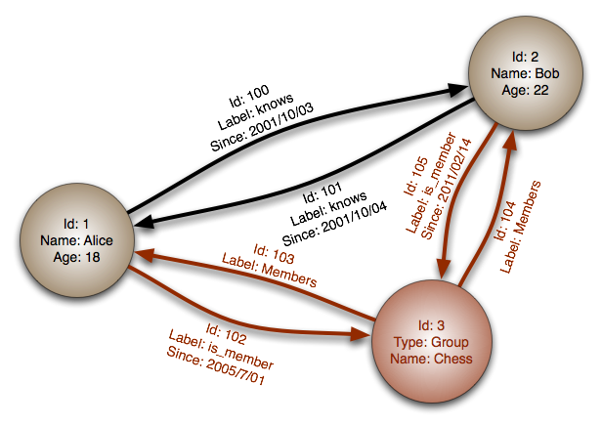
Graph Store
AllegroGraph
ArangoDB
Bigdata
Bitsy
BrightstarDB
DEX/Sparksee
Execom IOG
Fallen *
Filament
FlockDB
GraphBase
Graphd
Horton
HyperGraphDB
IBM System G Native Store
InfiniteGraph
InfoGrid
jCoreDB Graph
MapGraph
Meronymy
Neo4j
Orly
OpenLink virtuoso
Oracle Spatial and Graph
Oracle NoSQL Datbase
OrientDB
OQGraph
Ontotext OWLIM
R2DF
ROIS
Sones GraphDB
SPARQLCity
Sqrrl Enterprise
Stardog
Teradata Aster
Titan
Trinity
TripleBit
VelocityGraph
VertexDB
WhiteDB
(www.nosql-database.org
www.db-engines.com
www.wikipedia.com)
Neo4j - “The Neo Database – A Technology Introduction,” 2006.
The basic data model:
  Directed graphs
  Nodes & edges, with properties, i.e., “labels”
Notes:
Compared to the relational model, this is relatively primitive.
No notion of normalization or dependency.
Operations are very primitive, and put the burden on the software for sophisticated processing.

Slide 23
Document Store
MongoDB - “How a Database Can Make Your Organization Faster, Better, Leaner,” February 2015.
The basic data model:
  The general notion of a document – words, phrases, sentences, paragraphs, sections,
  subsections, footnotes, etc.
  Flexible schema – subcomponent structure may be nested, and vary from
  document-to-document.
  Metadata – title, author, date, embedded tags, etc.
  Key/identifier.
  One implementation detail:
  Formats vary greatly – PDF, XML, JSON, BSON, plain text, various binary,
  scanned image.
AmisaDB
ArangoDB
BaseX
Cassandra
Cloudant
Clusterpoint
Couchbase
CouchDB
Densodb
Djondb
EJDB
Elasticsearch
eXist
FleetDB
iBoxDB
Inquire
JasDB
MarkLogic
MongoDB
MUMPS
NeDB
NoSQL embedded db
OrientDB
RaptorDB
RavenDB
RethinkDB
SDB
SisoDB
Terrastore
ThruDB
(www.nosql-database.org
www.db-engines.com
www.wikipedia.com)
Notes:
In a document DB the schema is more flexible and CFL-ish.
In a relational DB the schema is more rigid and regular.

Slide 24
ACID vs. BASE
Database systems traditionally support ACID requirements:
  Atomicity, Consistency, Isolation, Durability
In a distributed web applications the focus shifts to:
  Consistency, Availability, Partition tolerance
CAP theorem - At most two of the above can be enforced at any given time.
  Conjecture – Eric Brewer, ACM Symposium on the Principles of Distributed Computing, 2000.
  Proved – Seth Gilbert & Nancy Lynch, ACM SIGACT News, 2002.
Reducing consistency, at least temporarily, maintains the other two.
Notes:
"Microarrays allow us to see if a particular gene is on or off in a particular tissue. The colors on this picture correspond to whether or not the gene is expressed. So each row is a gene, and each column is a particular experiment, for example a particular type of tissue. If you see a red spot for some gene for breast tumors, that means this gene is expressed in breast cancer. But that same gene is not expressed in the brain, for example."

Slide 25
ACID vs. BASE
Thus, distributed NoSQL systems are typically said to support some form of BASE:
  Basic Availability
  Soft state
  Eventual consistency*
“We’d really like everything to be structured, consistent and harmonious,…, but what we are faced with is a little bit of punk-style anarchy. And actually, whilst it might scare our grandmothers, it’s OK...”
-Julian Browne
Notes:
"Microarrays allow us to see if a particular gene is on or off in a particular tissue. The colors on this picture correspond to whether or not the gene is expressed. So each row is a gene, and each column is a particular experiment, for example a particular type of tissue. If you see a red spot for some gene for breast tumors, that means this gene is expressed in breast cancer. But that same gene is not expressed in the brain, for example."

Slide 26

Brewer’s CAP theorem
Can optimize for only two of three priorities in a distributed database:
Consistency
  All clients have same view of the data
  Requires atomicity, transaction isolation
Availability
  Node failures do not prevent survivors from continuing to operate (All clients can find some available replica)
Partition Tolerance
  Partitions happen if certain nodes can’t communicate
  No set of failures less than total network failure is allowed to cause the system to respond incorrectly.
  The system continues to operate despite arbitrary message loss (i.e. even when split into disconnected subsets, for example by a network disruption)
    The theorem:
      A distributed system can satisfy any two of these guarantees at the same time, but not all the three.

Slide 27
Implications of CAP theorem
Any two properties can be achieved
CP
  If messages between nodes are lost then system waits
  Possible that no response returned at all
  No inconsistent data returned to client
CA
  No partitions, system will always respond and data is consistent
AP
  Response always returned even if some messages between nodes
  Different nodes may have different views of the data

Slide 28
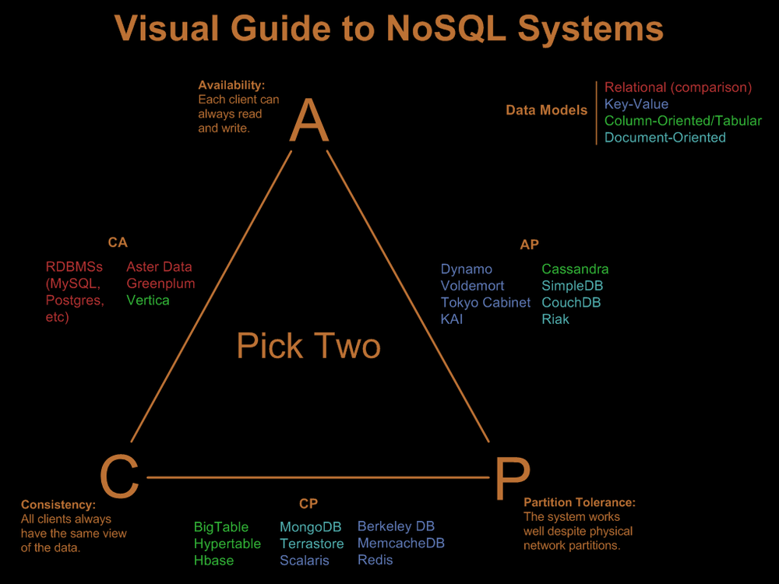
Implications of CAP theorem
Choose a database whose priorities match the application
http://blog.nahurst.com/visual-guide-to-nosql-systems

Slide 29
NoSQL solutions
    What is NoSQL ?
      Not only SQL
      Non-relational
    What do they bring ?
      Eventual consistency (BASE)
      There is a weakly structured schema/no schema (documents)
      JavaScript, JSON, REST
      Distributed, horizontally scalable
      Can cope with huge data
    Directions of innovation
      In-memory computing
      Different (non-relational) data structure
      Multitenancy support

Slide 30
NoSQL advantages/disadvantages
    Pros
      Open source
      Some serious and innovative science behind
      Massive data store, horizontally scalable
      Great fit for many “Web 2.0”services and modern applications
    Cons
      They are no panacea!
      No standards, different DBs are suitable for different tasks (DS DBs)
      Limited query capabilities
      We do not think non-relational … yet (mindset change is needed)
      Some are still experimental (alpha)
      Still most productive DB systems are relational
      Probably a hybrid solution is the best

