Slide 1
Mining Social-Network Graphs
Direct Discovery of Communities
Partitioning of graphs
Finding overlapping communities
Counting Triangles
Neighborhood properties of graphs

Slide 2
Direct Discovery of Communities
In the previous session, we have discussed the Between to find the communities by partitioning all the individuals in a social network.
Even this approach is an efficient, it has many shortcomings
It is not possible to place an individual in two different communities, and everyone is assigned to a community
A technique for discovering communities directly by looking for subsets of the nodes that have a relatively large number of edges among them. → indirectly this technique finds the large frequent itemsets in graph

Slide 3
Direct Discovery of Communities
How we could find sets of nodes with many edges between them ?
Idea : Finding the large clique.
Clique definition: In the mathematical area of graph theory, a clique is a subset of vertices of an undirected graph such that every two distinct vertices in the clique are adjacent; that is, its induced subgraph is complete.
Finding Maximum clique in a graph is NP-Complete problem.
even approximating the maximal clique is hard.
it is possible to have a set of nodes with almost all edges between them, yet with relatively small cliques.

Slide 4
Direct Discovery of Communities
How we could find sets of nodes with many edges between them ?
Idea : Finding the large clique.
Clique definition: In the mathematical area of graph theory, a clique is a subset of vertices of an undirected graph such that every two distinct vertices in the clique are adjacent; that is, its induced subgraph is complete.
Finding Maximum clique in a graph is NP-Complete problem.
even approximating the maximal clique is hard.
it is possible to have a set of nodes with almost all edges between them, yet with relatively small cliques.

Slide 5
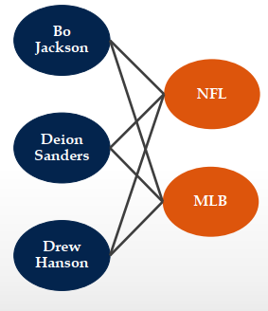
Direct Discovery of Communities
Another Idea : Bipartite Graphs.
A complete bipartite graph consists of s nodes on one side and t nodes on the other side, with all st possible edges between the nodes of one side and the other present. Denote this graph as K_{s,t}.
it is possible to guarantee that a bipartite graph with
many edges has a large complete bipartite subgraph
(unlike cliques). Bipartite subgraph → bi-clique
might be regarded as the nucleus of community

Slide 6
Direct Discovery of Communities
If the graph itself is k-partite then then we can take nodes of two types and the edges between them to form a bipartite graph.
In this bipartite graph, we can search for complete bipartite subgraphs as the nuclei of communities.
complete bipartite subgraphs also used to find community in ordinary graphs where nodes all have the same type.
Divide the nodes into two equal groups at random.
If a community exists, then we would expect about half its nodes to fall into each group, and we would expect that about half its edges would go between groups.
Thus, we still have a reasonable chance of identifying a large complete bipartite subgraph in the community.
To this nucleus we can add nodes from either of the two groups, if they have edges to many of the nodes already identified as belonging to the community.

Slide 7
Direct Discovery of Communities
If the graph itself is k-partite then then we can take nodes of two types and the edges between them to form a bipartite graph.

Slide 8
Partition of Graphs
It is an another approach to organizing social-network graphs.
Problem:
partitioning a graph to minimize the number of edges that connect different components (communities)
Goal:
Minimizing the cut size.
It uses important concepts from Matrix theory such as spectral methods.

Slide 9
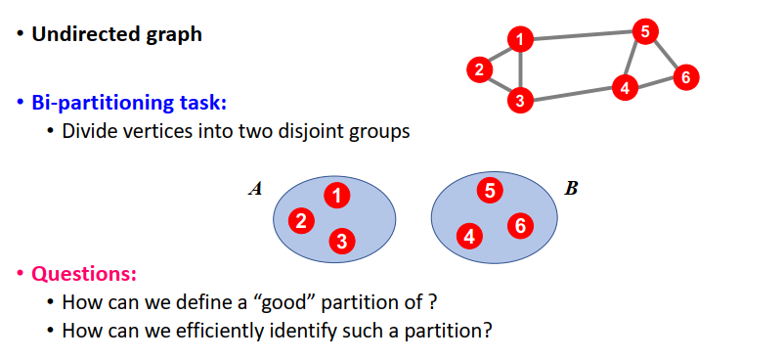
Partition of Graphs

Slide 10
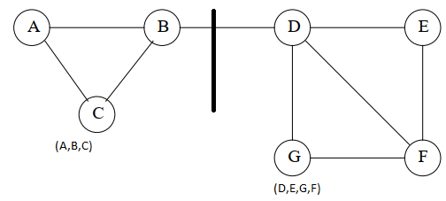
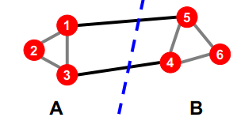
Partition of Graphs
What makes good partition?
Divide nodes into two sets so that the cut (set of edges that connect nodes in different sets) is minimized.
It needs the two sets to be approximately equal in size.
Maximize the number of within-group connections
Minimize the number of between-group connections
Examples:

Slide 11
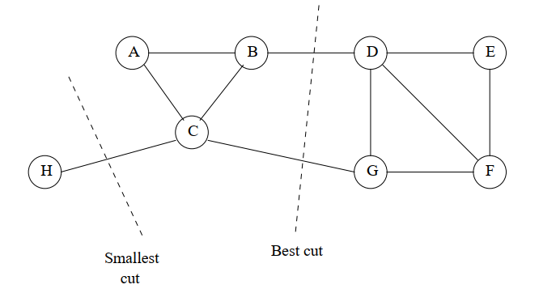
Partition of Graphs
Example – 3:
It is a variant of previous example
If all we wanted was to minimize the size of the cut, then the best choice would be to put H in one set and all the other nodes in the other set.
But is not acceptable, because one set is too small
Better is to use cut with (B,D) and (C,G)
Smallest cut is not necessarily the best cut

Slide 12
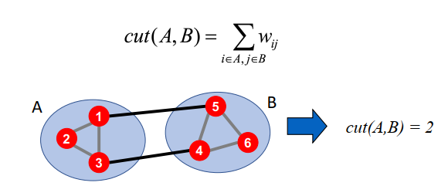
Partition of Graphs
Graph cut..
Express partitioning objectives as a function of the “edge cut” of the partition
CUT: Set of edges with only one vertex in a group

Slide 13
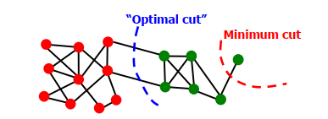
Partition of Graphs
Criterion: Minimum Cut
Minimize weight of connections between groups
arg(MIN_{A,B} CUT(A,B))
Problems:
Only considers external cluster connections
Does not consider internal cluster connectivity

Slide 14
Partition of Graphs
Normalized cut..
Good Cut → It must balance the size of the cut itself against the difference in the sizes of the sets that the cut creates. → this becomes the criterion.
To do this we are using “Normalized cut” [Shi-Malik, ’97]
Connectivity between groups relative to the density of each group
Let us assume the Normalized cut is represented as “ncut”
It is used to produce more balanced partitions
How do we efficiently find a good partition?
Problem: Computing optimal cut is NP-hard

Slide 15

Partition of Graphs
Normalized cut..
Vol(S) defines the volume of the set – S. The volume of the set specifies the number of edges in the set.
Let us assume we partition the nodes of a graph into two disjoint sets S and T
Let Cut(S, T ) be the number of edges that connect a node in S to a node in T. Then Normalized Cut :

Slide 16
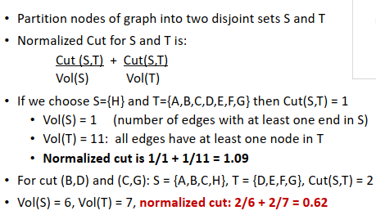
Partition of Graphs
Normalized cut: Example

Slide 17
Partition of Graphs
Matrix representation of a Graph:
1. Adjacency Matrix
2. Degree Matrix
3. Laplacian Matrix

Slide 18
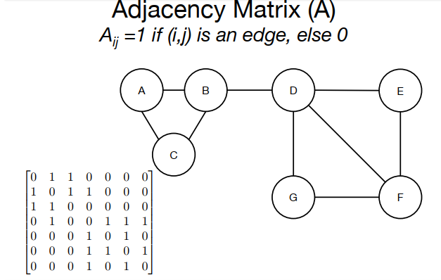
Partition of Graphs

Slide 19
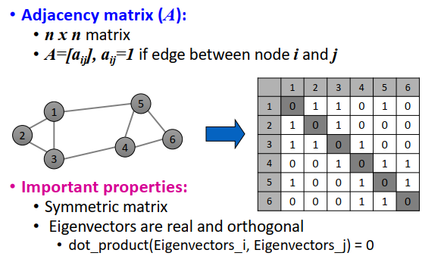
Partition of Graphs

Slide 20
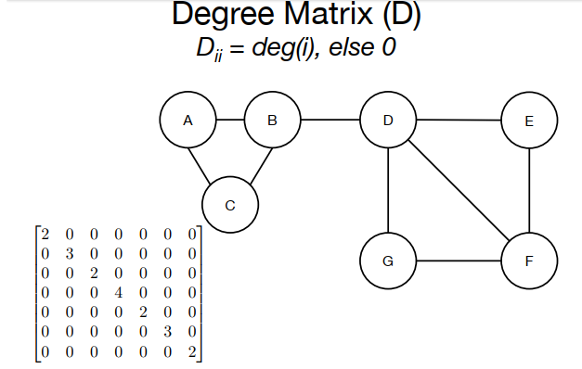
Partition of Graphs

Slide 21
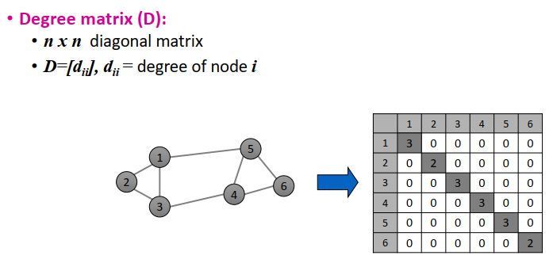
Partition of Graphs

Slide 22
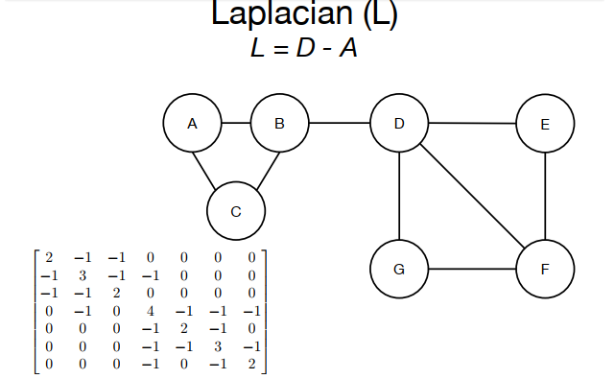
Partition of Graphs

Slide 23
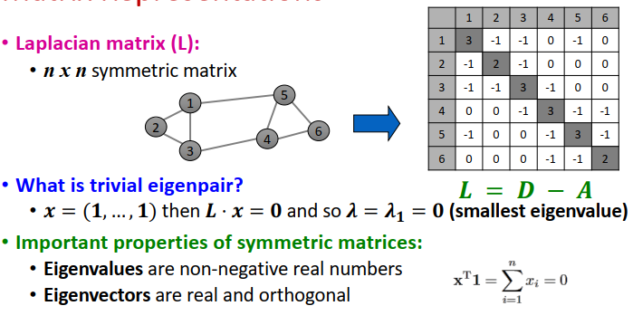
Partition of Graphs

Slide 24
Partition of Graphs
With the help of eigenvalues and eigenvectors of a Laplace matrix of the given graph, we can get a good idea on best way of partition of a given graph.
When dealing with the Laplacian matrix, however, it turns out that the smallest eigenvalues and their eigenvectors reveal the information we desire.
The smallest eigenvalue for every Laplacian matrix is 0, and its corresponding eigenvector is [1, 1, . . . , 1].
Second smallest eigenvalue of the Laplace symmetric matrix give the best partition of the given graph.

Slide 25
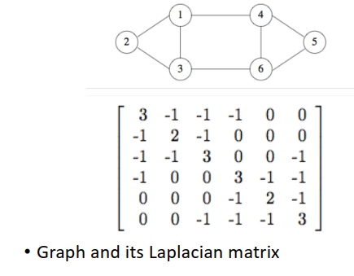
Partition of Graphs

Slide 26
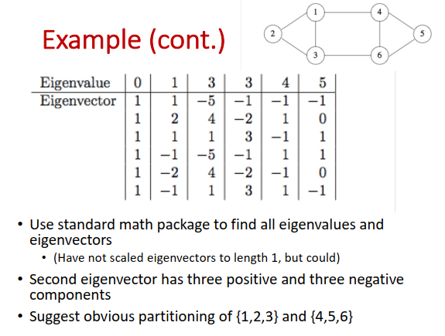
Partition of Graphs

