Slide 1
Control Prescription Drug abuse
Northeastern University, College of Engineering
Username: nineninenortheastern
Password: Northeastern@1

Slide 2
Problem Statement
In countries around the world, drug abuse is a growing menace due to many factors. Higher dosage of prescription pain-pills or anti-depressants by doctors can cause a patient to get addicted.
In cases of addiction, patients go to multiple doctors (known as double-doctoring) to get a higher dosage of pills to sustain their addiction.
Addicted people in many cases get pills with the same doctor’s prescription by going to multiple stores. This is how rampant drug abuse has become a major problem.

Slide 3
Objective - (Solution to the problem)
The project aims at addressing the problem of addiction to prescription pills. As doctors prescribe high-doses of pills, some patients are addicted to it even after they are cured of the original ailment.
Our objective is to have a solution by introducing a governing body that is responsible for monitoring the medicines prescribed by a doctor.
It also acts as a controlling body for medicines received by the patient.
With the suggested design solution, we provide a way to track the amount of drugs taken by a person at the stores, the drugs administered by the doctors and the enforcement body also ranks doctors.
Our solution also helps the doctors make the right choice while prescribing medication to patients by reviewing their prescription history.

Slide 4
Approach
Creation of a governing body to handle prescription requests and collect data.
Enforcement Body is responsible for taking actions like revoking the license of doctors who over prescribe medication.
Doctors can look at the entire history of a patient.
Patients can no longer abuse the prescriptions given to them because the only way to get medication is through the governing body.

Slide 5
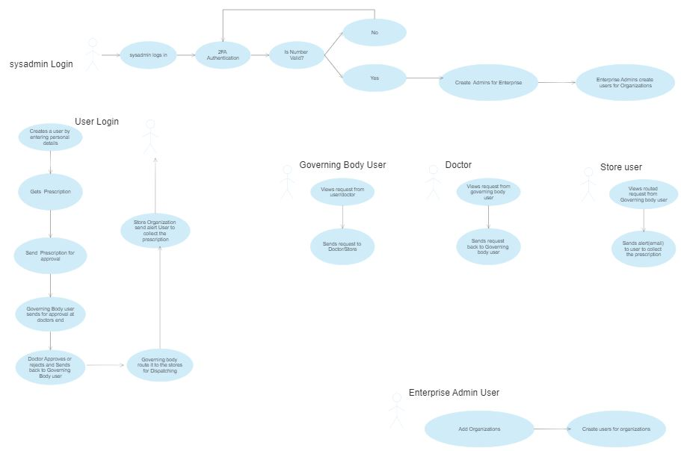
Use Case Diagram

Slide 6
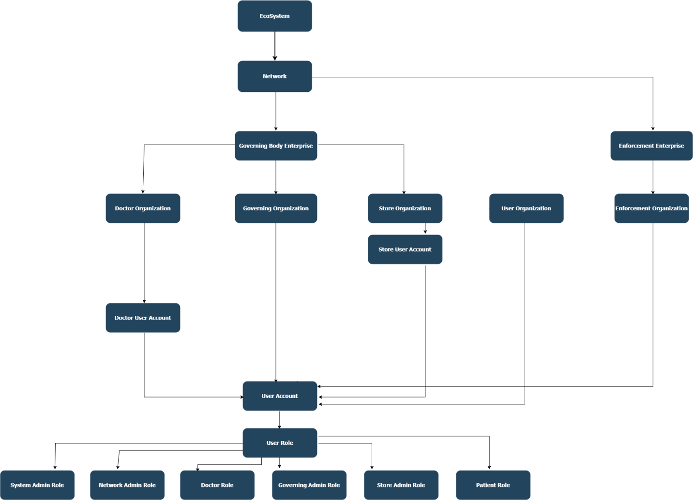
Ecosystem Architecture Diagram (Object Model)

Slide 7
Workflow
Creation of system admin.
Creation of admin users for governing and enforcement body.
Governing body creates three organizations (Doctor, Governing and Store organization) and their admins.
Enforcement body creates its own organization and its admin.

Slide 8
Governing Body Workflow
A signed in user can get prescription and then forward it to the governing organization for approval.
The governing body then might forward the prescription request to the doctor for a decision.
The doctor can view the patients history and make the appropriate decision.
If the doctor rejects the prescription the request status is reflected in the user login view.
If the doctor approves the prescription the request is then sent to the governing organization for further processing.
The governing org then sends the request to the appropriate store to issue the medication.

Slide 9
Governing Body Workflow (Continued)
The store user dispatches the request and the user is intimated by an email.

Slide 10
Enforcement Body Workflow
The enforcement organization has access to all the records including doctor licenses.
The data is then analyzed by the application and the enforcement organization can revoke the license of the doctor if need be.

Slide 11
References
Last week tonight – Opiods crisis

Slide 12
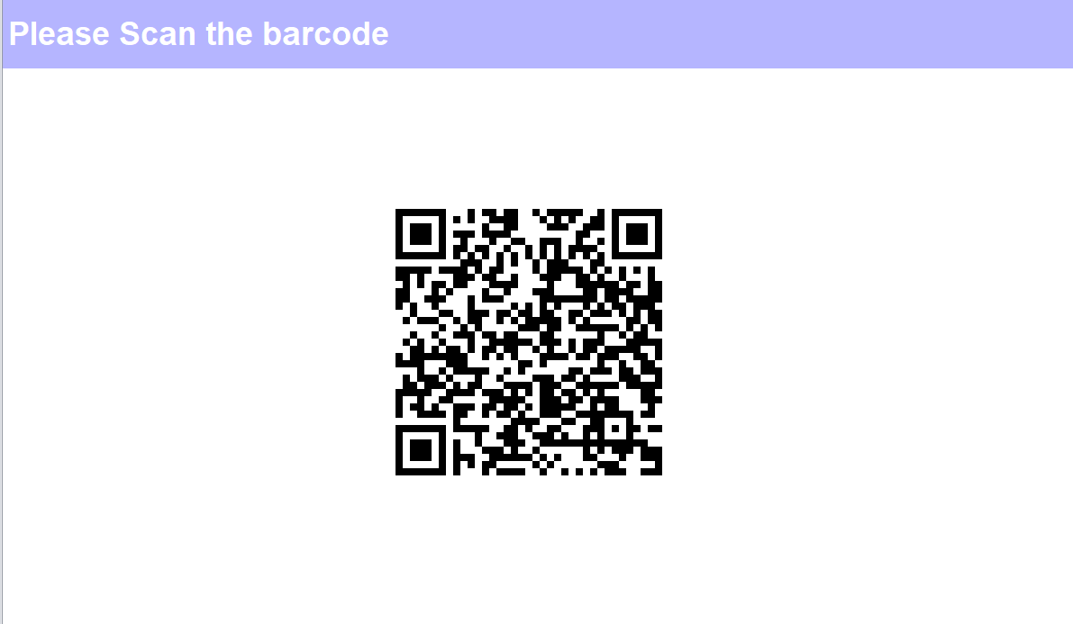

Slide 13
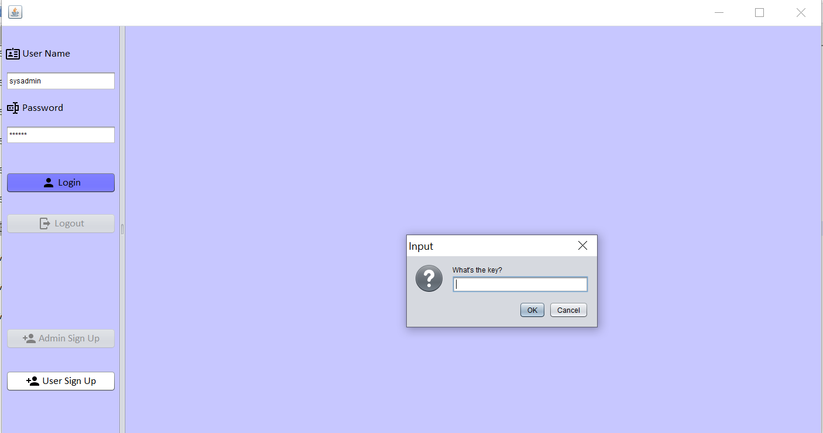

Slide 14
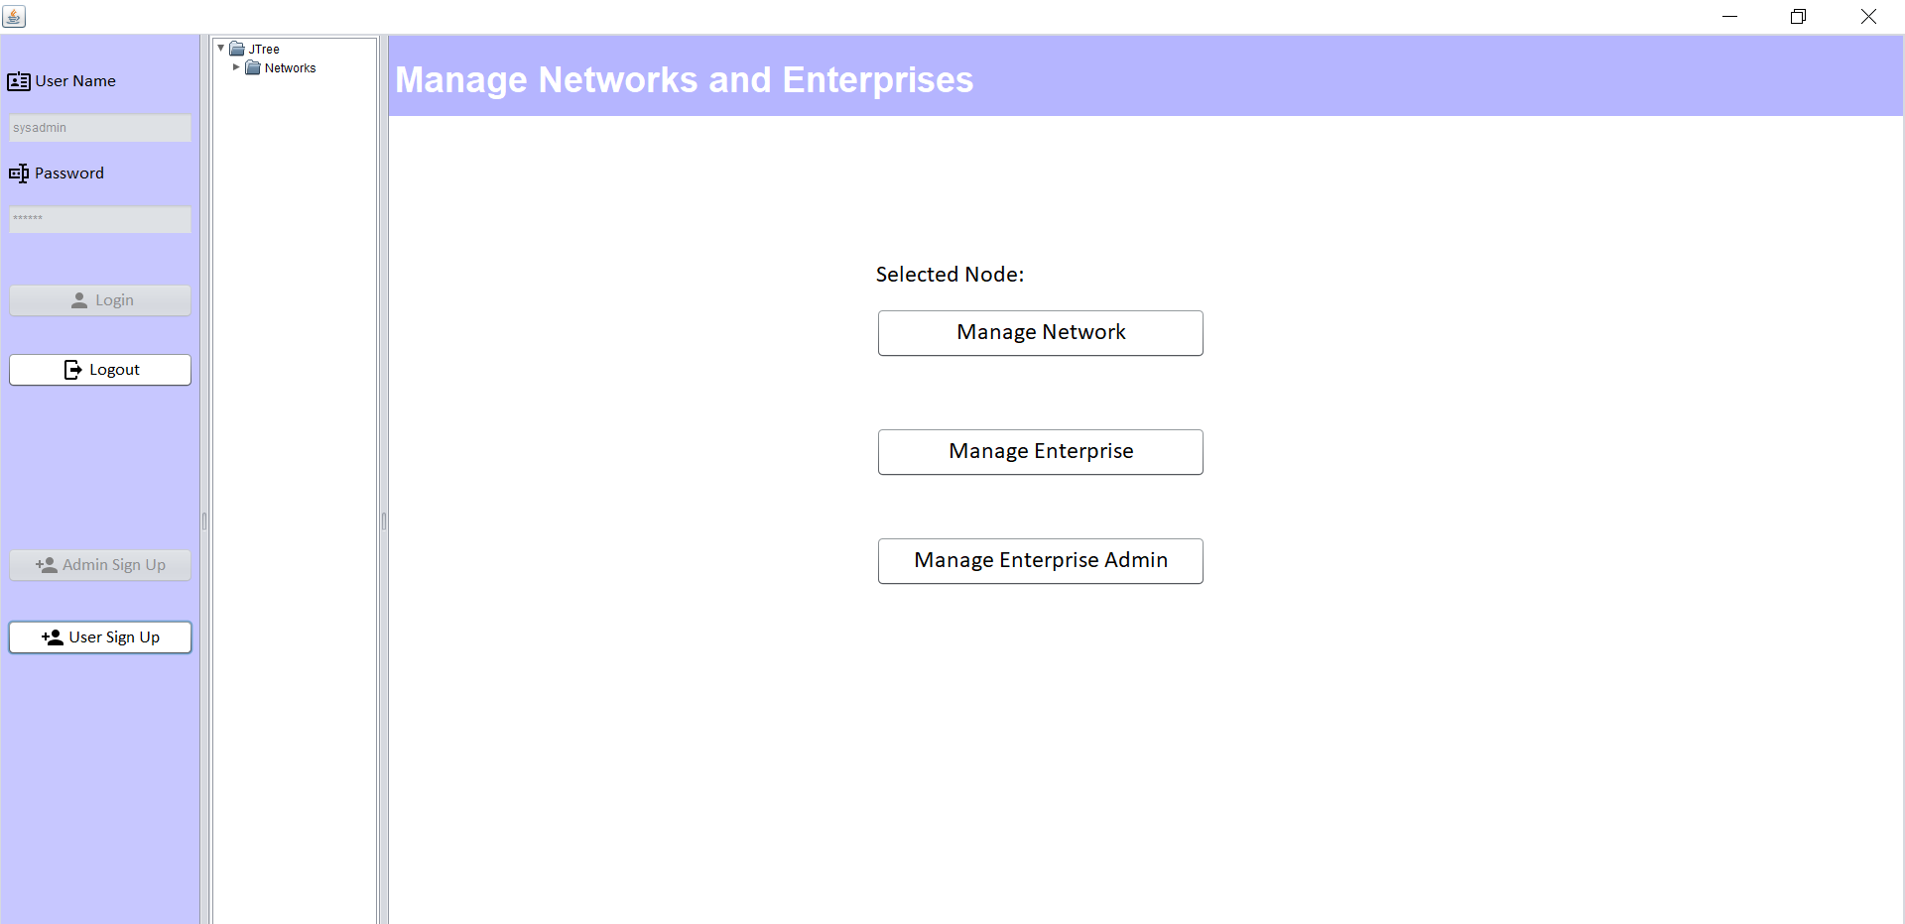

Slide 15
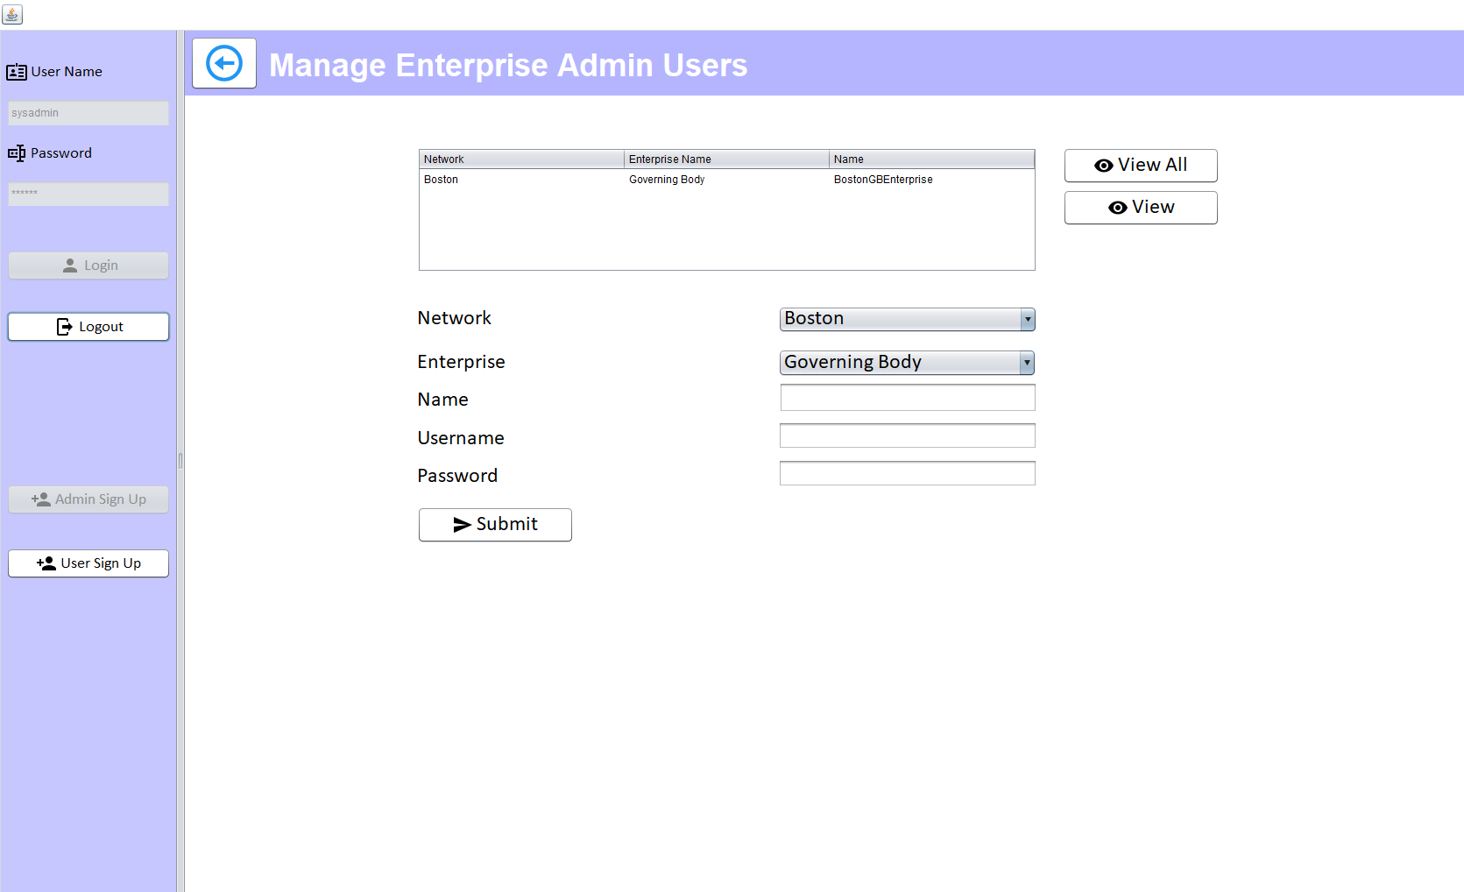

Slide 16
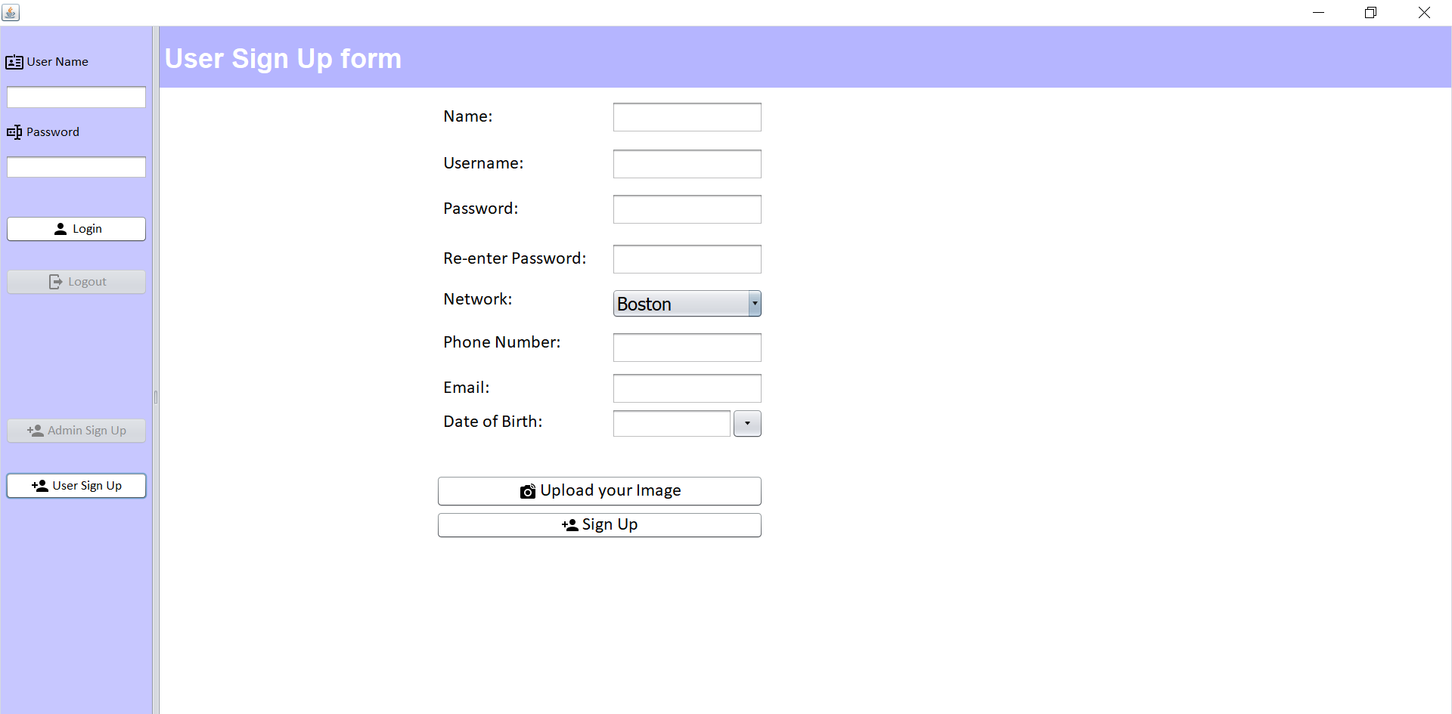

Slide 17
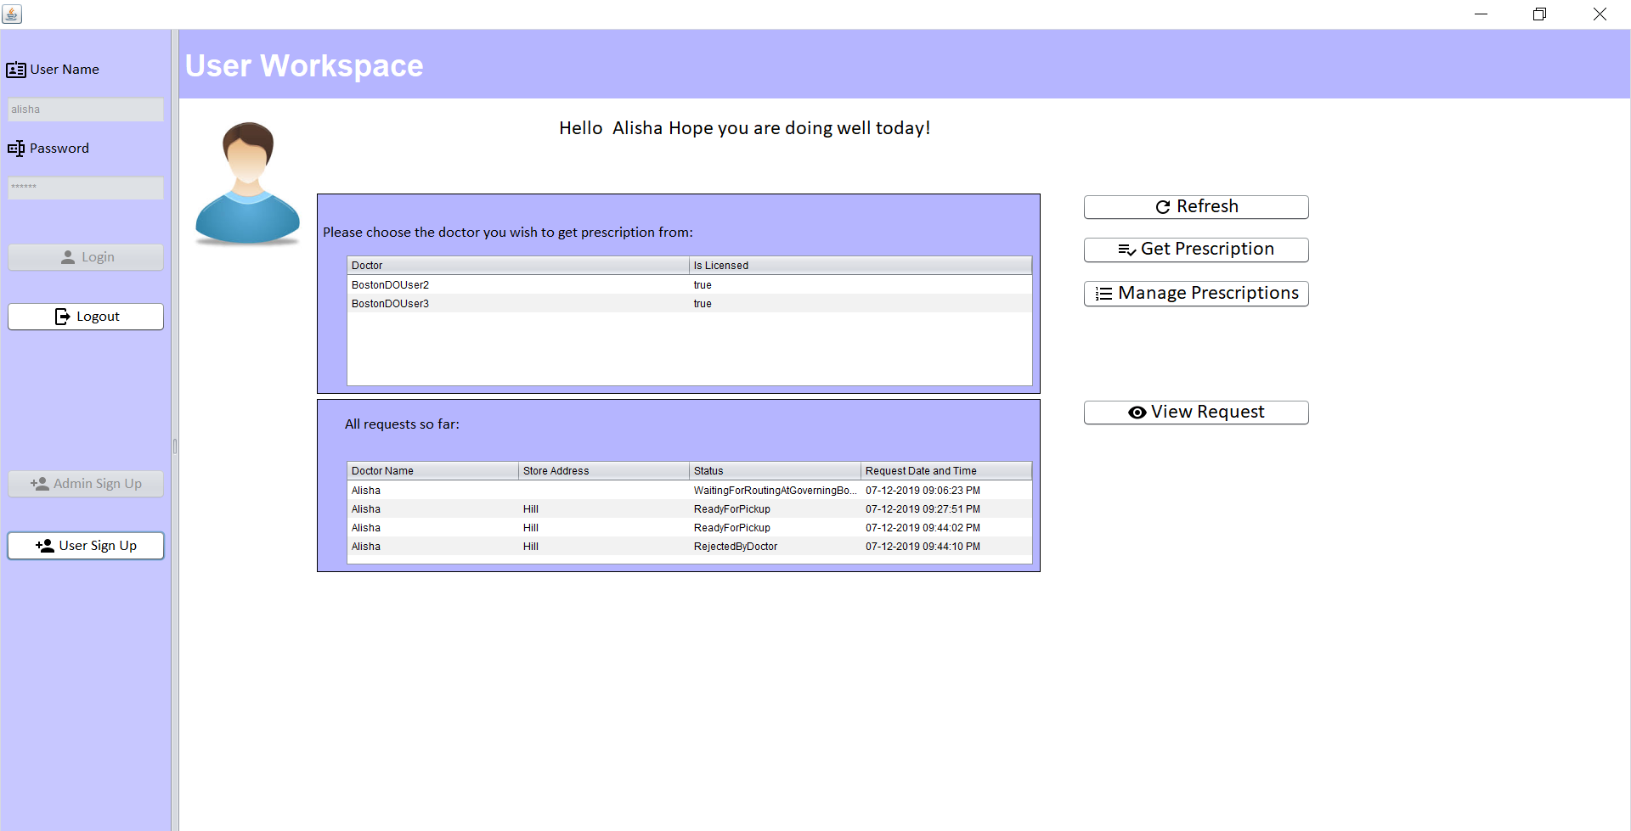

Slide 18
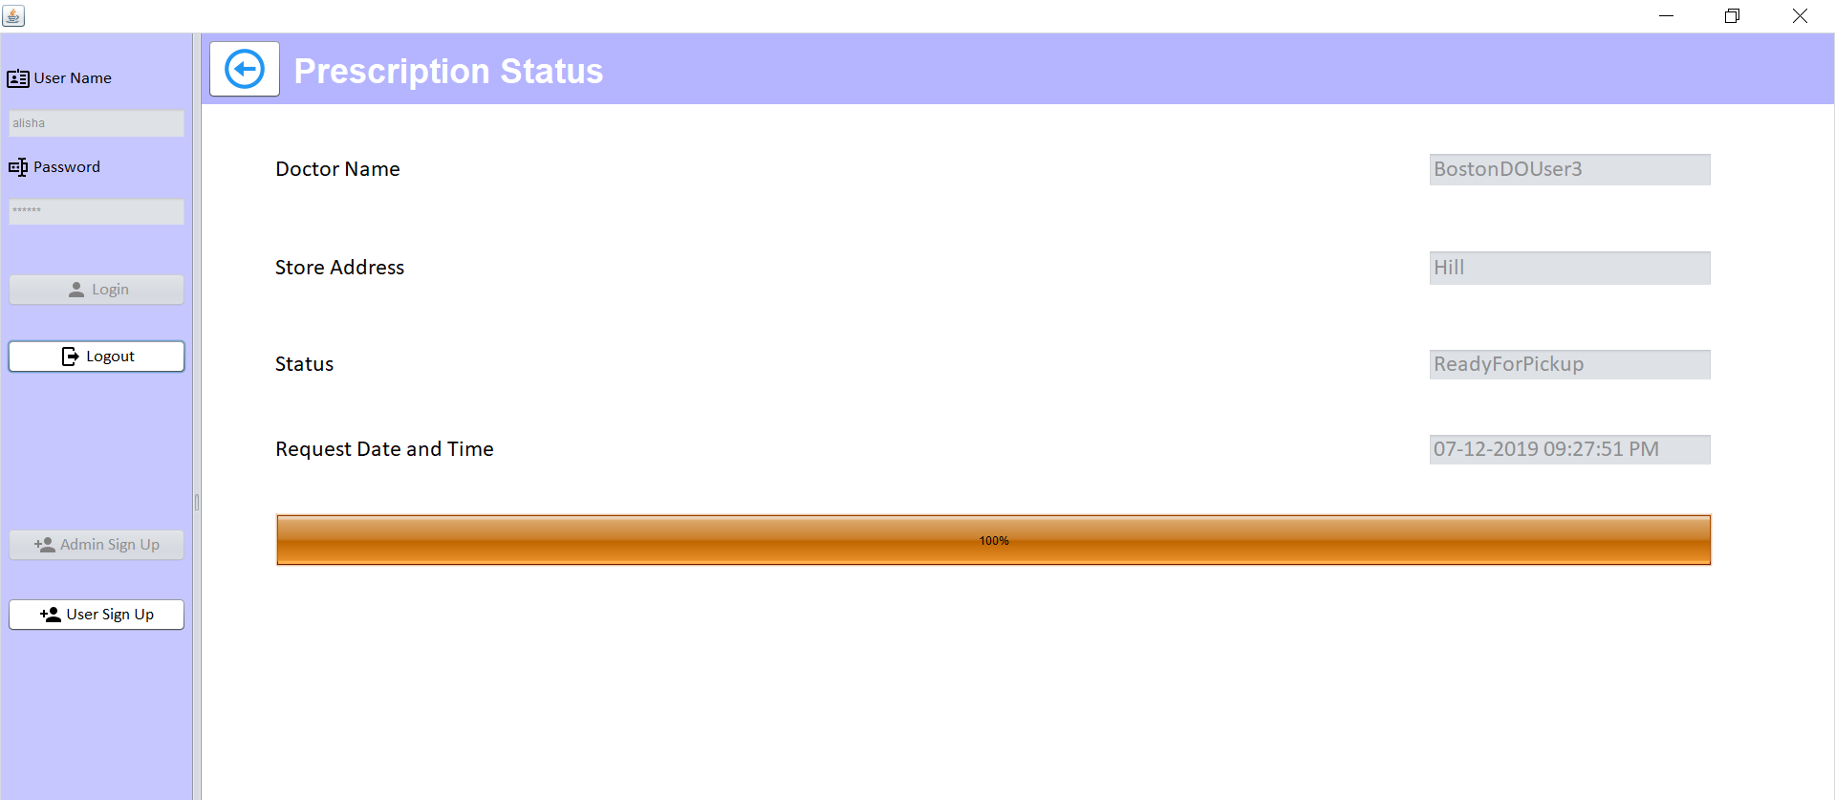

Slide 19
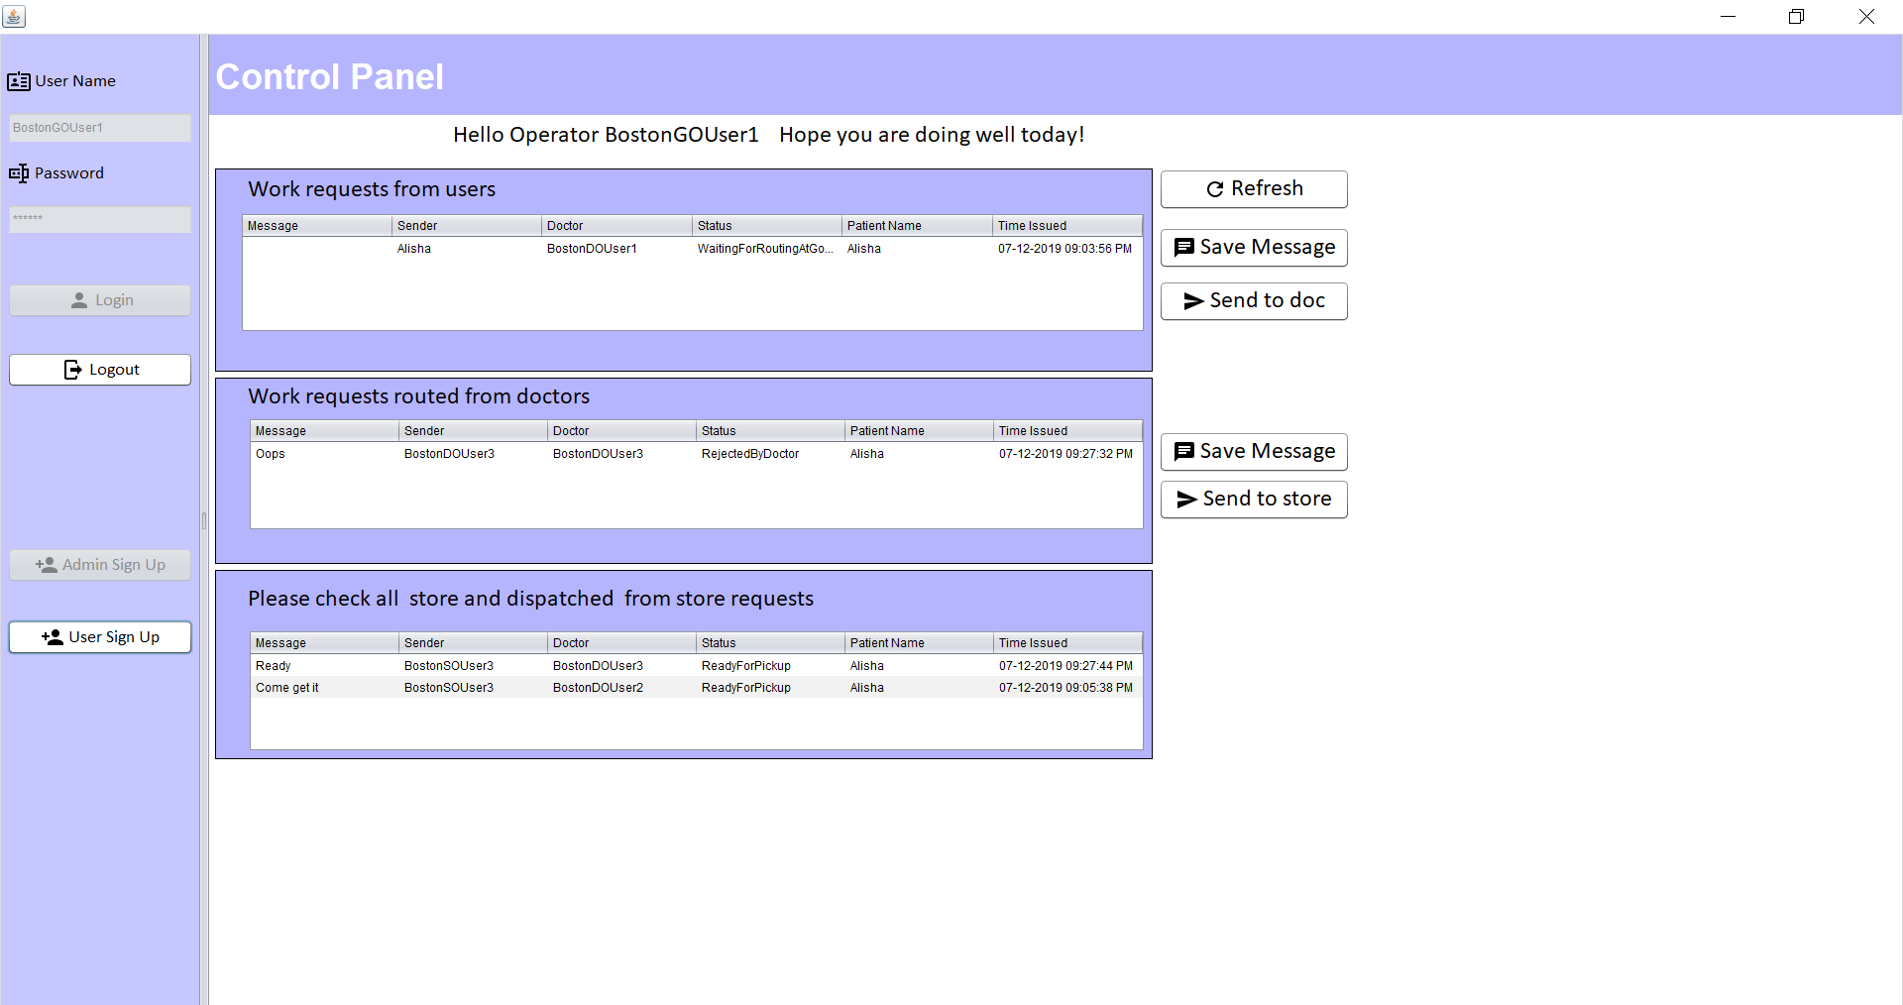

Slide 20
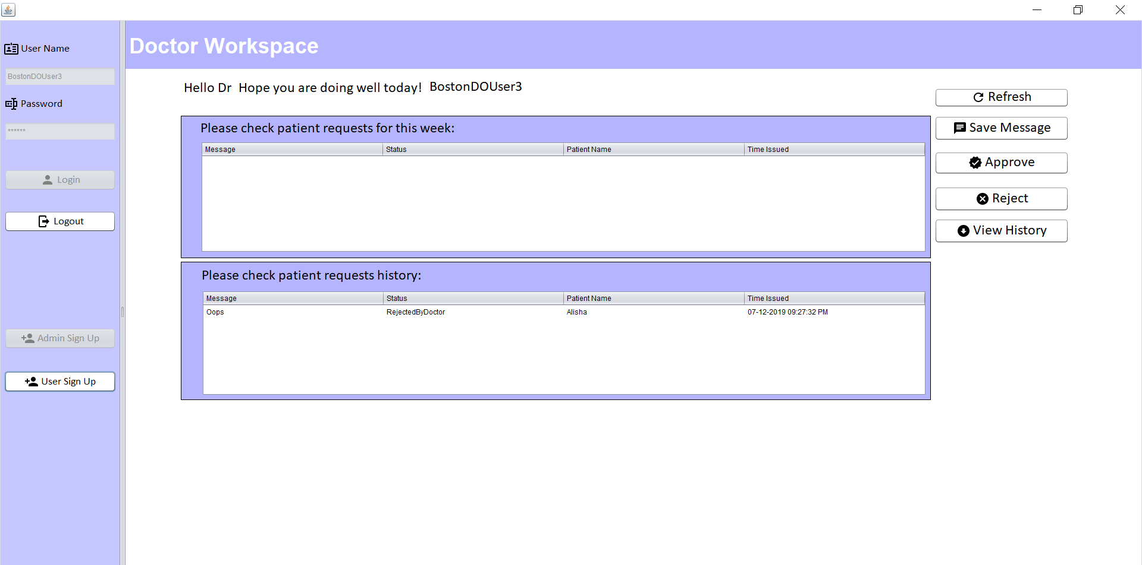

Slide 21
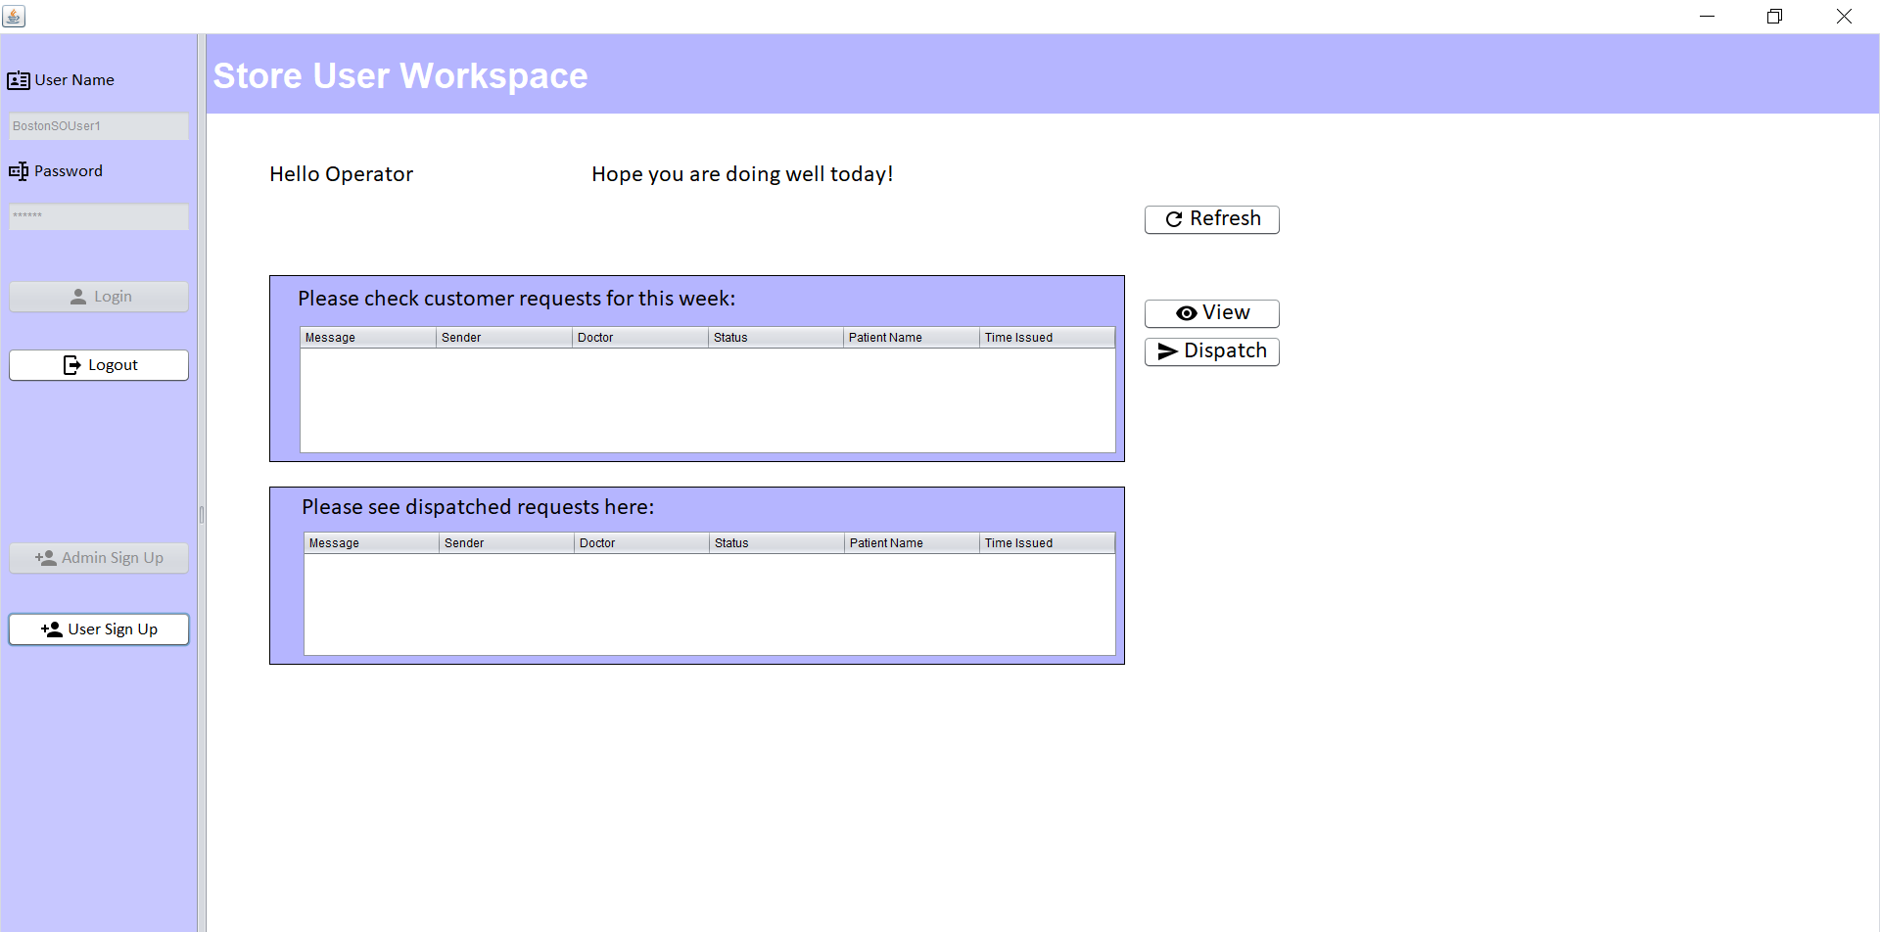

Slide 22
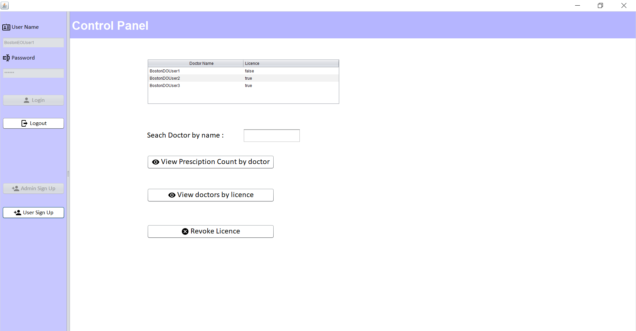

Slide 23
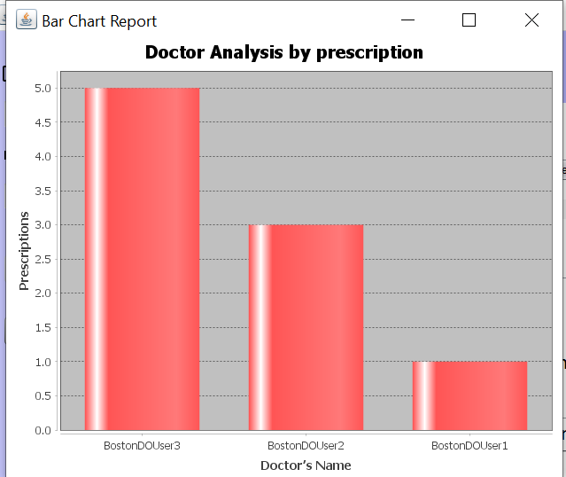

Slide 24
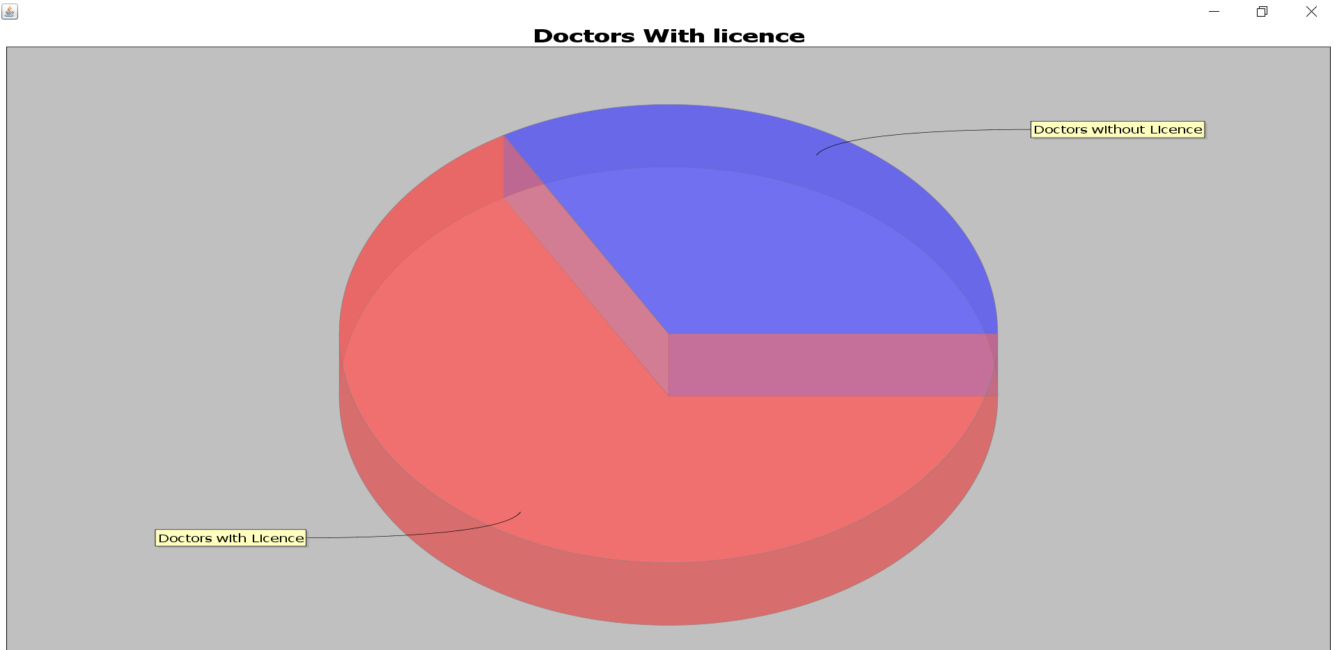

Slide 25
THANK YOU !!

