Slide 1

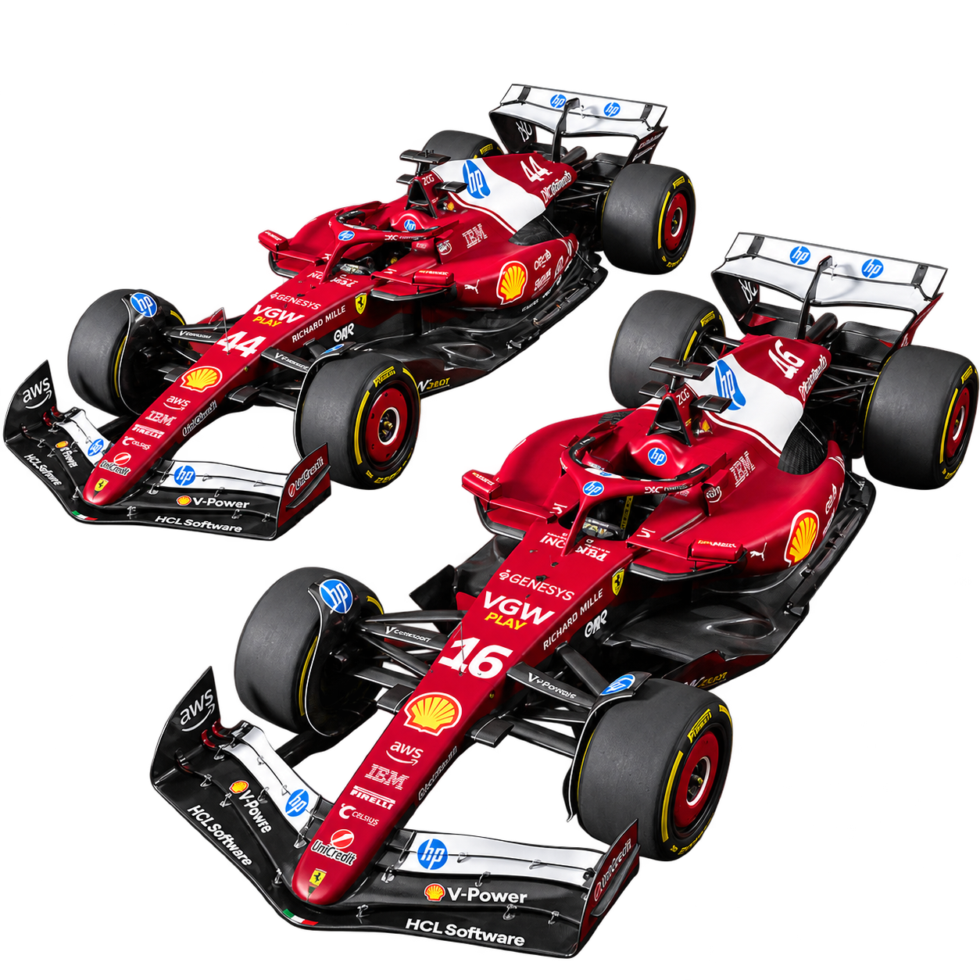
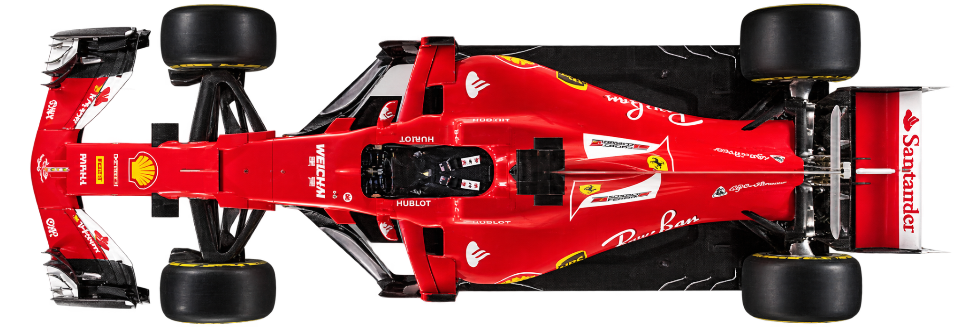
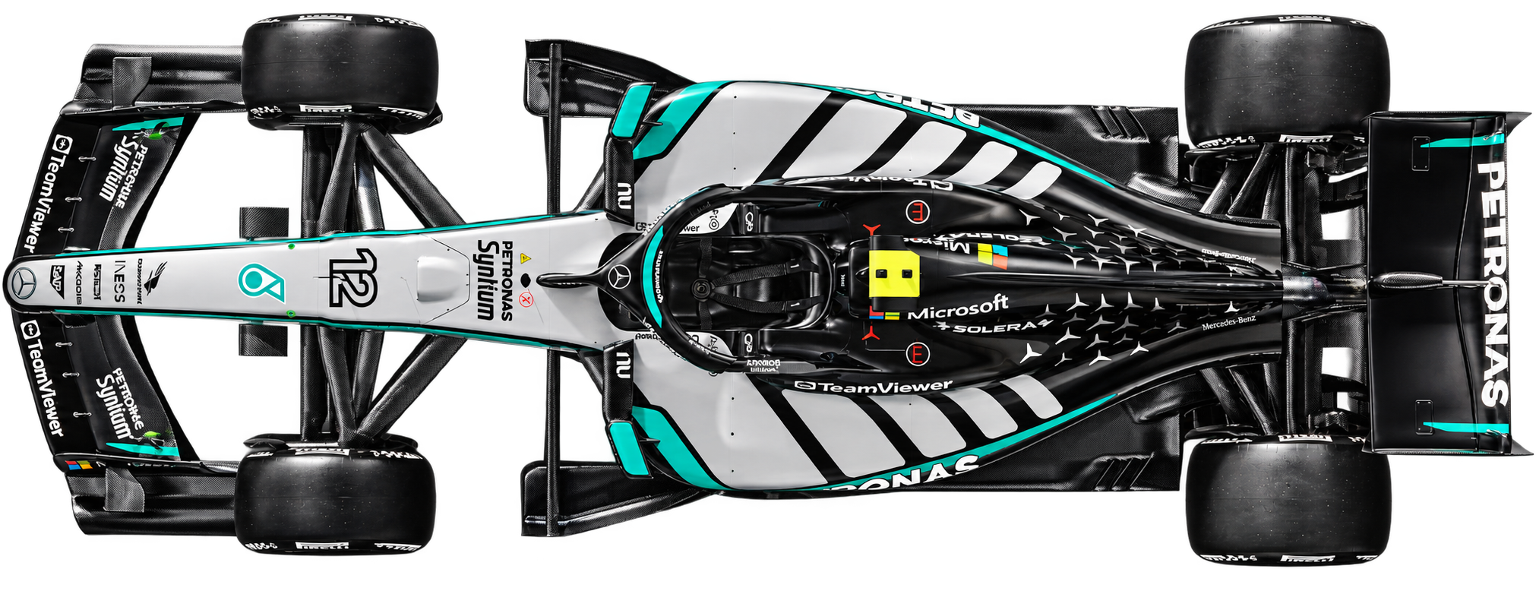
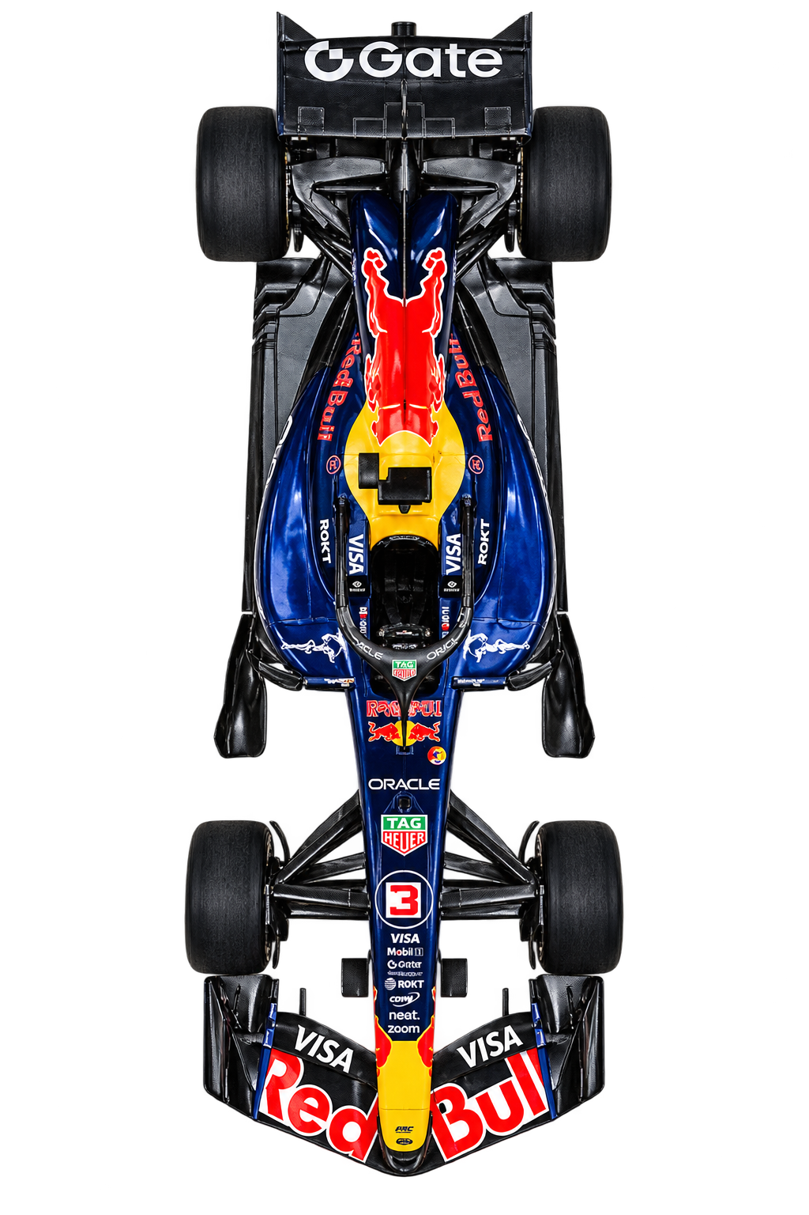

Did F1’s Cost Cap Level the Grid?
An Analysis of Competitive Balance, 2010-2025
B05 - Adrian Marcell, Ashwin Pillanda Ravindra,
Jenniffer Hierro Cruz, and Saleha Hassan Alvi
Notes:
SPEAKER: ADRIAN | Slide 1 | Target: 0:25
Good afternoon, everyone. We're Team B05. I'm Adrian, and this is Ashwin, Jenni, and Saleha.
Our project asks a pretty simple question: did Formula 1's cost cap actually balance the competition? We looked at results from 2010 to 2025 to see whether success was spread across more teams after the new spending rules started in 2021.

Slide 2


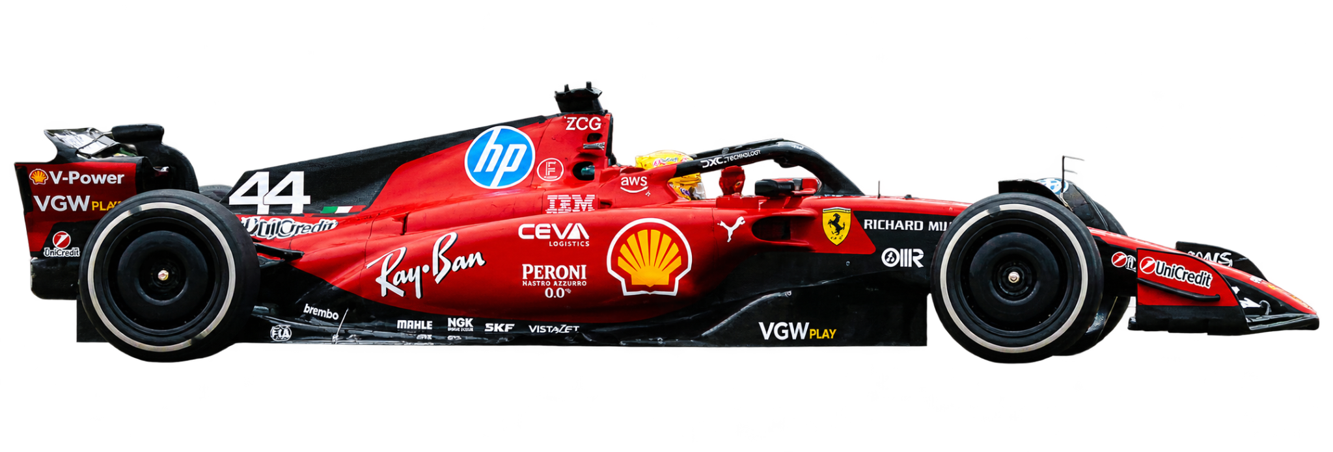
Formula 1 & The Cost Cap
02
Our Question: Did competition become more balanced after the 2021 cost cap implementation?
FIA Formula One World Championship Overview
How Formula 1 Works
What Changed in 2021
•
Teams compete in the Constructors’ Championship.
•
Formula 1 introduced a cost cap.
•
Teams accumulate points throughout the season.
•
The cap limits specified team spending.
•
Championship standings rank teams by their total points.
•
Our analysis examines whether competition became more balanced afterward.
Sources: Formula 1, “The 2021 rules and regulation changes” (formula1.com).
Notes:
SPEAKER: ADRIAN | Slide 2 | Target: 1:10
Again, we are answering the question:....
If you don't follow F1, here's the quick version. The constructors are the teams, like Ferrari, Mercedes, and McLaren. Each team has two drivers, and their race finishes earn points. Those points add up over the season to decide the Constructors' Championship. That's the championship we studied, not the drivers' one.
If you don't follow F1, here's the quick version. The constructors are the teams, like Ferrari, Mercedes, and McLaren. Each team has two drivers, and their race finishes earn points. Those points add up over the season to decide the Constructors' Championship. That's the championship we studied, not the drivers' one. Before 2021, the richest teams could simply outspend everyone else on their cars. So in 2021, F1 put a cap on certain kinds of team spending. It started at 145 million dollars and came down to 135 million by 2023. But a spending limit doesn't automatically make the cars equally fast. So instead of assuming it worked, we checked what actually happened in the results.

Slide 3
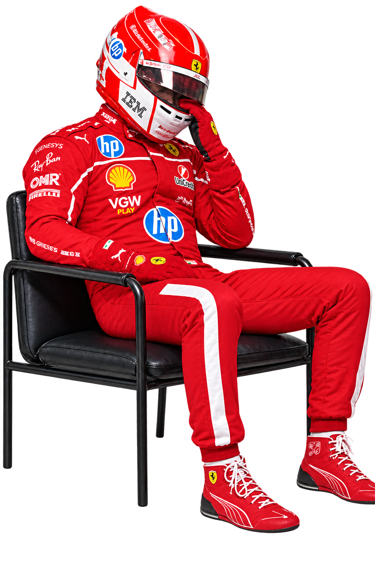
Why Competitive Balance Matters
03
Why should fans, teams, and sponsors care about a more competitive grid?
FANS
Closer racing can make each race more exciting and keep fans engaged.
SPONSORS
More teams competing near the front can create additional sponsorship opportunities.
F1 & TEAMS
A more balanced grid can help smaller teams compete and strengthen F1's appeal.
Our focus: Did the cost-cap era spread competitive success across more teams?
Sources: Liberty Media Investor Presentations, FIA Financial Audits, Team B05 Analysis.
Notes:
SPEAKER: Jenni | Slide 3 | Target: 0:55
Why does competitive balance matter? For fans, closer racing can make seasons less predictable and more exciting. For sponsors, more competitive teams could mean more opportunities to get exposure near the front. And for F1 and the smaller teams, a more balanced grid could make the championship more appealing and give more teams a realistic chance to compete.
That leads to our central question: after the cost cap, did success spread across more teams, or did the leading teams just change? Ashwin will explain how we measured that.

Slide 4
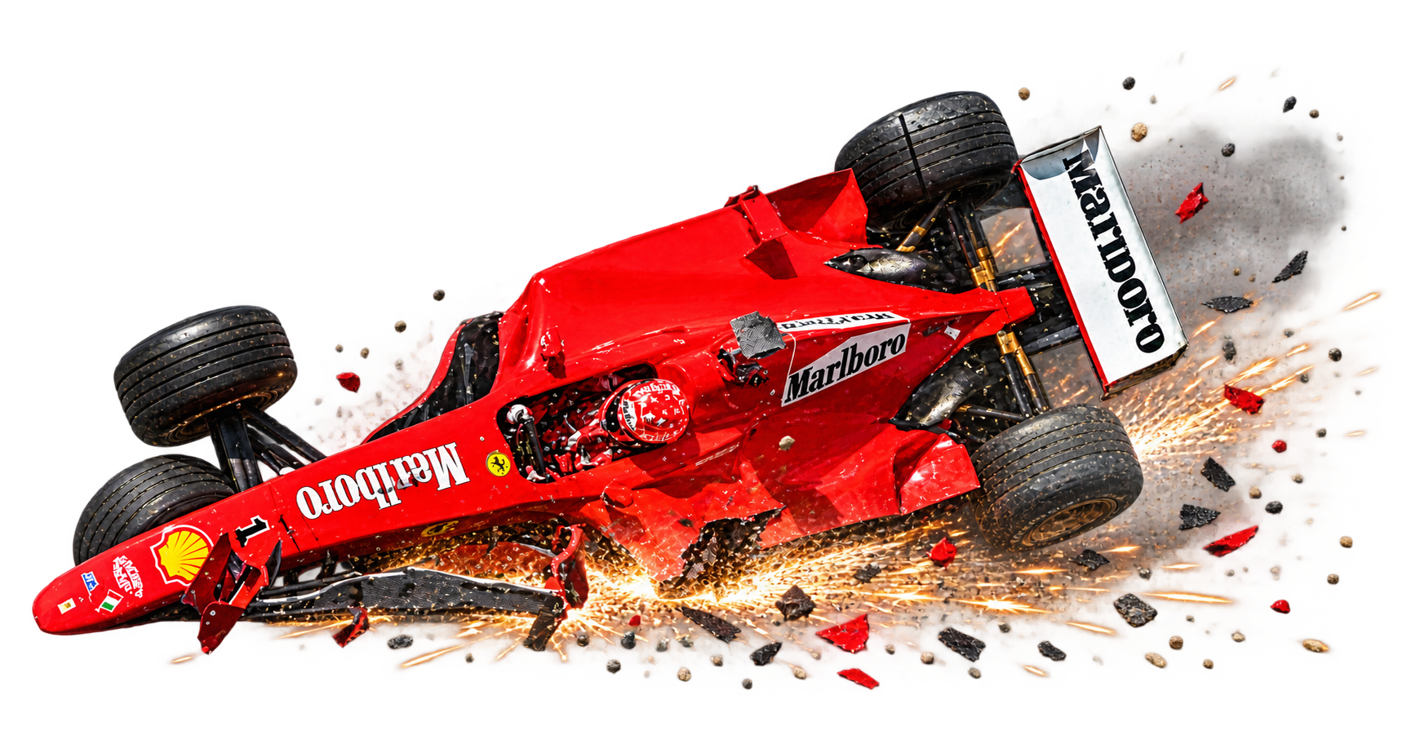
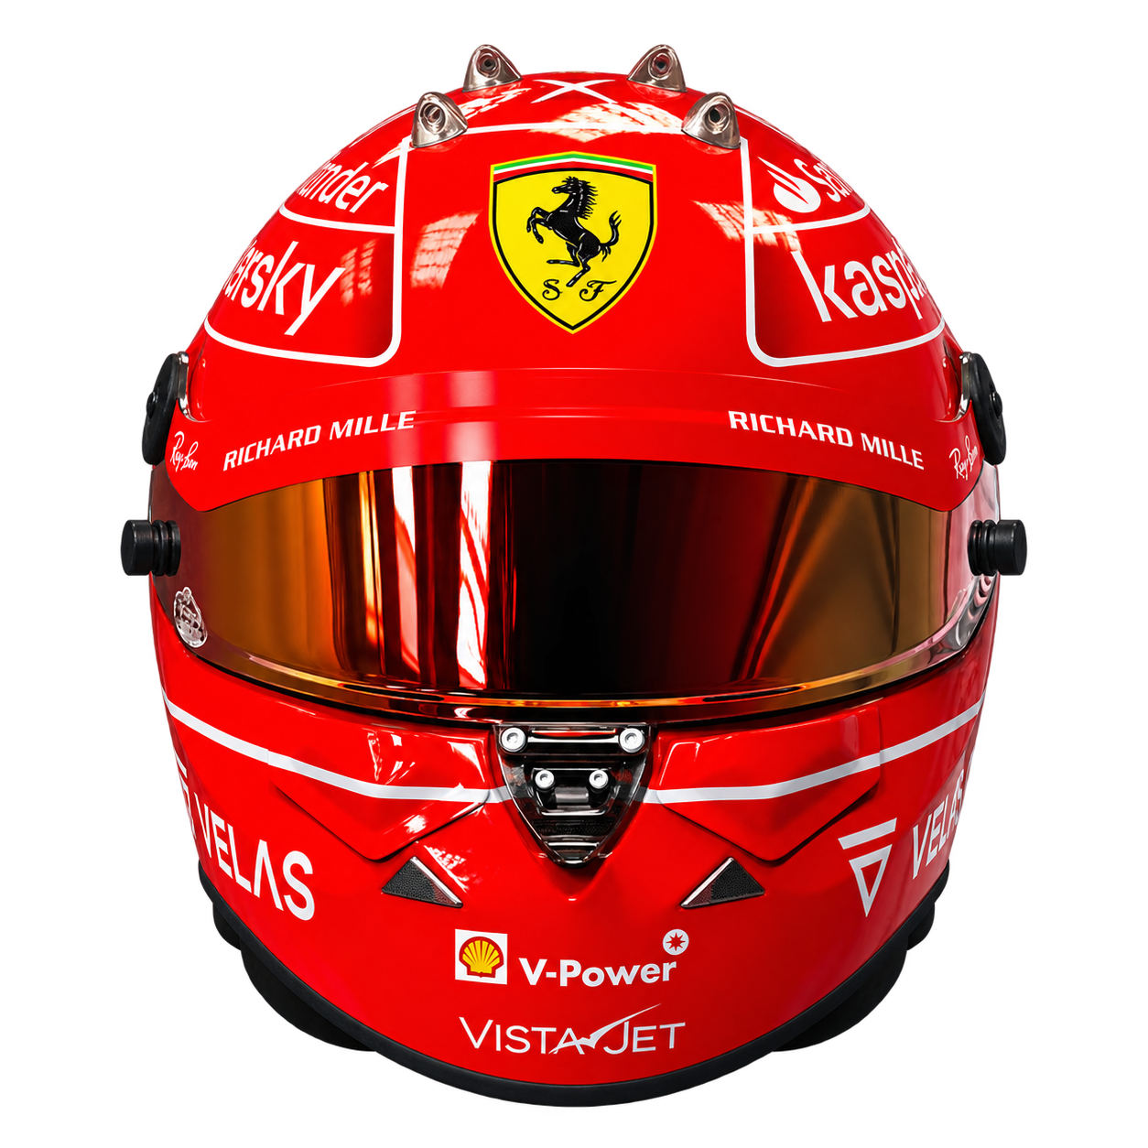
Data & Measures
04
How did we clean our dataset and define our measures?
Data Measurement Overview
Data
Measures
•
Source: F1DB constructor standings and Grand Prix results.
•
Point share: (team point / all team points in season) x 100.
•
Pre-cap: 2010 - 2020 (11 seasons).
•
Top-two share (CR2): combined share of P1 and P2 .
•
Post-cap: 2021-2025 (5 Seasons).
•
Midfield Share: combined share of P4 through P7.
•
Renamed teams grouped consistently.
•
Big Three Share: combined points share of Ferrari, Mercedes, and Red Bull.
Sources: F1DB contributors, release v2026.15.1 (github.com/f1db/f1db), CC BY 4.0; Formula 1, “Racing Point Force India entry” (formula1.com).
Notes:
SPEAKER: ashwin | Slide 4 | Target: 0:55
●We used the F1DB constructor standings and Grand Prix results from 2010 through 2025. We compared eleven seasons before the cost cap, 2010 to 2020, with five seasons after it, 2021 to 2025. We left out 2026 because that season wasn't complete in our analysis.
●
●We also accounted for teams that changed names. For example, Force India, Racing Point, and Aston Martin are connected in the team's history, so we treated renamed teams consistently instead of counting a name change as a brand-new competitor.
●
●Our main measure is points share: one team's points divided by all constructors' points in that season. CR2 is the combined share of the top two teams. Midfield share covers fourth through seventh. And our Big Three measure follows Ferrari, Mercedes, and Red Bull. Together, they show different sides of competition.

Slide 5
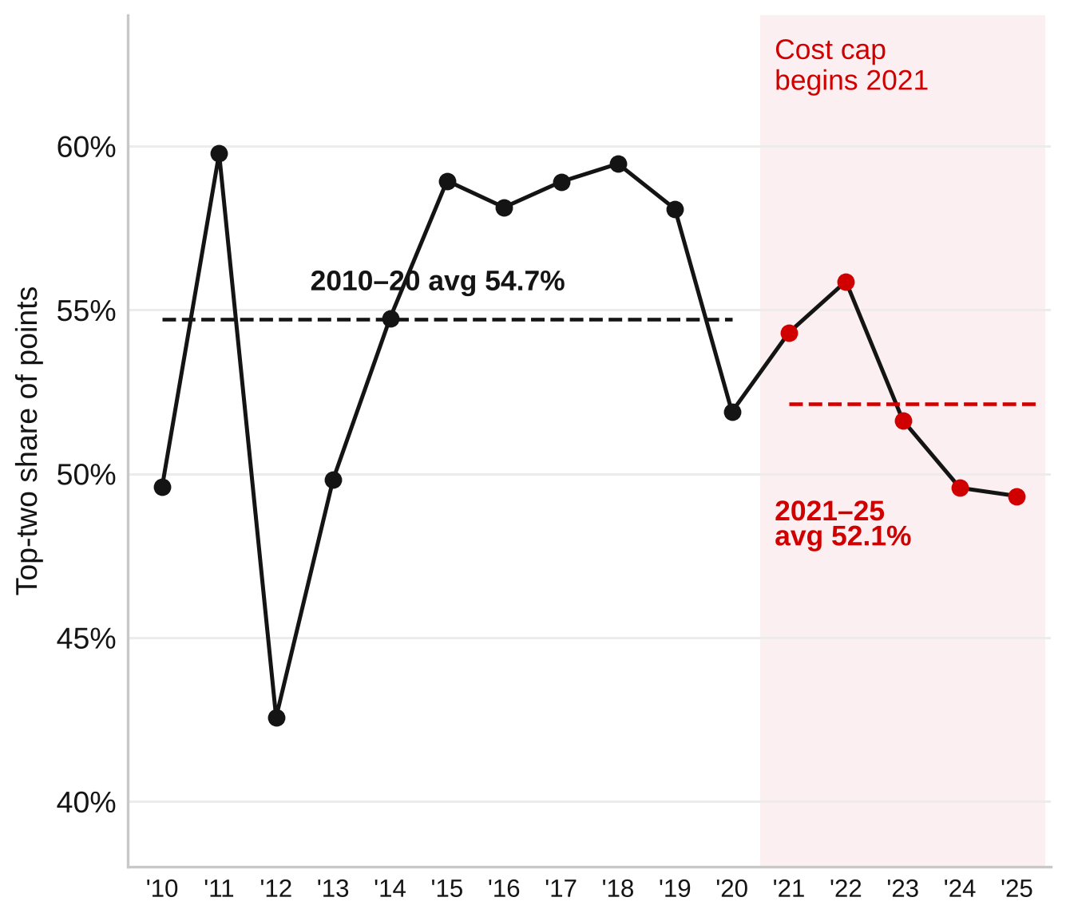
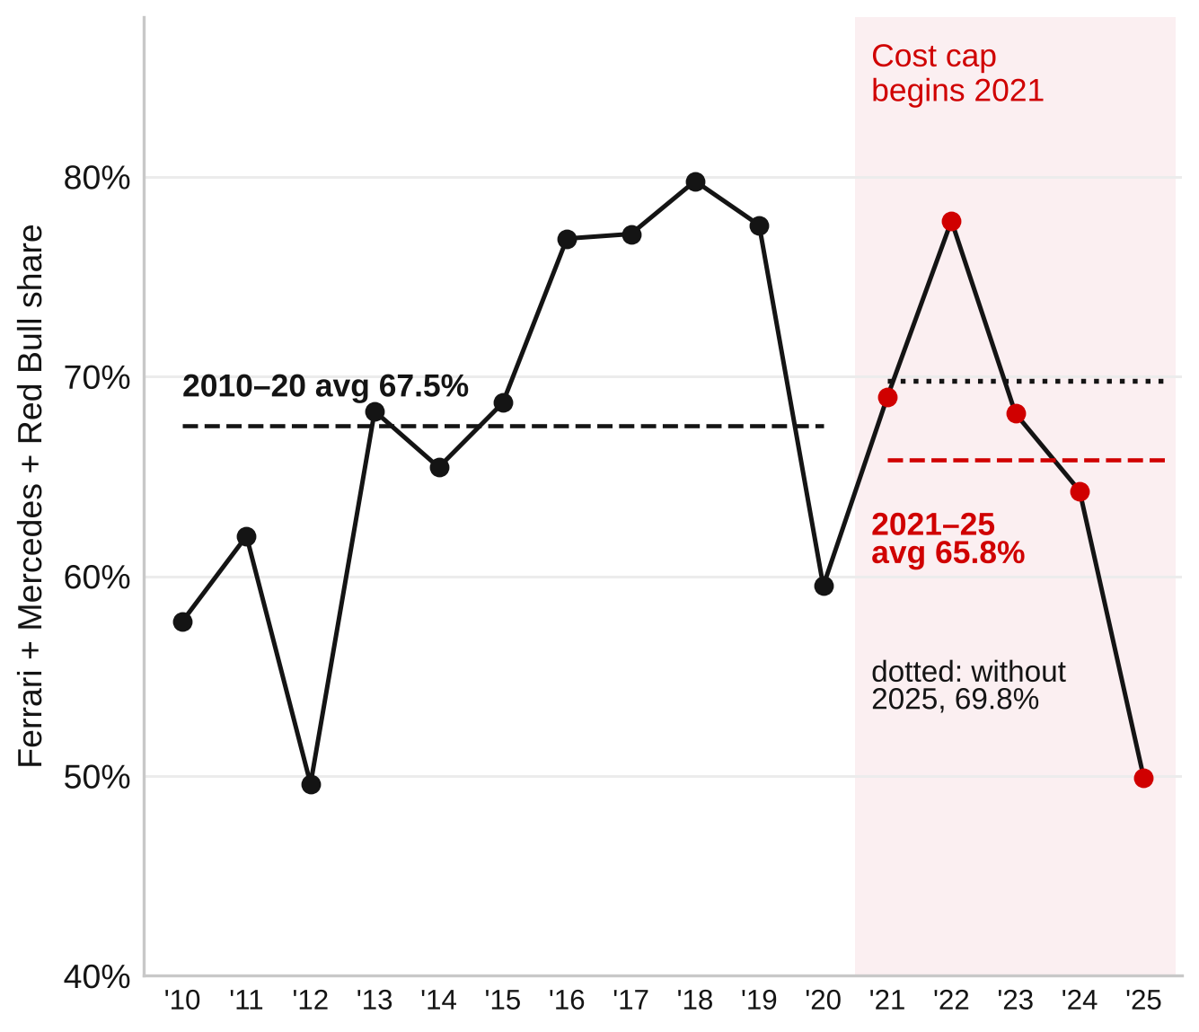
Top-team Concentration Fell Slightly
05
Sources: F1DB contributors, release v2026.15.1 (github.com/f1db/f1db), CC BY 4.0, filtered and aggregated by the team; SciPy developers, scipy.stats.ttest_ind (Welch’s test).
Notes:
SPEAKER: ASHWIN | Slide 5 | Target: 1:30
On the left, the top two teams earned about 54.7 percent of all constructor points per season before the cap. Afterward, that fell to about 52.1 percent, a drop of 2.58 percentage points. That moves in the direction of better balance, but it's not a huge change. And our Welch t-test gave a p-value of 0.245, which means we don't have strong statistical evidence of a difference in the averages.
On the right, we're looking at Ferrari, Mercedes, and Red Bull specifically. Their average combined points share fell from about 67.5 to 65.8 percent. But here's the important catch: if we leave out 2025, the post-cap average becomes about 69.8 percent, actually higher than before. So a lot of the apparent improvement depends on 2025.
We also have to be careful about saying the cost cap caused any of this. The 2022 aerodynamic changes and other regulations happened around this period too. Our data shows what changed, not which rule was responsible. I'll pass it to Jenniffer to look at who benefited and what happened in individual races.

Slide 6
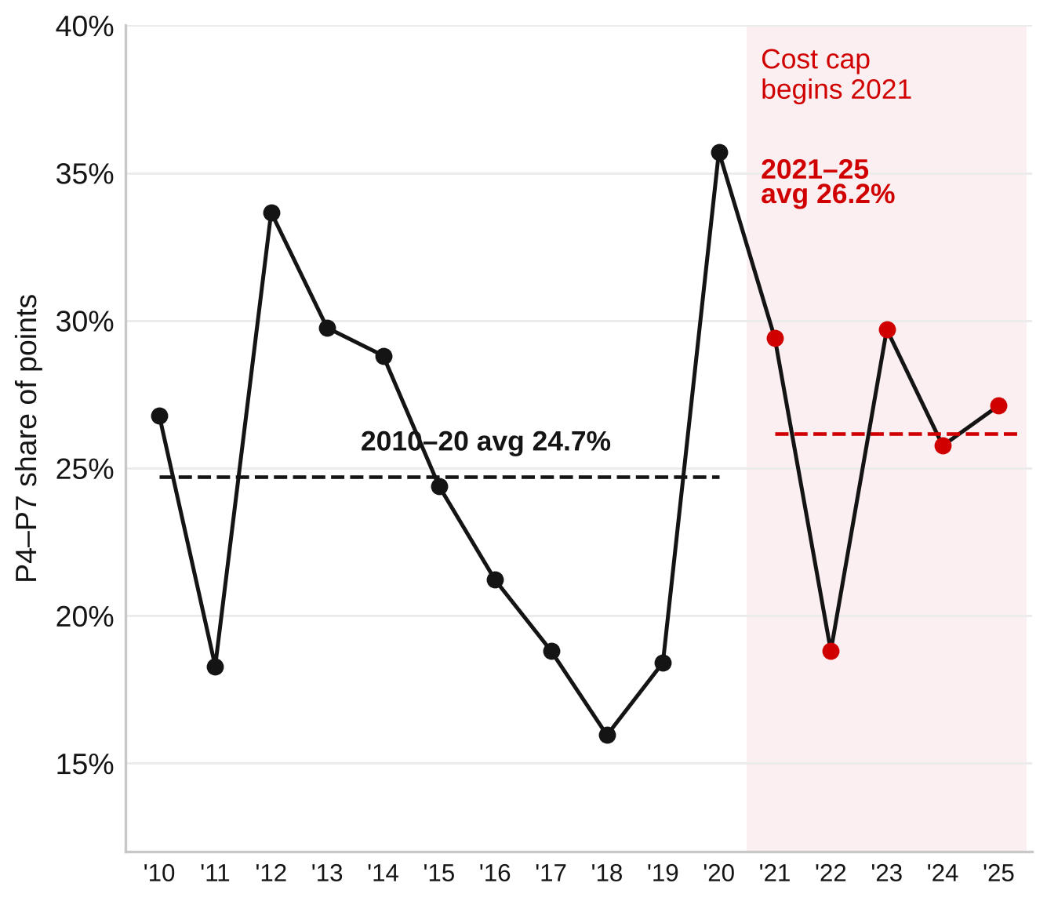
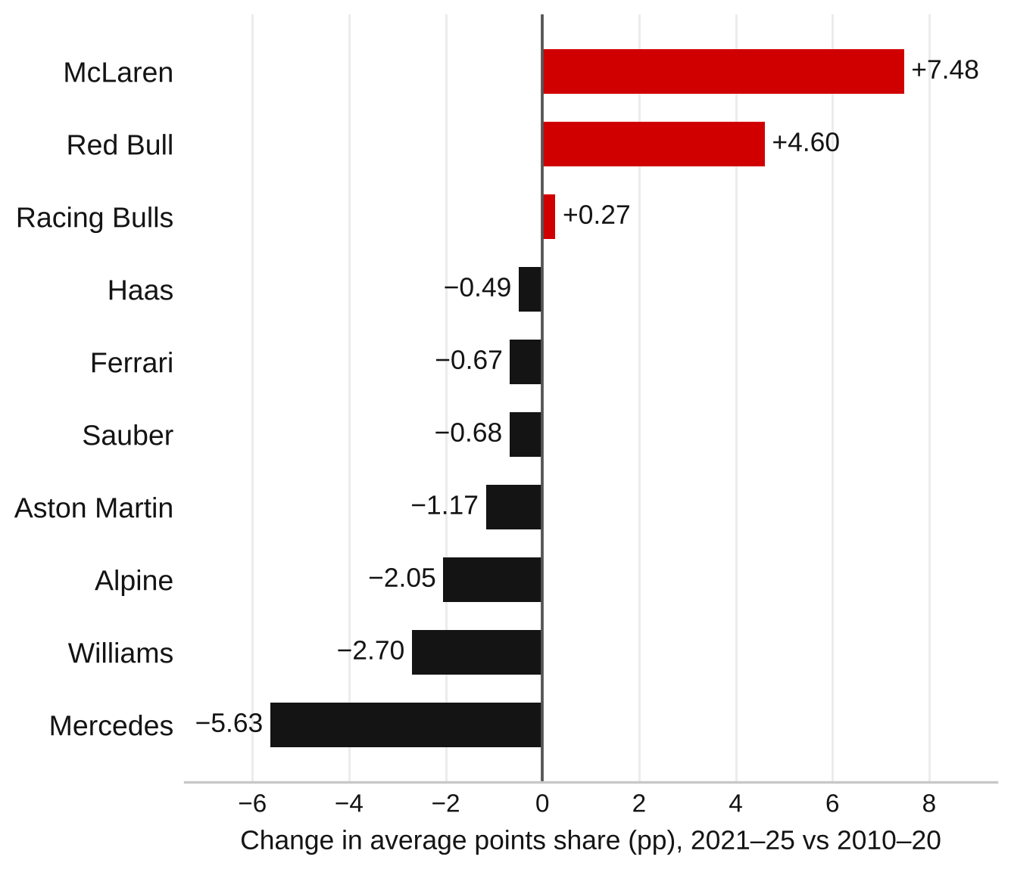
Gains were Concentrated in a Few Teams
06
Sources: F1DB contributors, release v2026.15.1 (github.com/f1db/f1db), CC BY 4.0; Formula 1, “McLaren year by year” (formula1.com), for McLaren’s 2024 and 2025 constructors’ titles.
Notes:
SPEAKER: JENNIFFER | Slide 6 | Target: 1:15
Now, let's look at the teams outside the very top.
Starting with the graph on the left, teams finishing fourth through seventh earned an average of 24.7% of championship points before the cost cap, compared to 26.2% afterward.
That's only a 1.45 percentage-point increase, and as you can see, the results fluctuate quite a lot between seasons. So although the midfield gained some ground, the improvement was fairly small.
Now, looking at the graph on the right, we wanted to see which specific teams gained or lost points share.
McLaren had the biggest increase at around 7.5 percentage points, followed by Red Bull at 4.6, while Mercedes lost around 5.6.
What's interesting is that these changes weren't evenly spread across the grid. Instead, certain teams gained while others fell behind.
So our main takeaway is that different teams becoming successful doesn't necessarily mean the sport became more competitive overall. It could simply mean that the dominant teams changed.
To explore this further, we also looked at which teams actually won races and reached the podium.

Slide 7
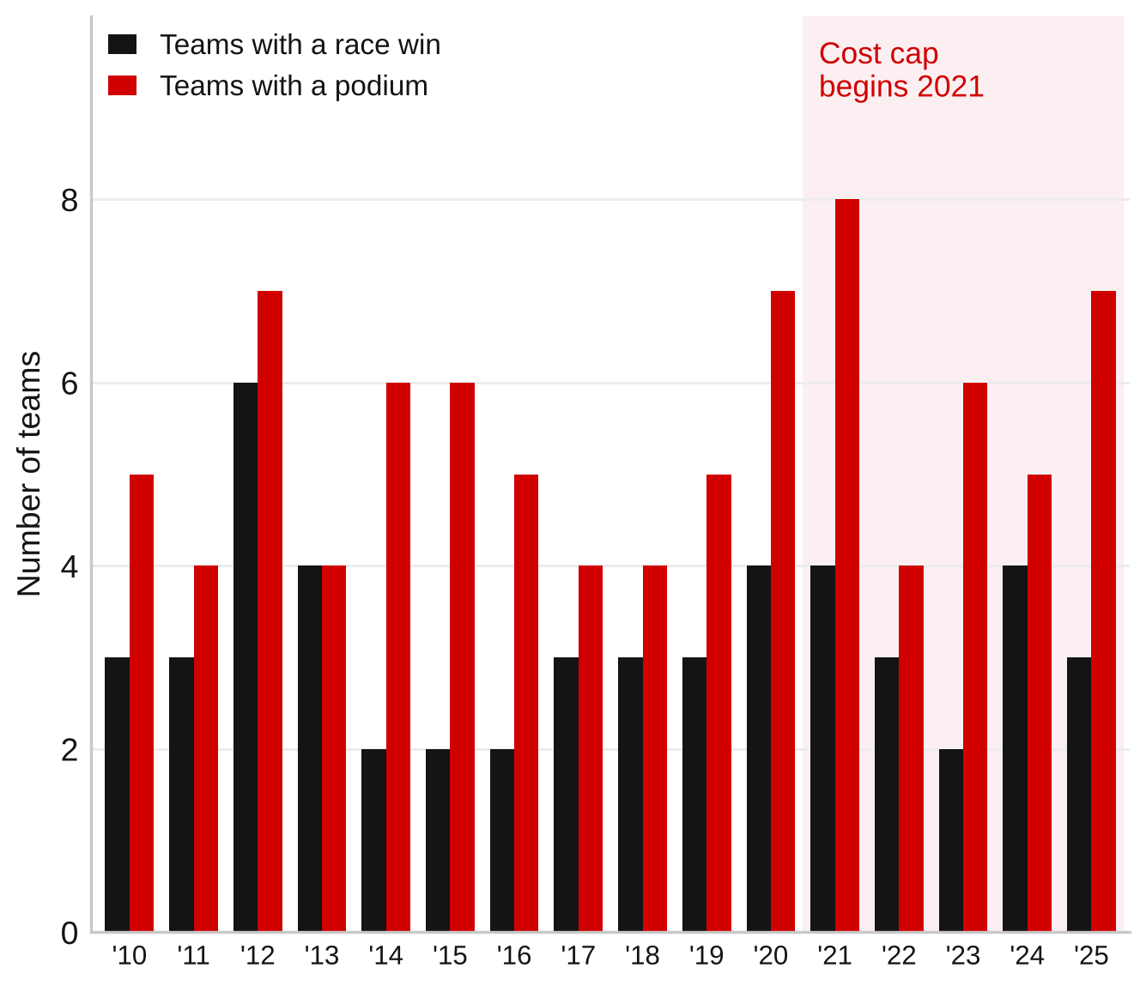
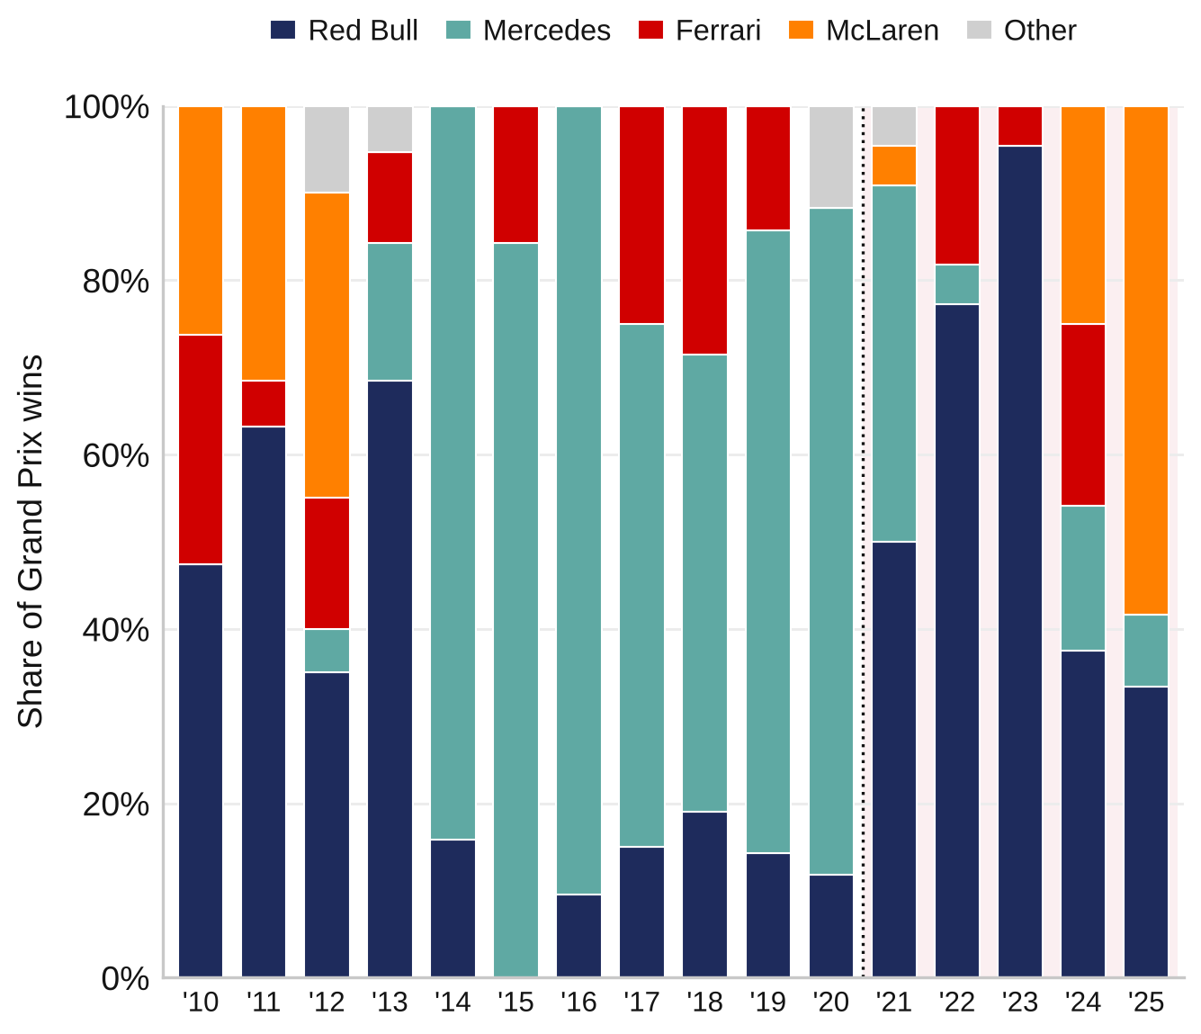
More Teams Reached Podium, Wins Remain Concentrated
07
Sources: F1DB contributors, release v2026.15.1 (github.com/f1db/f1db), CC BY 4.0: Grand Prix results and constructors chronology, aggregated by the team.
Notes:
SPEAKER: SALEHA | Slide 7 | Target: 1:15
Here, the left chart separates race-winning teams from teams that finished on the podium, meaning the top three in a Grand Prix. Before the cap, an average of 3.18 different constructors won at least one race per season. After the cap, it was 3.20. That's practically unchanged. But the average number of teams that made the podium increased from roughly 5.2 to 6.0. So podium finishes became a bit more accessible, without a similar rise in the number of teams actually winning.
The graph on the right shows how concentrated race wins could still be. Red Bull won about 95.5 percent of Grand Prix races in 2023. In 2024, victories were spread more evenly: no single constructor won more than 37.5 percent.
This is why we don't want to judge the cost cap from just one season. The level of dominance still changed dramatically from year to year. Saleha will bring these results together and go through our recommendations.

Slide 8
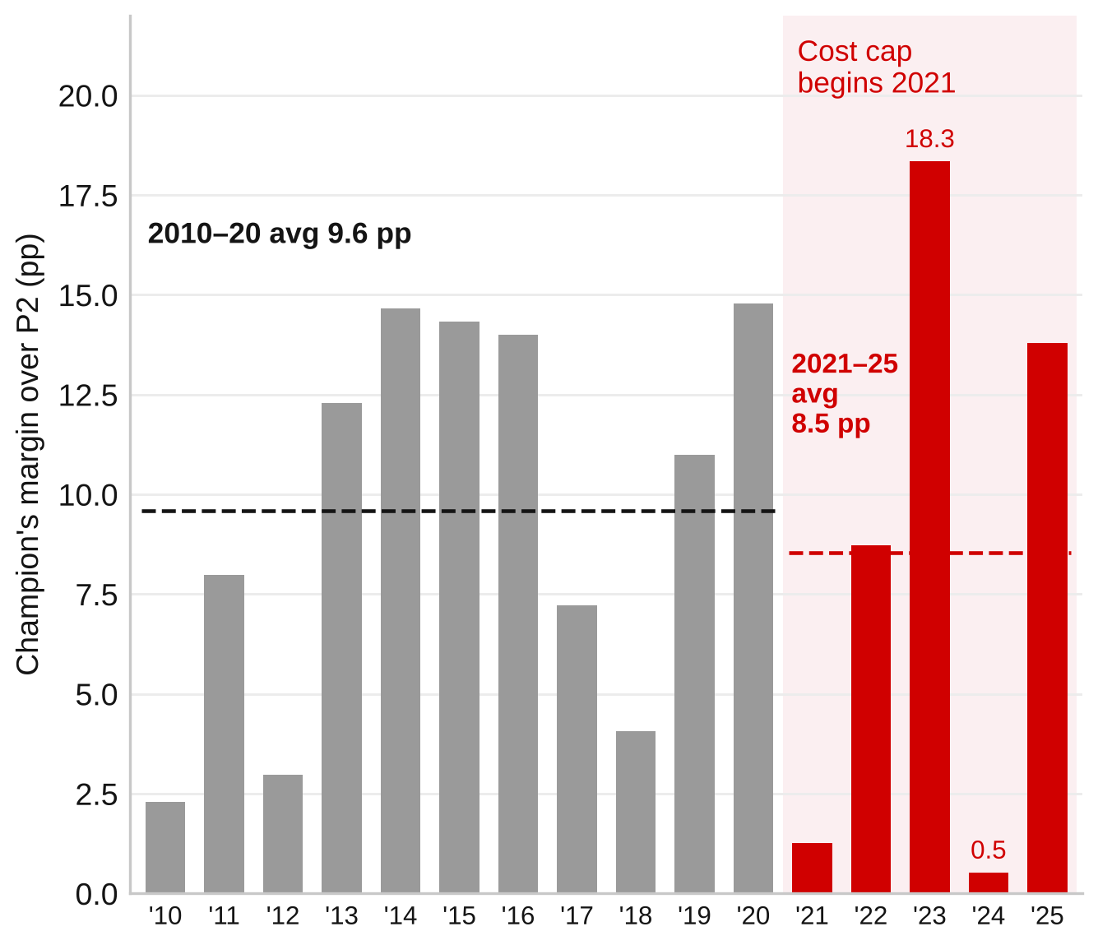
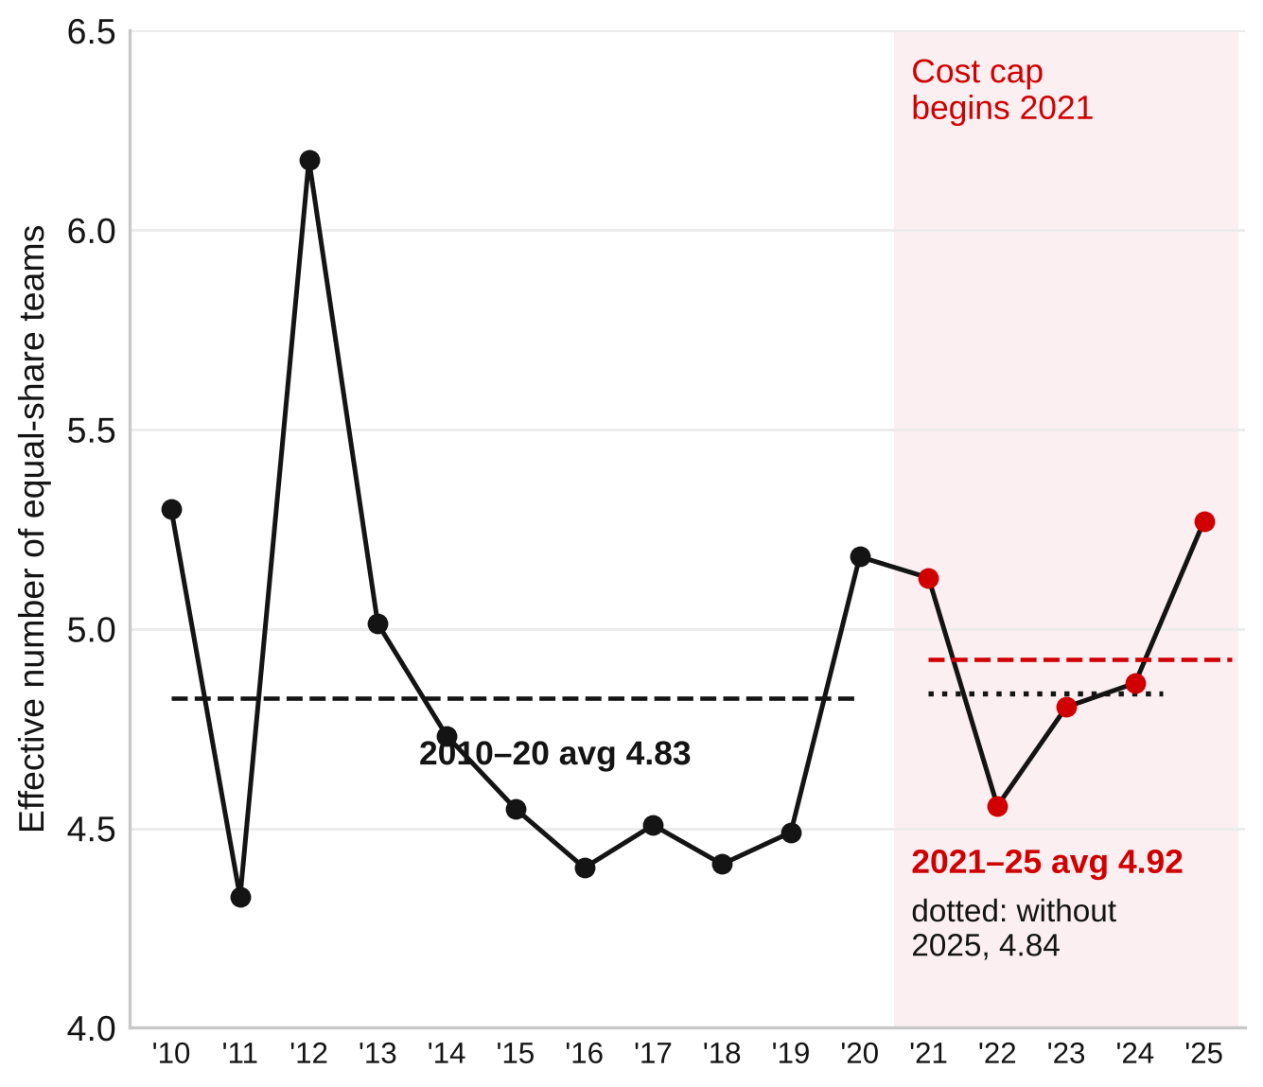
Close Title Fights didn’t Consistently Extend Across Fields
08
Sources: F1DB contributors, release v2026.15.1 (github.com/f1db/f1db), CC BY 4.0; U.S. Department of Justice, “Herfindahl–Hirschman Index” (justice.gov/atr), for the HHI definition.
Notes:
SPEAKER: SALEHA | Slide 8 | Target: 1:15
We then asked whether close championship fights meant the whole field became more balanced. The left chart shows the points-share gap between the champion and the runner-up. That gap averaged 9.6 percentage points before the cap and 8.5 afterward. But the seasons vary a lot: the gap was about 18.3 points in 2023, compared with roughly half a point in 2024.
The right chart looks beyond just the top two. We used HHI, a concentration measure, and converted it into the effective number of equally competitive teams. Higher means points are more evenly distributed. The average moved from 4.83 before the cost cap to 4.92 afterward, an increase of only 0.09. And without 2025, the post-cap average is about 4.84.
So even when we measure the whole grid, the improvement is extremely small. That's consistent with the idea that success shifted between leading teams rather than spreading widely.

Slide 9
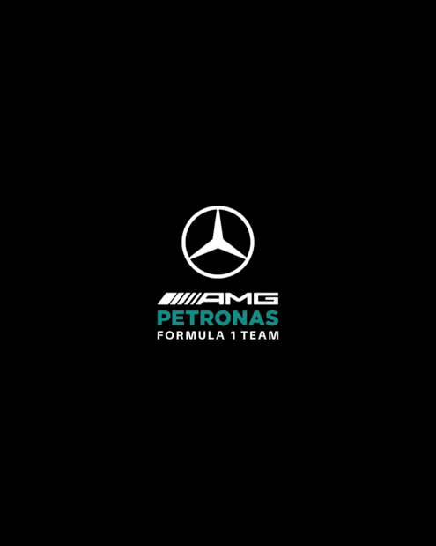


What Should Stakeholders Do?
09
Practical steps to drive results, supported by our findings
Stakeholder | Recommended Action | Evidence & Limitation
FIA | Require a competitive-balance review across a full rules cycle before changing financial rules. Include both baselines and results excluding the latest season. | Conclusions change with the comparison period. Points data cannot isolate the cost cap’s effect.
Middle-Ranked Teams | Set performance targets across several seasons and benchmark their progress against improving teams. | McLaren gained considerably, while several midfield teams lost share. The analysis does not reveal their spending decisions.
Sponsors | Include emerging contenders in sponsorship shortlists and use performance conditions in deals. | Podium opportunities expanded outside the Big Three, particularly in recent seasons. Sponsorship returns were not measured.
Sources: F1DB contributors, release v2026.15.1 (github.com/f1db/f1db), CC BY 4.0; Formula 1, “The 2021 rules and regulation changes” and “Seven key rule changes for 2022” (formula1.com).
Notes:
SPEAKER: adrian | Slide 9 | Target: 0:55
Based on that, our recommendations are cautious. For the FIA, we recommend reviewing several competitive-balance measures across more seasons before changing the financial rules. The findings shift depending on the years we compare, and our dataset cannot isolate the effect of the cost cap.
For midfield teams, we'd focus on tracking progress over multiple seasons and comparing their performance with teams that improved, such as McLaren, rather than judging success from a single year. For sponsors, emerging contenders may be worth considering alongside the traditional leaders. But we haven't measured sponsorship returns, so that last recommendation is a possibility to explore, not a proven financial benefit.

Slide 10
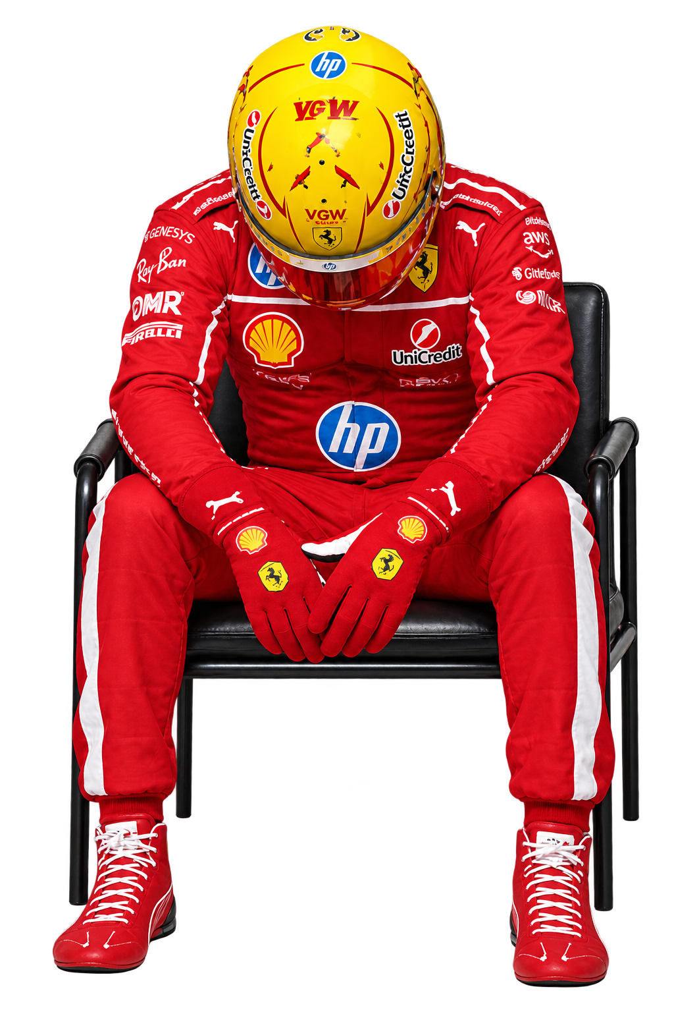
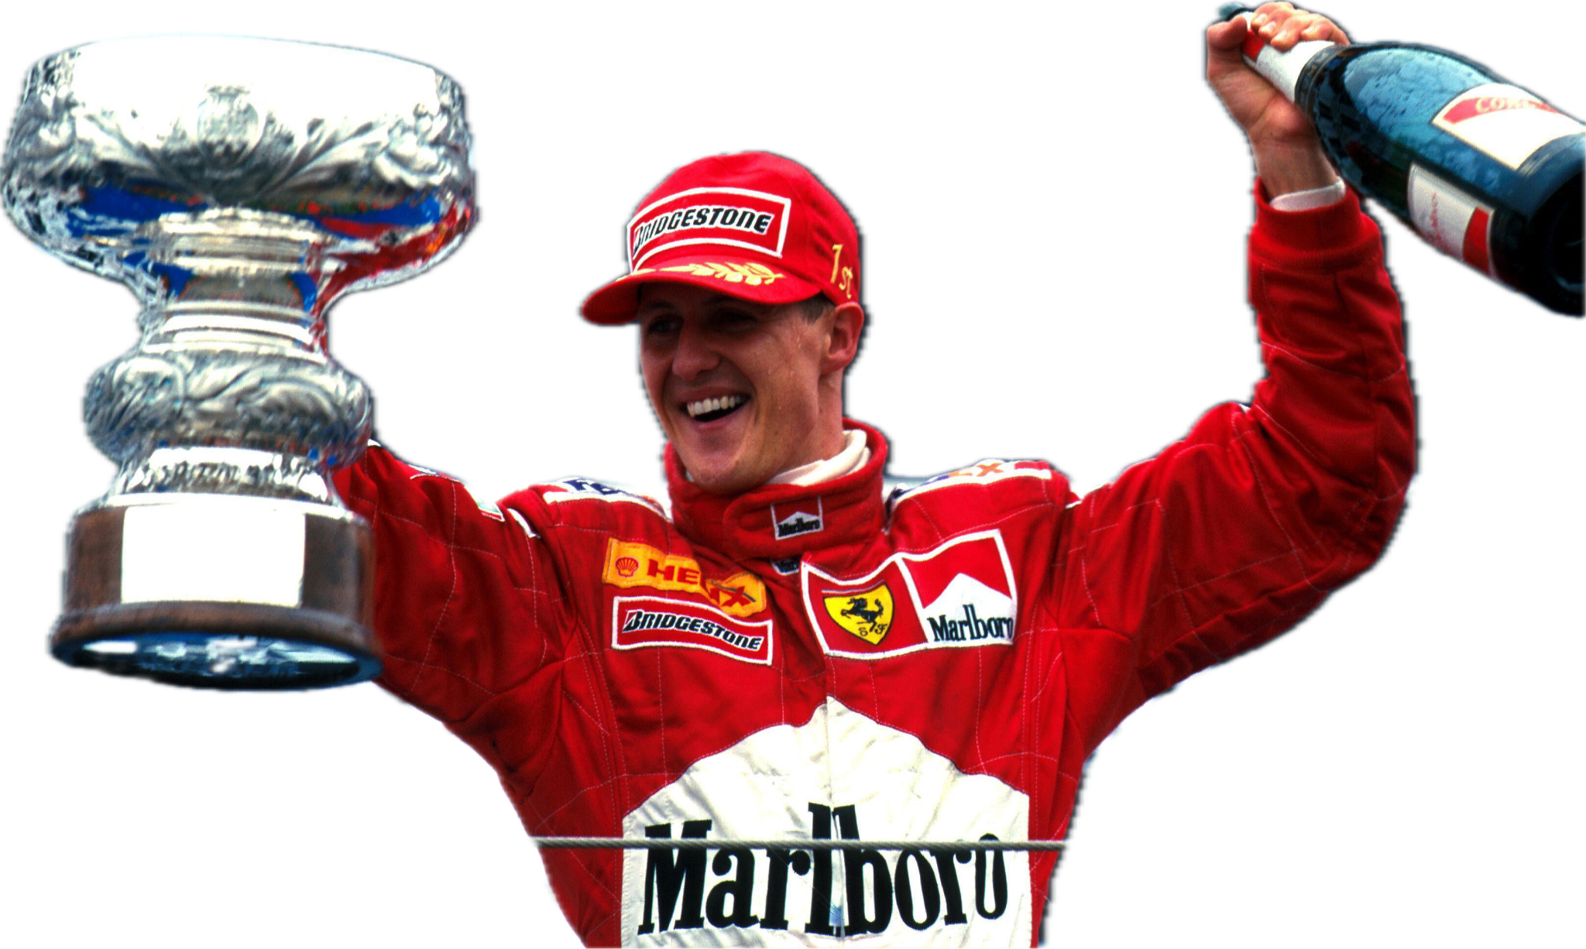
Conclusion
10
Small shifts in competitive balance, not a clear transformation
What We Found
What This Means
•
The top two teams earned a slightly smaller share of points −2.58 pp. (p = 0.245)
•
Different teams had success, but the grid is still dominated by a few.
•
Midfield teams gained some ground, but the increase was small. 69.8% Big Three share without 2025 (vs 65.8%)
•
We cannot say the cost cap caused these changes.
•
The number of teams winning races barely changed. (3.18 → 3.20)
•
We need more seasons to see if the pattern continues.
Sources: F1DB contributors, release v2026.15.1 (github.com/f1db/f1db), CC BY 4.0; Formula 1, 2021 and 2022 rule-change articles (formula1.com); SciPy developers, scipy.stats.ttest_ind.
Notes:
SPEAKER: SALEHA | Slide 10 | Target: 0:20
To conclude, we found some small improvements: top-two points share declined and more teams reached podiums. But the number of race-winning constructors hardly changed, and the whole-field points distrbution stayed almost the same. We can't say the cost cap alone caused those results. More completed seasons and spending data would help answer that. Thank you — we're happy to take questions.
Takeaway: Success shifted between leading teams, but the overall distribution of points changed very little. More seasons and spending data are needed before attributing changes to the cost cap.

