Slide 1
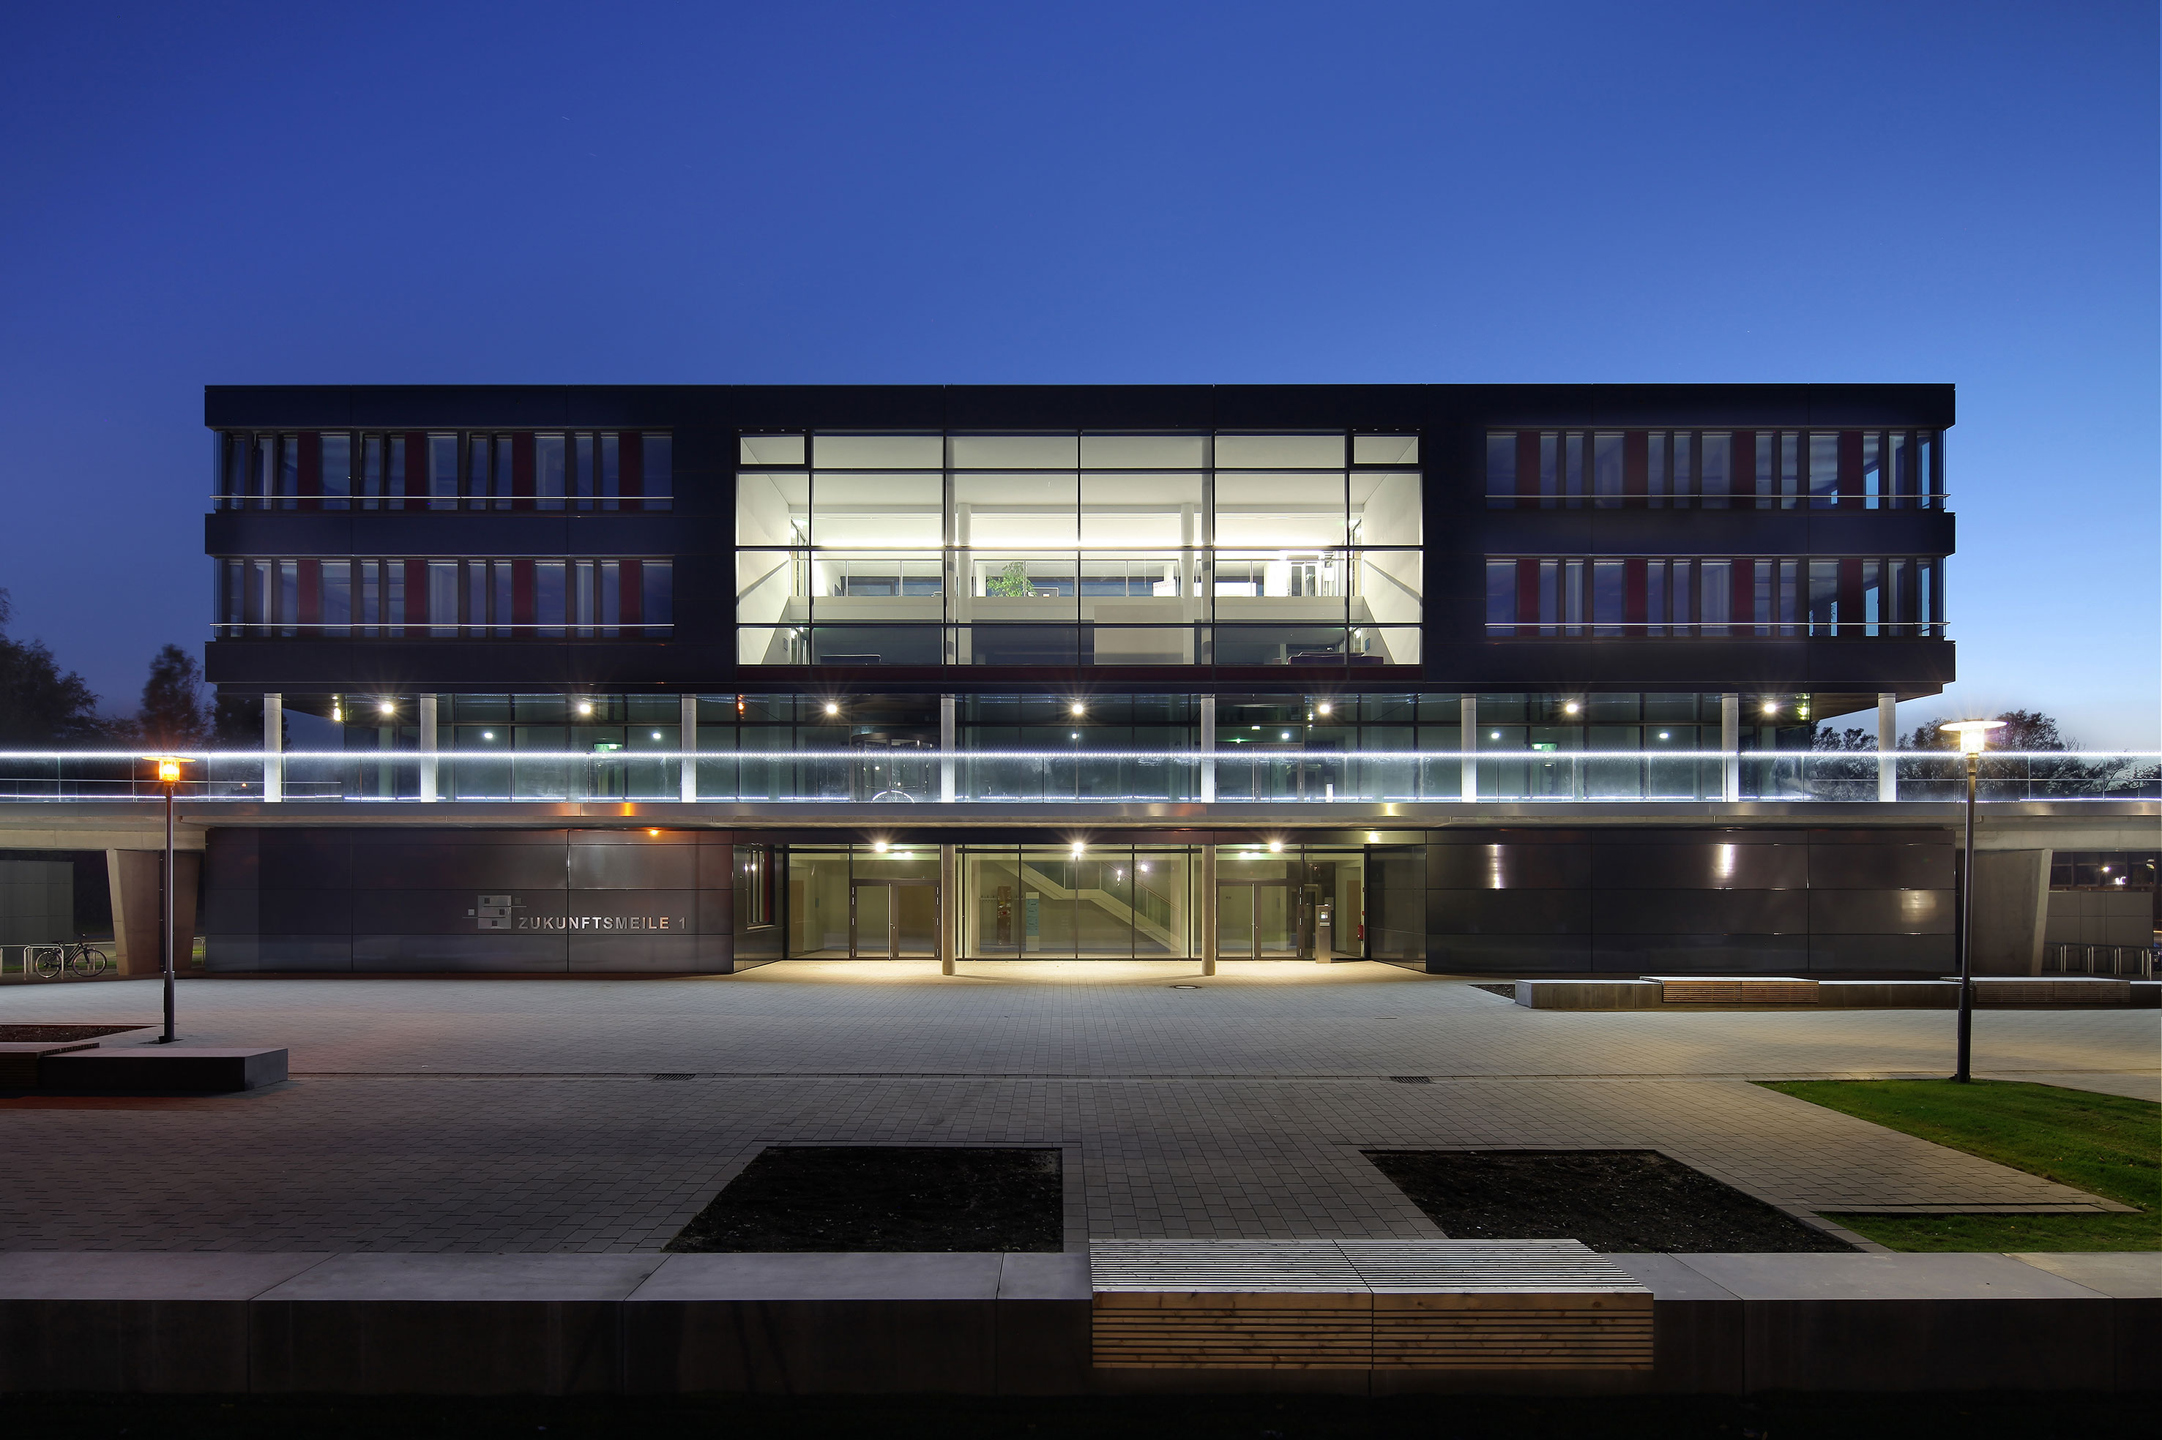
TypeEvalPy
Common Evaluation Framework
with Benchmarks for Type Inference
Samkutty Sabu
Advisor: Ashwin Prasad SV Supervisor: Prof. Dr. Eric Bodden
Paderborn | 07-03-2023

Slide 2

SECTION
Introduction
Background
Problem Description
Thesis Goals
Thesis Structure
Time Plan

Slide 3
Introduction
1

Slide 4
INTRODUCTION
Static Analysis
Static Analysis - White box analysis
Type Inference
Type Inference in Python
Dynamic type system
x = "Hello World"
x = 20.5
x = ["one", "two", "three"]
Type Inference tools
Mypy, Pyright, Scalpel, Pyinfer, Typilus
str
float
print(type(x))
list
4
© Heinz Nixdorf Institut / Fraunhofer IEM
Notes:
4

Slide 5
INTRODUCTION
Type Inference in Python
Type hints Handled
Built-in Types: int, str, bool, list, dict, NoneType …
Abstract base classes : Sequence, Mapping, Iterable…
Types module : FunctionType, LambdaType, MethodType, ModuleType, CoroutineType
User-defined Types :
Typing module
Benchmarks in Python
Real-world benchmark
Micro benchmark
Common framework
5
© Heinz Nixdorf Institut / Fraunhofer IEM
Notes:
5

Slide 6
Background
2

Slide 7
BACKGROUND
Type Inference
Determine the types of variables
Type annotations
Type Inference Tools
Academic Tools
Industry-standard tools
PYInfer
HiTyper
Typilus
Typewriter
Mypy
Pyright
Jedi
Pytype
7
© Heinz Nixdorf Institut / Fraunhofer IEM
Notes:
7

Slide 8
BACKGROUND
Benchmarks
Micro Benchmarks
PyCG
PyPt
Scalpel
Real world Benchmarks
ManyTypes4Py
Type4Py
TypePY
Typilus
OSS dataset of Typewriter
}
Call Graph Benchmarks
8
© Heinz Nixdorf Institut / Fraunhofer IEM
Notes:
8

Slide 9
Problem Description
3

Slide 10

PROBLEM DESCRIPTION
Benchmarks
Micro Benchmarks
PyCG
PyPt
Scalpel
}
Call Graph Benchmarks
No Ground Truth
Relatively small
No robust benchmark exists
10
© Heinz Nixdorf Institut / Fraunhofer IEM
Notes:
10

Slide 11
PROBLEM DESCRIPTION
Benchmarks
Real world Benchmarks
ManyTypes4Py
Type4Py
TypePY
Typilus
OSS dataset of Typewriter
}
Vary in Scope (ML based inference)
Methodology of selection
Mypy dependency
Annotations
GitHub stars ..
Might not capture all complexities of Python programming
No uniformity
11
© Heinz Nixdorf Institut / Fraunhofer IEM
Notes:
11

Slide 12
PROBLEM DESCRIPTION
No Single Micro Benchmark exists
Real world Benchmarks might not capture all complexities of Python programming
No Common framework for comparison
12
© Heinz Nixdorf Institut / Fraunhofer IEM
Notes:
12

Slide 13
Thesis Goals
4

Slide 14
THESIS GOALS
Primary objective
Provide a benchmark framework for evaluating type inference tools for Python.
Goals
1. Developing a Micro-benchmark
2. Standardization of Real-world benchmarks
3. Developing a common framework
14
© Heinz Nixdorf Institut / Fraunhofer IEM
Notes:
14

Slide 15
THESIS GOALS
1. Developing a Micro-benchmark
1.1 Develop diverse benchmark
1.2 Develop ground truths
1.3 Add Type annotations
15
© Heinz Nixdorf Institut / Fraunhofer IEM
Notes:
15

Slide 16
THESIS GOALS
1. Developing a Micro-benchmark
1.1 Develop diverse benchmark
PyCG
Scalpel
}
No ground truth
Missing features
Categorised Python features
Diverse Benchmark
Ground truths
Relatively small
16
© Heinz Nixdorf Institut / Fraunhofer IEM
Notes:
16

Slide 17
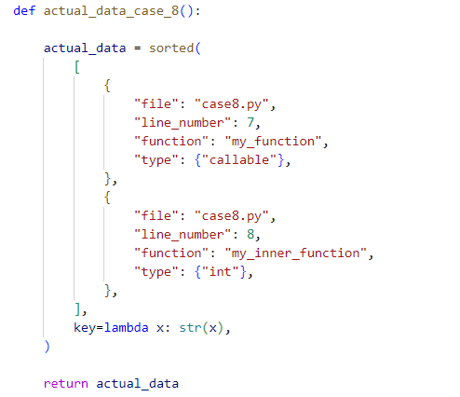
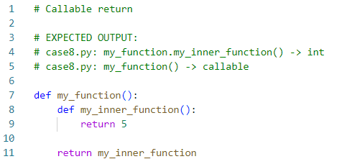
THESIS GOALS
1. Developing a Micro-benchmark
1.2 Develop ground truths
Using Scalpels method
Better representation?
Fig: Example test case
Fig: Ground Truth
17
© Heinz Nixdorf Institut / Fraunhofer IEM
Notes:
17

Slide 18
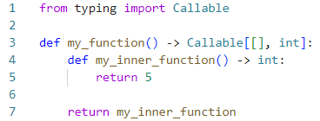

THESIS GOALS
1. Developing a Micro-benchmark
1.3 Add Type annotations
Fig: Example test case
Fig: Annotated test case
18
© Heinz Nixdorf Institut / Fraunhofer IEM
Notes:
18

Slide 19
THESIS GOALS
2. Standardization of Real-world benchmarks
Should support both academic and Industry standard tools
Bring uniformity to existing benchmarks
19
© Heinz Nixdorf Institut / Fraunhofer IEM
Notes:
19

Slide 20
THESIS GOALS
3. Common Evaluation Framework
Standardized format for comparison of performance
3.1 Integration of Benchmarks
Common point to select benchmarks
User-friendly interface
3.2 Common Input and Result Format
Common input format
Format code snippets
Adapt to different requirements of tools
Common result format
3.3 Evaluation Metrics
20
© Heinz Nixdorf Institut / Fraunhofer IEM
Notes:
20

Slide 21


THESIS GOALS
3. Common Evaluation Framework
3.3 Evaluation Metrics
Exact Match
Base Type Match
Rank-based Match
Computation Time
GT: List[str] List[str]
List[int]
}
Precision
GT: List[str] List[str]
List[int]
Recall
Common/Rare
GT: Ground Truth
21
© Heinz Nixdorf Institut / Fraunhofer IEM
Notes:
21

Slide 22
THESIS GOALS
3. Common Evaluation Framework
3.3 Evaluation Metrics
Micro-Benchmark
Soundness
Completeness
No false negative
No false positive
22
© Heinz Nixdorf Institut / Fraunhofer IEM
Notes:
22

Slide 23
THESIS GOALS
Evaluation
Evaluation of tools
Research Questions
How do existing type inference tools for Python perform on the developed micro-benchmark?
Does deep learning based tools support complex python features?
Does existing real-world benchmarks capture complex features of Python?
How does existing tools compare on the combined real-world benchmark?
23
© Heinz Nixdorf Institut / Fraunhofer IEM
Notes:
23

Slide 24
THESIS STRUCTURE
5

Slide 25
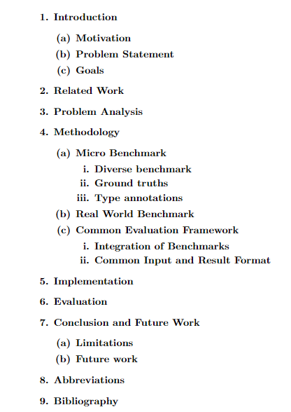
THESIS STRUCTURE
25
© Heinz Nixdorf Institut / Fraunhofer IEM
Notes:
25

Slide 26
TIME PLAN
6

Slide 27
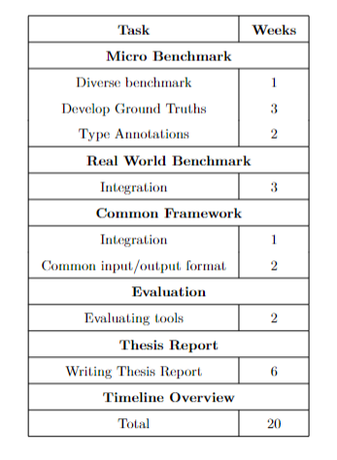
Time Plan
27
© Heinz Nixdorf Institut / Fraunhofer IEM
Notes:
27

Slide 28
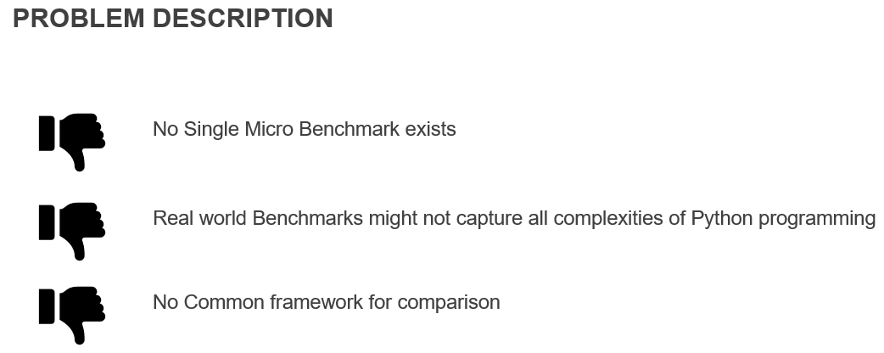
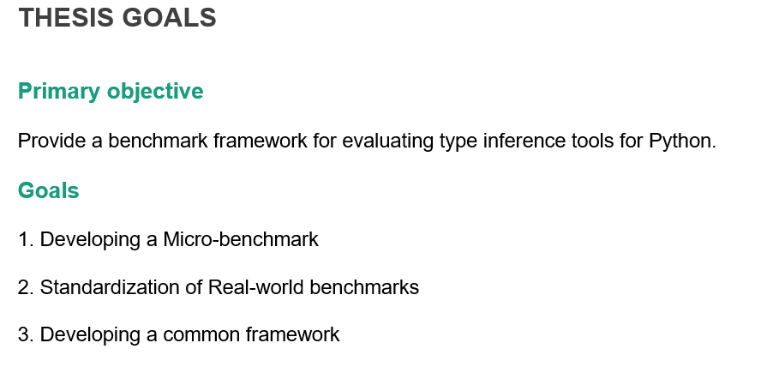
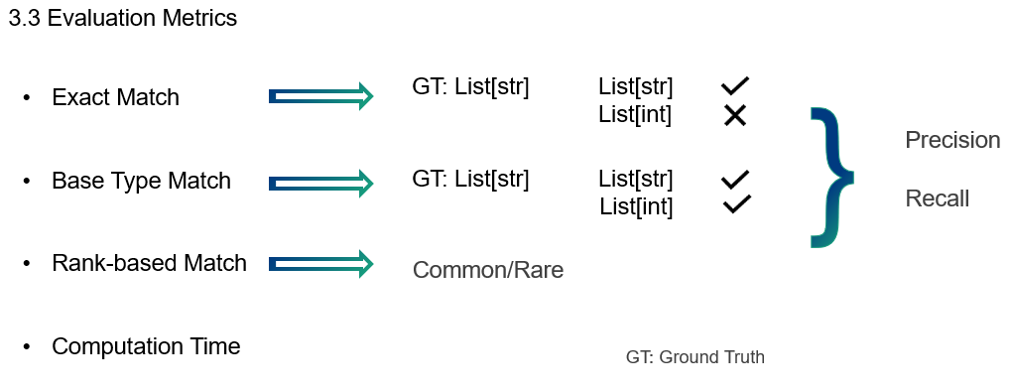
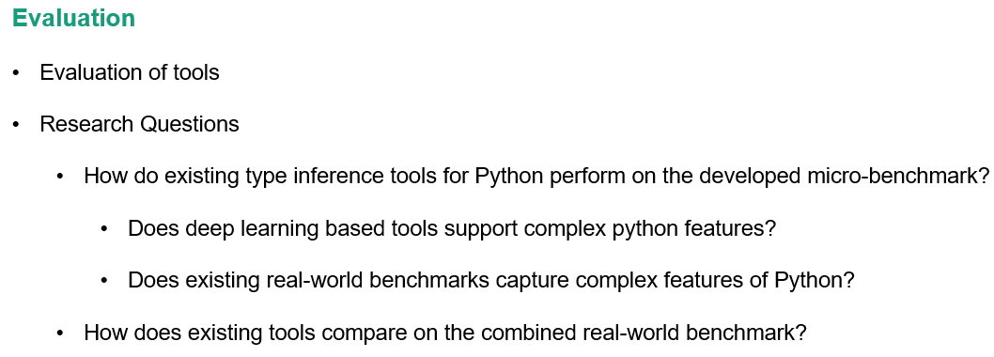
Summary
28
© Heinz Nixdorf Institut / Fraunhofer IEM
Notes:
28

Slide 29





Contact
Samkutty Sabu
Paderborn University
Warburger Str. 100
33098 Paderborn Germany
6919792
samkutty@mail.uni-paderborn.de
https://www.linkedin.com/in/samkutty-sabu/
+49 17657968737

Slide 30
Many thanks for your attention
!
Wallpaper placeholder is deactivated
→ over menu "Start“ → "Edit" tab → "Mark" → "Selection range“ → activate layer "Image" symbol "Eye“ → insert image into placeholder

