Slide 1
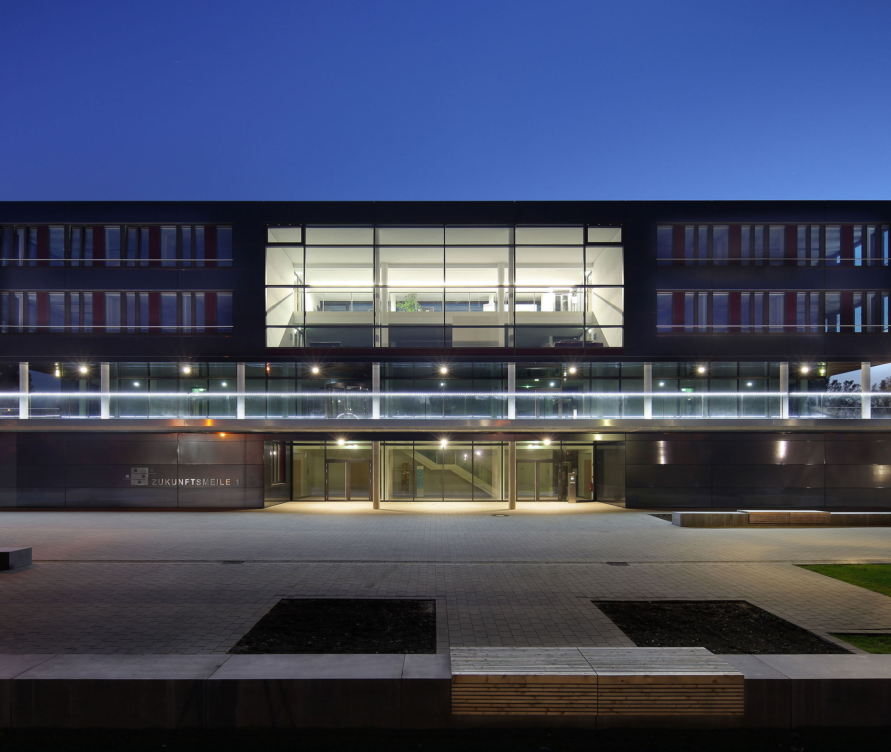
TypeEvalPy
Common Evaluation Framework
with Benchmarks for Type Inference
Samkutty Sabu
Advisor: Ashwin Prasad SV Supervisor: Prof. Dr. Eric Bodden
Paderborn | 07-03-2023

Slide 2

SECTION
Introduction
Background
Problem Description
Thesis Goals
Thesis Structure
Time Plan

Slide 3
Introduction
1

Slide 4
INTRODUCTION
Static Analysis in Python
Static Analysis - White box analysis
Type Inference
Type Inference tools
Mypy, Pyright, Scalpel, Pyinfer, Typilus
Need for Common Benchmark
Real-world benchmark
Micro benchmark
Common framework
4
© Heinz Nixdorf Institut / Fraunhofer IEM
Notes:
4

Slide 5
Background
2

Slide 6
BACKGROUND
Type Inference
Determine the types of variables
Type annotations
Type Inference Tools
Academic Tools
Industry-standard tools
PYInfer
HiTyper
Typilus
Typewriter
Mypy
Pyright
Jedi
Pytype
6
© Heinz Nixdorf Institut / Fraunhofer IEM
Notes:
6

Slide 7
BACKGROUND
Benchmarks
Micro Benchmarks
PyCG
PyPt
Scalpel
Real world Benchmarks
ManyTypes4Py
Type4Py
TypePY
Typilus
OSS dataset of Typewriter
7
© Heinz Nixdorf Institut / Fraunhofer IEM
Notes:
7

Slide 8
Problem Description
3

Slide 9
PROBLEM DESCRIPTION
Benchmarks
Micro Benchmarks
PyCG
PyPt
Scalpel
}
Call Graph Benchmarks
No Ground Truth
Relatively small
9
© Heinz Nixdorf Institut / Fraunhofer IEM
Notes:
9

Slide 10
PROBLEM DESCRIPTION
Benchmarks
Real world Benchmarks
ManyTypes4Py
Type4Py
TypePY
Typilus
OSS dataset of Typewriter
}
Vary in Scope (ML based inference)
}
Application Specific Benchmarks
10
© Heinz Nixdorf Institut / Fraunhofer IEM
Notes:
10

Slide 11
Thesis Goals
4

Slide 12
THESIS GOALS
Primary objective
Provide a benchmark framework for evaluating type inference tools for Python.
Goals
1. Developing a Micro-benchmark
2. Aggregating Real-world benchmarks
3. Developing a common framework
12
© Heinz Nixdorf Institut / Fraunhofer IEM
Notes:
12

Slide 13
THESIS GOALS
1. Developing a Micro-benchmark
1.1 Develop diverse benchmark
1.2 Develop ground truths
1.3 Add Type annotations
13
© Heinz Nixdorf Institut / Fraunhofer IEM
Notes:
13

Slide 14
THESIS GOALS
1. Developing a Micro-benchmark
1.1 Develop diverse benchmark
PyCG
Scalpel
}
No ground truth
Categorised Python features
Diverse Benchmark
Ground truths
Relatively small
14
© Heinz Nixdorf Institut / Fraunhofer IEM
Notes:
14

Slide 15
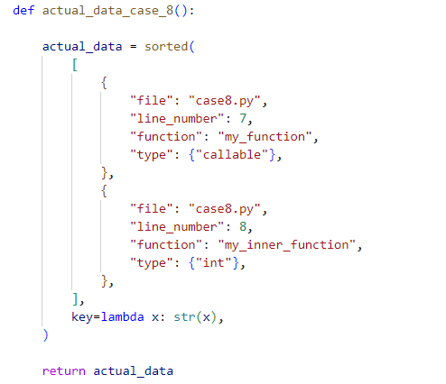
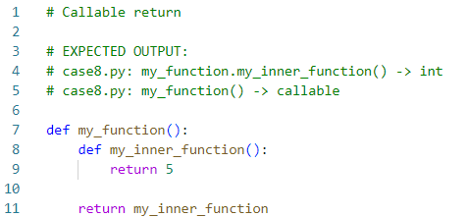
THESIS GOALS
1. Developing a Micro-benchmark
1.2 Develop ground truths
Using Scalpels method
Fig: Example test case
Fig: Ground Truth
15
© Heinz Nixdorf Institut / Fraunhofer IEM
Notes:
15

Slide 16
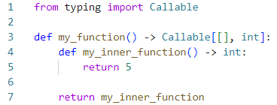

THESIS GOALS
1. Developing a Micro-benchmark
1.3 Add Type annotations
Fig: Example test case
Fig: Annotated test case
16
© Heinz Nixdorf Institut / Fraunhofer IEM
Notes:
16

Slide 17
THESIS GOALS
2. Aggregate Real-world benchmarks
Should support both academic and Industry standard tools
Cover all Python features
Aggregation of existing benchmarks
17
© Heinz Nixdorf Institut / Fraunhofer IEM
Notes:
17

Slide 18
THESIS GOALS
3. Common Evaluation Framework
Standardized format for comparison of performance
3.1 Integration of Benchmarks
Common point to select benchmarks
User-friendly interface
3.2 Common Input and Result Format
Common input format
Format code snippets
Adapt to different requirements of tools
Common result format
18
© Heinz Nixdorf Institut / Fraunhofer IEM
Notes:
18

Slide 19


THESIS GOALS
3. Common Evaluation Framework
Evaluation Metrics
Exact Match
Base Type Match
Rank-based Match
GT: List[str] List[str]
List[int]
GT: List[str] List[str]
List[int]
Common/Rare
GT: Ground Truth
19
© Heinz Nixdorf Institut / Fraunhofer IEM
Notes:
19

Slide 20
THESIS GOALS
Evaluation
Evaluation of tools
Research Questions
How do existing type inference tools for Python perform on the developed micro-benchmark?
Can type inference tools benefit from using type annotations to improve their performance?
How does existing tools compare on the combined real-world benchmark?
20
© Heinz Nixdorf Institut / Fraunhofer IEM
Notes:
20

Slide 21
THESIS STRUCTURE
5

Slide 22
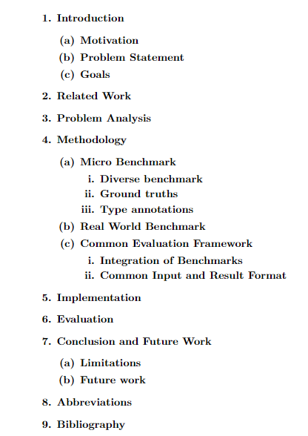
THESIS STRUCTURE
22
© Heinz Nixdorf Institut / Fraunhofer IEM
Notes:
22

Slide 23
TIME PLAN
6

Slide 24
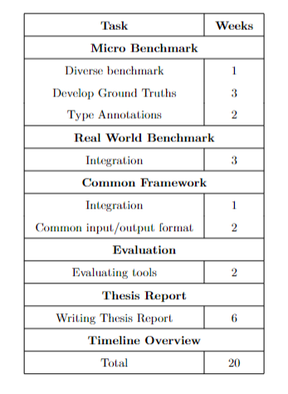
Time Plan
24
© Heinz Nixdorf Institut / Fraunhofer IEM
Notes:
24

Slide 25
Many thanks for your attention
!
Wallpaper placeholder is deactivated
→ over menu "Start“ → "Edit" tab → "Mark" → "Selection range“ → activate layer "Image" symbol "Eye“ → insert image into placeholder

