Slide 1
Cuda|OpenCLifying AES for OpenSSL
Ashwin Raghav Mohan Ganesh

Slide 2
Introduction
The security Karma.
Goals of the project:
Port OpenSSL (atleast parts of it) to GPU and watch it burn
Understand the effects of system parameters on performance
Demistifying the GPU. What tasks can it best accomplish?

Slide 3
Simplifying AES
Is AES computationally intensive? Conflict time!
Stages of the AES algorithm: Sub bytes, Shift Rows, Mix Columns, Add Round Keys
Keisuke Iwai et al simplify these transformations
e0 = T0[a0,j] xor T1[a1,j+1] xor T2[a2,j+2] xor T3[a3,j+3] xor kj

Slide 4
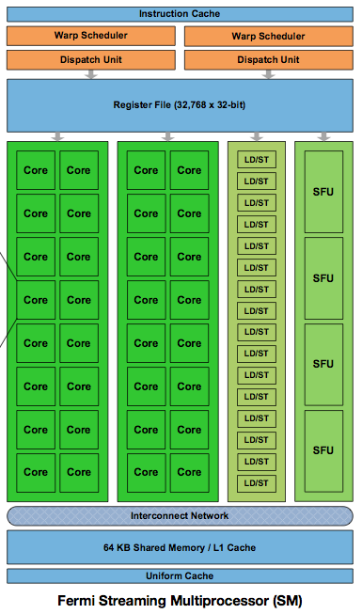
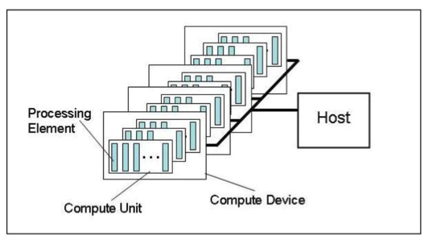
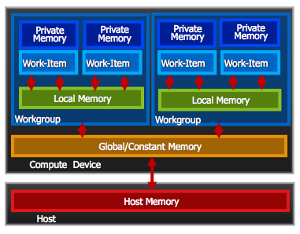
Ze abstractions…

Slide 5
OpenCl AES -- Implementation
Application using libcrypto
Plain Text
Cipher Text
libcrypto (OpenSSL)
OpenCL-AES
Other Engines
...
128M Blocks | 128M Blocks | ...... | 128M Blocks
Work Group 0 | Work Group 1 | ...... | Work Group 65535
Work Item 128 16 Bytes | Work Item 129 16 Bytes | ...... | Work Item 255 16 Bytes

Slide 6
Results and Analysis

Slide 7
Results and Analysis

Slide 8
Conclusion
High communication overhead 80%!!
GPU AES outperforms CPU implementations
Given that a GPU is fully occupied, total no of threads is the dominant factor and not the distribution
Find the source and installation instructions: https://github.com/ashwinraghav/Parallel_Open_SSL

