Slide 1

Performance Limitations in Wide Superscalar Processors
Aswin Ramachandran
PhD Final Presentation
10/23/2008

Slide 2
Overview
OSU AbaKus Computer Architecture Simulator
Designing Superscalar Models
Eager Executions

Slide 3
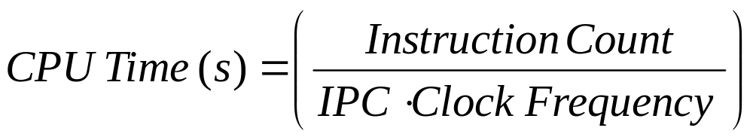
Overview…
Evaluating Processor Performance:
Primary Objective of the processor design involves trade-off between these 3 parameters.
where, IPC is “Instructions per Clock Cycle”

Slide 4
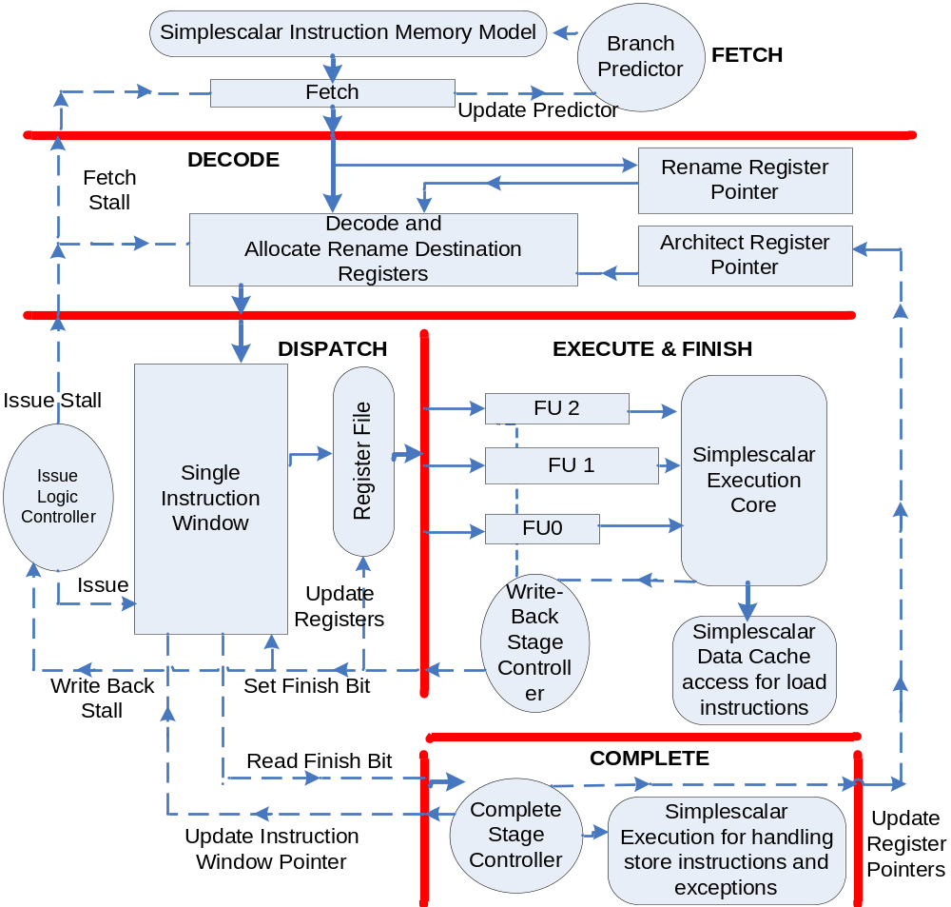
Baseline Superscalar Model…

Slide 5
Module Evaluations
LOGIC TO EVALUATE:
C
A
E
B
D
1. Cycle-Time Based Execution (Simplescalar):
Global Variables
Cycle | List of Modules Executed
0 | A, B, C, D, E
1 | A, B, C, D, E
… | A, B, C, D, E
n | A, B, C, D, E
A
B
C
D
E

Slide 6
2. Event-Driven Execution (Verilog, Intel’s ASIM, SystemC):
Cycle | Evaluate | Process Queue
0 | A, B, C, D,E | Initial
 | A | B, C
 | B | C, D
 | C | E
 | D | E
 | E | C
1 | B, 3C, D, 2E
 | B | C, D
 | 3C | 3E
 | D | E
 | 2E | 2C
2 | 3C, D, 4E
 | 3C | 3E
 | D | E
 | 4E | 4C
3 | 4E, 4C
 | 4E | 4C
 | 4C | 4E
LOGIC TO EVALUATE:
C
A
E
B
D
Structural Design:
Global Variables
A
B
C
D
E

Slide 7
Clocked Buffer Concept
OUTPUT
Data
Structure 1
INPUT
Module A
Cycle 1
Cycle 2
Module B
OUTPUT
Data
Structure 2
INPUT
Cycle 2
Cycle 1
Evaluate Phase (1)
Evaluate Phase (1)
Update Phase (2)
Clock
Evaluate
Update

Slide 8
3. Modular Execution (AbaKus):
LOGIC TO EVALUATE:
C
A
E
B
D
Structural Design:
Cycle | List of Modules Executed
0 | A, B, C, D, E
1 | A, B, C, D, E
… | A, B, C, D, E
n | A, B, C, D, E
Global Variables
A
B
C
D
E

Slide 9
Design Challenges
Modularity : Breaks down performance modeling into different pieces.
Reusability of modules: Increases productivity and robustness of the software.
Fast Simulation Speed
Familiarity with HDL programming
Debugging Features.

Slide 10
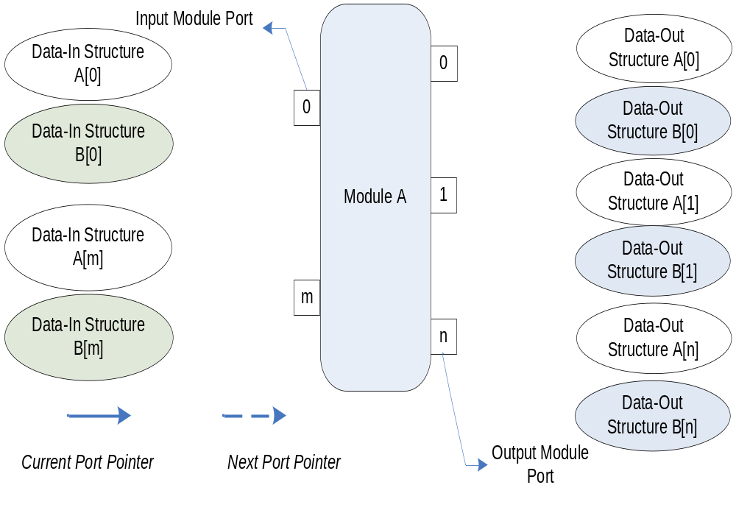
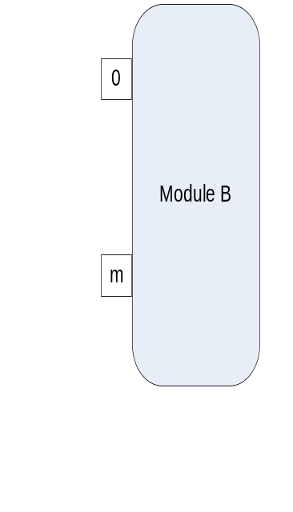
Modularity through Ports

Slide 11
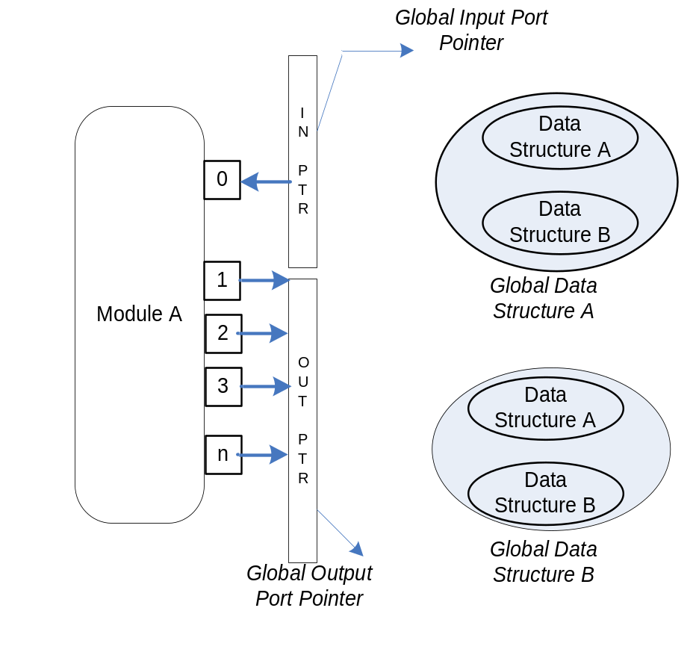
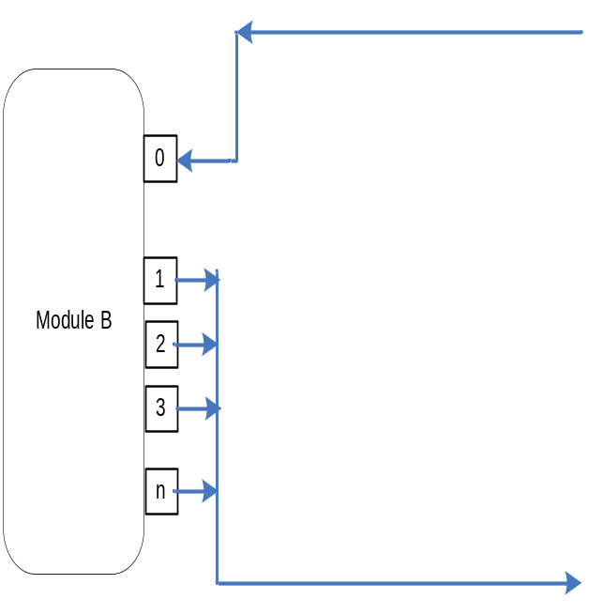
Global Pointer
Advantages:
Avoids the increase in computation time with the increase in number of ports as in [Liberty, SystemC Models].
Register Update time is independent of number of ports.

Slide 12
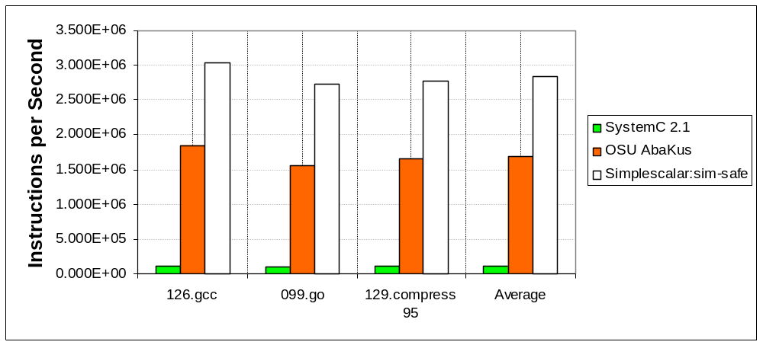
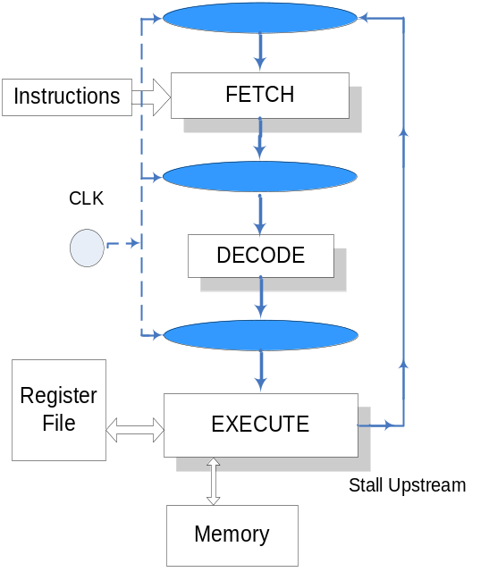
Performance of the Simulators for 3-Stage MIPS Pipeline on SPEC-95 Benchmarks
Instruction Execution Rate for Different Benchmarks
Three-Stage MIPS Pipeline
Executed on AMD Duron 750MHz, 128 MB RAM
Comparison of Execution Time (s)
SPEC 95 Benchmarks | Simplescalar 3.0: sim-safe (seconds) | OSU AbaKus (seconds) | SystemC 2.1 (seconds)
126.gcc | 92 | 190 | 3,306
099.go | 351 | 726 | 11,381
129.compress | 29 | 61 | 873
Average | 157.33 | 325.66 | 5186.67
Aswin Ramachandran and Louis Johnson, Advanced Microarchitecture Design Simulator for Design, Verification & Synthesis, IEEE MWSCS 2007.

Slide 13
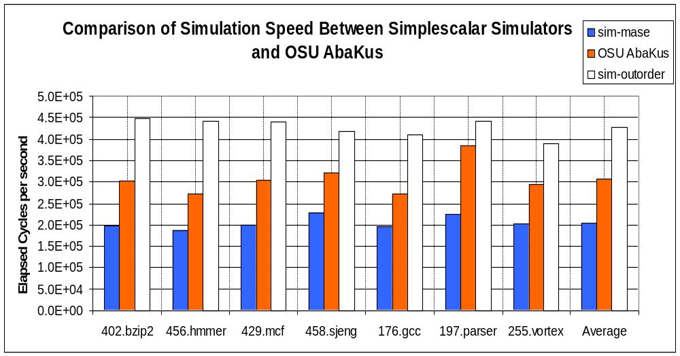
Performance of the Simulators for Superscalar Architecture on SPEC CPU 2000/2006 Benchmarks
Design Parameters | sim-outorder | OSU AbaKus | sim-mase
Instruction Fetch Width | 4 inst/cycle | 4 inst/cycle | 4 inst/cycle
Instruction Window Size | 64 | 64 | 64
Physical Registers | 32 | 100 | 100
Issue Width | 8 | 8 | 8
Commit Width | 8 | 8 | 8
Branch Predictor | Perfect | Perfect | Perfect
Integer ALU units (Latency =1) | 3 | 3 | 3
Mul/Div Unit (Latency = 6) | 1 | 1 | 1
Float ALU units | 4 | Exception call | 4
Write Back Bus Width | Not Modeled | 4 | Not Modeled
Execution | Inorder | True out-of-order | True out-of-order
Exceptions | Not Modeled | Precise | Precise
Average IPC | 2.165 | 1.794 | 1.884
Average Simulation Time (seconds) | 6,520.1 | 11,268.7 | 15,655.0
Comments:
Inherent difference between simulators exists.
OSU AbaKus performance is 1.502 times faster on average in terms of cycles/s than Simplescalar’s sim-mase.
More detailed behavior has to be incorporated.

Slide 14
Overview
OSU AbaKus
Designing Superscalar Models
Eager Executions

Slide 15
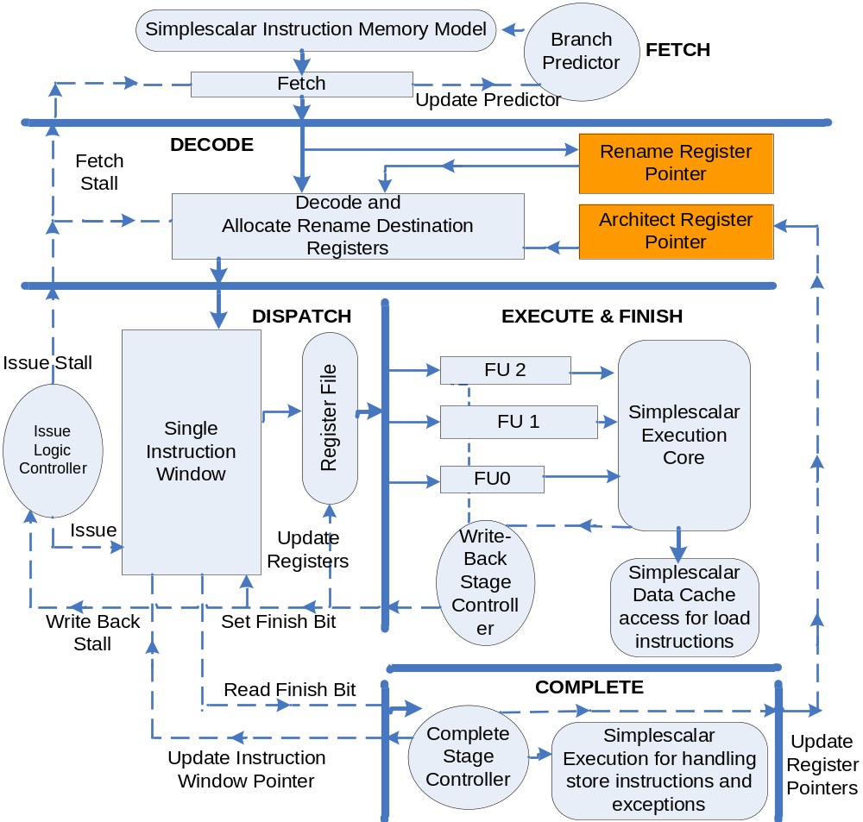
Baseline Superscalar Model…

Slide 16
OSU Virtual Register File Design
beq R23, R0, 0x100
lw R16, 0(R29)
addiu R1, R16, 72
Rename Register Pointer (RRP)
Register | Pointer | Valid
1
…
16
…
31 | 31
1
1
0
1
0
DISPATCH
16
0
EXECUTE / FINISH
1
COMPLETE
1
DECODE
0
32
32
1
0
Register | Pointer
0 | 0
1 | 1
…
16
…
31 | 31
Architect Register Pointer (ARP)
16
RECOVERY
Free List
Reduced Hardware Complexity compared to IBM RS/6000

Slide 17
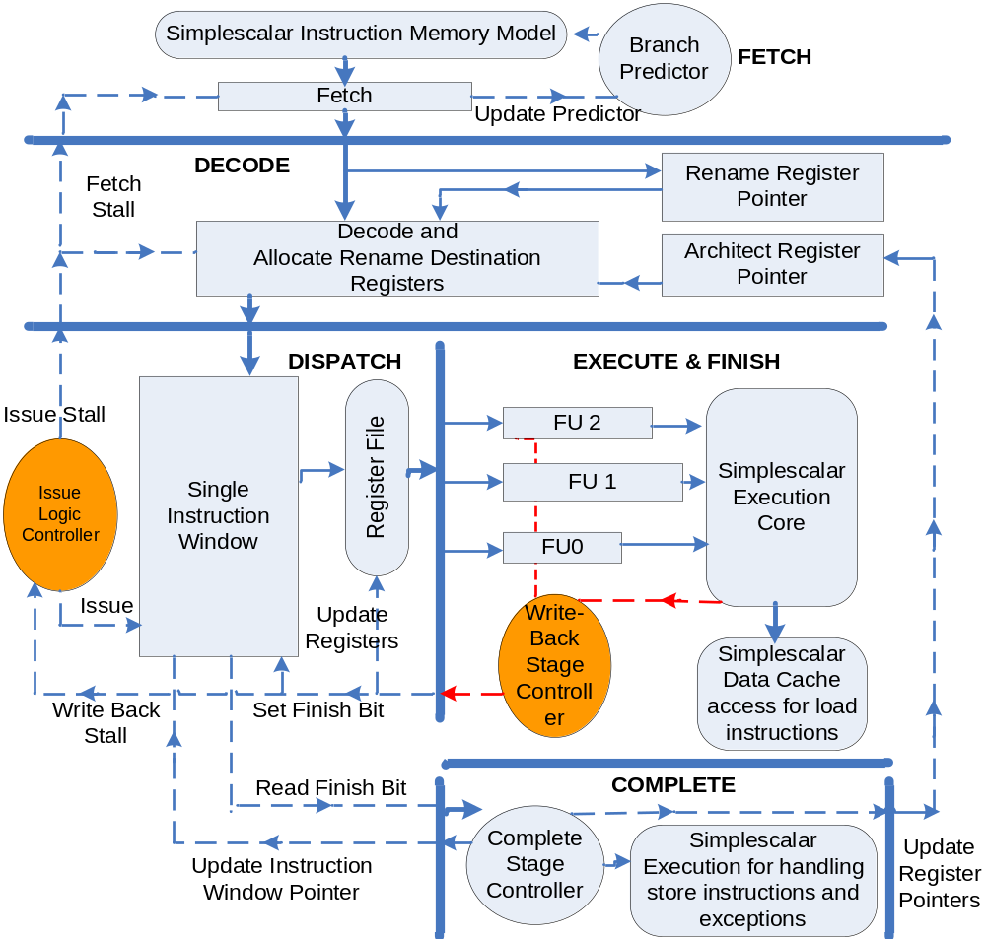
Baseline Superscalar Model…

Slide 18
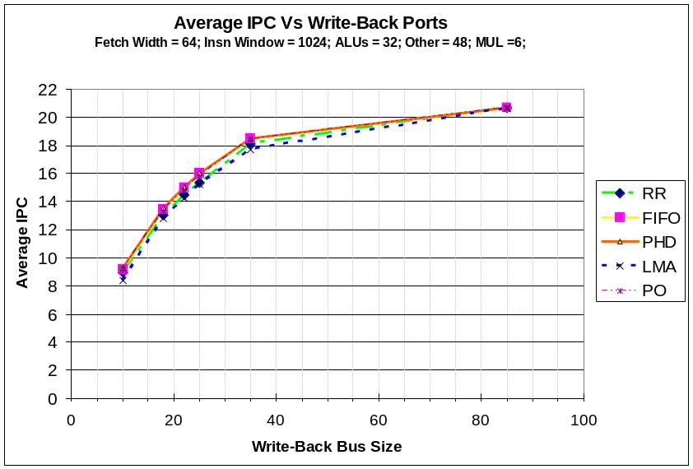
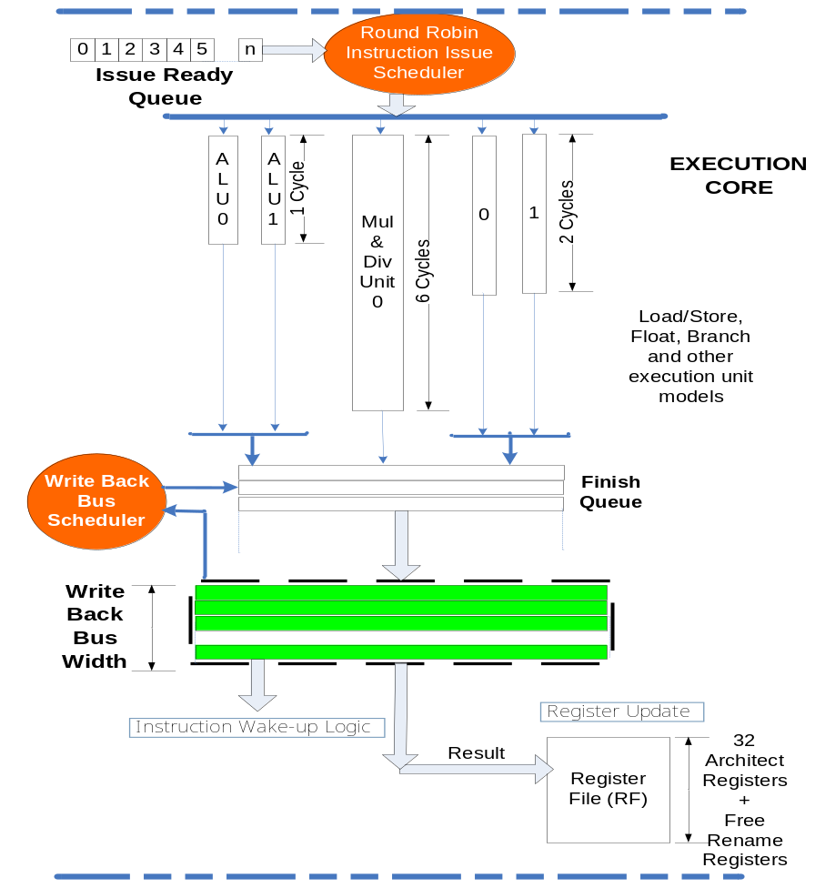
Write-Back Bus Scheduling
Comments:
FIFO, PO and Priority to High Dependent (PHD) instruction has approx. 4.22% higher IPC than LMA

Slide 19
OSU AbaKus Microarchitecture Simulator – Achieved Goals
Modularity : Through Port definitions
Simple Interconnections to interface.
Reusability of modules.
Adaptable to familiar HDL languages.
Reasonable Simulation Speed to execute SPEC Benchmarks.
Quickly able to identify the Bottle-Necks.
In-Order Instruction Checker for Debugging.

Slide 20
Overview
OSU AbaKus
Designing Superscalar Models
Eager Executions

Slide 21
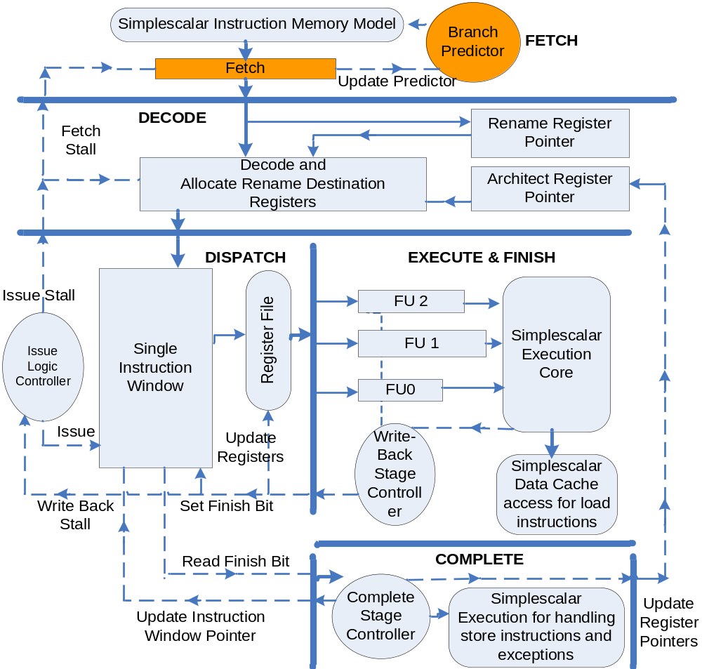
Baseline Superscalar Model…

Slide 22
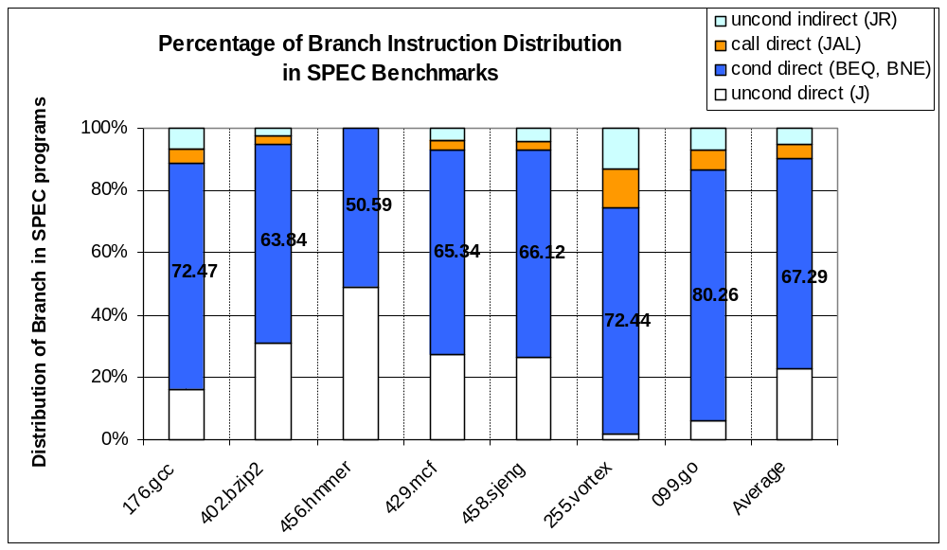
Resolving conditional branches are important
About 67.29% are Conditional Branches and so are important to resolve them correctly.

Slide 23
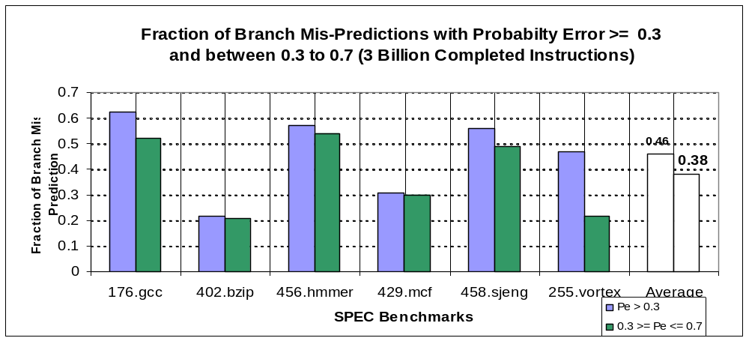
Branch Mispredictions
Why is it important to fix it?
38% of the Branch Mispredictions have P_{error} between 0.3 and 0.7
How does a branch mispredictions affect performance?

Slide 24
Penalty in Branch Prediction…
Pipeline Model
Branch Levels
1
2
3
Bad Path
Good Path
Ds
Is
Branch
EXE
Fn
F
D
C
Recovery penalty is severe in case there is a branch misprediction

Slide 25
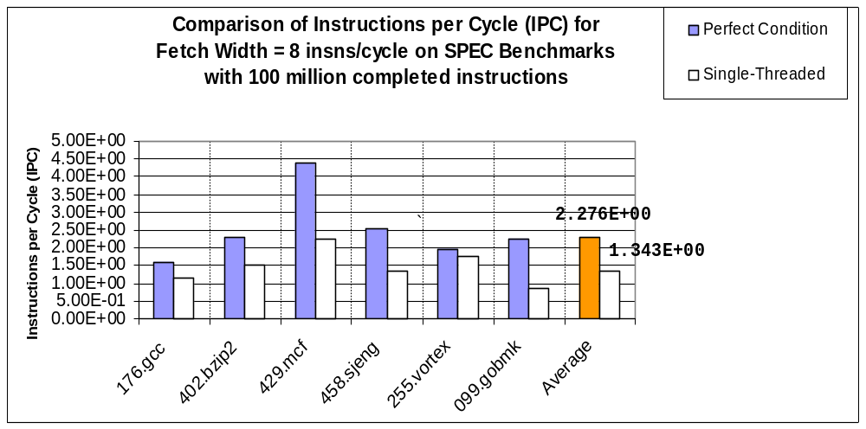
Performance Loss due to mispredictions
About 69.4% Performance Loss due to conditional branch mispredictions

Slide 26
Eager Executions…
IBM 3168 and 3033 mainframes fetch instructions from both the paths.
MIPS R10000 stores instructions from second path in Resume Cache.
Multipath Eager Execution (Smith et al, 1996)
Confidence-Based Eager Execution (Klauser 1998)
  Disjoint Eager Execution (Uht & Sindagi, 1995)
    Selective Disjoint Eager Execution
    Variable Fetch Rate Eager Execution
Disjoint-Eager based executions have never before studied with conventional architecture designs.

Slide 27
Eager Threads…
Pipeline Model
Branch Levels
1
2
3
1
2
F
D
Ds
Is
Branch
EXE
Fn
C
3
No Recovery necessary
But fetch band width is affected!
Thread Wrapping

Slide 28
Disjoint Eager Threads
Branch Levels
1
0.45
0.55
2
0.202
0.247
0.302
3
0.166
F
D
Ds
Is
Branch
EXE
Fn
C
Threads | Path Confidence
1 | 0.0911
2 | 0.1113
3 | 0.1113
4 | 0.1361
5 | 0.1361
6 | 0.1663
7 | 0.1113
8 | 0.1361
Depends on the Confidence Value.
Some useful work done even during a misprediction.
Fetch Width not affected.
1. Selective Disjoint Eager: Selects a set of high confidence paths and follows it
2. Variable Fetch Rate Eager: Fetch width of the high confidence path is proportional to the confidence value.

Slide 29
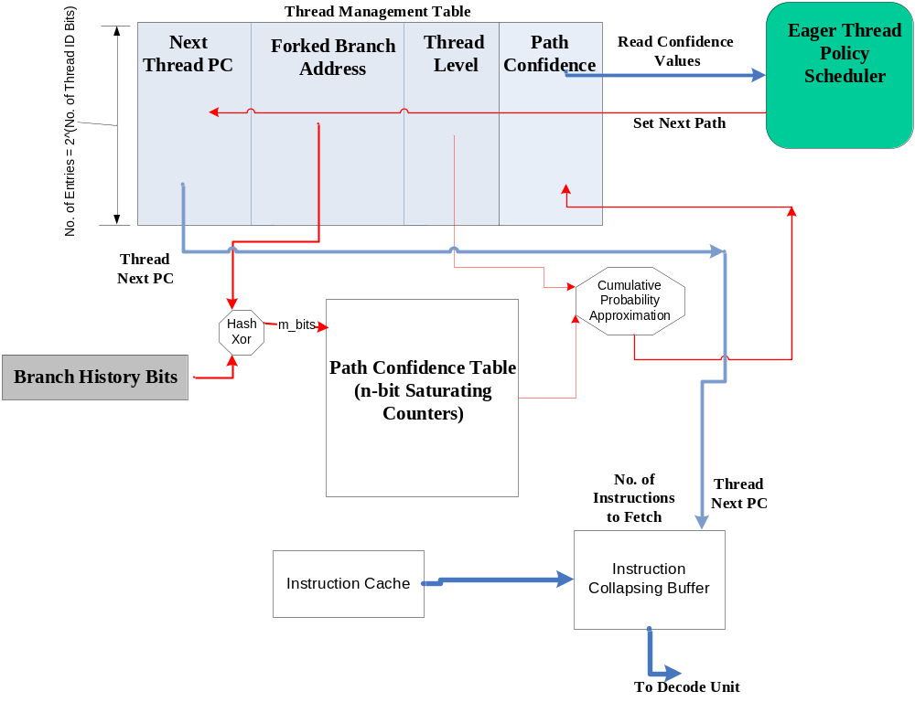
Block Level Design of Confidence Estimator
Design
4-Bit Saturating Counters
0-7: Low Confidence
8-15: High Confidence
Update Logic
Incremented on correct prediction and high confidence;
Reset to 8 at incorrect prediction and high confidence.

Slide 30
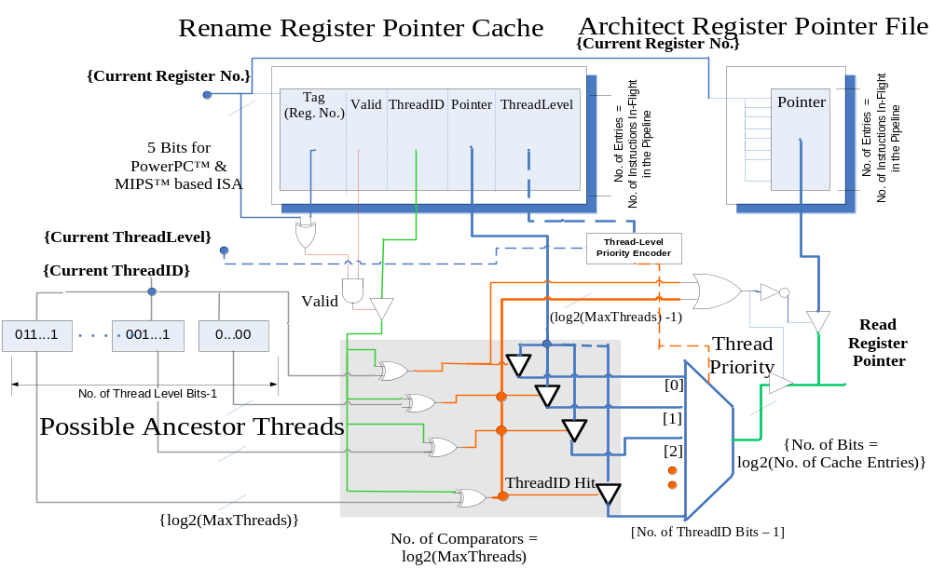
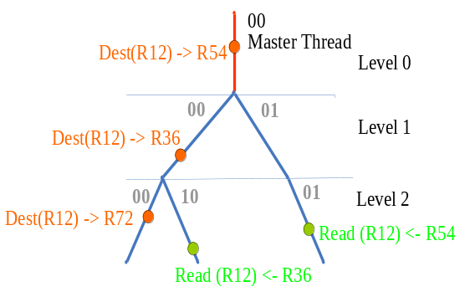
Register Rename Mechanism
Renamed Registers
Aswin Ramachandran and Louis G. Johnson, "Rename Register Cache Support for Open MP", 13th Conference on Architecture Support for Programming Languages and Operating Systems (ASPLOS ‘08), March 2008 (Poster)

Slide 31
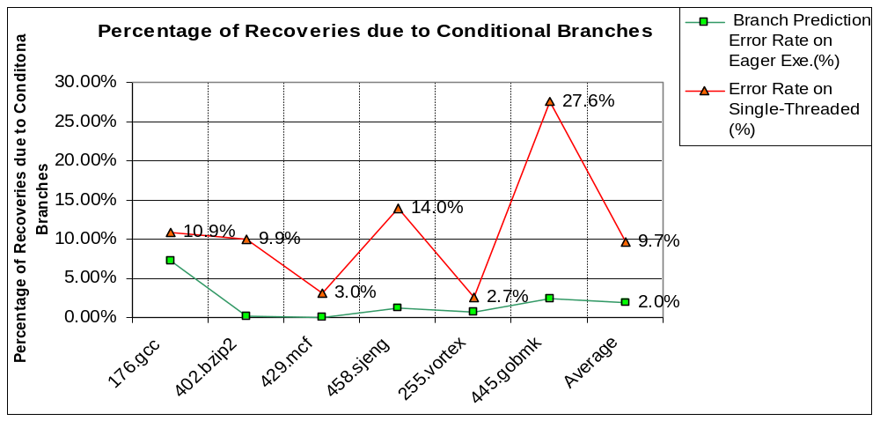
Lower Branch Error Rate!
Benchmarks | Compul-sory Misses
176.gcc | 12099
402.bzip | 143
456.hmmer | 1
429.mcf | 166
458.sjeng | 1226
255.vortex | 1549
099.go | 4113
Branch Mispredictions are negligible for Eager Executions.

Slide 32
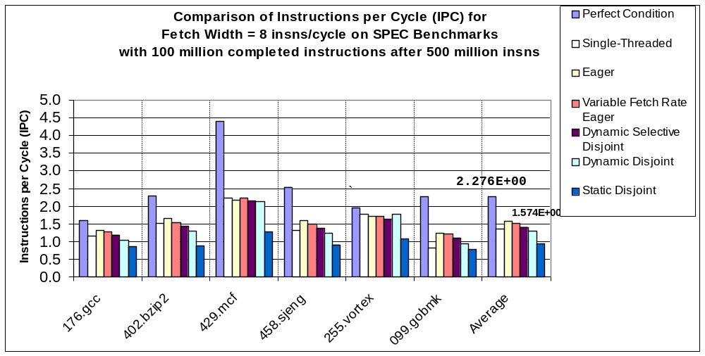
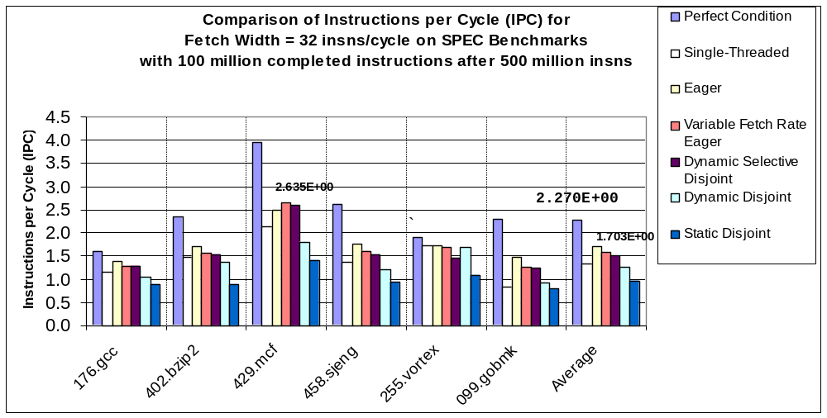
Performance of Eager-Based Executions
Code-Phases in large benchmarks
Confidence Estimator have to be improved

Slide 33
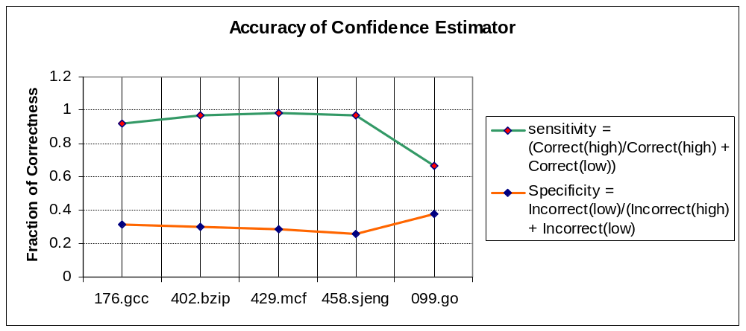
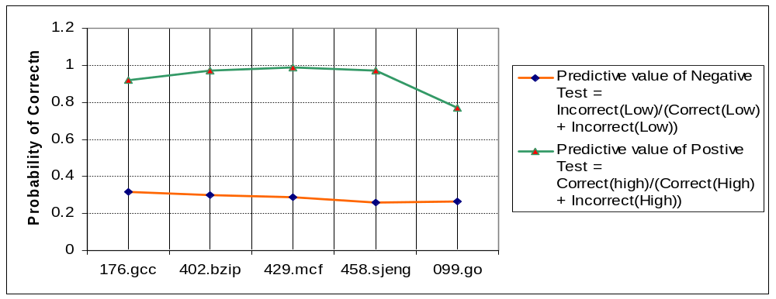
Performance of the Confidence Estimator
It is important that Specificity and PVN are high.
Quality of the Confidence Estimator

Slide 34
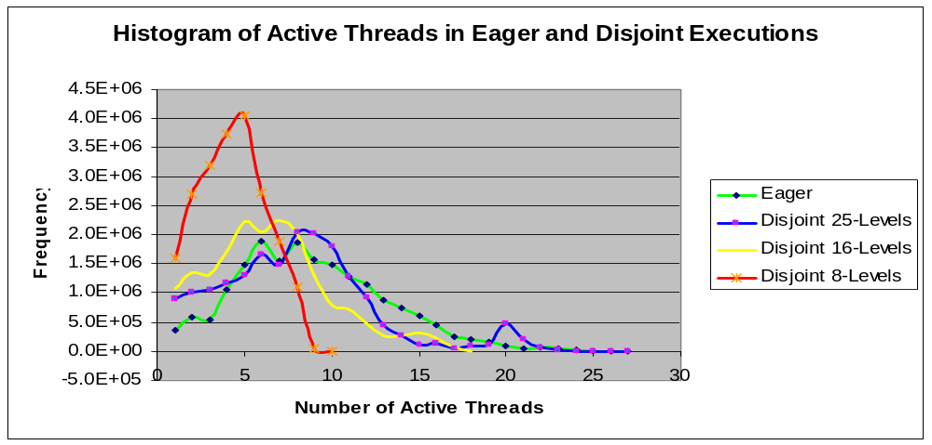
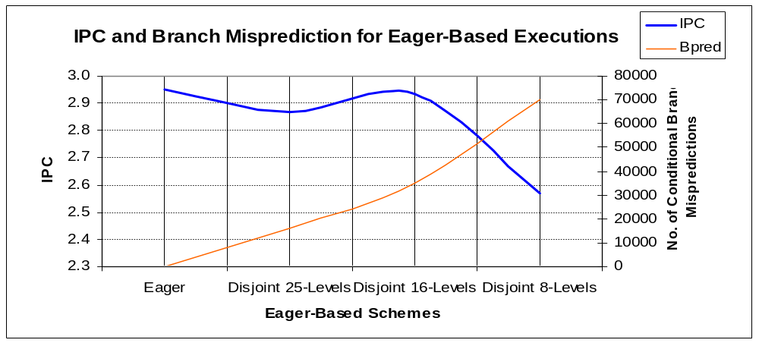
Closer look at the problem…
Less mispredictions
but fetch width
is affected
429.mcf benchmark
More dependence on Branch Prediction
Benchmarks compiled with poor compilers do not take advantage of the architecture
429.mcf benchmark

Slide 35
Contributions so far…
OSU AbaKus is a free Open-Source simulator for hardware design engineers.
Incorporated a Superscalar Architecture Model that is extensible.
Studied about write-back bus scheduling and load speculation techniques.
Proposed and demonstrated Eager-Based execution policies to solve Control Dependency Problems.
Future Work:
  SystemC AbaKus
  Confidence Estimators with data value prediction
  Load/Store Prediction Problem

Slide 36
Recognitions…
2008 Graduate College Summer Research Fellowship
2005 Lynn T. Miller Doctoral Scholarship Award.
Best Paper, Undergraduate Technical Paper Presentation on Radar Systems, CEG, Anna University, Chennai, India, 2000.
Research and Travel Grants to participate in HOTCHIPS ’08, ASPLOS ’08, ISPASS ’08 and Oklahoma Venture Capitalists Forum ‘07 .
Publications/Presentations:
Aswin Ramachandran and Louis Johnson, “Port Communications on AbaKus Processor Simulator” October 2008. (Paper Submitted).
Aswin Ramachandran and Louis Johnson," Rename Register Cache Support for Open MP" , 13th Conference on Architectural Support for Programming Languages and Operating Systems (ASPLOS '08), March 2008.
Aswin Ramachandran and Louis Johnson, “Advanced Microarchitecture Simulator for Design, Verification and Synthesis, Proceedings of 50th IEEE Mid-West Symposium for Circuits and Systems (MWSCS ‘07), Aug 2007.
Aswin Ramachandran and Louis Johnson, “OSU AbaKus 1.1 Microarchitecture Simulator, 2007 Bricktown Venture Capital Conference, Oklahoma, Sept 2007.

