Slide 1
OSU AbaKus - An Advanced Microarchitecture Design Simulator
Aswin Ramachandran
PhD Qualification Presentation
11/20/2007

Slide 2
Overview
Clock Buffer Model
Literature Review
Module Evaluations
Superscalar Architecture Model
Load/Store Model
Future Work
Clocked Buffer
Literature Review
Module Evaluations
Superscalar Model
Load/Store Model
Future Work

Slide 3
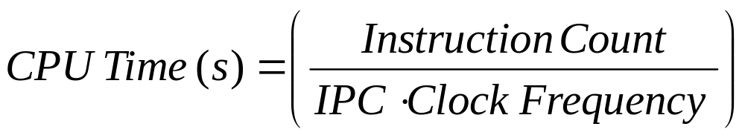
Overview …
Evaluating Processor Performance:
Primary Objective of the processor design involves trade-off between these 3 parameters.
where, IPC is “Instructions per Clock Cycle”
Clocked Buffer
Literature Review
Module Evaluations
Superscalar Model
Load/Store Model
Future Work

Slide 4
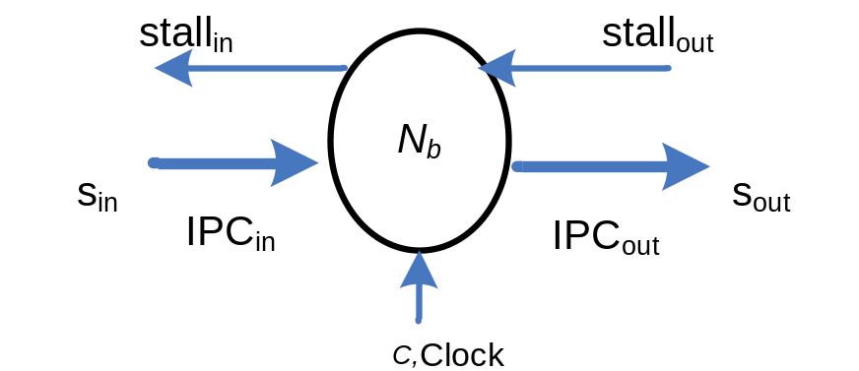
Clocked Buffer Model
Where, Nb is the total number of instructions that the buffer can store;
s_{in} and s_{out} are the number of instructions that are flowing into and out of the buffer in a clock cycle;
I_{b} is the number of instructions present in the buffer;
Clocked Buffer
Literature Review
Module Evaluations
Superscalar Model
Load/Store Model
Future Work

Slide 5
Clocked Buffer Concept
OUTPUT
Data
Structure 1
INPUT
Module A
Cycle 1
Cycle 2
Module B
OUTPUT
Data
Structure 2
INPUT
Cycle 2
Cycle 1
Evaluate Phase (1)
Evaluate Phase (1)
Update Phase (2)
Clock
Evaluate
Update
Clocked Buffer
Literature Review
Module Evaluations
Superscalar Model
Load/Store Model
Future Work

Slide 6
Literature Review
Cycle-Time Based Simulation
  Simplescalar 3.0
  Sim-Mase (Simplescalar 4.0)
Event-Driven Simulation
  Liberty Simulation Environment
  Intel’s ASIM
  SystemC based tools: ArchC, MicroLib
Clocked Buffer
Literature Review
Module Evaluations
Superscalar Model
Load/Store Model
Future Work

Slide 7
Module Evaluations
LOGIC TO EVALUATE:
C
A
E
B
D
1. Cycle-Time Based Execution (Simplescalar):
Global Variables
Cycle | List of Modules Executed
0 | A, B, C, D, E
1 | A, B, C, D, E
… | A, B, C, D, E
n | A, B, C, D, E
A
B
C
D
E
Clocked Buffer
Literature Review
Module Evaluations
Superscalar Model
Load/Store Model
Future Work

Slide 8
2. Event-Driven Execution (Verilog, Intel’s ASIM, SystemC):
Cycle | Evaluate | Process Queue
0 | A, B, C, D,E | Initial
 | A | B, C
 | B | C, D
 | C | E
 | D | E
 | E | C
1 | B, 3C, D, 2E
 | B | C, D
 | 3C | 3E
 | D | E
 | 2E | 2C
2 | 3C, D, 4E
 | 3C | 3E
 | D | E
 | 4E | 4C
3 | 4E, 4C
 | 4E | 4C
 | 4C | 4E
LOGIC TO EVALUATE:
C
A
E
B
D
Structural Design:
Global Variables
A
B
C
D
E

Slide 9
3. Modular Execution (AbaKus):
LOGIC TO EVALUATE:
C
A
E
B
D
Structural Design:
Cycle | List of Modules Executed
0 | A, B, C, D, E
1 | A, B, C, D, E
… | A, B, C, D, E
n | A, B, C, D, E
Global Variables
A
B
C
D
E
Clocked Buffer
Literature Review
Module Evaluations
Superscalar Model
Load/Store Model
Future Work

Slide 10
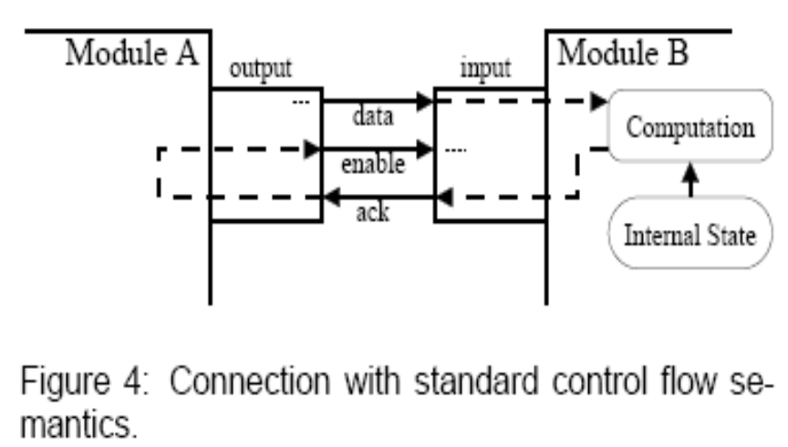
Liberty’s
Synchronous Reactive Model
Data ready on the port
Module B determines if it can accept the data.
If yes, sends ACK High.
Module A makes Enable High
Otherwise, Enable Low i.e. data should not be used by module B
…continues until the system stabilizes.
Connections with Standard Control Flow Semantics
Disadvantages:
Overhead in 3-way hand shake communication.
Slows down with the increase in number of ports.
[Source: Vachharajani et al, Microarchitectural Exploration with Liberty, MICRO’ 35, 2002]
Clocked Buffer
Literature Review
Module Evaluations
Superscalar Model
Load/Store Model
Future Work

Slide 11
Intel’s ASIM
Modules that represent hardware structures exchange information through ports [FIFO queues].
Clocked Modules are connected through ports.
Event-Driven Simulation.
Joel Emel et al, "Asim: A Performance Model Framework," Computer ,vol. 35, no. 2, pp. 68-76, February, 2002.
Clocked Buffer
Literature Review
Module Evaluations
Superscalar Model
Load/Store Model
Future Work

Slide 12
SystemC Variants
ArchC:
  Architecture description tool: User describes the Instruction Set Architecture (ISA) and modules.
  Wrapper for computer architecture design.
MicroLib (FastSysC)
  Removed virtual method calls and introduced in-line functions.
  Avoids data movements through pointers
  Complex acyclic scheduling.
Sandro Rigo et al, ArchC: A SystemC-Based Architecture Description Language, Symposium on Computer Architecture and High Performance Computing (SBAC). 2004, http://archc.org
Daniel Perez et al, A Fast SystemC Engine, Design, Automation and Test in Europe, 2004. http://www.microlib.org and http://unisim.org
Clocked Buffer
Literature Review
Module Evaluations
Superscalar Model
Load/Store Model
Future Work

Slide 13
Design Challenges
Modularity : Breaks down performance modeling into different pieces.
Reusability of modules: Increases productivity and robustness of the software.
Fast Simulation Speed
Familiarity with HDL programming
Debugging Features.
Clocked Buffer
Literature Review
Module Evaluations
Superscalar Model
Load/Store Model
Future Work

Slide 14
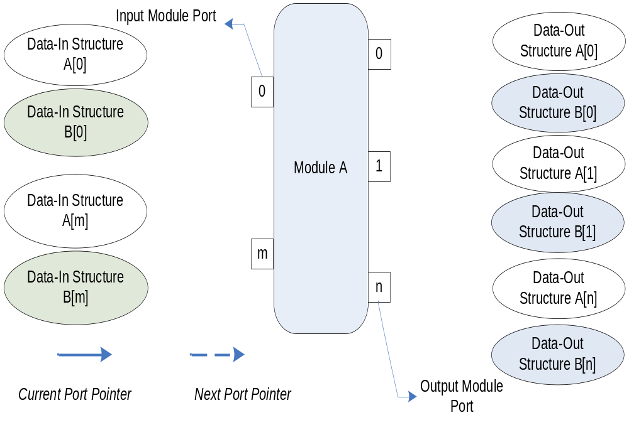
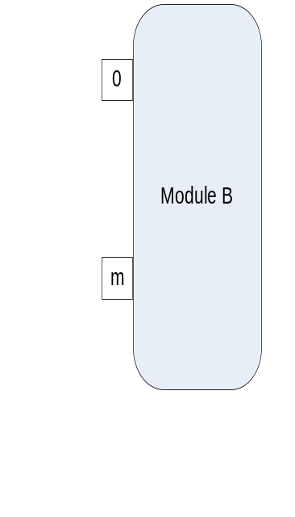
Modularity through Ports
Clocked Buffer
Literature Review
Module Evaluations
Superscalar Model
Load/Store Model
Future Work

Slide 15
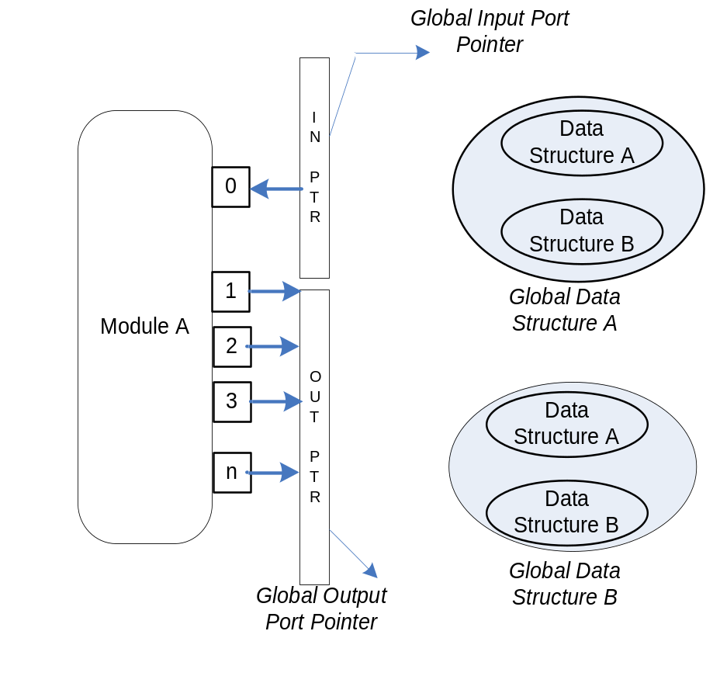
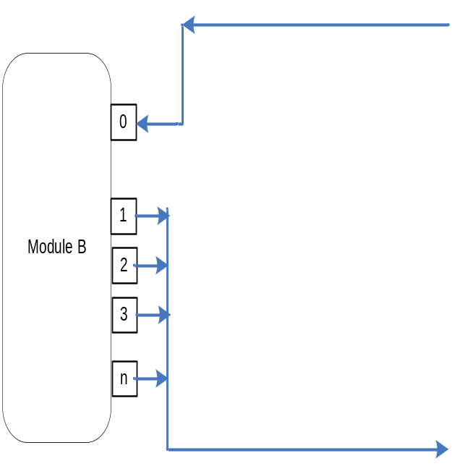
Global Pointer
Advantages:
Avoids the increase in computation time with the increase in number of ports as in [Liberty, SystemC Models].
Register Update time is independent of number of ports.
Clocked Buffer
Literature Review
Module Evaluations
Superscalar Model
Load/Store Model
Future Work

Slide 16
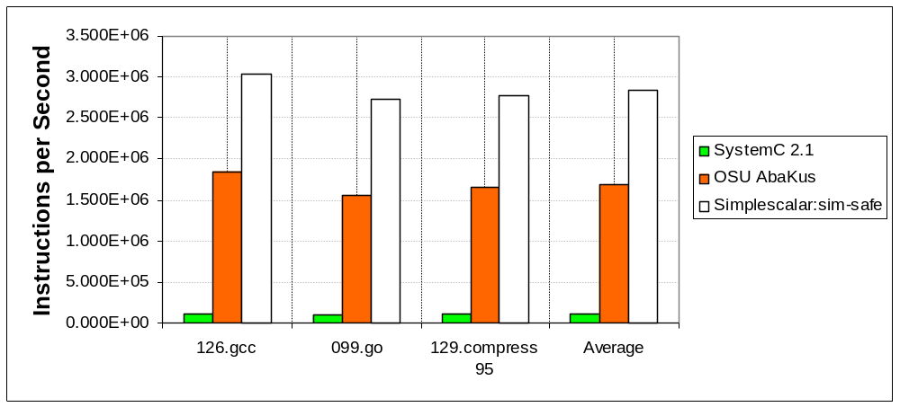
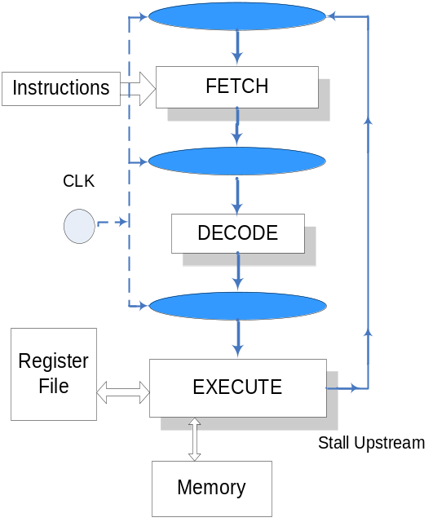
Performance of the Simulators for 3-Stage MIPS Pipeline on SPEC-95 Benchmarks
Instruction Execution Rate for Different Benchmarks
Three-Stage MIPS Pipeline
Executed on AMD Duron 750MHz, 128 MB RAM
Comparison of Execution Time (s)
SPEC 95 Benchmarks | Simplescalar 3.0: sim-safe (seconds) | OSU AbaKus (seconds) | SystemC 2.1 (seconds)
126.gcc | 92 | 190 | 3,306
099.go | 351 | 726 | 11,381
129.compress | 29 | 61 | 873
Average | 157.33 | 325.66 | 5186.67
Aswin Ramachandran and Louis Johnson, Advanced Microarchitecture Design Simulator for Design, Verification & Synthesis, IEEE MWSCS 2007.

Slide 17
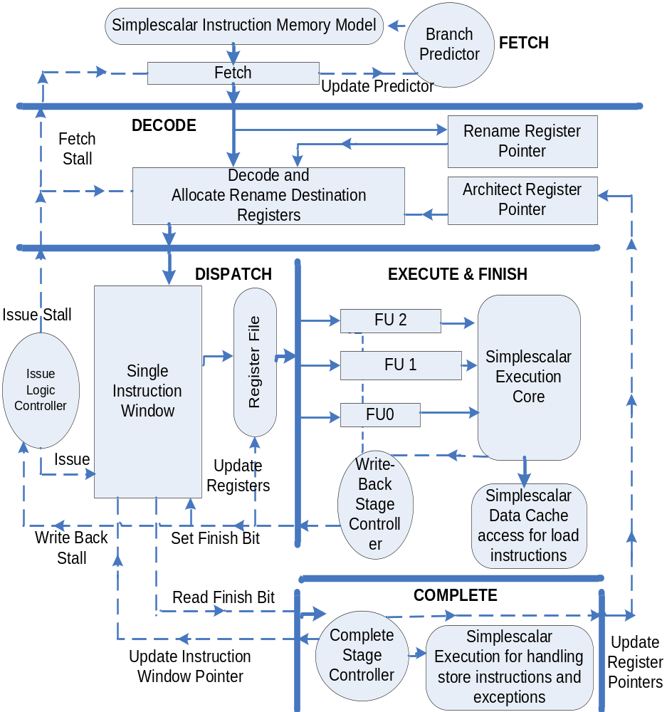
Moving to Superscalar Models…
Next
Return
Clocked Buffer
Literature Review
Module Evaluations
Superscalar Model
Load/Store Model
Future Work

Slide 18
Register Renaming: IBM RS/6000, 1989
Pointer Map Table
DECODE STAGE
Free List (FL)
Register | Pointer
0 | 0
1
…
16
…
31 | 31
32
33
34
35
.
.
38
39
1
RECOVERY
16
Pending Target Return Queue (PTRQ)
ADVANTAGES:
No data is transferred. Instead only pointers (6 bits) are moved.
DISADVANTAGES:
Hardware Complexity.
Rewriting Old Pointers during Recovery.
32 Registers
beq R23, R0, 0x100
lw R16, 0(R29)
addiu R1, R16, 72
Clocked Buffer
Literature Review
Module Evaluations
Superscalar Model
Load/Store Model
Future Work

Slide 19
OSU Virtual Register File Design
beq R23, R0, 0x100
lw R16, 0(R29)
addiu R1, R16, 72
Rename Register Pointer (RRP)
Register | Pointer | Valid
1
…
16
…
31 | 31
1
1
0
1
0
DISPATCH
16
0
EXECUTE / FINISH
1
COMPLETE
1
DECODE
0
32
32
1
0
Register | Pointer
0 | 0
1 | 1
…
16
…
31 | 31
Architect Register Pointer (ARP)
16
RECOVERY
Free List
…Superscalar Design
Clocked Buffer
Literature Review
Module Evaluations
Superscalar Model
Load/Store Model
Future Work

Slide 20
Instruction Wake-Up Logic
lw R16, 0(R29)
bne R16, R3, 0x 200
addiu R1, R16, 72
Wake-Up Table
Single Instruction Window
SlotID |  |  |  | Length
22 | 23 | 24 | … | 2
23 |  |  |  | 0
24 | 30 |  |  | 1
SlotID | Insn | Rs | Rt | Rd
…
22 |  | - | R29 | R16
23 |  | R16 | R3 | -
24 |  | - | R16 | R1
… | …
EXECUTE / FINISH
lw
COMPLETE
bne
DISPATCH
addiu
…Superscalar Design
Clocked Buffer
Literature Review
Module Evaluations
Superscalar Model
Load/Store Model
Future Work

Slide 21
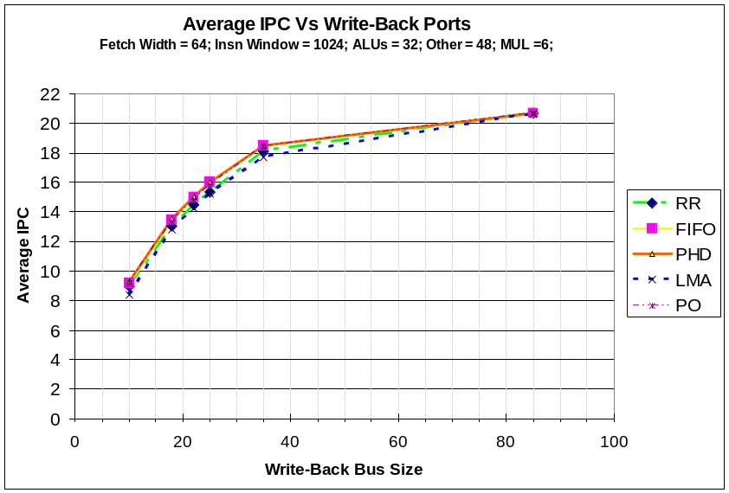
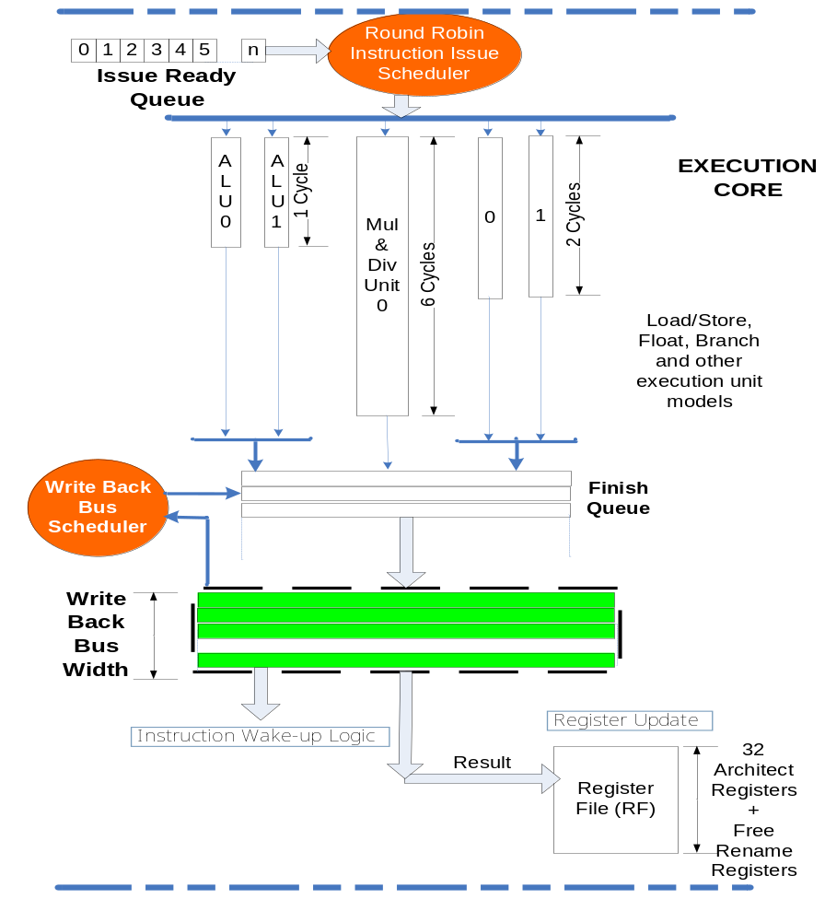
Write-Back Bus Scheduling
Comments:
FIFO, PO and Priority to High Dependent (PHD) instruction has approx. 4.22% higher IPC than LMA
Scope for Superscalar Architecture still exits.
…Superscalar Design
Clocked Buffer
Literature Review
Module Evaluations
Superscalar Model
Load/Store Model
Future Work

Slide 22
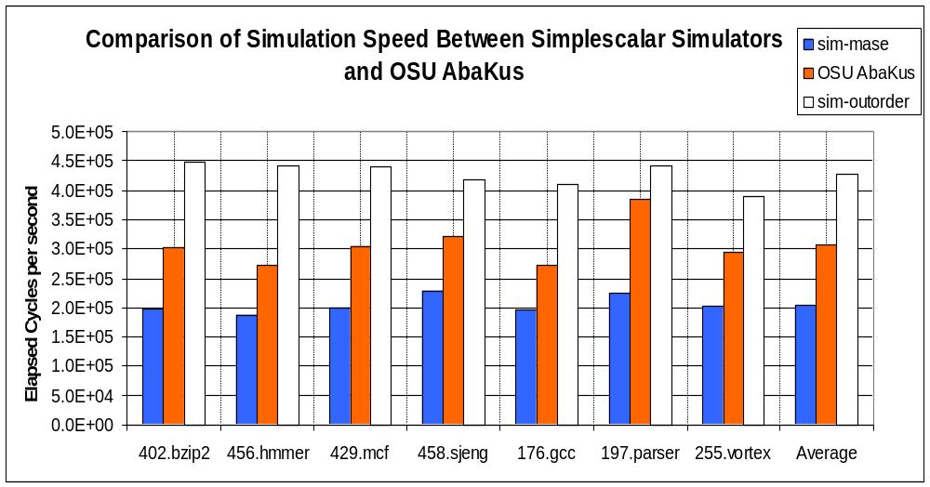
Performance of the Simulators for Superscalar Architecture on SPEC CPU 2000/2006 Benchmarks
Design Parameters | sim-outorder | OSU AbaKus | sim-mase
Instruction Fetch Width | 4 inst/cycle | 4 inst/cycle | 4 inst/cycle
Instruction Window Size | 64 | 64 | 64
Physical Registers | 32 | 100 | 100
Issue Width | 8 | 8 | 8
Commit Width | 8 | 8 | 8
Branch Predictor | Perfect | Perfect | Perfect
Integer ALU units (Latency =1) | 3 | 3 | 3
Mul/Div Unit (Latency = 6) | 1 | 1 | 1
Float ALU units | 4 | Exception call | 4
Write Back Bus Width | Not Modeled | 4 | Not Modeled
Execution | Inorder | True out-of-order | True out-of-order
Exceptions | Not Modeled | Precise | Precise
Average IPC | 2.165 | 1.794 | 1.884
Average Simulation Time (seconds) | 6,520.1 | 11,268.7 | 15,655.0
Comments:
Inherent difference between simulators exists.
OSU AbaKus performance is 50.27% higher on average in terms of cycles/s than Simplescalar’s sim-mase.
More detailed behavior has to be incorporated.
…Superscalar Design

Slide 23
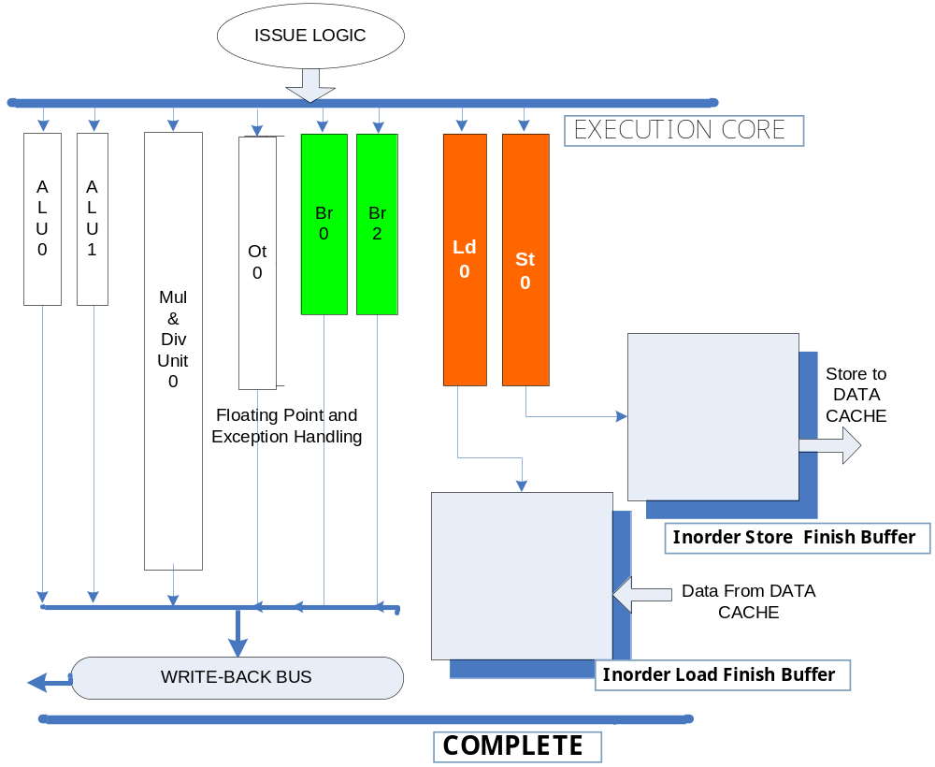
Load Forwarding through Store Buffer
R5 << 200
0xA lw R5, 0(200)
0xB sw R3, 0(200)
R3 >> 200
0xC lw R5, 0(200)
R5 << 200
B
A
C
Shen and Lipasti, Modern Processor Design, McGraw Hill, 2003
Clocked Buffer
Literature Review
Module Evaluations
Superscalar Model
Load/Store Model
Future Work

Slide 24
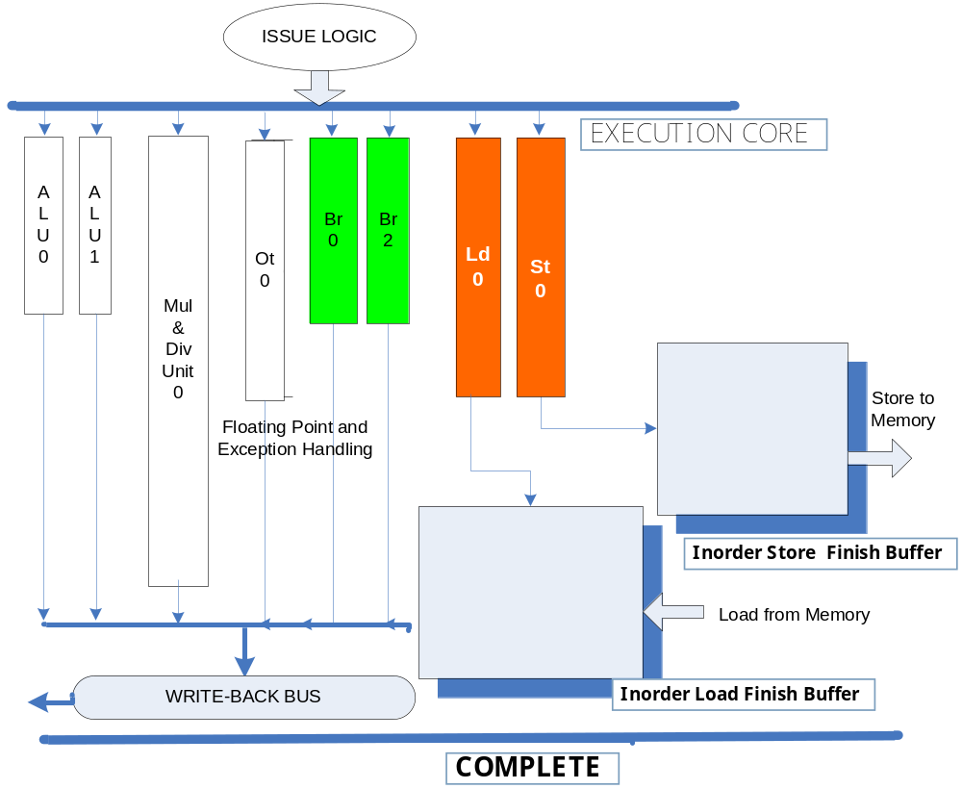
WAR Hazard Detection…
0xA lw R5, 0(200)
0xB sw R3, 0(200)
R3 >> 200
0xC lw R5, 0(200)
R5 << 200
Dependence Predictions:
Data Memory Address Prediction (AddrPred)
Instruction Address Prediction (Program Counter Prediction) (PC)
B
A
R5 << 200
C
Memory Violation & Set Processor State Recovery
Clocked Buffer
Literature Review
Module Evaluations
Superscalar Model
Load/Store Model
Future Work

Slide 25
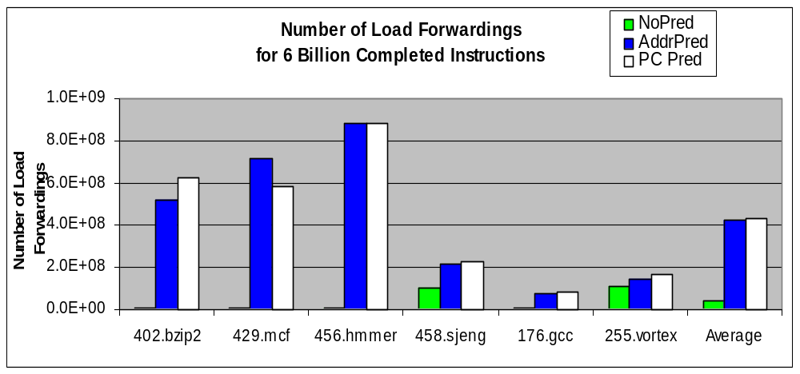
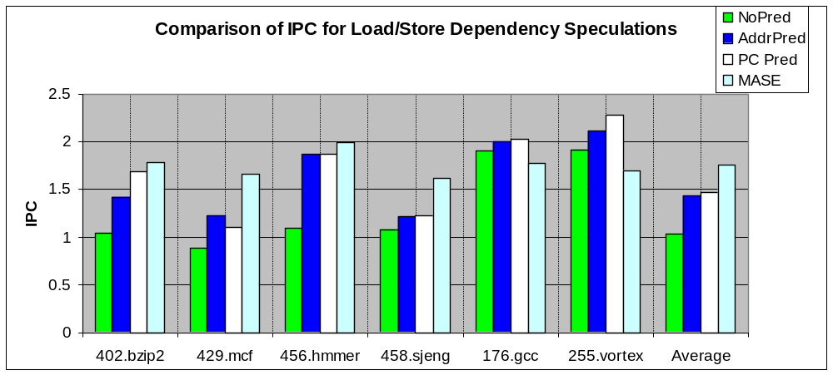
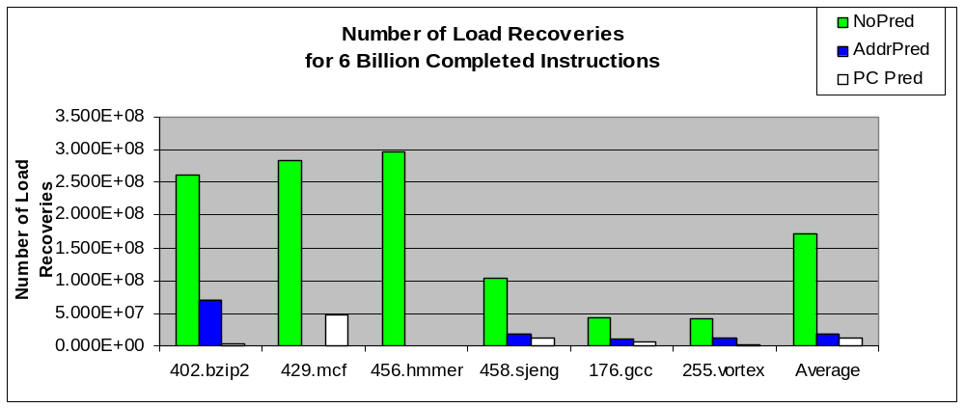
Performance of Load/Store Dependence Prediction
Data Memory Address Prediction (AddrPred)
Challenges:
a. for(i=1 to 1x10⁶)
R3 = Load(&Y);
Store(&X + i) = R3;
b. Store byte & Load word
2. Instruction Memory Address Prediction (PC):
Challenges:
a. for(i=1 to 1x10⁶)
if ( m = 0 )
R3 = Load(&Y);
else
R3 = Load(&Z);
Store(&X) = R3;
b. Store byte & Load word
Clocked Buffer
Literature Review
Module Evaluations
Superscalar Model
Load/Store Model
Future Work

Slide 26
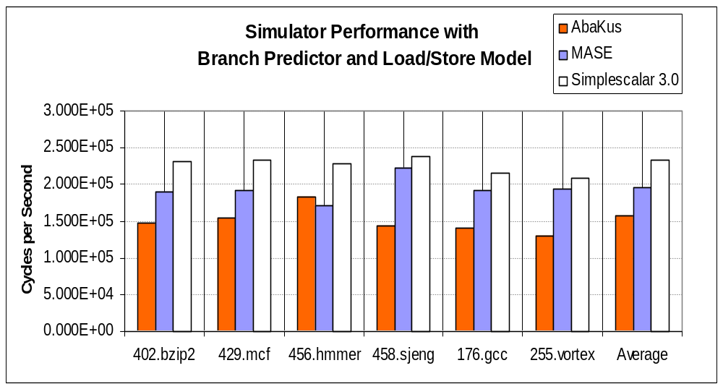
Performance of the Simulators for Superscalar Architecture on SPEC CPU 2000/2006 Benchmarks
Design Parameters | sim-outorder | OSU AbaKus | sim-mase
Instruction Fetch Width | 4 inst/cycle | 4 inst/cycle | 4 inst/cycle
Instruction Window Size | Single Window: 64 | Single Window: 64 | Split Window: 64
Physical Registers | 32 | 100 | 100
Issue Width | 8 | 8 | 8
Commit Width | 8 | 8 | 8
Branch Predictor 2048 Entries, 16 history bits | gShare | gShare | gShare
Integer ALU units (Latency =1) | 3 | 3 | 3
Mul/Div Unit (Latency = 6) | 1 | 1 | 1
Ld/St (Latency = 2) | 8 | 6 | 8
Branch (Latency = 2) | No explicit unit | 6 | No explicit unit
Float ALU units | 4 | Exception | 4
Load Dependence Prediction | Not Required | Yes | Uses Oracle
Average Simulation Time (seconds) | 13,684 | 24,960 | 17,904
Comments:
OSU AbaKus performance is 1.26 times slower in terms of cycles/s than Simplescalar’s sim-mase.
Even more differences between simulators.

Slide 27
OSU AbaKus Microarchitecture Simulator – Achieved Goals
Modularity : Through Port definitions
Simple Interconnections to interface.
Reusability of modules.
Adaptable to familiar HDL languages.
Reasonable Simulation Speed to execute SPEC Benchmarks.
Quickly able to identify the Bottle-Necks.
In-Order Instruction Checker for Debugging.
Clocked Buffer
Literature Review
Module Evaluations
Superscalar Model
Load/Store Model
Future Work

Slide 28
Contributions so far…
OSU AbaKus is a free Open-Source simulator for hardware engineers.
Incorporated a Superscalar Architecture Model that could be easily extended.
Studied about write-back bus scheduling and load speculation techniques.
Clocked Buffer
Literature Review
Module Evaluations
Superscalar Model
Load/Store Model
Future Work

Slide 29
Future Work
Incorporate Floating-Point Execution Units.
Pre-Fetching on Data Cache based on speculated load address.
Improve the multi-threaded simulator model.
  OPEN MP based programming model for shared-cache architectures
OPEN MP specification for Parallel Programming; http://www.openmp.org
Clocked Buffer
Literature Review
Module Evaluations
Superscalar Model
Load/Store Model
Future Work

Slide 30
Future Work…
Variable Instruction Fetch-Rate based on Branch Confidence.
20 %
50 %
Br0
T
50 %
NT
80 %
100 %
Predicted = T
B0
Confidence = 20 %
B1
NT
Br1
T
NT
Br2
T
Predicted = NT
Predicted = NT
Confidence = 30 %
Confidence = 60 %
B2
B3
B4
B5
Clocked Buffer
Literature Review
Module Evaluations
Superscalar Model
Load/Store Model
Future Work

Slide 31
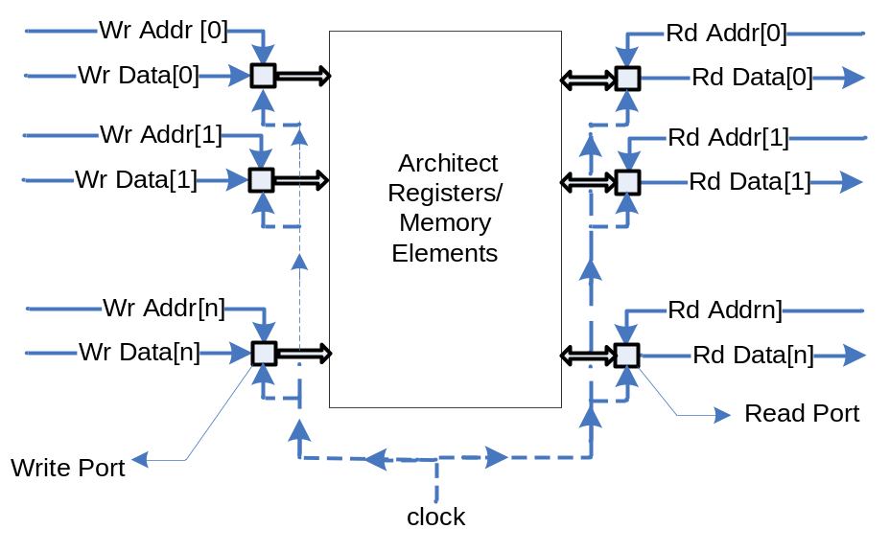
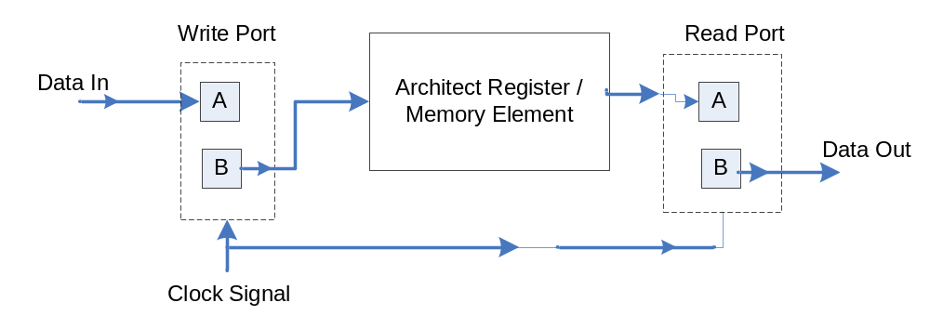

Slide 32
Comparison between SystemC & Liberty
Model | Mean cycles/s | Speedup | Build time (s)
Custom SystemC | 53,722 | 1 | 49.06
Custom LSE | 155,111 | 2.88 vs. SystemC | 15.4
Reusable LSE | 40,649 | 0.26 vs. Custom LSE | 33.9
Superscalar based on Alpha ISA
Fetch Size = 4 Instructions
Instruction Window = 16 Instructions
Reorder Buffer = 32 Instructions
Perfect Memory Model
[ Source: David Penry & David August, Optimizations for a Simulator Construction System Supporting Reusable Components, DAC, 2003]
Clocked Buffer
Literature Review
Module Evaluations
Superscalar Model
Load/Store Model
Multi-Threading Issues

Slide 33
Multi-Threaded Simulator Performance
Average Elapsed Simulation Time (seconds) on the Tested Machines
Three-Stage MIPS Pipeline with PThreads Library
1 Process | Average Elapsed Time (s) | StdDev (s)
Earth | 12.67 | 0.57
Pumpkin | 9.33 | 0.57
Bullet | 9.67 | 0.57
Lychee | 10.00 | 0.0
4 Threads | Average Elapsed Time (s) | StdDev (s)
Earth | 587.0 | 9.5
Pumpkin | 3,658.7 | 213.9
Bullet | 2,763.7 | 30.0
Lychee | 1,908.7 | 24.2
Benchmark Under Test: SPEC 95 129.Compress averaged over 3 executions
 | AMD Opteron 152 | Intel Xeon 5130 | Intel Xeon | Intel Core2 6400
Computer Name | Earth | Pumpkin | Bullet | Lychee
L1 Cache (KB) | 1024 | 4096 | 2048 | 2048
Frequency (GHz) | 2.613 | 1.995 | 3.192 | 2.131
Cores | 1 | 2 | 2 | 2
RAM (GB) | 2.0 | 16.4 | 4.0 | 1.9
Total CPUs | 1 | 4 | 4 | 2
Clocked Buffer
Literature Review
Module Evaluations
Superscalar Model
Load/Store Model
Multi-Threading Issues

Slide 34
Machine Configurations
P0
P1
P2
P3
P0
P0
P1
L1
L1
L1
L1
L1
L1
L1
L2 Cache
L2 Cache
L2 Cache
L2 Cache
L2 Cache
L2 Cache
Memory
Memory
Memory
Earth
587 s
Pumpkin & Bullet
Lychee
Clock
Evaluate
Update
Clocked Buffer
Literature Review
Module Evaluations
Superscalar Model
Load/Store Model
Multi-Threading Issues

