Slide 1


Consistency of Judging as a Proxy for LLM Intelligence
Ashwin Ramaswamy
Nestor Demeure
Ermal Rrapaj

Slide 2
Measuring Intelligence of LLMs
Motivation: New LLMs are released every day. We need a way to evaluate their capabilities, knowledge, and overall intelligence.
Estimating using external properties (e.g. parameter size) doesn’t work.
Domain-specific benchmarks (MMLU, MedQA, HLE, etc.) exist.
They are objective and come from a fixed distribution.
Measures only knowledge (CoT reasoning must be evaluated manually).
Training on test set.

Slide 3
Elo Score as a Metric for Intelligence
It is a relative metric - calculated from binary preferences.
More contests and more competitors produces a more accurate Elo score.
Based on Bradley-Terry model: P(a > b).
Unlike objective tests, Elo scoring encodes accuracy and human-compatibility.
3rd party (human or AI) needs to give preferences to contests.
<Text 1> | <Text 2> : <preference>
<Text 3> | <Text 4> : <preference>
...
Notes:
im sure you can agree this is a reasonable definition for intelligence.

Slide 4
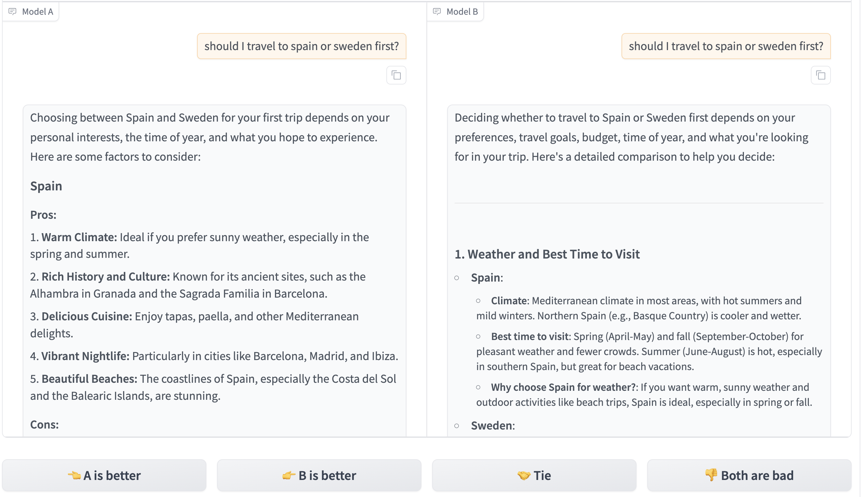

Slide 5
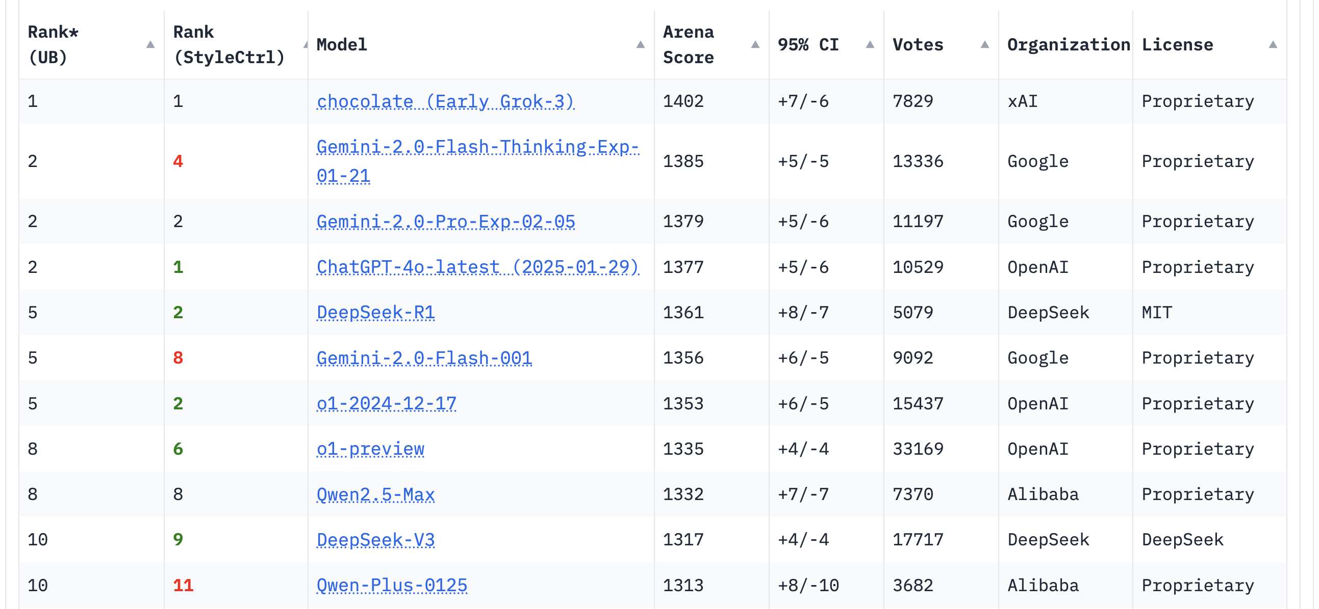

Slide 6
Problem: Eliciting Preferences is Tricky
Humans are slow. Upwards of 10k votes to minimize a 95% CI.
How many different humans needed? How many preferences per human? No clear consensus on how this affects Elo score consistency.
Use LLM-as-a-Judge? It’s much faster. But unless we can be sure it is aligned with the aggregate of humans, it won’t be useful.
Problem: Do we have to elicit preferences from humans every time we want to determine the Elo score of an LLM? (new model release, fine-tuned model)
It would probably be useful to estimate Elo score without humans.

Slide 7
Can we estimate intelligence without using humans?
Hypothesis: there is a relationship between an LLM’s intelligence and its ability to make decisions (judging responses).
Let’s make our target LLM serve as a Judge for other LLMs’ responses.
Let’s analyze how it gives preferences. Quantify its consistency.
Distinction:
OLD: to find the Elo score of model Q, we compared the responses of Q along with the responses of other LLMs (A, B, C, D, ...) and got relative Elos.
NEW: to find the Elo score of model Q, make it judge the responses of other LLMs (A, B, C, D, ...).
This proxy allows intelligence to be estimated independently.

Slide 8
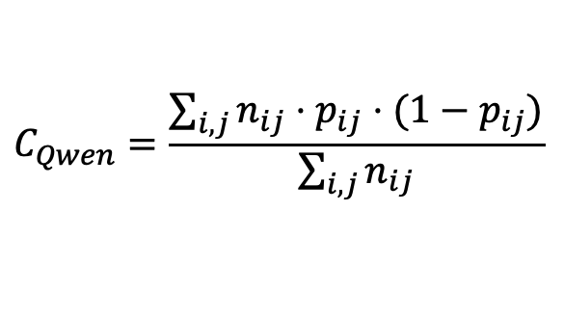
How smart is Qwen?
Qwen
prompt 1
LLM 1 response
LLM 2 response
Judge LLM pref
prompt 2
LLM 1 response
LLM 2 response
Judge LLM pref
prompt 3
LLM 1 response
LLM 2 response
Judge LLM pref
. . .
prompt N
LLM 1 response
LLM 2 response
Judge LLM pref
Llama 3
Claude
Llama 3
Claude
Vicuna
Vicuna
Gemini
Gemini
GPT4
GPT4
Claude
0.1
0.7
0.7
0.5
Claude
23
18
34
20
Vicuna
0.8
0.8
0.5
0.0
Vicuna
19
20
22
21
0.3
0.6
0.9
0.4
17
23
21
20
$$C_{Qwen}=\frac{\sum_{i,j}{n_{ij}⋅p_{ij}⋅(1−p_{ij})}}{\sum_{i,j}{n_{ij}}}$$
GPT4
GPT4
Gemini
0.1
0.2
0.8
0.6
Gemini
20
21
24
24
Llama 3
0.4
1.0
0.4
0.5
Llama 3
22
25
23
24

Slide 9
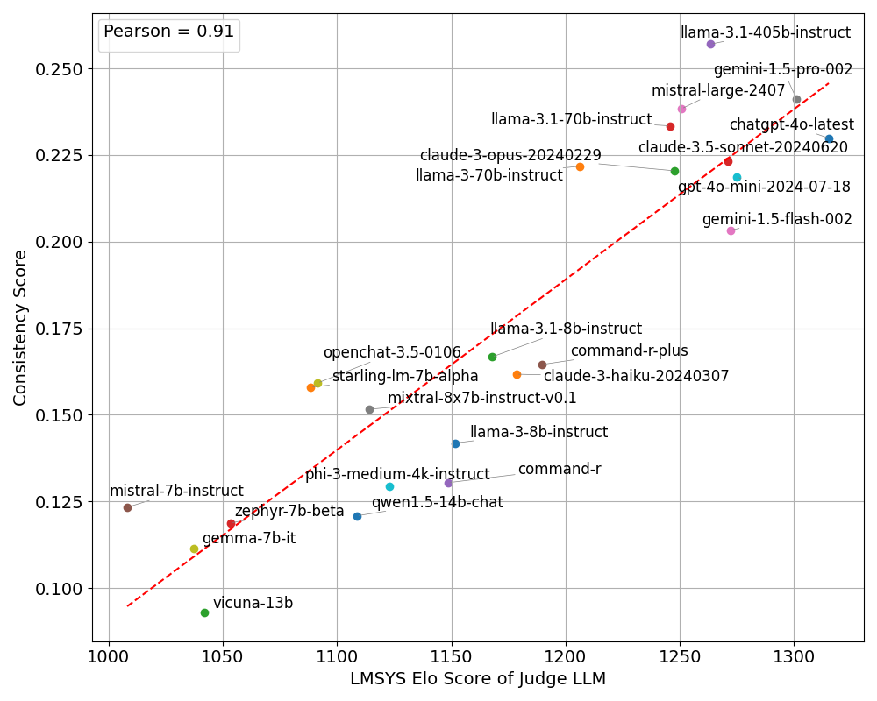
Notes:
from a utility perspective, this is sufficient. We have established a baseline proxy. Then people can work on improving this model.

Slide 10
Noteworthy:
Our formula doesn’t consider if the target LLM’s responses are objectively ‘correct’, or if the LLM is aligned with the human.
This predictive metric establishes correlation, not causation.
The estimation is on average only 35 Elo points away from the LLM’s true Elo score.

Slide 11
Why? Let’s dive into the data.
Is there some property of the matchups that are being judged that causes the correlation?
Let’s consider 2 things:
the difference between the LMSYS Elo scores of the LLMs whose responses are being evaluated
the variance of consistency scores across all judging LLMs
Logical next step: plot the relationship between these 2 things.

Slide 12
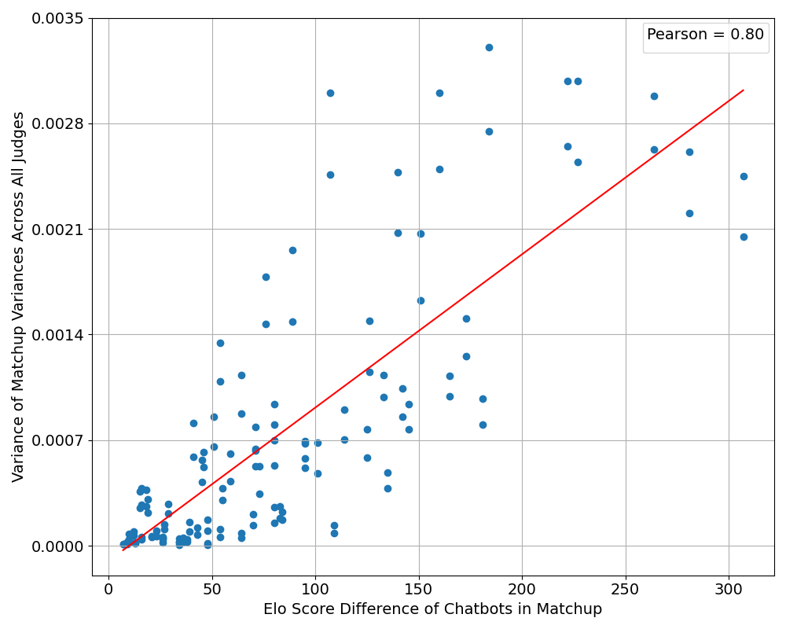
Notes:
This is tricky

Slide 13
Greater difference in Elo score = higher variance of consistency scores
Smart LLMs have higher consistency, dumb LLMs have low consistency
If the two models in a matchup have similar Elo scores, then no judge manages to reliably differentiate them, leading to low consistency across all judges and thus low variance between judges.
Pairs with a larger Elo difference are easier to discriminate, allowing good judges to excel while bad judges remain unable to consistently pick the best answer, increasing the variance on those pairs.
This suggests that pairs with large Elo differences are the most effective for identifying consistent judges.
How much data do we need to achieve the maximum correlation?

Slide 14
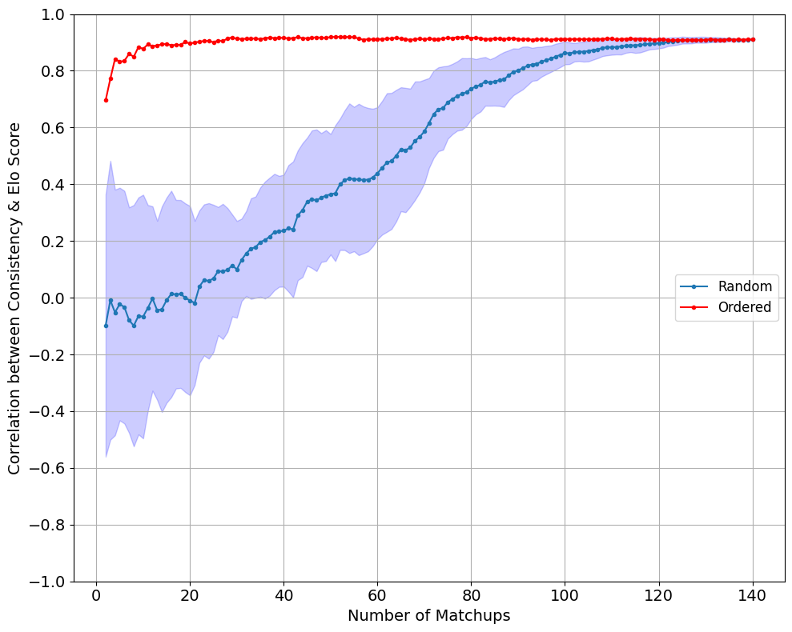

Slide 15
What does this tell us about LLM intelligence?
The distinction in intelligence for LLMs emerges when they are asked to judge between responses from discrepant LLMs.
Smart LLMs and dumb LLMs are equally consistent when judging responses from similarly intelligent models.
Smart models distinguish themselves from dumb models when judging responses from discrepant LLMs.

Slide 16
Perspectives: Limitations and Thoughts
We only tried this on one task: judging pairs of responses.
The correlation within clusters is not strong.
What can we do to improve the correlation?
This provides a promising avenue for further research to minimize human involvement in intelligence evaluation.
Can we shorten the pipeline? New LLM -> some automated tests -> Elo score
Can it be unsupervised?

Slide 17
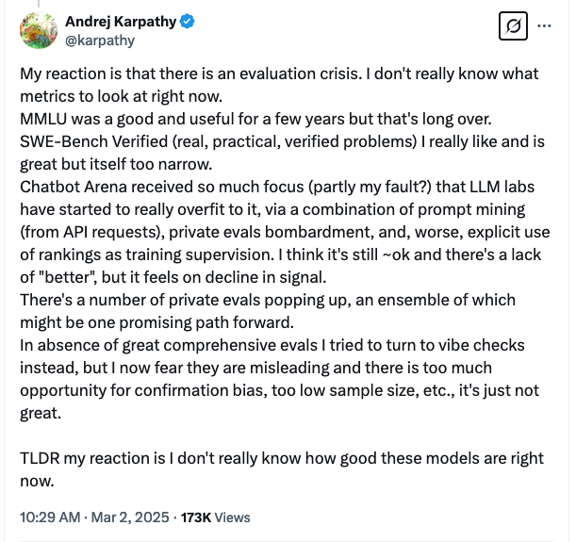

Slide 18
Conclusions
The consistency with which an LLM judges pairwise contests of responses from other LLMs is correlated with its LMYS Elo score.
This correlation is strong only if the LLM evaluates pairwise responses from chatbots that are intellectually different. It doesn't matter if similarly intelligent models (both smart or both dull) are not evaluated in the pairwise comparison - their informational contribution is marginal, as the maximum information is extracted from discrepant models.
By using just the 10 most diverse matchups, we can achieve nearly the maximum correlation.

